Slide 1
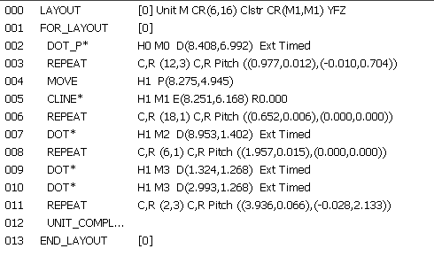
Repeat until Col,Row 6,16
Repeat DotP until Index Col,Row 12,3
Repeat Line until Index Col,Row 18,1
Repeat Dot until Index Col,Row 6,1
Repeat 2 Dots until Index Col,Row 2,3

Slide 2
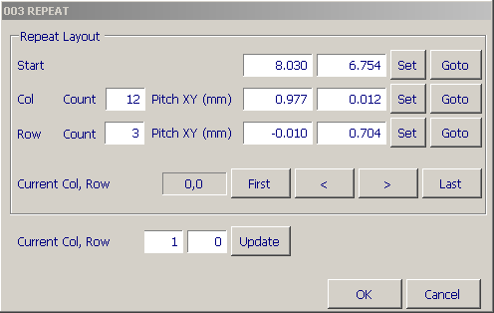
Set/Goto Start Index
Set/Goto Last Column Index
Set/Goto Last Row Index
Moves Indexes
Update current index to DispProgram

