Slide 1
TestVDB
Using LLMs to Find Bugs Where Actual Behaviour Diverges from Its Documentation
Authors (TBD)
Affiliation
Venue / Session (TBD)

Slide 2
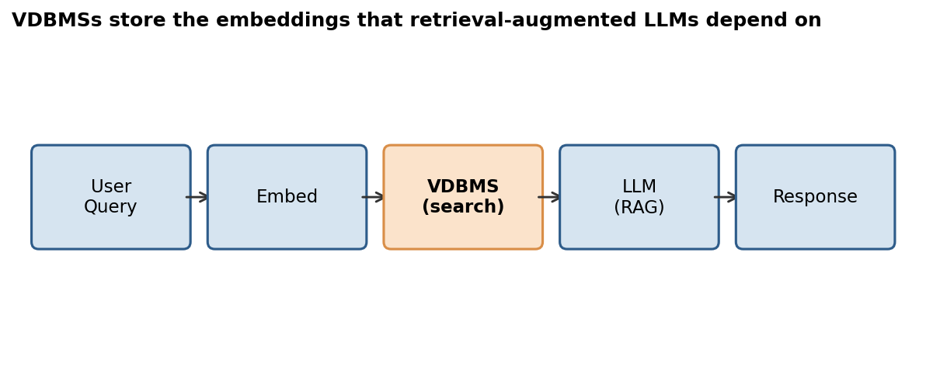
VDBMS defects are costly — and mostly functional
P2/20 Opening
Source | Finding
Empirical bug study (Xie 2025) | > 50% functional failures
Testing roadmap (Wang 2025) | ~43% incorrect behavior; oracle key challenge
VDBFuzz (Wang 2026) | only VDBMS fuzzer — crash oracle

Slide 3
Doc-implementation defects: actual behaviour diverges from documentation
P3/20 Problem
• Doc-implementation consistency — does API accept/reject match documentation?
• Correctness — is the result mathematically right?
Documentation
"nprobe (int): Range 0-16384"
(should reject nprobe=0)
API Actual Behaviour
accepts nprobe=0
-> search runs (wrong results)
no crash, no error code
Divergence -> query semantics corrupted; 37 of 38 such defects produce no crash

Slide 4
Only an LLM reaches the doc-implementation residual
P4/20 Naive oracles
Candidate oracle | Reaches | Why it misses the residual
Crash (VDBFuzz) | crash/hang | 37 of 38 do not crash
Differential testing | math invariants | accept/reject diverges by design
Metamorphic relations | result correctness | output relation, not input-acceptance
Property-based testing | math + schema | needs machine-checkable property + OpenAPI
REST doc/spec oracles | status/field assertions | reliable from low-ambiguity sources
LLM-derived oracle (TestVDB) | accept/reject vs documentation | residual needs semantic judgment

Slide 5
TestVDB: LLM extracts claims and judges conformance
P5/20 Method
1. Extract
LLM reads documentation -> behavioral claims
2. Attack
boundary inputs targeting each claim
3. Judge
LLM checks response -> conform or violate?
-> verdict (may be wrong)
This naive pipeline produces false positives — the LLM judge is unreliable (next).

Slide 6
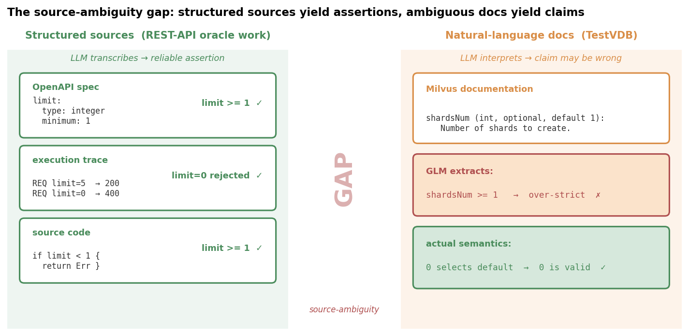
The source-ambiguity gap: assertions vs claims
P6/20 Core insight

Slide 7
Family-specific errors: the judge confirms the extractor's biases
P7/20 Core insight
• one LLM family extracts claims AND judges — shared biases
• judge confirms extractor errors — self-preference
• Panickssery (2024); Wataoka (2024)
• mitigation: cross-model validation

Slide 8
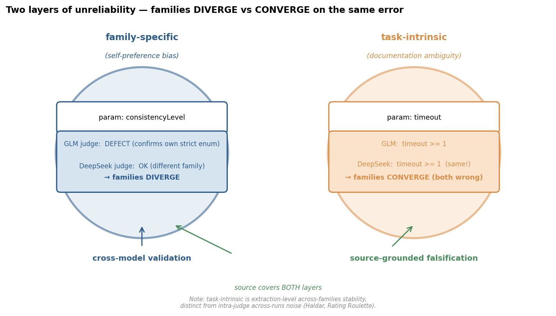
Task-intrinsic errors: different families infer the same wrong claim
P8/20 Core insight

Slide 9
Cross-model validation covers family-specific, not task-intrinsic
P9/20 Core insight
family-specific
task-intrinsic
• consistencyLevel — GLM/DeepSeek disagree
• cross-model catches divergence
• timeout — both extract '>= 1' (same error)
• cross-model sees agreement
• only source falsifies

Slide 10
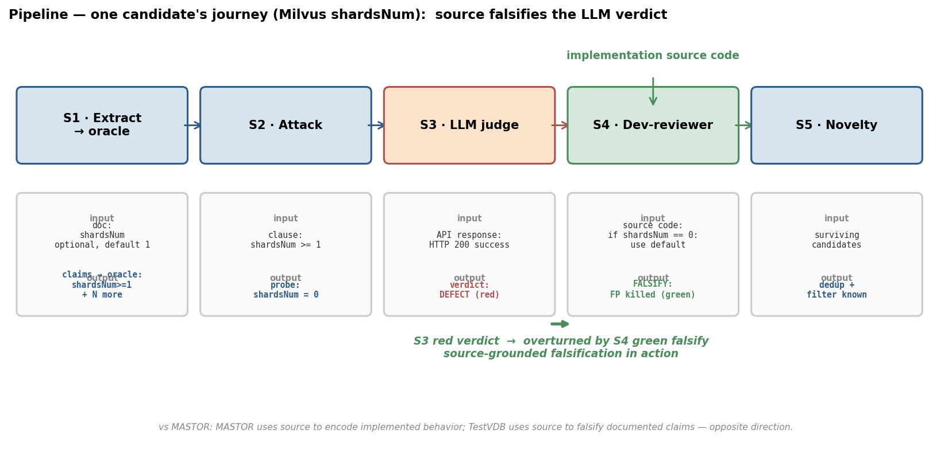
Complete pipeline: source-grounded falsification resolves what cross-model cannot
P10/20 Method
Added to naive pipeline (P6): dev-reviewer reads source to falsify LLM claims. 12-clause pilot: cross-model 7/12, source 12/12 (see P17 for n=29).

Slide 11
Falsification rule: shardsNum=0 selects the default
P11/20 Method
Over-strict clause (LLM)
Source-grounded falsification
• shardsNum >= 1
• probe: shardsNum=0 -> API 200
• LLM verdict: 'violation'
• source: if shardsNum==0 { use default }
• 0 selects default — over-strict
• FP killed
• opposite of MASTOR (as currently designed)
+ dev-reviewer reads source to falsify claims; novelty gate removes duplicates. Suppresses FPs from naive pipeline (P6).

Slide 12
Four RQs; 111 submitted, 38 acknowledged
P12/20 Evaluation
RQ | Question
RQ1 | how many doc-impl defects?
RQ2 | does source suppress FPs?
RQ3 | cross-model vs source?
RQ4 | model-free subclass?
VDBMS | Submitted | Ack.
Milvus | 51 | 22
Weaviate | 30 | 3
Qdrant | 26 | 13
MeiliSearch | 3 | 0
Chroma | 1 | 0
Total | 111 | 38

Slide 13
~85% doc-impl defects; VDBFuzz: 0 crashes
P13/20 Evaluation
Composition (not prevalence)
VDBFuzz (Qdrant v1.18.2)
• ~85% doc-implementation defects
• ~10% classical
• ~5% concurrency
• 89% on acknowledged
• we ran VDBFuzz: 26,000 requests
• 0 crashes, 0 non-200
• TestVDB found doc-impl defects
• disjoint classes

Slide 14
Source anchor: 81% FP suppression (up from 31%)
P14/20 Evaluation
81%
FP suppressed by source anchor
up from 31%; 96.7% TP retention (n=30)

Slide 15
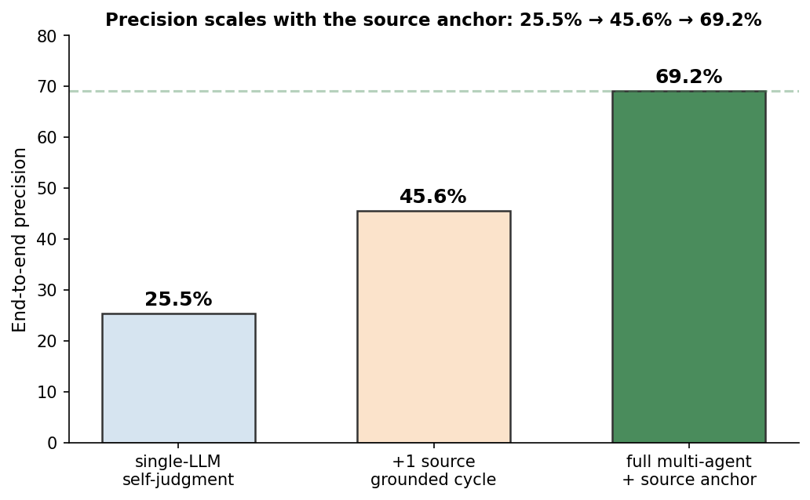
Precision scales: 25.5% -> 45.6% -> 69.2%
P15/20 Evaluation

Slide 16
RQ3 n=29: source 16/16; explicit-bound 0/13; kappa=1.0
P16/20 Evaluation
Subtype | n | Task-intrinsic | Cross-model | Source
Parameter over-strict | 12 | 5/12 | 7/12 | 12/12
Behavior over-strict | 4 | 4/4 | 0/4 | 4/4
Explicit-bound negative | 13 | 0/13 | - | -
Within-vendor contrast | - | 56% vs 0% | - | -
Cross-model kappa (n=20) | 20 | - | kappa=1.0 | -

Slide 17
A model-free invariant subclass finds bugs on its own
P17/20 Evaluation
Invariant | Observation | Cross-vendor
COSINE bound | distance > 1.0 identical vectors | Milvus+Qdrant
Index completeness | index returns 2 of 25 | Milvus+Qdrant
Payload filter | filter absent field returns points | Milvus+Qdrant

Slide 18
Prior work: low-ambiguity; TestVDB: ambiguous regime
P18/20 Related work
Line of work | Representative | Difference
VDBMS testing | VDBFuzz/roadmap/bug study | crash vs doc-impl
REST oracle | AGORA+/SATORI/MASTOR | low-ambiguity; we use NL docs
Doc-derived oracle | Toradocu/Doc2OracLL/AugmenTest/Konstantinou | trust LLM; we falsify
DB correctness | NoREC/TLP/DQE/DDLCheck | reference semantics; ours lacks
LLM-judge | Panickssery/Wataoka/Haldar | orthogonal — source grounding

Slide 19
Threats and conclusion
P19/20 Closing
Threats
Conclusion
• over-strict (n=16) most contingent
• Milvus+Qdrant only
• mechanism correlative
• doc-impl resists checking
• LLM: family-specific + task-intrinsic
• generalizes beyond VDBMSs

Slide 20
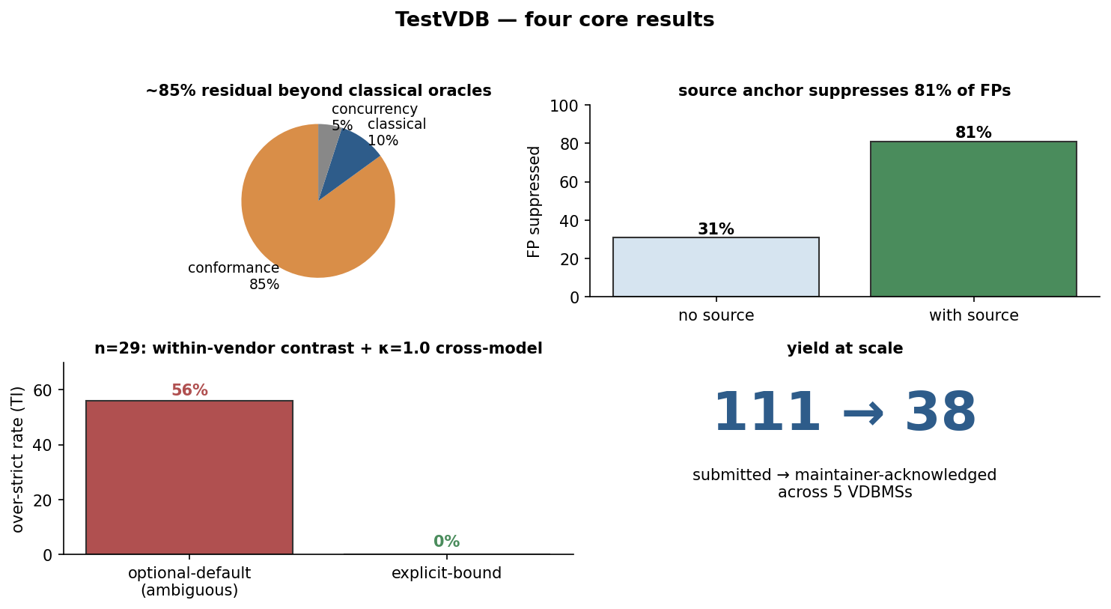
TestVDB — four core results
P20/20 Closing

