Slide 1
Detecting Logic Defects in VDBMS with LLMs
用 LLM 发现向量数据库的逻辑缺陷
Yihui Huang

Slide 2
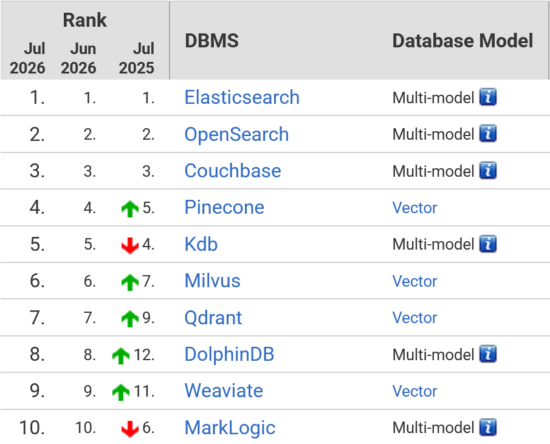





2
Vector Database Management System(VDBMS)
VDBMS are widely used to store and retrieve vector embeddings.
Faiss
VDB-Engines Ranking[1]
[1] https://db-engines.com/en/ranking/vector+dbms (26 systems in ranking, July 2026)

Slide 3
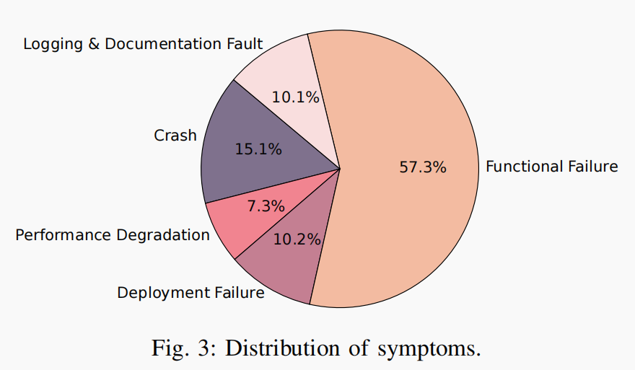
2
VDBMS Bug Distribution
VDBMS bugs are mostly logical bugs
Previous VDBMS bug symptom distribution research
Incorrect Behavior
43.0%
VDBFuzz [3]only covers crash bugs
Crash/Hang
23.1%
Others
15.0%
Build Failure
9.7%
Performance
9.3%
[1]
[2]
[1] Towards Reliable Vector Database Management Systems: A Software Testing Roadmap for 2030
[2] Toward Understanding Bugs in Vector Database Management Systems
[3] VDBFuzz: Understanding and Detecting Crash Bugs in Vector Database Management Systems

Slide 4
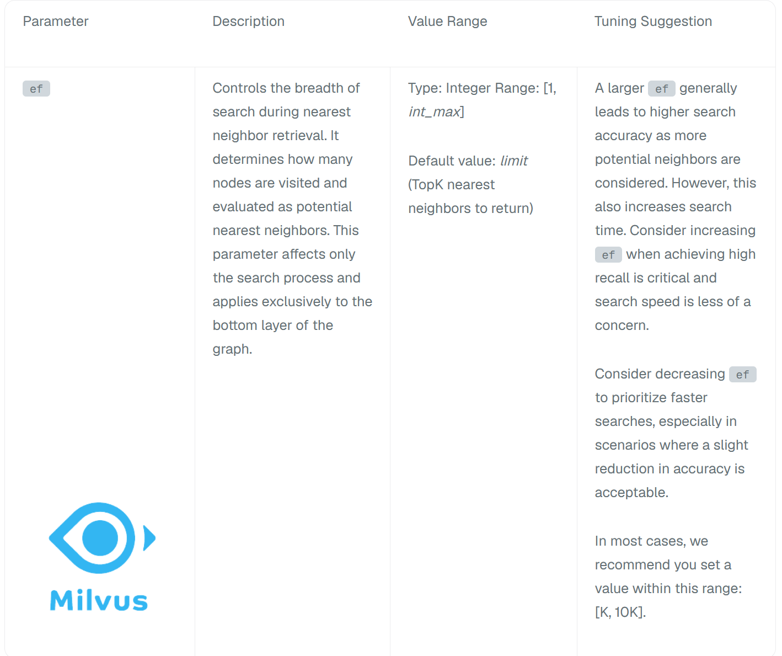
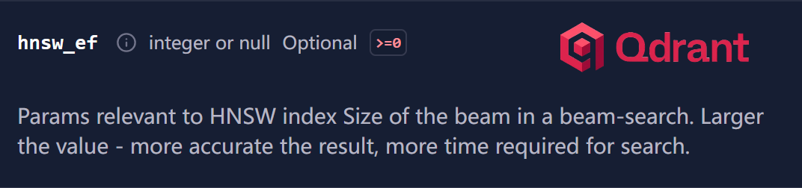
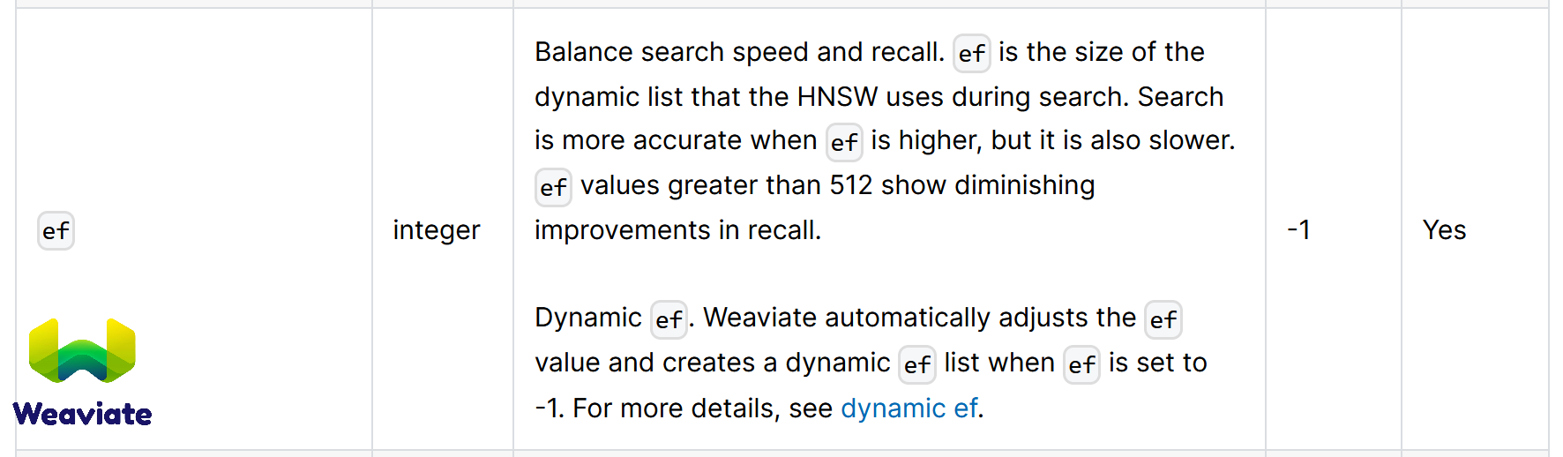
2
VDBMS Documentation
Mostly natural-language docs:Hard to structure
Different VDBMS,different standards: Hard to do differential testing

Slide 5
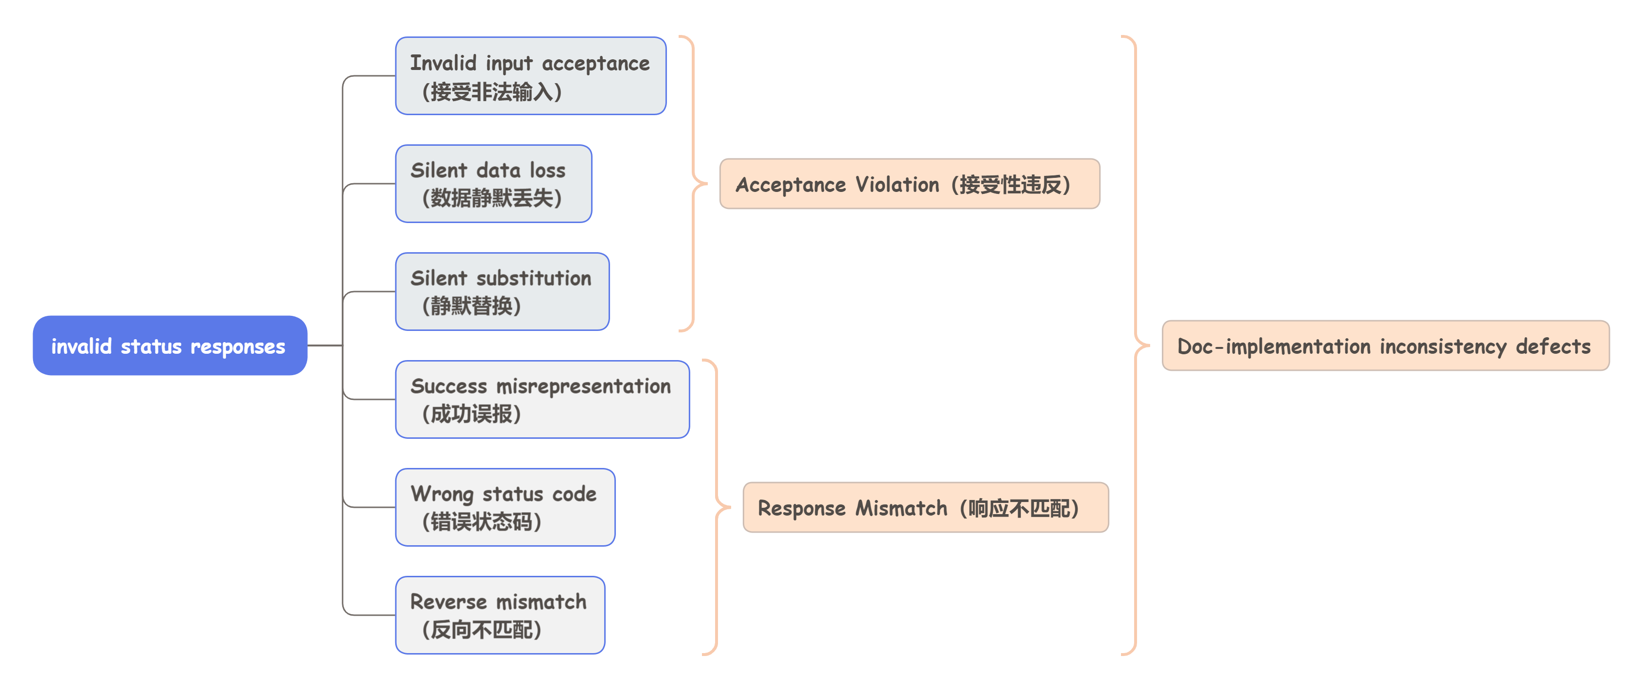
Target:Doc-implementation inconsistency defects
2
我们选择从官方文档（documentation）提取“预先给定的行为声明”，问题变成“如何找出VDBMS真实行为与文档描述不一致之处”，即Doc-implementation inconsistency。
根据实际挖掘得到的更多表现形式

Slide 6









Target:Doc-implementation inconsistency defects
2
我们选择从官方文档（documentation）提取“预先给定的行为声明”，问题变成“如何找出VDBMS真实行为与文档描述不一致之处”，即Doc-implementation inconsistency。
Expected VDBMS Behavior in Documentation
VDBMS’s
Actual Behaviour
Not a Bug
Bug

Slide 7



2
Existing Approach
Existing approach(VDBFuzz) focuses on detecting crash bugs
vdb
Templates
Test
scripts
Test
scripts
VDBMS
① Templates
② Pattern-based Input Mutation
③ Test Execution
④ Crash Oracle
Bug found
VDBFuzz cannot be effectively applied to detect Doc-implementation inconsistency bugs

Slide 8



2
Observation
How a bug that “silently accepts queries with nprobe=0”[1] is discovered
documentation
........ nprobe (int,must): range: [1,16384]
（应拒绝nprobe=0）
........
nprobe=0时， 预期正确行为：
HTTP/1.1 400 Bad Request
{
"code": 1100,
"message": "nprobe must be in [1, 16384]; got 0"
}
nprobe=0时，
VDBMS实际行为：
code: 0 +HTTP 200 : VDBMS报告查询操作成功，nprobe=0 被静默接受,返回了"结果"。
VDBMS Response
HTTP/1.1 200 OK
Content-Type: application/json
{
"code": 0,
"cost": 0,
"data": [
{"id": "1", "distance": 0.834},
{"id": "2", "distance": 0.721},
{"id": "3", "distance": 0.655}
]
}
user’s operation
POST /v2/vectordb/entities/search
Host: localhost:19530
{
"collectionName": "demo",
"data": [[0.1, 0.2, 0.3, ..., 0.512]],
"searchParams": {
"params": { "nprobe": 0 }
}
}
Execution
尝试进行nprobe=0的查询
[1] https://github.com/milvus-io/milvus/issues/49823

Slide 9






2
Approach
We propose TestVDB to detect Doc-implementation inconsistency logic bugs in VDBMSs
vdb
Documentation
Behavioral
claims
Behavioral
claims
Test
scripts
Test
scripts
VDBMS
VDBMS response
VDBMS logs
VDBMS state
① Behavioral_claims Extraction
② Test Script
Generation
③ Test Script
Execution
④ Defect Confirmation
Expected VDBMS Behavior in Documentation
VDBMS’s
Actual Behaviour
No Bug.
Bug found！

Slide 10

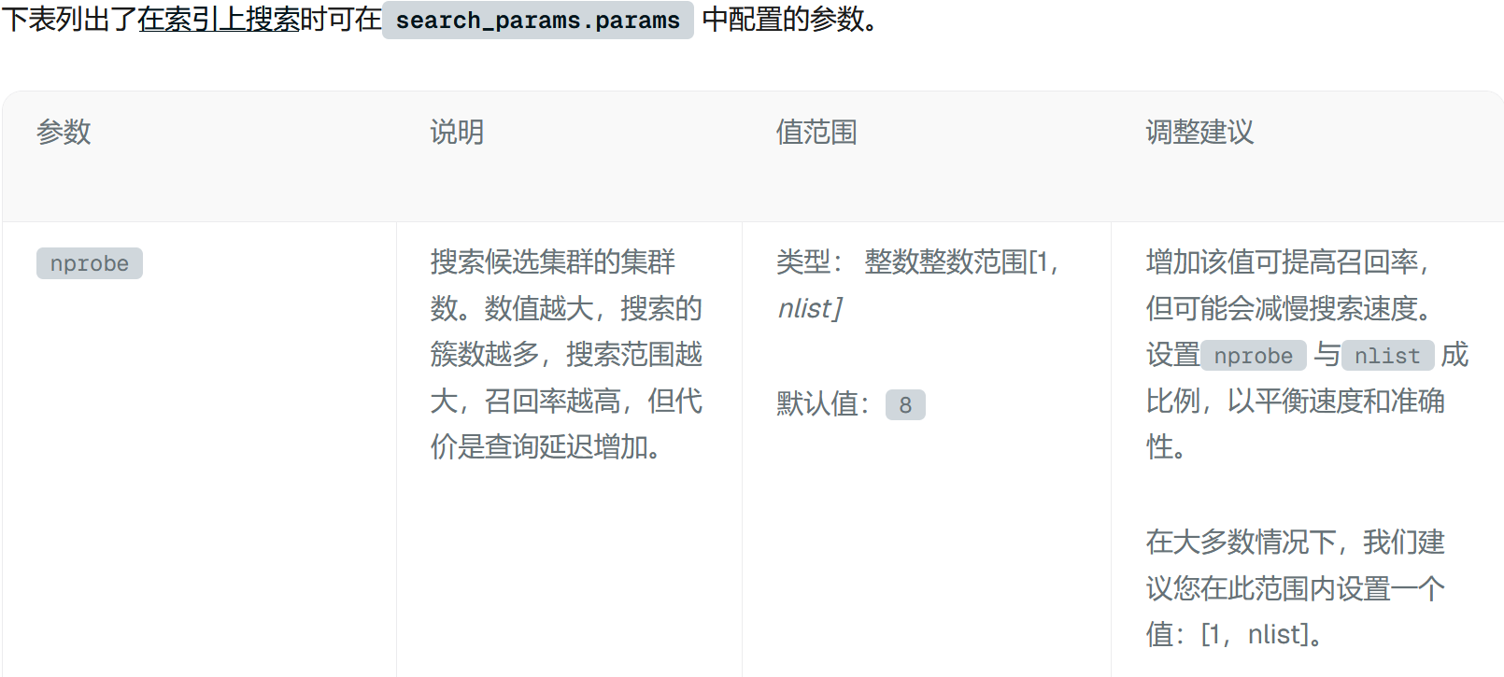
2
Behavioral claims extraction
Step 1: We extract structured behavioral claims from natural- language documentation
documentation
behavioral claims
{
"constraint_id": "xxxx_001",
"endpoint": "entities+search",
"description": "nprobe must be an integer in [1, nlist]",
"assertion": "nprobe >= 1 && nprobe <= nlist",
"type": "range_constraint",
"confidence": 1.0,
"evidence_tier": "explicit",
"source_url": "xxxx",
"source_verified": true
}

Slide 11
2
Test Script Generation
Step 2: We generate executable test scripts from the structured contract
behavioral claims
test scripts
{
"constraint_id": "xxxx_001",
"endpoint": "entities+search",
"description": "nprobe must be an integer in [1, nlist]",
"assertion": "nprobe >= 1 && nprobe <= nlist",
"type": "range_constraint",
"confidence": 1.0,
"evidence_tier": "explicit",
"source_url": "xxxx",
"source_verified": true
}
POST /v2/vectordb/entities/search
Host: localhost:19530
{
"collectionName": "demo",
"data": [[0.1, 0.2, 0.3, ..., 0.512]],
"searchParams": {
"params": { "nprobe": 0 }
}
}

Slide 12
2
Test Script Execution
Step 3:we execute the generated scripts against a sandboxed VDBMS instance
VDBMS response
VDBMS logs
test scripts
[2026/05/15 06:44:24.253 Z] [GIN]
[/v2/vectordb/entities/search]
[traceID=92b0db3bcacc727fbe4727333ca5a0ce]
[code=200] [latency=2.513332ms]
[client=172.18.0.1] [method=POST] [error=]
POST /v2/vectordb/entities/search
Host: localhost:19530
{
"collectionName": "demo",
"data": [[0.1, 0.2, 0.3, ..., 0.512]],
"searchParams": {
"params": { "nprobe": 0 }
}
}
HTTP/1.1 200 OK
Content-Type: application/json
{
"code": 0,
"cost": 0,
"data": [
{"distance": 0, "id": 1},
{"distance": 64, "id": 2},
{"distance": 256, "id": 3}
],
"topks": [3]
}
No state change observed.
VDBMS state

Slide 13

2
Defect Confirmation
Step 4:we confirm defects by comparing the expected behavior (claims) against the actual behavior (execution)
No Bug.
VDBMS response
VDBMS logs
comparison
Bug found！
[2026/05/15 06:44:24.253 Z] [GIN]
[/v2/vectordb/entities/search]
[traceID=92b0db3bcacc727fbe4727333ca5a0ce]
[code=200] [latency=2.513332ms]
[client=172.18.0.1] [method=POST] [error=]
HTTP/1.1 200 OK
Content-Type: application/json
{
"code": 0,
"cost": 0,
"data": [
{"distance": 0, "id": 1},
{"distance": 64, "id": 2},
{"distance": 256, "id": 3}
],
"topks": [3]
}
behavioral claims
{
"constraint_id": "xxxx_001",
"endpoint": "entities+search",
"description": "nprobe must be an integer in [1, nlist]",
"assertion": "nprobe >= 1 && nprobe <= nlist",
"type": "range_constraint",
"confidence": 1.0,
"evidence_tier": "explicit",
"source_url": "xxxx",
"source_verified": true
}
No state change observed.
VDBMS state

Slide 14



2
Use LLM for Automation
Use LLMs to read VDBMS NL docs→ extract behavioral claims
→ generate test scripts → adjudicate responses.
documentation
### search params
nprobe (int, optional):
Number of buckets to probe in IVF-based indexes.
Range: [1, 16384]. Default: 8.
{
"status": "success",
"code": 0,
"http": 200,
"data": [{"id": "1", "distance": 0.834}, ...]
}
client = VDBClient(uri="http://localhost:19530")
client.create_collection("demo", schema=..., index_type="IVF_FLAT")
client.insert("demo", data=vectors)
response = client.search(
"demo",
data=[query_vec],
search_params={"metric_type": "L2", "params": {"nprobe": 0}}
)
{
"constraint_id": "xxxx_001",
"endpoint": "entities+search",
"description": "nprobe must be an integer in [1, 16384]",
"assertion": "nprobe >= 1 && nprobe <= 16384",
"type": "range_constraint",
"confidence": 1.0,
"evidence_tier": "explicit",
"source_url": "xxxx",
"source_verified": true
}
or
1.Behavioral_claims Extraction
behavioral claims
output
2.Scripts Generation
LLM judge
test scripts
4.Defect Confirmation
3.Scripts Execution
VDBMS Response

Slide 15

2
The Problem of False Positive
Extraction 端：Hallucination[1]
Judging 端：Self-Preference Bias[2]
When hallucinations don’t happen
Extraction 端
### search params
nprobe (int, optional):
Number of buckets to probe in IVF-based indexes.
Range: [1, 16384]. Default: 8.
{
"constraint_id": "xxxx_001",
"endpoint": "entities+search",
"description": "nprobe must be an integer in [1, 16384]",
"assertion": "nprobe >= 1 && nprobe <= 16384",
"type": "range_constraint",
"confidence": 1.0,
"evidence_tier": "explicit",
"source_url": "xxxx",
"source_verified": true
}
documentation
1.Behavioral_claims Extraction
behavioral claims
[1] Survey of Hallucination in Natural Language Generation
[2] LLM Evaluators Recognize and Favor Their Own Generations

Slide 16


2
The Problem of False Positives
Extraction 端：Hallucination[1]
Judging 端：Self-Preference Bias[2]
When hallucinations happen (case 1)
Extraction 端
{
"constraint_id": "xxxx_001",
"endpoint": "entities+search",
"description": "nprobe must be an integer in [8, 16384]",
"assertion": "nprobe >= 8 && nprobe <= 16384",
"type": "range_constraint",
"confidence": 1.0,
"evidence_tier": "explicit",
"source_url": "xxxx",
"source_verified": true
}
### search params
nprobe (int, optional):
Number of buckets to probe in IVF-based indexes.
Range: [1, 16384]. Default: 8.
documentation
Over-strict:
1.Behavioral_claims Extraction
Treat default as bound
behavioral claims
[1] Survey of Hallucination in Natural Language Generation
[2] LLM Evaluators Recognize and Favor Their Own Generations

Slide 17

2
The Problem of False Positives
Extraction 端：Hallucination[1]
Judging 端：Self-Preference Bias[2]
When hallucinations happen (case 2)
Extraction 端
{
"constraint_id": "xxxx_001",
"endpoint": "entities+search",
"description": "nprobe must be a power of 2",
"assertion": "isPowerOfTwo(nprobe)",
"confidence": 0.5,
"evidence_tier": "implicit" "source_url": "xxxx",
"source_verified": true
}
### search params
nprobe (int, optional):
Number of buckets to probe in IVF-based indexes.
Range: [1, 16384]. Default: 8.
documentation
fabricated constraint:
LLM makes up a constraint
1.Behavioral_claims Extraction
behavioral claims
[1] Survey of Hallucination in Natural Language Generation
[2] LLM Evaluators Recognize and Favor Their Own Generations

Slide 18

2
The Problem of False Positives
Extraction 端：Hallucination[1]
Judging 端：Self-Preference Bias[2]
When Self-Preference Bias doesn’t happen
Judging 端
documentation
1.Behavioral_claims Extraction
behavioral claims
output
wrong claims
2.Scripts Generation
LLM judge
wrong scripts
test scripts
4.Defect Confirmation
legal behaviour
There’s a problem with the claim / script,not a bug.
3.Scripts Execution
VDBMS Response
[1] Survey of Hallucination in Natural Language Generation
[2] LLM Evaluators Recognize and Favor Their Own Generations

Slide 19
2
The Problem of False Positives
Extraction 端：Hallucination[1]
Judging 端：Self-Preference Bias[2]
When Self-Preference Bias happens
Judging 端
It’s hard for LLM to find out the mistake made by the same LLM.
documentation
1.Behavioral_claims Extraction
False positive!
behavioral claims
output
wrong claim
2.Scripts Generation
LLM judge
wrong scripts
test scripts
4.Defect Confirmation
There’s a bug!
legal behaviour
3.Scripts Execution
VDBMS Response
[1] Survey of Hallucination in Natural Language Generation
[2] LLM Evaluators Recognize and Favor Their Own Generations

Slide 20
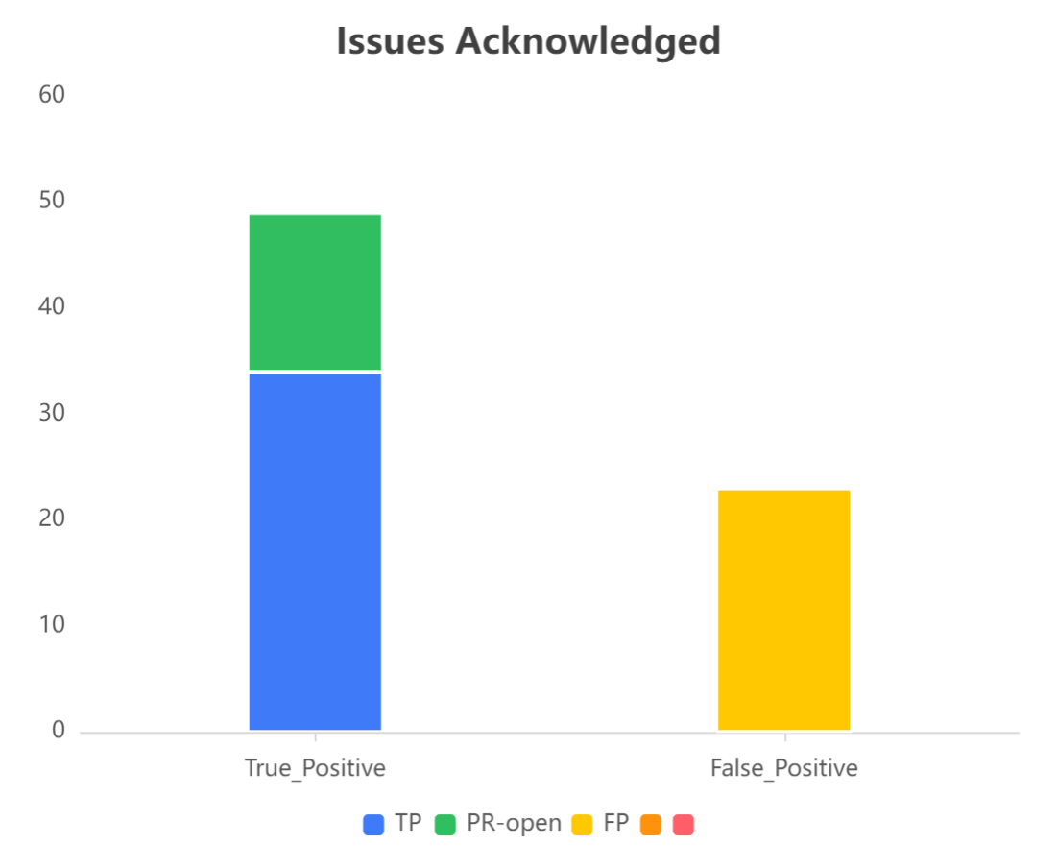
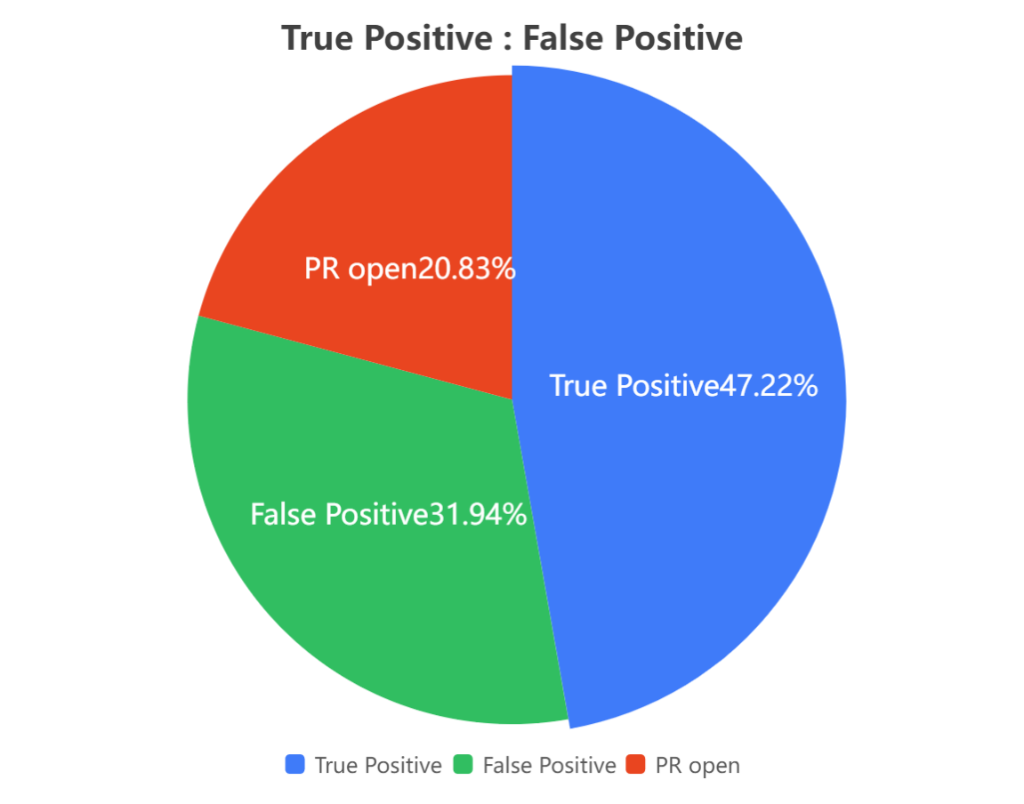
2
The Problem of False Positives
How serious can it be?

Slide 21
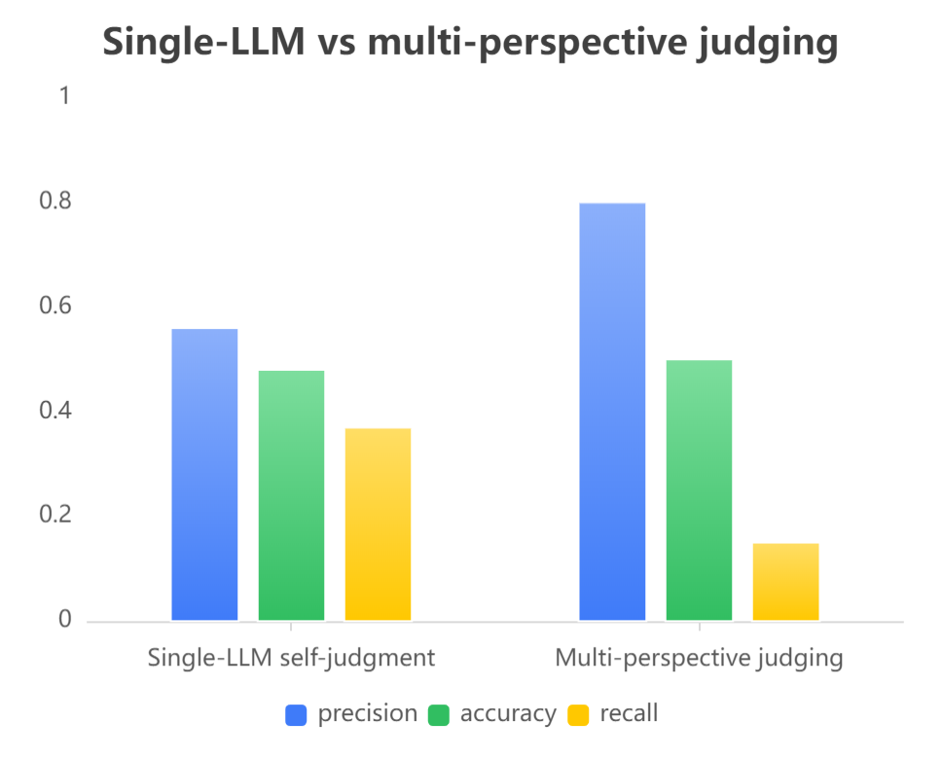






2
Can multi-perspective judging solve the FP problem?
It does work,but still not good enough.
48 candidates[1]（27TP[milvus 20,qdrant 7]+21FP[milvus 12,qdrant 9]）
or
documentation
Vote
LLM judges
1.Behavioral_claims Extraction
Judge_doc
behavioral claims
Judge_evidence
2.Scripts Generation
test scripts
Judge_severity
3.Scripts Execution
Judge_novelty
VDBMS Response
[1] sampled from the 49-TP + FP pool for ablation

Slide 22




Dev-Reviewer: Source-Grounded Falsifier
2
Act like a VDBMS maintainer: reproduce, cross-check source, try to disprove
documentation
LLM judge（dev_reviewer）
input
Final adjudication
behavioral claims
Check every defect candidate:
Not-a-defect
input
test scripts
1. Independently reproducible?
no
yes
VDBMS Response
no
2. Evidence sufficient?
LLM judges
yes
yes
Defect
Judge_doc
3. Falsifiable?
no
output
Judge_evidence
Judge_severity
input
input
output
Judge_novelty
defect candidates
VDBMS source code

Slide 23
2
Evaluation
RQ1: Bug detection capability
What doc-implementation bugs can TestVDB detect in real-world VDBMSs?
RQ2: Effectiveness of source-grounded falsification
How effective is source-grounded falsification at suppressing false positives in TestVDB?
RQ3: Comparing with existing approach
How many defects detected by TestVDB can be found by existing approach（VDBFuzz）?

Slide 24
2
Bug Detection Capability
107 bugs were submitted
34 bugs were confirmed as new bugs
15 bugs were fixed
VDBMS | Submitted | Confirmed | PR_open | Fixed | False Positive | Pending& duplicate
Milvus | 51 | 21 | 1 | 5 | 12 | 17
Qdrant | 26 | 10 | 4 | 8 | 9 | 3
Weaviate | 30 | 3 | 11 | 2 | 2 | 15
Total | 107 | 34 | 16 | 15 | 23 | 35

Slide 25
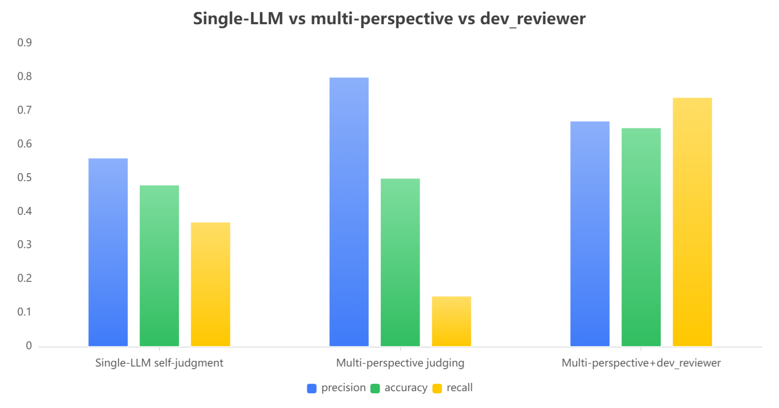
Effectiveness of False Positive Suppression
2
48 candidates[1]（27TP[milvus 20,qdrant 7]+21FP[milvus 12,qdrant 9]）
precision:
整体判断能力
accuracy：
剔除假阳性能力
recall：
保留真阳性能力
[1] sampled from the 49-TP + FP pool for ablation

Slide 26
Comparing with Existing Approach
2
Investigate whether the 49 TPs Bugs can be detected by existing approach(VDBFuzz)
VDBMS | TestVDB | VDBFuzz
Milvus | 22 | 0
Qdrant | 14 | 0
Weaviate | 13 | 0
Total | 49 | 0
On Qdrant v1.18.0, TestVDB found a silent-accept defect (#9045: empty vectors accepted via wait=false) ,which later triggers server panic on search,but VDBFuzz missed it—a crash oracle cannot fire on 200 OK.
Conversely, on Qdrant v1.4.0, TestVDB reached VDBFuzz's divide-by-zero crash (size=2⁶³) by contract reasoning.

Slide 27
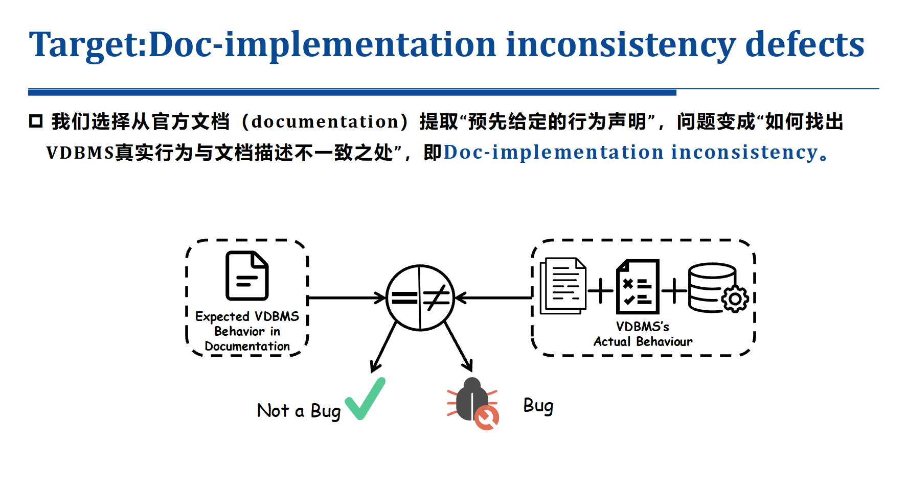
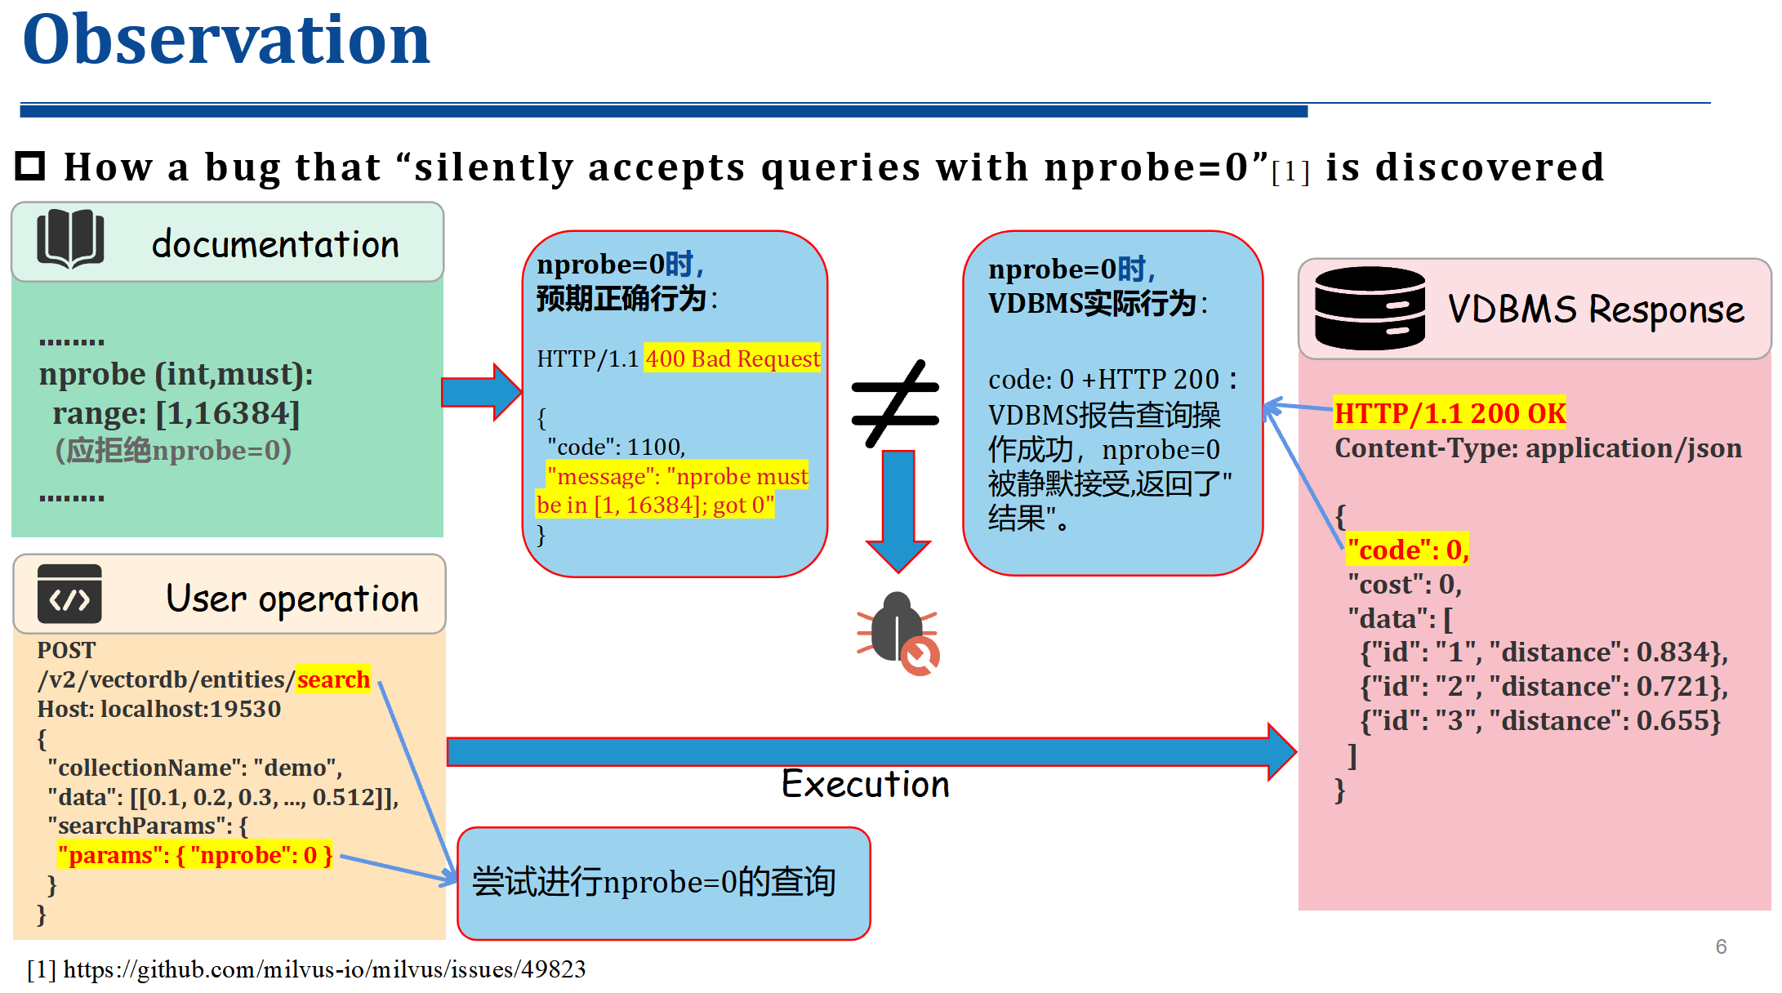
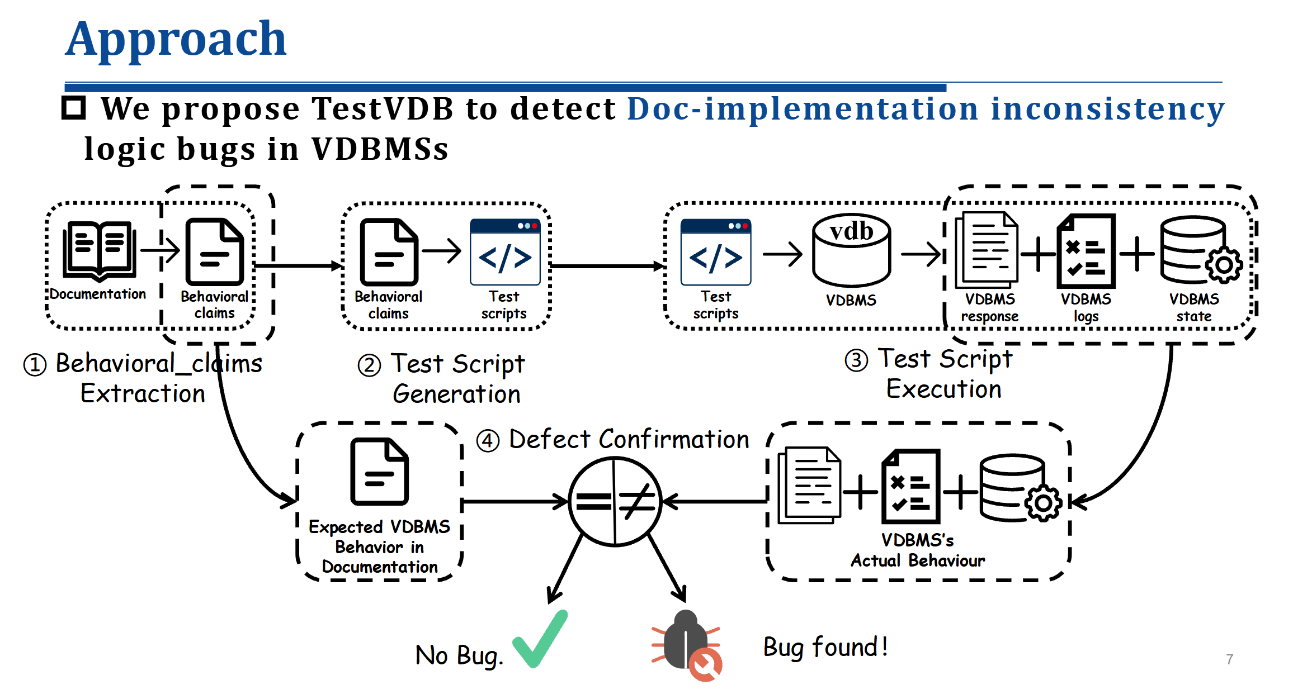
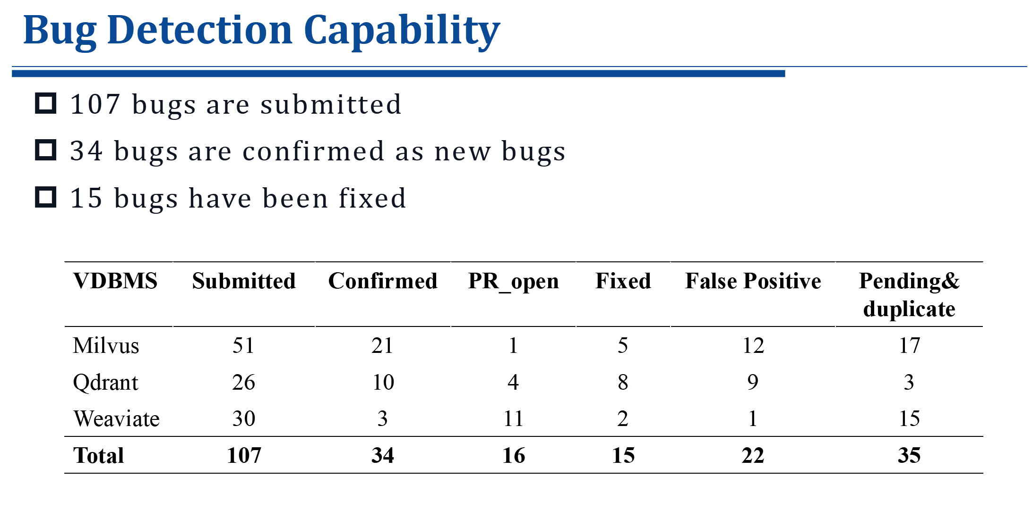
2
Conclusions

