Slide 1
Detecting Logic Bugs in VDBMS with LLMs
用 LLM 检测向量数据库的逻辑缺陷
Yihui Huang

Slide 2
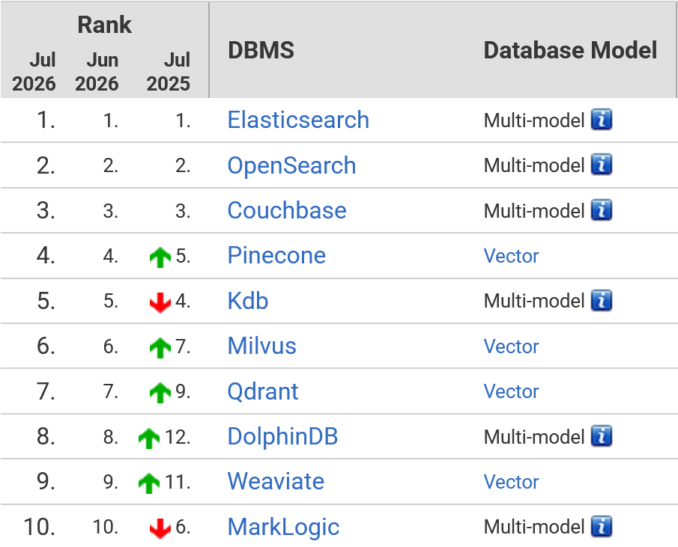





2
Vector Database Management System(VDBMS)
VDBMS are widely used to store and retrieve vector embeddings.
Faiss
VDB-Engines Ranking[1]
[1] https://db-engines.com/en/ranking/vector+dbms (26 systems in ranking, July 2026)

Slide 3
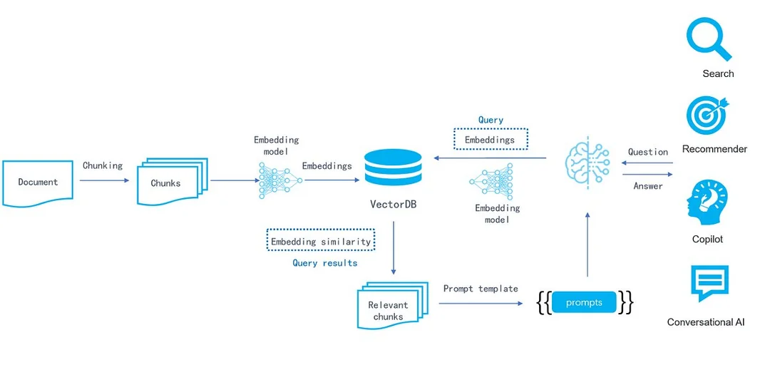

2
What Happens When VDBMS Bugs Occur
VDBMS bugs can lead to serious consequences, ranging from "unexpected results" to "service unavailability".
① service unavailability
② unexpected results

Slide 4
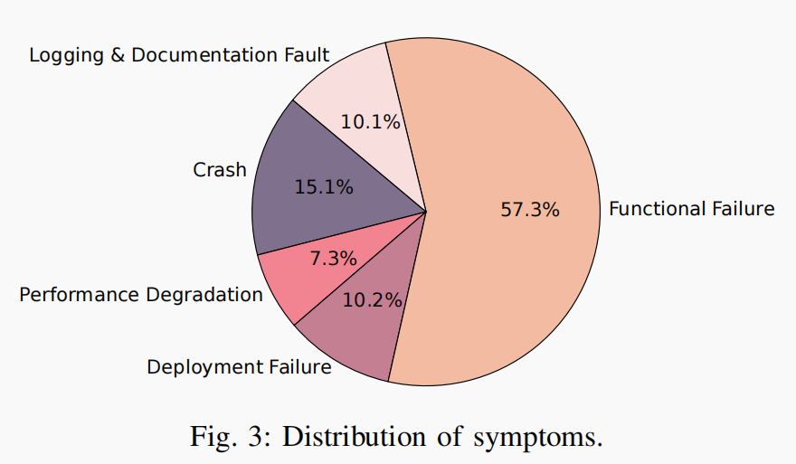
2
VDBMS Bug Distribution
VDBMS bugs are mostly non-crashing bugs
Previous VDBMS bug symptom distribution research
Incorrect Behavior
43.0%
VDBFuzz [3]only covers crash bugs
Crash/Hang
23.1%
Others
15.0%
Build Failure
9.7%
Performance
9.3%
[1]
[2]
[1] Towards Reliable Vector Database Management Systems: A Software Testing Roadmap for 2030
[2] Toward Understanding Bugs in Vector Database Management Systems
[3] VDBFuzz: Understanding and Detecting Crash Bugs in Vector Database Management Systems

Slide 5









Target:Doc-implementation inconsistency bugs
2
我们选择从官方文档（documentation）提取“预先给定的行为声明”，问题变成“如何找出VDBMS真实行为与文档描述不一致之处”，即Doc-implementation inconsistency。
Expected VDBMS Behavior in Documentation
VDBMS’s
Actual Behaviour
Not a Bug
Bug

Slide 6
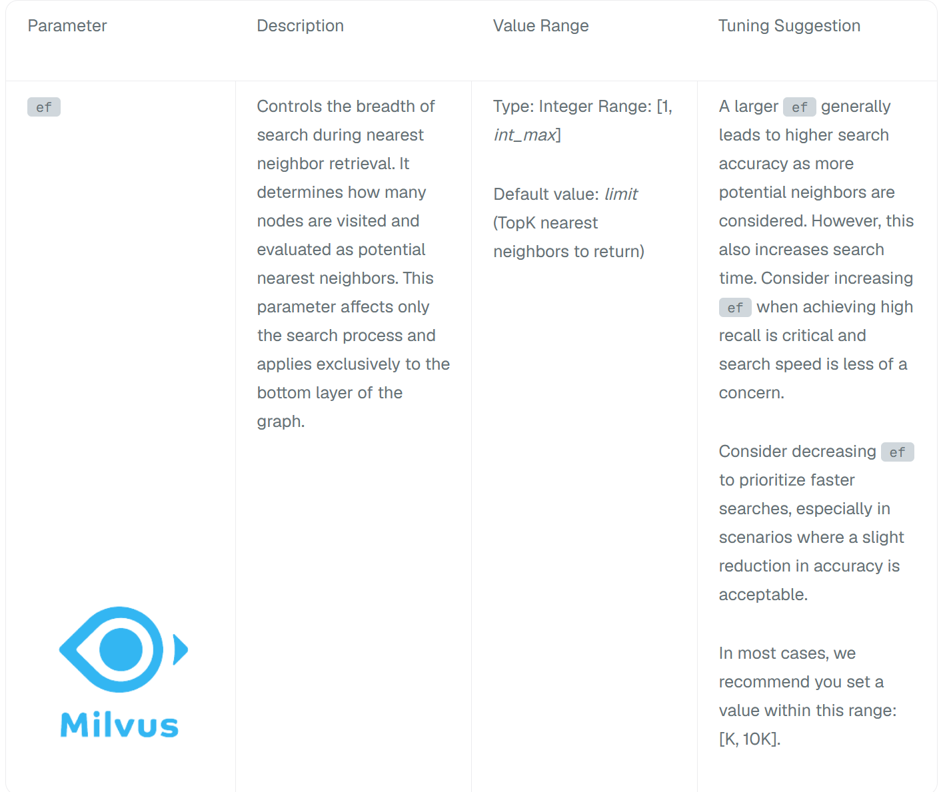
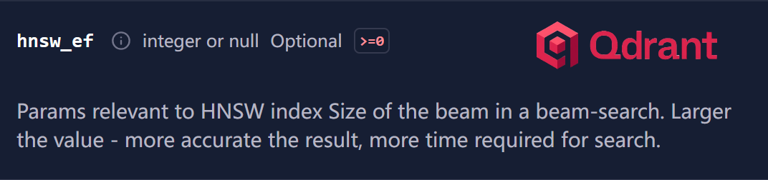
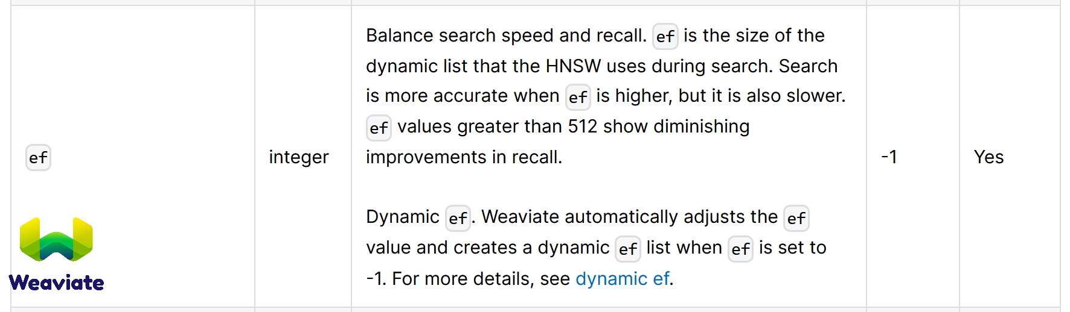
2
VDBMS Documentation
Mostly natural-language docs:Hard to structure
Different VDBMS,different standards: Hard to do differential testing

Slide 7



2
Existing Approach
Existing approach(VDBFuzz) focuses on detecting crash bugs
vdb
Templates
Test
scripts
Test
scripts
VDBMS
① Templates
② Pattern-based Input Mutation
③ Test Execution
④ Crash Oracle
Bug found
VDBFuzz cannot be effectively applied to detect Doc-implementation inconsistency bugs

Slide 8



2
Observation
How a bug that “silently accepts queries with nprobe=0”[1] is discovered
documentation
........
nprobe (int,must):
range: [1,16384]
（推测：应拒绝nprobe=0）
........
nprobe=0时，
预期正确行为：
HTTP/1.1 400 Bad Request
{
"code": 1100,
"message": "nprobe must be in [1, 16384]; got 0"
}
nprobe=0时，
VDBMS实际行为：
code: 0 +HTTP 200 :
VDBMS报告查询操作成功，nprobe=0 被静默接受,返回了"结果"。
VDBMS Response
HTTP/1.1 200 OK
Content-Type: application/json
{
"code": 0,
"cost": 0,
"data": [
{"id": "1", "distance": 0.834},
{"id": "2", "distance": 0.721},
{"id": "3", "distance": 0.655}
]
}
user’s operation
POST /v2/vectordb/entities/search
Host: localhost:19530
{
"collectionName": "demo",
"data": [[0.1, 0.2, 0.3, ..., 0.512]],
"searchParams": {
"params": { "nprobe": 0 }
}
}
Execution
尝试进行nprobe=0的查询
[1] https://github.com/milvus-io/milvus/issues/49823

Slide 9






2
Approach
We propose TestVDB to detect Doc-implementation inconsistency logic bugs in VDBMSs
vdb
Documentation
Behavioral
specification
Behavioral
specification
Test
scripts
Test
scripts
VDBMS
VDBMS response
VDBMS logs
VDBMS state
① Behavioral Specification Extraction
② Test Script
Generation
③ Test Script
Execution
④ Bug Confirmation
Expected VDBMS Behavior in Documentation
VDBMS’s
Actual Behaviour
No Bug.
Bug found！

Slide 10

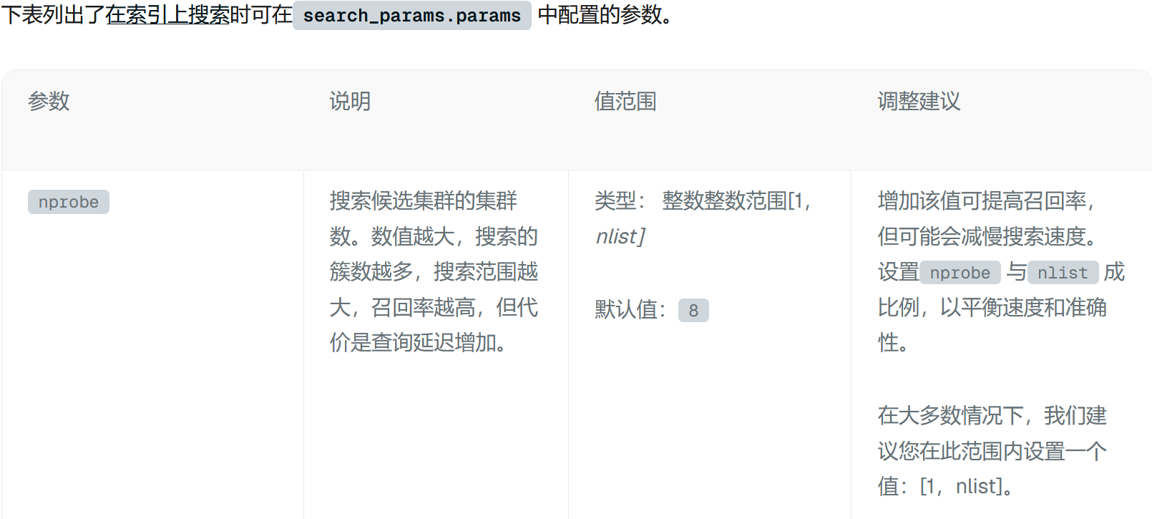
2
Behavioral specifications extraction
Step 1: We extract structured behavioral specifications from natural- language documentation
documentation
behavioral specifications
{
"constraint_id": "xxxx_001",
"endpoint": "entities+search",
"description": "nprobe must be an integer in [1, nlist]",
"assertion": "nprobe >= 1 && nprobe <= nlist",
"type": "range_constraint",
"confidence": 1.0,
"evidence_tier": "explicit",
"source_url": "xxxx",
"source_verified": true
}

Slide 11




2
Behavioral specifications extraction
Step 1: We extract structured behavioral specifications from natural- language documentation
target + version
Crawl4AI
Docker Container
documentation
webpage URL
1.Web pages crawling
documentation
documentation
Web pages crawling
knowledge extractor
2.extract information
knowledge extractor
3.write knowledge.json
not pass
knowledge.json
4. Endpoint coverage
self-check
specification extractor
pass
specification.json
knowledge.json
behavioral specifications

Slide 12
Knowledge template
2
文件命名：{target} v{version} API Knowledge
Document Metadata
- doc_version: {actual_document_version}
- target_version: {target_version}
- version_match: {major.minor 匹配结果: matched | mismatched}
- source_url: {文档首页 URL}
- fetched_at: {ISO 8601 timestamp}
Document Sources
| # | URL | Doc Version | Fetched At | Version Match |
|---|-----|-------------|------------|---------------|
| 1 | {url_1} | {version_1} | {timestamp_1} | matched/mismatched |
| 2 | {url_2} | {version_2} | {timestamp_2} | matched/mismatched |
| ... |
API Endpoints / SQL Operations
{category_name}
{endpoint_name}
- Method: {HTTP_METHOD}
- Path: {path}
- Source URL: {该端点文档的具体 URL}
- Doc Version: {该页面的文档版本}
- Parameters:
- {param_name} ({type}, required={true/false}): {description}
- Constraints:
- type: {type_constraint}
- range: {range_constraint}
- state: {state_constraint}
- behavioral: {behavioral_contract}
- others: {others_constraint}
- Expected Responses:
- 200: {description}
- 400: {description}
- 404: {description}
- ...
Data Types
- {type_name}: {description}

Slide 13
Knowledge template
2
文件命名：{target} v{version} API Knowledge
Document Metadata
- doc_version: {actual_document_version}
- target_version: {target_version}
- version_match: {major.minor 匹配结果: matched | mismatched}
- source_url: {文档首页 URL}
- fetched_at: {ISO 8601 timestamp}
Document Sources
| # | URL | Doc Version | Fetched At | Version Match |
|---|-----|-------------|------------|---------------|
| 1 | {url_1} | {version_1} | {timestamp_1} | matched/mismatched |
| 2 | {url_2} | {version_2} | {timestamp_2} | matched/mismatched |
| ... |
Check whether the document version aligns with our target version, which is the precondition for the behavioral specifications to be effectively used to test the target VDBMS.

Slide 14
Knowledge template
2
1. Group by the way the official documentation organizes document information.
API Endpoints / SQL Operations
{category_name}
{endpoint_name}
- Method: {HTTP_METHOD}
- Path: {path}
- Source URL: {该端点文档的具体 URL}
- Doc Version: {该页面的文档版本}
- Parameters:
- {param_name} ({type}, required={true/false}): {description}
- Constraints:
- type: {type_constraint}
- range: {range_constraint}
- state: {state_constraint}
- behavioral: {behavioral_contract}
- others: {others_constraint}
- Expected Responses:
- 200: {description}
- 404: {description}
- ...
Data Types
- {type_name}: {description}
2.Group by API endpoint.
3.Record:
①parameter requirements；
②constraint information (categorized by type, range, state, and behavioral)；
③response code conventions；
and bind this information to the source webpage link.
4.Record the definitions of the database's custom or specific types, which can be used as a reference for organizing “type boundary attacks”.

Slide 15

2
Behavioral specifications extraction
Step 1: We extract structured behavioral specifications from natural- language documentation
knowledge.json
constraints:
(type/range/state
/behavior/others)
documentation
1.constraints
categorization
specification extractor
constraint level:
endpoint/system
knowledge extractor
2. Evidence leveling + filter
not pass
evidence_labels:
( explicit/
inferred_from_example/
inferred_from_behavior/convention )
knowledge.json
specification extractor
3.Source verification check
specifications.json
For each constraint: fetch source_url + verify genuine containment of the assertion
behavioral specifications
pass
specifications.json

Slide 16
2
Behavioral specifications extraction
What’s the difference between endpoint/system constraints?
The criterion is :”what kind of observation is needed to prove that this constraint has been violated?”
Level | Criterion | Typical Examples
endpoint | Involves only a single endpoint’s parameters/response; violation is observable within a single request | type/range/enum domains, required parameters, error code format
system | Involves multiple endpoints or cross-request sequences; requires sequential observation | read-your-write, delete-gone, alias consistency, eventual consistency window

Slide 17

2
Behavioral specifications extraction
Step 1: We extract structured behavioral specifications from natural- language documentation
documentation
Why not merge the knowledge extractor and the specification extractor ?
1. Auditability： Network access is granted only to the extractor, making it easier to determine whether a problem originates in document crawling or the formalization process.
2. Knowledge as Cache ： knowledge.md is a cross-session cache; changes to formalization rules only require rerunning the extractor, without needing to re-crawl the documentation.
3. Context budget： hundreds of pages of crawled content and hundreds of lines of schema specifications will compete for context; divide and conquer so that both can be done well.
knowledge extractor
knowledge.json
specification extractor
specifications.json
behavioral specifications

Slide 18
2
An entire process example ①
Recommend bypasses vector dimension validation for negative examples from lookup_from, returning silently wrong scores — qdrant v1.19.0 · #10369 [accepted]
① Behavioral_specification Extraction
- `lookup_from` (object or any, optional) — The location used to lookup vectors. If not specified - use current collection. Note: the other collection should have the same vector size as the current collection
- LookupLocation
- `collection` (string, required) — Name of the collection used for lookup
- ........
documentation
{
"constraint_id": "qdrant_state_recommend_001",
"endpoint": "points+recommend",
"description": "cross-collection lookup coupling: same vector size required",
"assertion": "lookup_from collection must have same vector size as target collection vector",
"type": "state_constraint",
"evidence_tier": "explicit",
"source_url": "https://api.qdrant.tech/v-1-18-x/api-reference/search/recommend-points.md",
"source_status": "reachable",
"source_verified": true,
"doc_version": "v1.18.x",
"level": "endpoint",
"bound_strategies": []
},
knowledge extractor
knowledge.json
specification extractor
specifications.json

Slide 19

2
Test Script Generation
Step 2: We generate executable test scripts from the structured contract
behavioral specifications
test scripts
{
"constraint_id": "xxxx_001",
"endpoint": "entities+search",
"description": "nprobe must be an integer in [1, nlist]",
"assertion": "nprobe >= 1 && nprobe <= nlist",
"type": "range_constraint",
"confidence": 1.0,
"evidence_tier": "explicit",
"source_url": "xxxx",
"source_verified": true
}
POST /v2/vectordb/entities/search
Host: localhost:19530
{
"collectionName": "demo",
"data": [[0.1, 0.2, 0.3, ..., 0.512]],
"searchParams": {
"params": { "nprobe": 0 }
}
}

Slide 20

2
Test Script Generation
Step 2: We generate executable test scripts from the structured contract
behavioral specifications
fail:regenerate
specifications.json
Run check scripts:
1.Check syntax with py_compile;
2.Check constraint_id exists in structured_contract.json;
3.Check for risky patterns (like lacking safe_request or “try:”);
4.Check for cross-DB contamination using a signature fingerprint table;
5.Pre-execution gate (oracle line + assertion × response-shape compatibility compatibility + required-field check）
attack-boundary
scripts&oracles
scripts&oracles
attack-state
scripts&oracles
attack-semantic
{.....}.py *N
pass: output
test scripts

Slide 21

2
Test Script Generation
Step 2: We generate executable test scripts from the structured contract
2. Select strategies
For every constraint in the current chunk：
endpoint-level：
built-in strategies binding；
system-level：
built-in strategies binding → scenario construction
3. Generate scripts
For every applicable strategy：
Generate test scripts based on the strategy
attack agents (boundary, state, semantic）
1.Read
specifications.json
fail
Run check scripts
pass
specifications.json
{.....}.py *N
behavioral specifications
test scripts

Slide 22
2
Test Script Generation
How to deal with constraints with different level(endpoint/system)?
A：use pre-binding strategies
B：scenario construction
Run check scripts
endpoint constraint
use pre-binding strategies
scenario construction
{.....}.py *N
test scripts
system
constraint
do nothing
scenario construction

Slide 23
2
Test Strategies
Strategy | Bind
Boundary Value[12] | 预绑定
Type Boundary[3] | 预绑定
Dimension Mismatch[1] | 运行时匹配
Special Values[7] | 运行时匹配
Error Message Quality | 伴随所有预期失败案例
Resource Limit / DoS[1] | 运行时匹配
Malformed Input / Character Fuzzing[1] | 运行时匹配
Strategy | Bind
CRUD + COUNT Consistency[1] | 运行时匹配
DELETE Consistency | 运行时匹配
Upsert Idempotence[2] | 运行时匹配
Concurrent Operations | 运行时匹配
Index Build Consistency | 运行时匹配
Lifecycle Concurrency | 运行时匹配
Strategy | Bind
Behavioral Specification Violation[4] | 运行时匹配
Error Diagnosis Quality | 运行时匹配
Ilegal Rejection | 运行时匹配
Implicit Type Coercion[5] | 运行时匹配
Search Semantic Correctness[1] | 运行时匹配
Metamorphic Relations | 运行时匹配
Filter Semantic Correctness | 运行时匹配

Slide 24
2
Attack-Boundary Built-in Test Strategies
Strategy | Applicability (Trigger) | Core Test Actions
Boundary Value[12] （边界值） | specifications contain range_constraints | Test min-1, max+1, 0, negative values
Type Boundary[3] （类型边界） | specifications contain type_constraints | Test null, [], type confusion, over-long strings
Dimension Mismatch[1] （维度不匹配） | Endpoints involving vector dimensions (schema create / insert) | Create with contract dimension, insert/search with wrong dimension
Special Values[7] （特殊值） | Universal (any endpoint accepting user input) | Test extreme min/max, Unicode, SQL/JSON injection
Error Message Quality（错误消息质量） | Subsidiary (any failing case expecting 4xx) | Check error body explicitly names the violating param and correct range
Resource Limit / DoS[1] （资源限制 / 拒绝服务攻击） | Any endpoint with numeric parameters (limit/dim/group_size) | Test 1e6, INT_MAX, combinatorial explosion; crash (5xx) is bug
Malformed Input / Character Fuzzing[1] （畸形输入/字符模糊测试） | Endpoints accepting string IDs or text input | Test malformed JSON, NUL bytes, UTF-16 lone surrogates, extremely long (10MB) strings

Slide 25
2
Attack-State Built-in Test Strategies
Strategy | Applicability (Trigger) | Core Test Actions
CRUD + COUNT Consistency[1] （CRUD与 计数一致性） | specifications contain state_invariants for count consistency | Insert N points → verify count increases by exactly N
DELETE Consistency （删除一致性） | Endpoints supporting deletion (collection/table/object) | Delete → subsequent GET/COUNT returns 404 or equivalent
Upsert Idempotence[2] （Upsert幂等性） | Endpoints supporting upsert (insert/update with same ID) | Upsert same ID twice → count increases by 1 (not 2), verify data correctness
Concurrent Operations（并发操作） | Universal for endpoints accepting concurrent writes/reads | Multi-threaded upsert/query → verify count = expected, no corruption, no crashes
Index Build Consistency （索引构建时一致性） | Endpoints supporting index creation (async or background) | Build index while concurrently querying/inserting → verify no 500, no data loss
Lifecycle Concurrency （生命周期并发） | Endpoints with collection/table lifecycle + access endpoints | Concurrent create/delete/recreate vs query/upsert → 500 is bug (should be 404/503)

Slide 26
2
Attack-Semantic Built-in Test Strategies
Strategy | Applicability (Trigger) | Core Test Actions
Behavioral Specification Violation[4]（行为声明违反） | specifications contain behavioral_contracts (timing/visibility guarantees) | Create → insert → search within 1s → verify immediate visibility per contract
Error Diagnosis Quality （错误诊断质量） | Any failing case expected to return 4xx with error details | Score error message: parameter named + format hint + actionable suggestion
Ilegal Rejection （非法拒绝/误拒绝） | Legitimate input ranges defined in contract | Traverse valid values (1, 5, 10, 100, 1000) → verify all accepted (200)
Implicit Type Coercion[5]（隐式类型转换） | Endpoints accepting typed parameters without strict validation | Send string ("100"), float (5.0), boolean (true) → verify proper rejection (4xx)
Search Semantic Correctness[1] （搜索语义正确性） | Search/query endpoints with nearest - neighbor semantics | Insert vectors at known distances → query → verify correct ordering (closest first)
Metamorphic Relations（蜕变关系） | Endpoints supporting multiple equivalent query formats | Same query in different formats → verify identical result sets / ordering
Filter Semantic Correctness （过滤语义正确性） | Endpoints supporting filter/where conditions | Insert labeled data → filter by category/score → verify filtered count matches expected

Slide 27

2
An entire process example ②
Recommend bypasses vector dimension validation for negative examples from lookup_from, returning silently wrong scores — qdrant v1.19.0 · #10369 [accepted]
② Test Script Generation
{ "constraint_id": "qdrant_state_recommend_001",
"endpoint": "points+recommend",
"description": "cross-collection lookup coupling: same vector size required",
"assertion": "lookup_from collection must have same vector size as target collection vector",
"type": "state_constraint",
.....................
"level": "endpoint"},
test script: state_recommend 02_lookup_dim_recreate.py
Oracle: with main collection size=4 holding ids 1=[1,0,0,0], 2=[0,2,0,0], 3=[1,1,0,0] and lookup collection size=4 holding id 101, a recommend positive=[101] lookup_from=lookup returns 200; after the lookup collection is deleted and recreated under the same name with size=8 (points upserted at size 8 with wait=true), a recommend positive=[101] lookup_from=lookup MUST be rejected with 400 and the error must report a vector dimension mismatch (expected dim 4, got 8)
- ......is a Type1 violation,...... is a Type3 violation; the dimension check must also......; after...... MUST ...... and...... proves stale cached state;
specifications.json
attack-state
The assertion can only hold if it is evaluated against the live lookup state on every request, in both directions of the restore (reject oversized, accept restored)
No pre-bind strategy?
→scenario construction

Slide 28
2
Test Script Execution
Step 3: We execute the generated scripts against a sandboxed VDBMS instance
VDBMS response
VDBMS logs
test scripts
[2026/05/15 06:44:24.253 Z] [GIN]
[/v2/vectordb/entities/search]
[traceID=92b0db3bcacc727fbe4727333ca5a0ce]
[code=200] [latency=2.513332ms]
[client=172.18.0.1] [method=POST] [error=]
POST /v2/vectordb/entities/search
Host: localhost:19530
{
"collectionName": "demo",
"data": [[0.1, 0.2, 0.3, ..., 0.512]],
"searchParams": {
"params": { "nprobe": 0 }
}
}
HTTP/1.1 200 OK
Content-Type: application/json
{
"code": 0,
"cost": 0,
"data": [
{"distance": 0, "id": 1},
{"distance": 64, "id": 2},
{"distance": 256, "id": 3}
],
"topks": [3]
}
No state change observed.
VDBMS state

Slide 29
2
Test Script Execution
Step 3: We execute the generated scripts against a sandboxed VDBMS instance
test scripts
1.Set variables + write .executor.env
(target/version/session_dir)
{.....}.py *N
docker
-executor
2.Ensure DB container is running (health check)
docker-executor
HTTP
via TESTVDB_DB_URL
Execution outputs
3.Run scripts in batch
(host Python, no docker exec)
raw HTTP request + response
output_${B}.log
VDBMS Container
4.Verify outputs
(.done / .log counts)
output_${B}.log.done
atomic completion marker
output_${B}.log *N
Test outputs

Slide 30
2
An entire process example ③
Recommend bypasses vector dimension validation for negative examples from lookup_from, returning silently wrong scores — qdrant v1.19.0 · #10369 [accepted]
② Test Script Generation
③ Test Script Execution
test script: state_recommend 02_lookup_dim_recreate.py
Run check scripts
pass
test scripts
{.....}.py *N
Oracle: with main collection size=4 holding ids 1=[1,0,0,0], 2=[0,2,0,0], 3=[1,1,0,0] and lookup collection size=4 holding id 101, a recommend positive=[101] lookup_from=lookup returns 200; after the lookup collection is deleted and recreated under the same name with size=8 (points upserted at size 8 with wait=true), a recommend positive=[101] lookup_from=lookup MUST be rejected with 400 and the error must report a vector dimension mismatch (expected dim 4, got 8)
- ......is a Type1 violation,...... is a Type3 violation; the dimension check must also......; after...... MUST ...... and...... proves stale cached state;
docker-executor
Execution outputs
output_${B}.log
http request
+ response
VDBMS Container
output_${B}.log.done
completion marker
output_${B}.log *N
Test outputs

Slide 31

2
Bug Confirmation
Step 4: We confirm bugs by comparing the expected behavior (specifications) against the actual behavior (execution)
Not a bug.
VDBMS response
VDBMS logs
comparison
Bug found！
[2026/05/15 06:44:24.253 Z] [GIN]
[/v2/vectordb/entities/search]
[traceID=92b0db3bcacc727fbe4727333ca5a0ce]
[code=200] [latency=2.513332ms]
[client=172.18.0.1] [method=POST] [error=]
HTTP/1.1 200 OK
Content-Type: application/json
{
"code": 0,
"cost": 0,
"data": [
{"distance": 0, "id": 1},
{"distance": 64, "id": 2},
{"distance": 256, "id": 3}
],
"topks": [3]
}
behavioral specifications
{
"constraint_id": "xxxx_001",
"endpoint": "entities+search",
"description": "nprobe must be an integer in [1, nlist]",
"assertion": "nprobe >= 1 && nprobe <= nlist",
"type": "range_constraint",
"confidence": 1.0,
"evidence_tier": "explicit",
"source_url": "xxxx",
"source_verified": true
}
No state change observed.
VDBMS state

Slide 32








Bug Confirmation
2
documentation
Bug-shape-extractor
issues, PRs
behavioral specifications
specifications.json
developer_cognition.json
(What situations are bugs
and what are not)
test scripts
Test outputs
Not a bug.
Evidence_Builder
Chain_auditor
evidence_chain.json
Bug found！
VDBMS source code
rebuild (max retry=3)

Slide 33
Bug Confirmation
2
Phase 1 – Execution Evidence & Document Verification
rebuild request
(from Chain_auditor)
Evidence_Builder
1.Check whether the test outputs align with the specification
2.Check document:content consistency
documentation
3.Check reproducibility and HTTP semantics
(2xx+error code vs. 4xx/5xx).
behavioral specifications
4.Trace the evidence chain: contract → doc → script → log; flag any broken link.
test scripts
Phase 2 – Source Code Grounding
Test outputs
1.Grep local clone for parameter/error code keywords
evidence_chain
.json
VDBMS source code
2.Determine verification_outcome: validation_absent / validation_present / by_design_in_source / not_found_in_source / webfetch_shallow

Slide 34
2
Evidence chain template
{
"bug_id": "<你的 bug_id>",
"endpoint": "...",
"bug_type": "Type1 | Type2 | Type3 | Type4",
"built_by": "evidence-builder",
"steps": {
"doc_verification": {
"result": "DOC_VERIFIED | DOC_PARTIAL | DOC_MISMATCH",
"link_reachability": "PASS | FAIL | PARTIAL",
"version_match": "PASS | PARTIAL | FAIL",
"content_consistency": "PASS | PARTIAL | FAIL",
"endpoint_precision": "PASS | PARTIAL | FAIL",
"sdk_rest_confusion": false,
"detail": "一句话各层结论",
"evidence_source": "doc"
},
"execution_evidence": {
"grade": "A | B | C | D",
"log_pattern": "...(主观测原始行，如 c1: password='abcdefgh' → http=200, code=0)",
"secondary_observations": ["...(次观测原文行，如 c3: length=1 → rejected)"],
"specification_alignment": "aligned | drifted | partial",
"http_semantics": {"client_error_returned_as": "HTTP 2xx + 业务错误码 | HTTP 4xx/5xx | N/A", "note": "..."},
"reproducibility": "多脚本稳定触发 | 单脚本 | 间歇 | 环境问题",
"script_error": false,
"triggering_scripts": ["..."],
"evidence_source": "behavior"
},
"contract_grounding": {
"constraint_id": "...",
"assertion_text_quoted": "<contract 原文>",
"api_violates_assertion": true,
"evidence_source": "doc"
},
"chain_trace": {
"chain_links": ["contract:...", "doc:...", "script:...", "log:..."],
"chain_broken_at": null,
"break_detail": null,
"evidence_source": "doc+behavior"
},
"source_grounding": {
"grep_queries": ["..."],
"files_examined": ["..."],
"source_excerpt": "...",
"call_chain_traced": "...",
"verification_outcome": "validation_absent | validation_present | by_design_in_source | not_found_in_source | webfetch_shallow",
"evidence_source": "source"
}

Slide 35
Bug Confirmation
2
evidence_chain.json
developer_cognition.json
“source_
grounding ”
pattern
A Perspective: Contract Run check_chain_grounding.py
Chain_auditor
Phase 1: Four Checks
Neutral
Confirmed
B Perspective: Physical Run check_physical_constraints.py
1.Completeness:All 5 sections present & non-empty
Refuted
rebuild
Not triggered
pass
Triggered
B
2.Consistency:Contract/Doc/Log/Source aligned
C
Triggered
C Perspective: Cognition
rebuild
pass
Supports
not a bug
No signal
3.Self-consistency:No internal contradictions
Not triggered
rebuild
Supports
bug
Supports
not bug
D Perspective: Source
pass
No signal
4.Correspondence: Primary observation matches specification?
rebuild
By_design
Not by_design
pass
rebuild

Slide 36
2
An entire process example ④
Recommend bypasses vector dimension validation for negative examples from lookup_from, returning silently wrong scores — qdrant v1.19.0 · #10369 [accepted]
④ Bug Confirmation
Chain_auditor
documentation
Phase 1: Four Checks
A : Contract
behavioral specifications
1.Completeness:All 5 sections present & non-empty
Confirmed
B : Physical
pass
test scripts
2.Consistency:Contract/Doc/Log/Source aligned
pass
C : Cognition
Test outputs
3.Self-consistency:No internal contradictions
C
pass
4.Correspondence: Primary observation matches specification?
D : Source
Evidence_Builder
evidence_chain
.json
No signal
VDBMS source code

Slide 37
2
Evaluation
RQ1: Bug detection effectiveness
  What doc-implementation bugs can TestVDB detect in real-world VDBMSs?
RQ2: Effectiveness of false positive interception
  How effective is chain-builder + chain-auditor at intercepting false positives in TestVDB?
RQ3: Comparing with existing approach
  How many bugs detected by TestVDB can be found by existing approach（VDBFuzz）?

Slide 38
2
Bug detection effectiveness
82 bugs were submitted
51 bugs were confirmed as new bugs
Among 51 confirmed bugs，29 bugs were fixed
VDBMS | Submitted | Confirmed | Fixed | False Positive | Pending
Milvus | 33 | 29 | 12 | 3 | 1
Qdrant | 25 | 14 | 9 | 2 | 9
Weaviate | 24 | 8 | 8 | 1 | 15
Total | 82 | 51 | 29 | 6* | 25
* Of the 29 historical false positives, the current TestVDB suppresses 23 (79.3%).

Slide 39
Effectiveness of false positive interception
2
  71 candidates[1]（44TP[milvus 29, qdrant 7, weaviate 8] + 27FP[milvus 14, qdrant 11, weaviate 2]）
Manual Check
42 real_bug
(真实缺陷_成功检出)
Bug Confirmation
47 is_bug
5 not_bug
(真实误报_漏检)
71 candidates
22 not_bug
(真实误报_成功拦截)
24 not_bug
2 real_bug
(真实缺陷_被误判)
[1] sampled from the 71-”TP + FP” pool for experiment

Slide 40
Effectiveness of false positive interception
2
judge_is_bug
42 real_bug
(真实缺陷)
Why were they detectable as FPs？
5 not_bug
(真实误报)
Interception evidence source | Correctly intercepted
source code only | 6
doc only | 4
both (doc+source code) | 7
execution evidence only | 5
judge_not_bug
22 not_bug
(真实误报)
2 real_bug
(真实缺陷)

Slide 41
Effectiveness of false positive interception
2
judge_is_bug
42 real_bug
(真实缺陷)
Which stage caused the FPs ?
5 not_bug
(真实误报)
mundane_api_semantics(正常语义被当作缺陷) | approximate_by_design（文档明示无精度承诺） | specification_misread（读错specification） | unreproducible（无法复现）
7 | 6 | 3 | 2
judge_not_bug
22 not_bug
(真实误报)
eventual_consistency（读取发生在传播完成前） | request_param_typo（攻击了不存在的参数） | script_error（脚本错误）
1 | 1 | 1
2 real_bug
(真实缺陷)

Slide 42
Effectiveness of false positive interception
2
judge_is_bug
42 real_bug
(真实缺陷)
Why were they misjudged as FP?
5 not_bug
(真实误报)
original log captured no HTTP observations; the bug is a distributed-mode race (100% reproducible only in cluster deployment, our sandbox is standalone) → violation cannot be established | no documentation information for value-domain semantics (age in [10,5] is syntactically valid; boolean docs are syntax-only); maintainer accepted it as a usability fix, not a documented-contract violation
1 | 1
judge_not_bug
22 not_bug
(真实误报)
2 real_bug
(真实缺陷)

Slide 43
Effectiveness of false positive interception
2
judge_is_bug
42 real_bug
(真实缺陷)
Why were they missed ?
5 not_bug
(真实误报)
Maintainers show inconsistent attitudes toward similar phenomena | no by-design information available
2 | 3
judge_not_bug
22 not_bug
(真实误报)
2 real_bug
(真实缺陷)

Slide 44
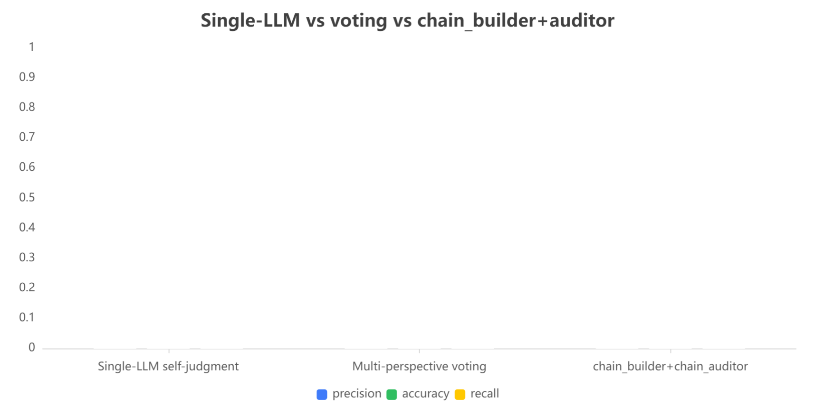
Effectiveness of false positive interception
2
  71 candidates[1]（45TP[milvus 29, qdrant 8, weaviate 8] + 26FP[milvus 14, qdrant 10, weaviate 2]）
precision:
整体判断能力
accuracy：
剔除误报能力
recall：
保留真缺陷能力
[1] sampled from the 71-”TP + FP” pool for experiment

Slide 45
Comparing with Existing Approach
2
  Investigate whether the 45 TPs Bugs can be detected by existing approach(VDBFuzz)
VDBMS | TestVDB | VDBFuzz
Milvus | 29 | 0
Qdrant | 8 | 0
Weaviate | 8 | 0
Total | 45 | 0
On Qdrant v1.18.0, TestVDB found a silent-accept bug (#9045: empty vectors accepted via wait=false) ,which later triggers server panic on search,but VDBFuzz missed it—a crash oracle cannot fire on 200 OK.
Conversely, on Qdrant v1.4.0, TestVDB reached VDBFuzz's divide-by-zero crash (size=2⁶³) by contract reasoning.

Slide 46
实现上：在最新版上直接跑对比实验，版本一致耗时一致即可，对比挖掘成果。理想情况下，如能获得vdbfuzz的bug list，可以再做一下testvdb挖掘复现尝试或者直接分析？
讲清楚：在最新版上直接跑对比实验，版本一致耗时一致即可，对比挖掘成果。

Slide 47
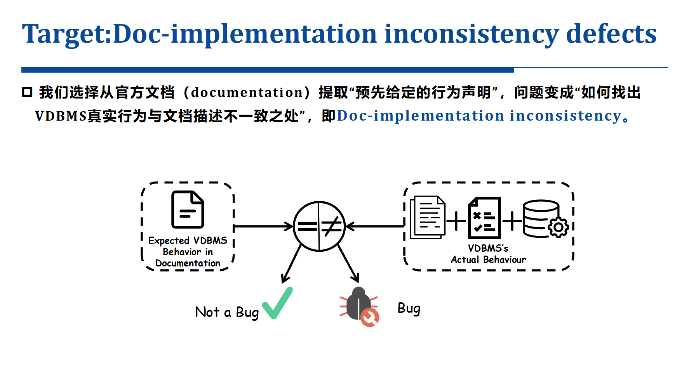
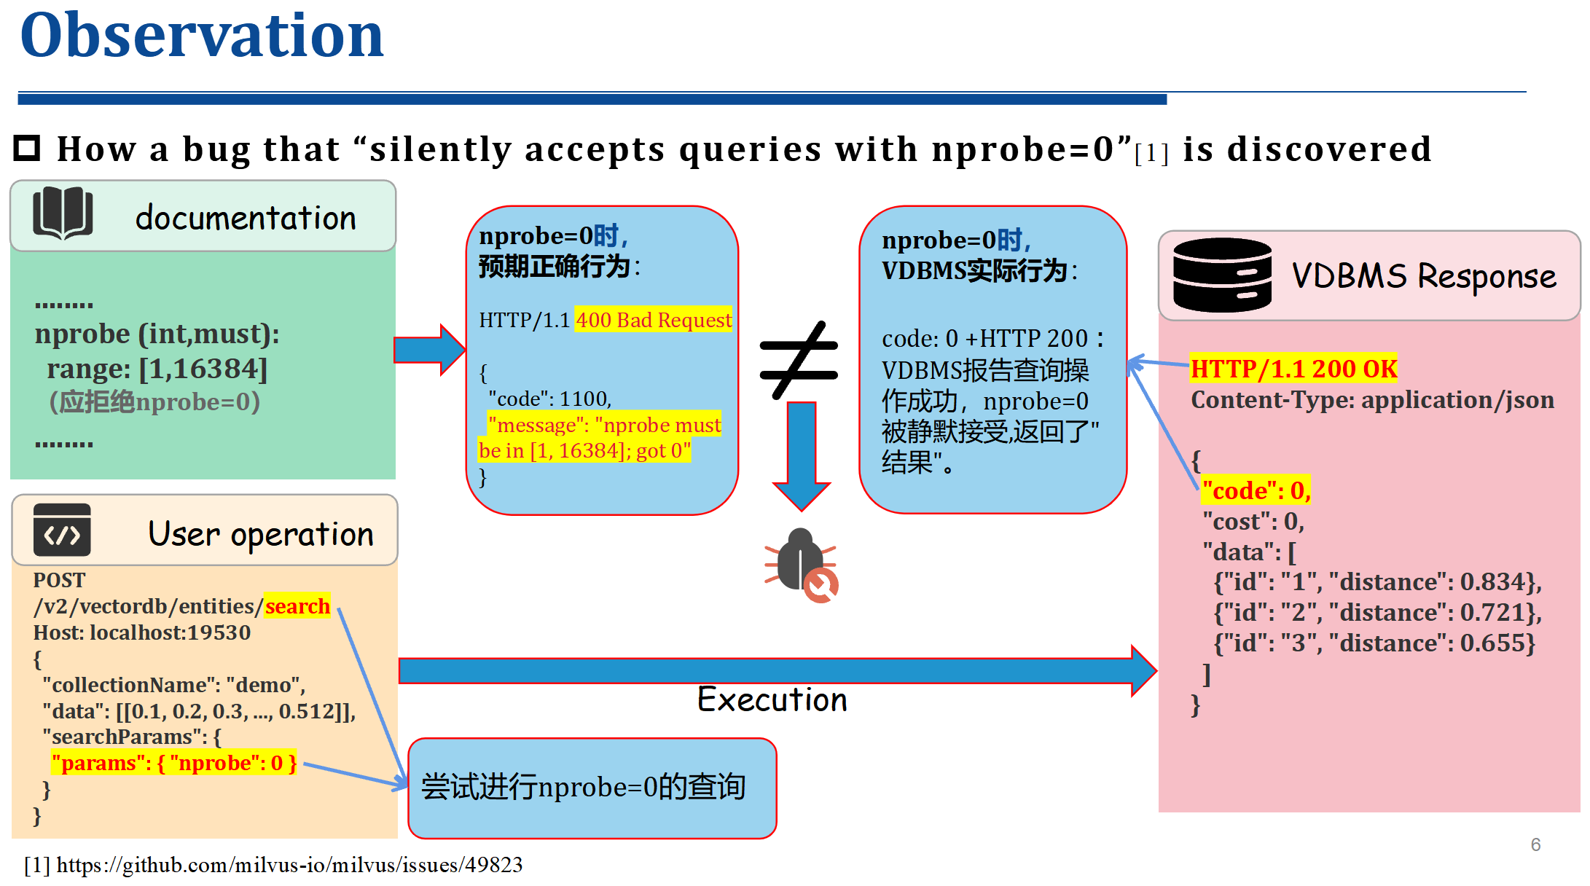
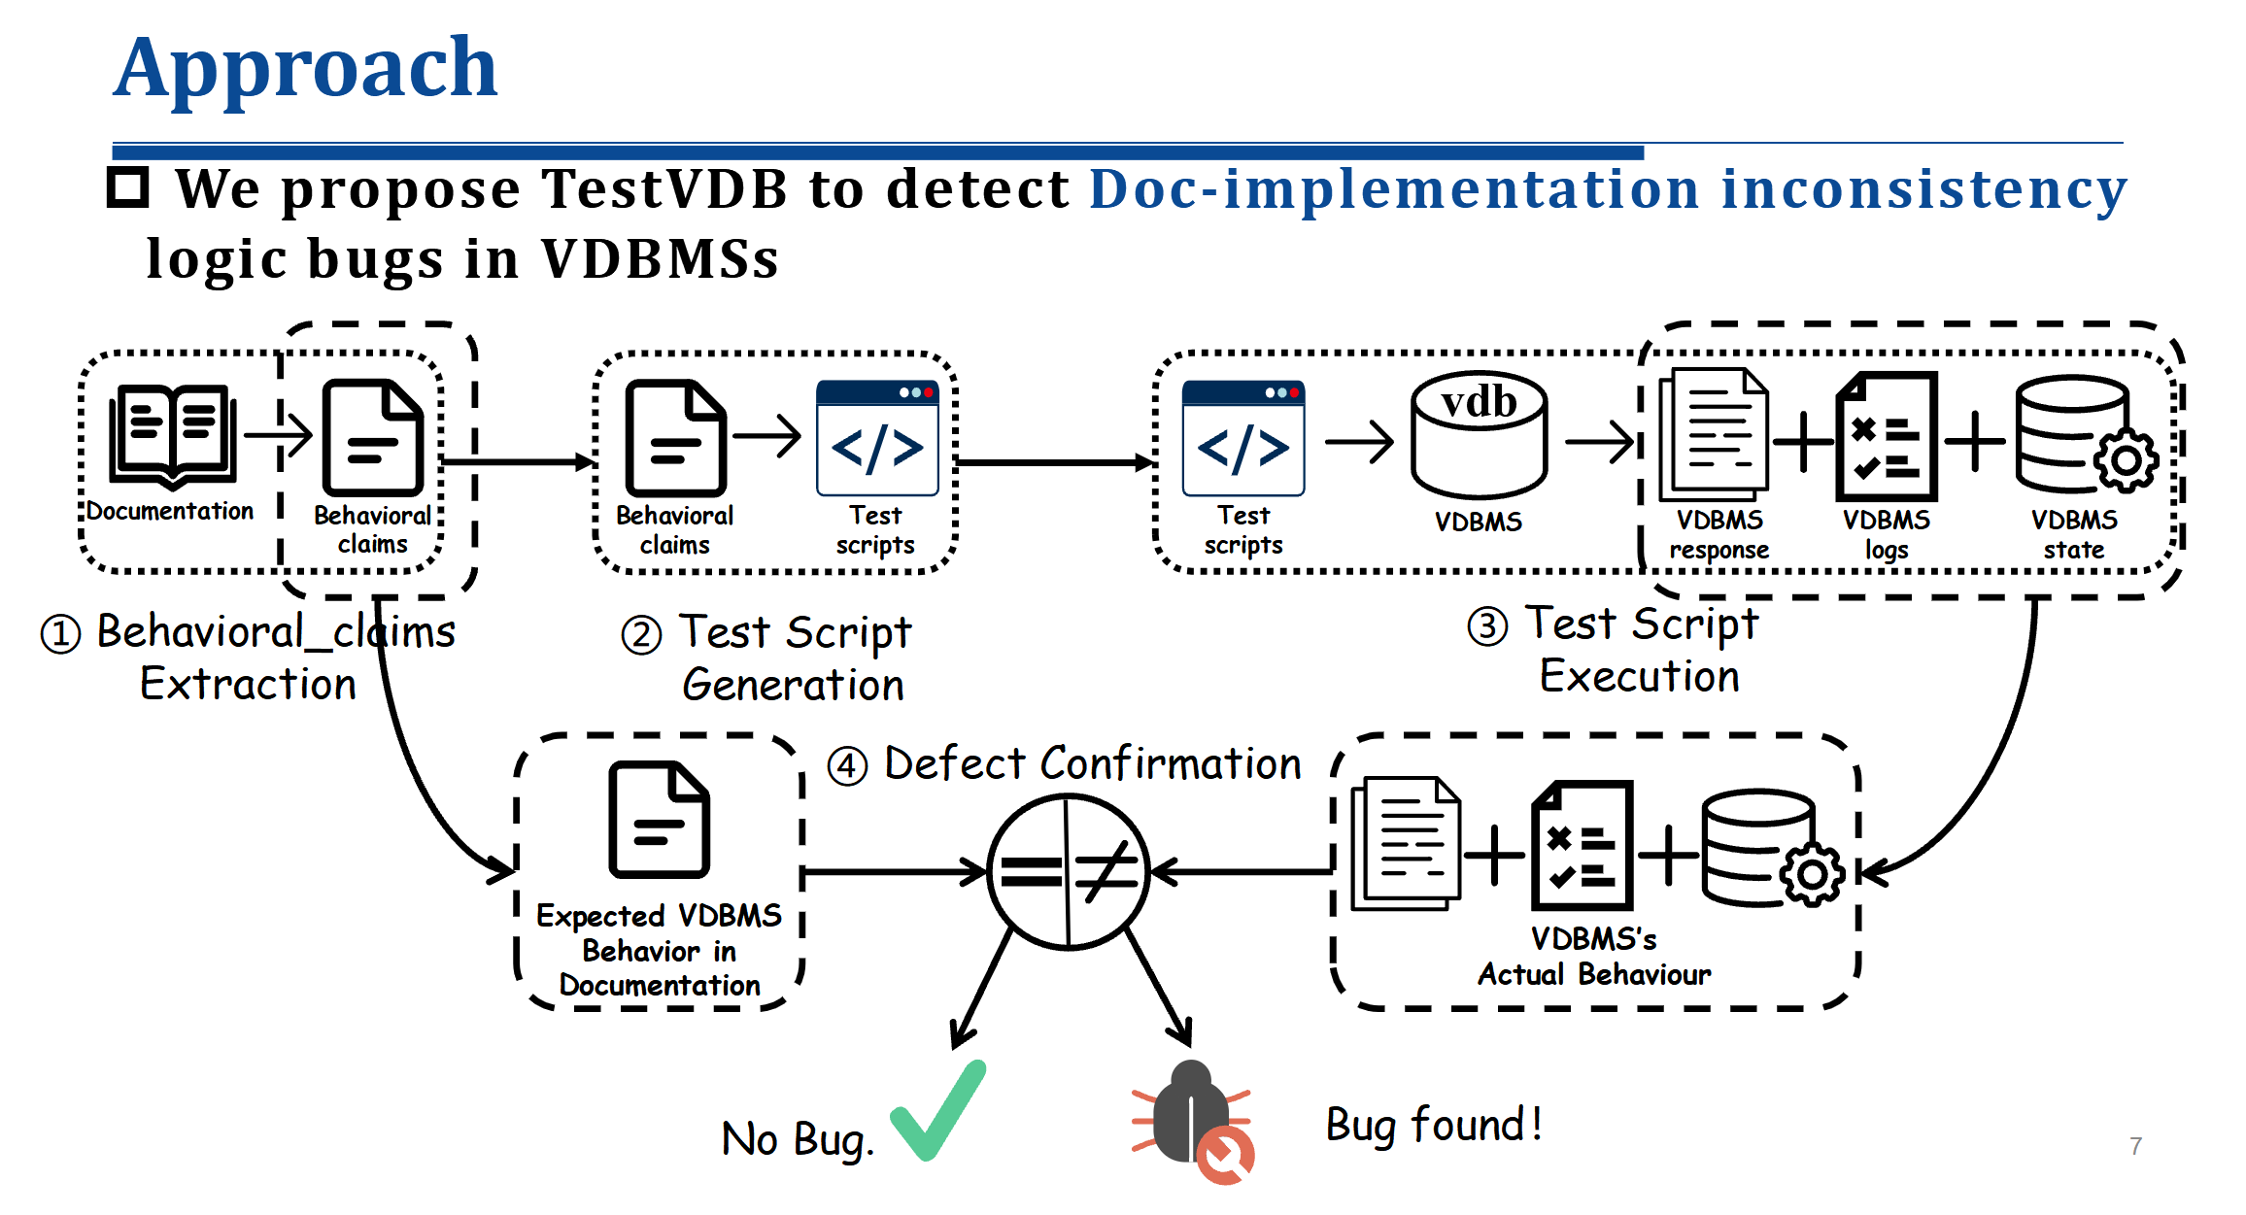
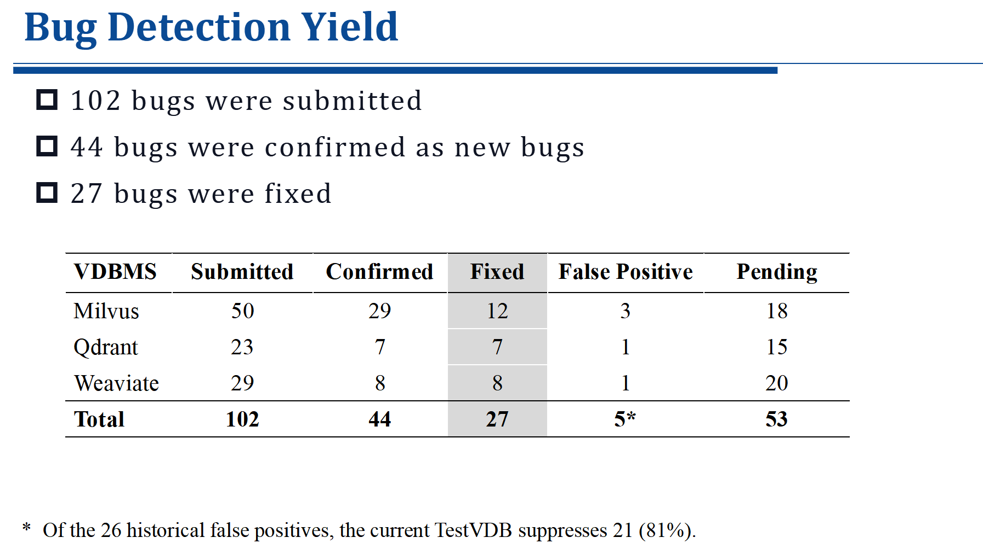
2
Conclusions

