Slide 1

Wollo University
Kombolcha Institute of Technology
College of Informatics
Department of:-computer science
Title: ACCIDENT INFORMATION MANAGEMENT
SYSTEM FOR KOMBOLCHA CITY POLICE STATION
PREPARED BY :-
1.Tesfaye Admasu ………….WOUR/1374/07
2.Siraj Mohammed….……….WOUR/2027/08
3.Taddese Adugna…………...WOUR/2028/08
4.Yordanos Kassahun………WOUR/2065/08
5.Zekiy Seid……………….WOUR/2068/08

Slide 2
Chapter One
Introduction
The development of one country is analyzed from many direction or factors such as peaceful, security of the people and their property etc.
Those are protected by accident management station such as police and society.
The institution of accident management station is standing to protect peoples and their property from danger.
Our project aimed to develop new web based accident management system.

Slide 3
Background about the organization
Kombolcha city police station is one of the institutions of accident management station on the given of this service there are many problem on the accident management that was established long years ago to give service to protect. kombolcha city from accident.
Background about the project
The project is intended to advocate for the need of kombolcha city police station to use facilitated computerized and web based accident information management system.
to kombolcha city police station migrate system to the computerized and web based accident information management system to facilitate their service that they give to the society.

Slide 4
Statement of the problem
The police station has the following problem:-
Difficult of getting real information at real time when accident occurred that help to have real time response to accident.
Difficult to manage the overall system.
Accident file control mechanism is very tedious and complicated.
Data redundancy and inconsistency.
Difficult of communication of field office, society and the station to give and get real time response to the accident.

Slide 5
Objective of the Project
General Objective
Specific Objective
To investigating how the existing system is operation.
To reviewing how the current system works and operates.
To forward the recommendation about system implementation.

Slide 6
Feasibility Analysis
Political feasibility
Economic Feasibility
Technical feasibility
Operation feasibility
Schedule feasibility

Slide 7
Significance of the project
Benefits to police station
Avoiding improper resource consumption like paper, pen.
Benefits to Citizens
Multiple channels to access services from police.
Benefits to Police Department
Enhanced tools for investigation.
Benefits to Team member
The team member can get additional knowledge.

Slide 8
Scope of project
Presence of centralized documented and organized record.
Learn society they protect from accident.
Report are cannot be visible to society.
Methodology
Data gathering Methodology
Interview
Observation
Document Analysis

Slide 9
Chapter Two
Description of the Existing System
File handling
Accident Detection
Report Generation

Slide 10
Players in the existing system
Field officer
society
Administrator/Dispatcher
Accident controlling team
Information Desk

Slide 11
Proposed solution for the new system
Handling Files
Report Generation
Requirement Specification
Functional Requirements
Functional Requirements are those that refer to the functionality of the system, i.e., what services it will provide to the user.
Non-Functional Requirements
Speed
Reliability
Availability
Security

Slide 12
Modeling the existing systems
Essential Use Case Modeling

Slide 13

Essential User Interface Prototyping
Date of incident: _______________ Time: ________ AM/PM

Slide 14
Domain modeling with class responsibility collaborator (CRC)
Dispatcher <<Actor>>
Fname Lname Age Gender Allocate resource () information desk Manage paper file () field officer View request ()
Information desk <<Actor>>
Fname Lname Age Gender documenting () dispatcher stor file () field officer view prepare file ()

Slide 15
Chapter Three
System Analysis
System use case diagrams

Slide 16
Delete user account
Use case Description
UC_ID: | UC_04
Actor: | Dispatcher
Description: | It describe how the dispatcher removes records of system user database.
Precondition: | the user should have logged in as Dispatcher
Flow Event: | Actor action | System response
 | Step1: the administrator wants to delete the account and he/she login to the system. Step2: the administrator selects the delete button(click). Step4:the administrator enters the account type and username of the user (click). Step7: the administrator selects the yes option. | step3:The system display a form Step5: the system checks the entered information with the existing account in the database Step6: the system sends message “Do you want to delete?” to the administrator Step8: the system delete the account from the system. Step 9: the use case ends
Post condition | The system removes the user details from the record
Alternate course of action: | 5.1: the system displays try again message and return step4. 5.2:the system displays empty form

Slide 17
Sequence Diagram

Slide 18
Activity Diagram
Logout Activity Diagram
Validate

Slide 19
Conceptual modeling

Slide 20
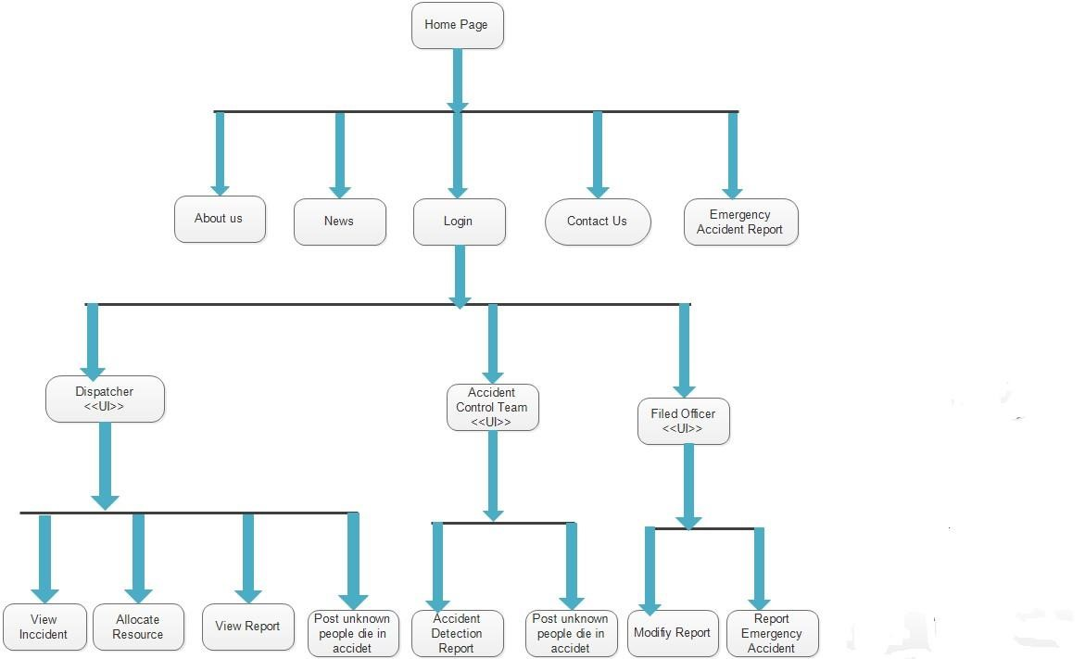
User interface Prototyping

Slide 21
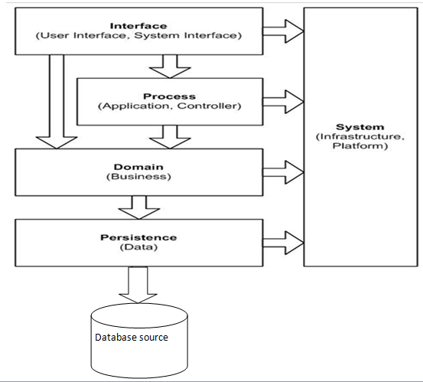
Chapter Four: System design
System design is the transformation of the analysis model into a system design model.
System design is the first part to get the solution
Class type architecture
A common architectural strategy, some might call it a pattern, is to layer the architecture of a system into several layers/strata.

Slide 22
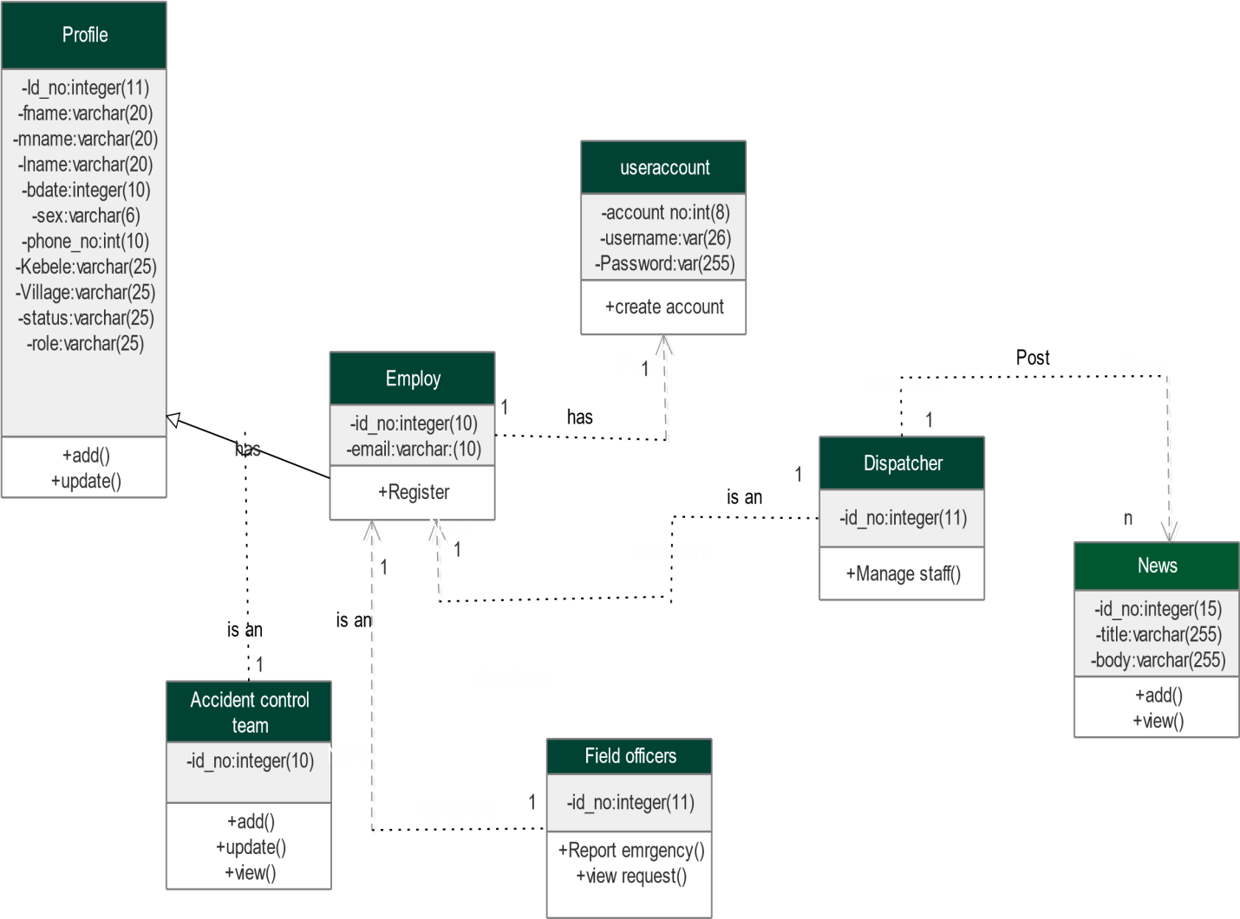
Class modeling
Class diagram shows the static structure of data and the operations that act on the data

Slide 23
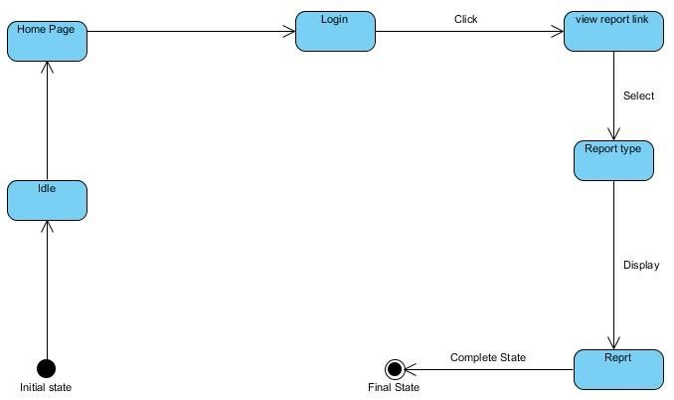
State chart modeling
the most important purpose of State chart diagram is to model life time of an object from creation to terminal.
Collaboration Modeling
Collaboration diagram shows the structural organization of objects that send and receive messages. Sequence and collaboration diagrams are jointly called interaction diagrams and they can be transformed one into another.

Slide 24
Component Modeling
components of the system will be wired showing that there is relation among components, management of the system, database and operations performed on databases security issue.

Slide 25
Deployment modeling
Deployment diagrams model the physical architecture of a system, and it shows the relationships between the software and hardware components in the system and the physical distribution of the processing.

Slide 26
Persistence modeling
Persistent data management deals with how the system is going to handle the actual data need to be stored on the database of the system.

Slide 27
Chapter Five: Implementation and Testing
Implementation refers to the Coding of all the documents gathered starting from requirement analysis to Design phase.
Final Testing of the system
Unit testing
Integrated testing
System testing
Hardware software acquisitions
User manual preparation
Training

Slide 28
Chapter Six: Conclusions and Recommandation
Conclusions
Implementing the analyzed and designed online accident management system might be the best solution to the current major kombolcha police station problem.
Recommandations
May used the web base to change in to android or mobile based application.
Use uninterruptible power supply or UPS if electric power is not available in station.
Integrate with the court system.
Adding the chatting system.

Slide 29
The End
Thank You…!!!

