Slide 1
Airbnb Price Prediction & City Dynamics Analysis: LA vs NY
METCS777
METCS 777 – Final Project
Yibing Wang & Yiming Chen

Slide 2
Introduction
What Is This Project About?
Predict nightly Airbnb prices using PySpark ML.
Compare key price-driving factors between LA and NYC.
Motivation
West Coast vs East Coast rental patterns differ.
Hosts need guidance on how listing attributes influence price.
Travelers need transparency on cost drivers.
Good case study for big data processing + ML modeling.
Why important
LA & NYC = largest Airbnb markets in the US.
Hosts and platforms need pricing insights.
Markets differ greatly in urban structure, demand, tourism.

Slide 3
Dataset Overview
Data Source:
Inside Airbnb public listings dataset
Cities analyzed: Los Angeles (LA) and New York City (NYC)
File format: listings.csv.gz
Key data fields:
Location: latitude, longitude, neighbourhood group
Listing: room_type, minimum_nights, availability_365
Demand: number_of_reviews, reviews_per_month
Host: host_listings_count, license (LA only)
Target: price → log_price

Slide 4
Data Cleaning & Processing
01
02
03
04
Remove Invalid Rows
Fix Data Types
Drop listings with invalid / non-numeric IDs
Remove rows with missing price
Exclude corrupted records & incorrect coordinates
Use try_cast to safely convert numeric fields
(price, nights, reviews, availability, host counts)
Convert last_review → date
Handle Missing Values
Price Outliers
reviews_per_month = 0
reviews_ltm = 0
Keep license as-is (LA only)
Removed extreme prices
Kept listings with price ≤ $2000

Slide 5
EDA Highlights

Slide 6
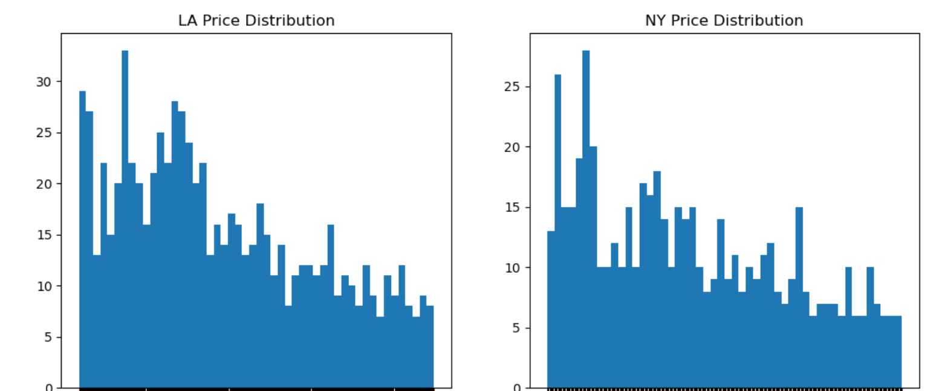
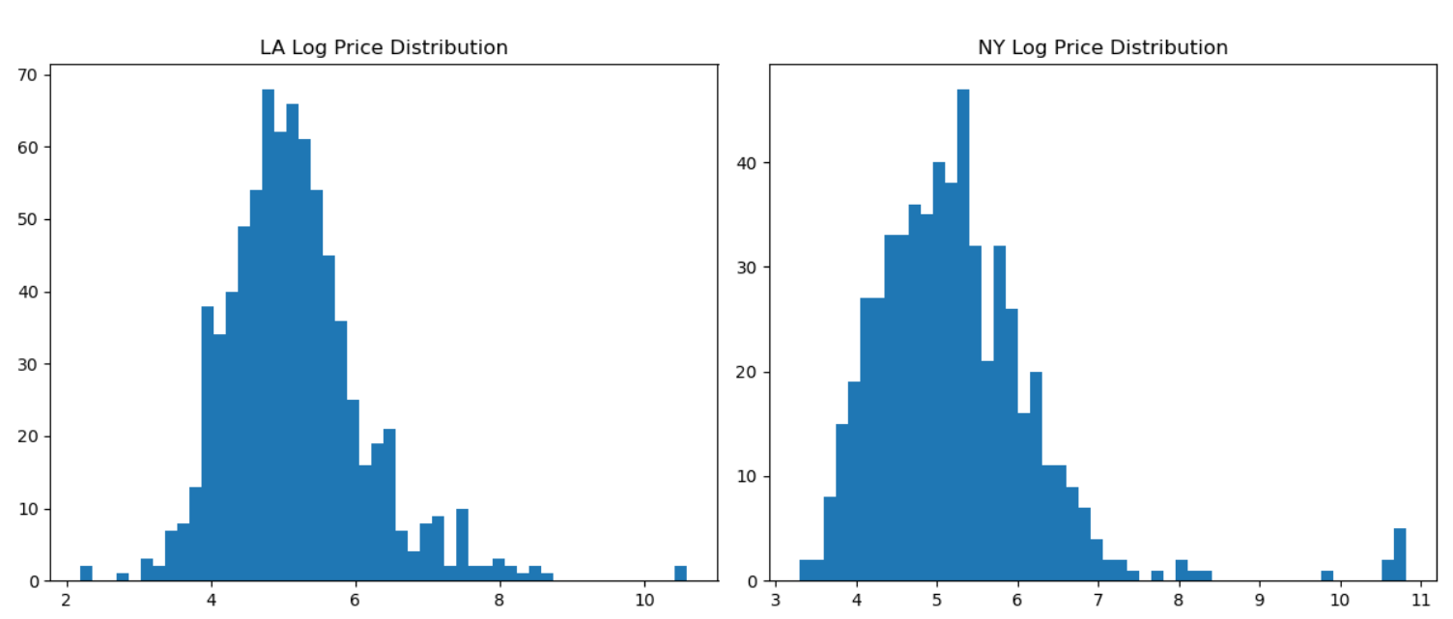
Price Distribution (LA vs NY)
Raw prices show a strong right-skew, with a small number of extremely high-priced listings.
After log transformation, price distributions become much more symmetrical and close to normal.
NY prices tend to be higher overall, with a more pronounced high-end tail than LA.
These patterns justify applying a log transformation to stabilize variance and improve model performance.

Slide 7
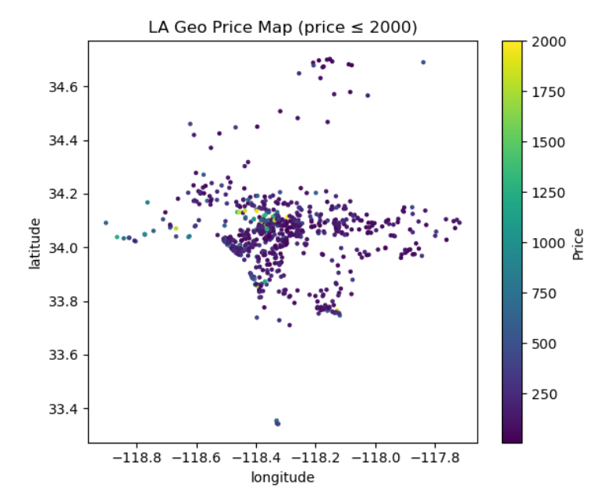
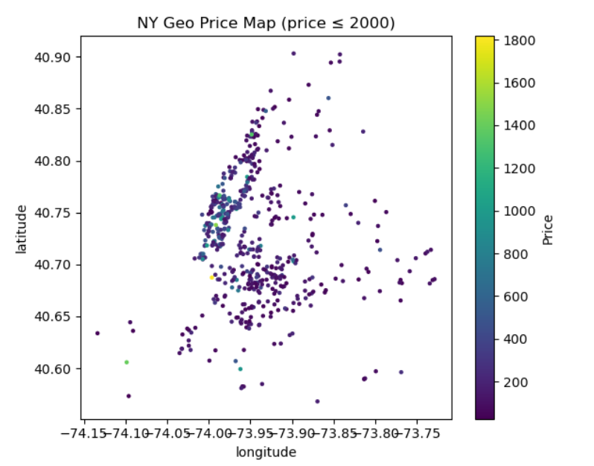
Geographic Price Mapping
LA
NY
Higher-priced listings cluster around central LA and coastal areas (e.g., Santa Monica / Malibu direction).
Prices spread more broadly due to LA’s decentralized urban structure.
High-price listings are tightly concentrated around Manhattan, especially Midtown & Lower Manhattan.
Much sharper spatial gradient than LA — prices drop quickly moving outward.

Slide 8
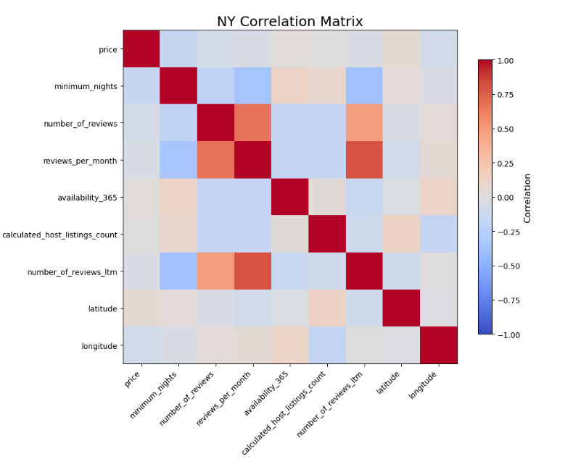
Correlation Insights (NY as example)
Strong positive correlation between review-based features
Pricing in NYC is influenced by non-linear and multi-factor interactions.
Raw features alone cannot fully capture location-driven and host-driven pricing patterns.
Feature engineering is essential — we need log-price, spatial features, and encoded categorical variables to model NYC pricing effectively.
Notes:
Unlike review features that behave strongly together, price behaves independently, with no single predictor showing a strong linear trend.
Because price is weakly correlated with raw features, we must engineer additional variables—such as log-price, spatial distance to city center, and encoded categorical attributes—to better capture the non-linear and geographic drivers of Airbnb pricing in NYC.

Slide 9
Feature Engineering

Slide 10
Applied log(price) to address right-skewed distribution.
Stabilizes variance and improves model regression performance.
Cleaned and standardized continuous variables that influence pricing
Numeric Feature Refinement
Target Variable Transformation
Categorical Feature Encoding
Final Feature Vector Assembly
Converted qualitative attributes into model-friendly vectors
All numeric + encoded categorical features were combined using VectorAssembler
Why These Features Matter
Captures location, host behavior, demand, and property characteristics.
Creates comparable patterns between LA vs NY for modeling and interpretation.
Directly supports cross-city feature importance comparison.

Slide 11
Modeling

Slide 12
Modeling Approach
End-to-End PySpark ML Pipeline
Models Used
Constructed a full machine learning workflow in PySpark
Data cleaning → feature engineering → VectorAssembler → ML models
Ensures consistency and scalability for both LA and NY datasets
Linear Regression (Baseline)
Evaluates whether a linear relationship can explain pricing
Random Forest Regressor
Handles nonlinear interactions
More robust to noise and outliers
Provides interpretable feature importance
Gradient-Boosted Trees (GBT)
Captures complex feature interactions
Works well without extensive tuning
Train/Test Split
80% training / 20% testing
Fixed random seed for reproducibility
Same split for both cities → ensures fair comparison

Slide 13
Model Performance — LA
Model | RMSE | MAE | R² | Interpretation
Linear Regression | 0.723 | 0.545 | 0.378 | Weak linear fit
Random Forest | 0.629 | 0.468 | 0.529 | Best overall performance
GBT | 0.677 | 0.492 | 0.455 | Moderate improvement vs LR

Slide 14
Model Performance — NY
Model | RMSE | MAE | R² | Interpretation
Linear Regression | 0.782 | 0.564 | 0.520 | baseline
Random Forest | 0.743 | 0.531 | 0.566 | Best overall performance
GBT | 0.854 | 0.551 | 0.429 | Overfits + underperforms

Slide 15
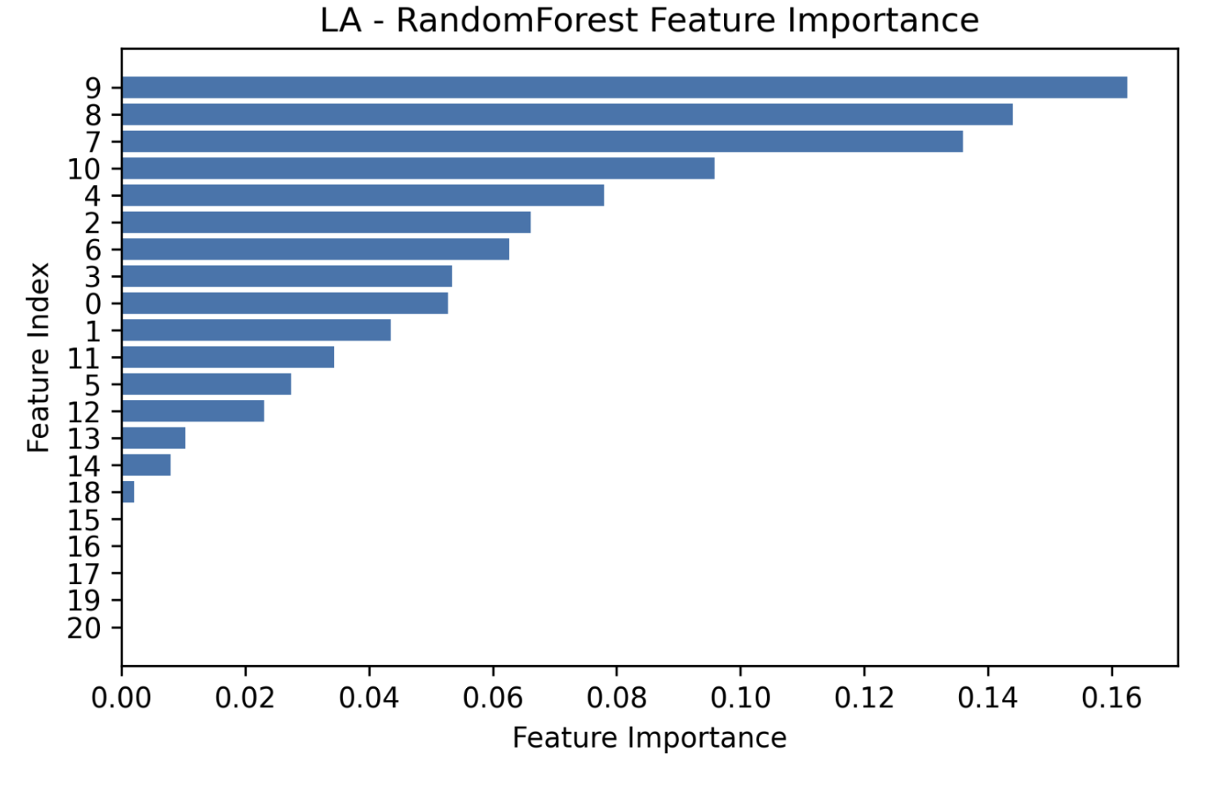
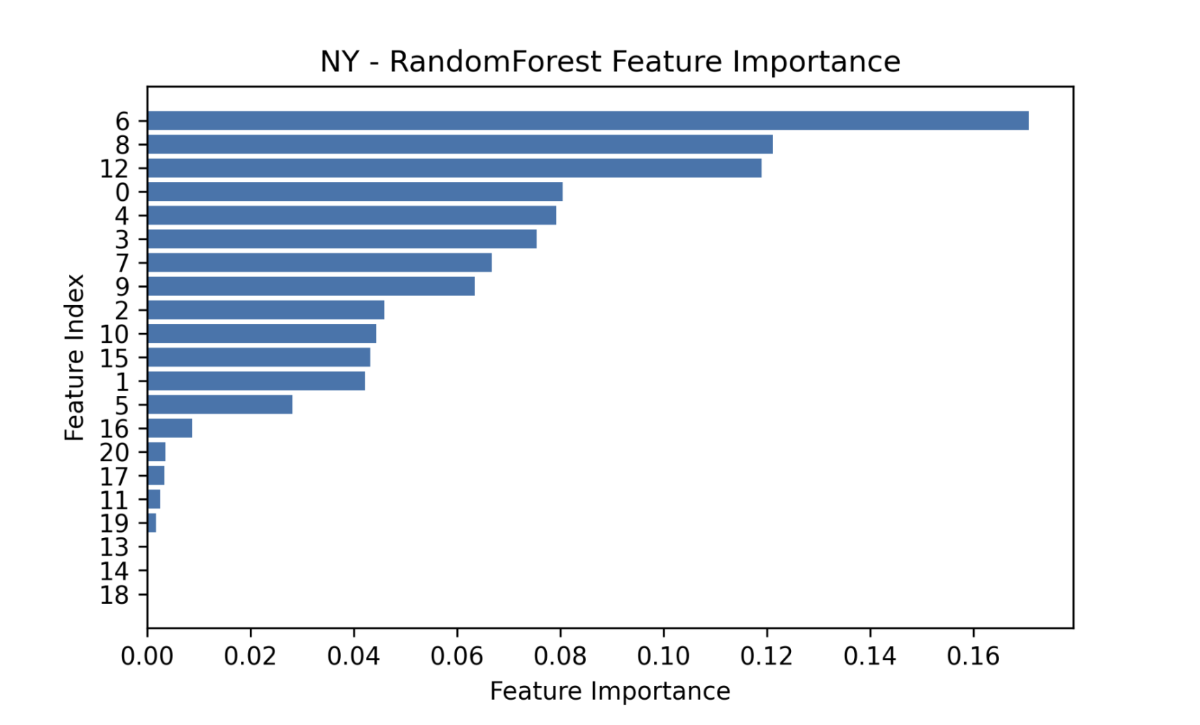
Feature Importance — Random Forest
Room type (largest effect)
Latitude & longitude (coastal & high-demand areas priced higher)
Host listing count (multi-unit hosts → higher price)
Distance to city center (strongest driver)
Longitude (Manhattan proximity)
Room type differences
Minimum nights requirement
Host listing count & review activity
Cross-City Takeaways
NY pricing is highly centralized; LA pricing is spatially dispersed.
Review & demand signals matter more in NY.
Room type is consistently influential across both markets.

Slide 16
Insights & Interpretation
New York
Los Angeles
Price is location-driven, with clear premiums near Manhattan.
Distance to center, availability, and review volume are major predictors.
Reflects a high-competition, demand-sensitive market
Pricing is more spread out across neighborhoods.
Lat/long (neighborhood differences) and room type are stronger drivers.
Market responds more to property characteristics than demand signals.
Cross-City Takeaways
NY: location + demand signals drive price.
LA: location + property attributes drive price.
Feature importance aligns with EDA findings.

Slide 17
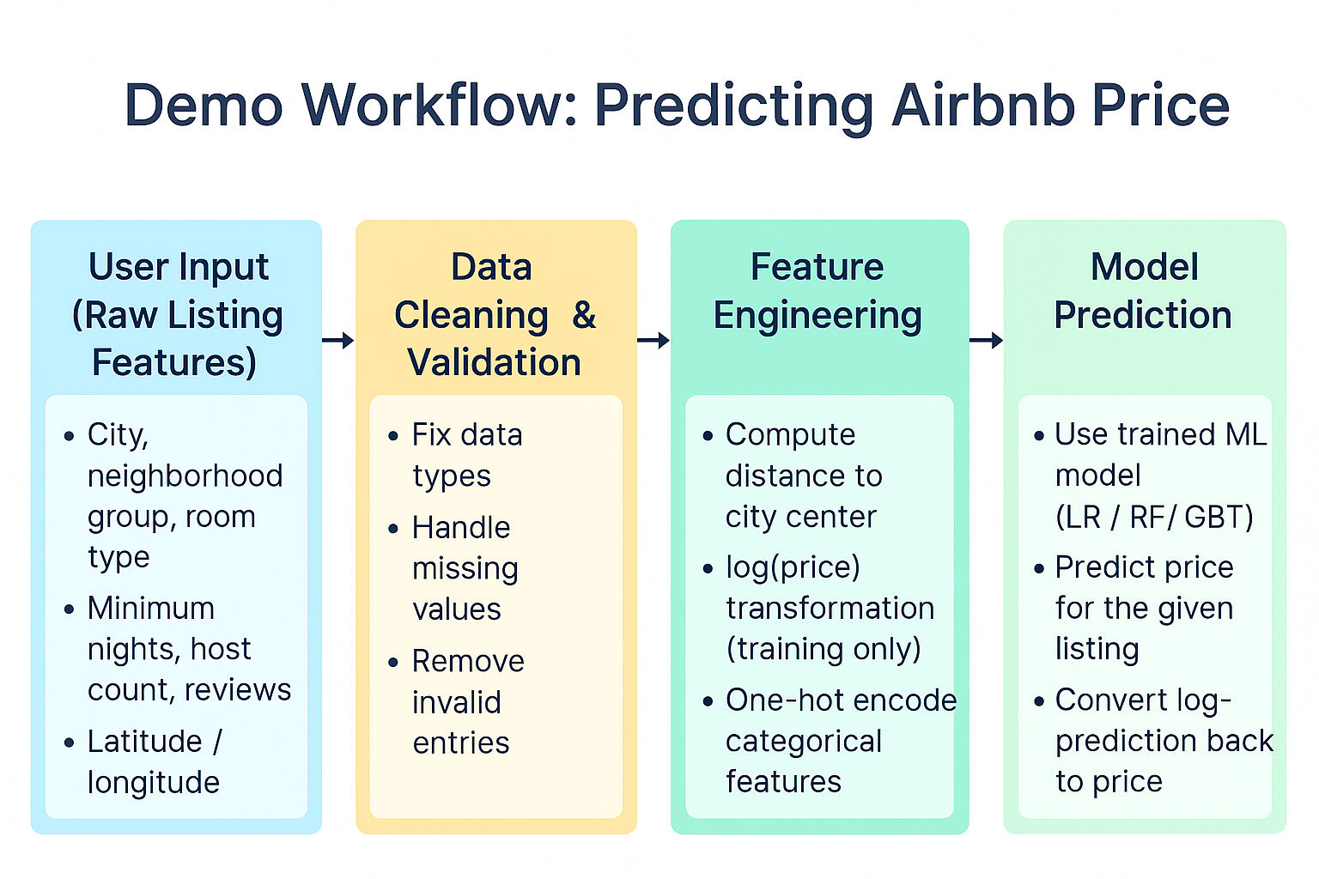

Slide 18
Conclusions
Airbnb pricing is shaped by different forces in LA and NY
Random Forest models performed best
NY
LA
highly centralized
distance to Manhattan and demand indicators (reviews, availability) dominate pricing.
spatially distributed
with latitude, longitude, and room type playing central roles
These results highlight how urban structure and market patterns shape Airbnb prices differently across cities, and demonstrate the value of scalable PySpark pipelines for building interpretable, city-level pricing insights.

Slide 19
Reference
“How is Airbnb really being used in and affecting the neighbourhoods of your city?” Insideairbnb.com, insideairbnb.com/.
“Airbnb Open Data.” Www.kaggle.com, www.kaggle.com/datasets/arianazmoudeh/airbnbopendata.
Pouya Rezazadeh Kalehbasti, et al. Airbnb Price Prediction Using Machine Learning and Sentiment Analysis. 29 July 2019, www.researchgate.net/publication/334783073_Airbnb_Price_Prediction_Using_Machine_Learning_and_Sentiment_Analysis.
Camatti, Nicola, et al. “Predicting Airbnb Pricing: A Comparative Analysis of Artificial Intelligence and Traditional Approaches.” Computational Management Science, vol. 21, no. 1, 6 May 2024, https://doi.org/10.1007/s10287-024-00511-4.

