Slide 1
Predict Future Sales
Yijia Chen

Slide 2
Dataset
This is a Kaggle ongoing Competition. In this competition, I will predict total sales for every product and store in next month
About the Dataset:
The dataset is provided by 1C Company, one of the largest Russian software firms. The dataset includes train and test dataset, as well as information about each store, category and product.

Slide 3
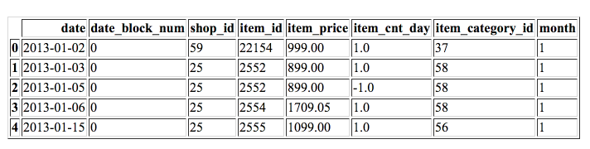
Dataset
shop_id - unique identifier of a shop
item_id - unique identifier of a product
item_category_id - unique identifier of item category
Item_cnt_day - sales
date_block_num - a consecutive month number, used for convenience. January 2013 is 0, February 2013 is 1,..., October 2015 is 33

Slide 4
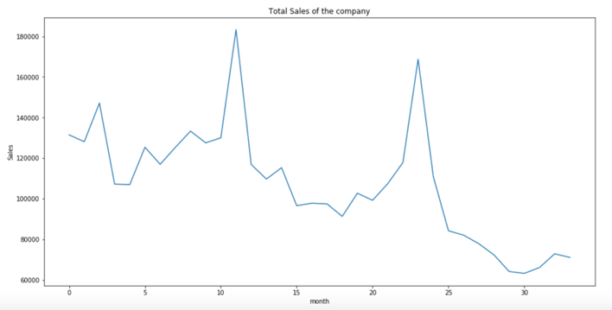
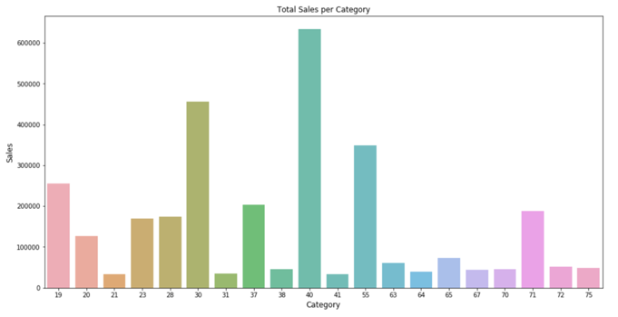
EDA

Slide 5
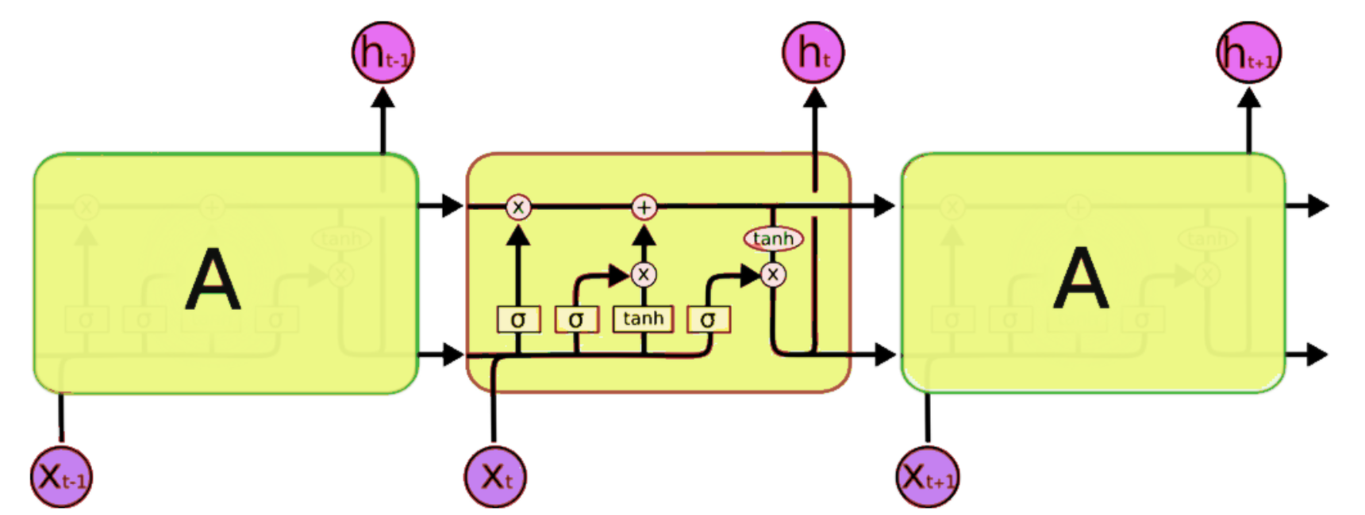

Long Short Term Memory

Slide 6
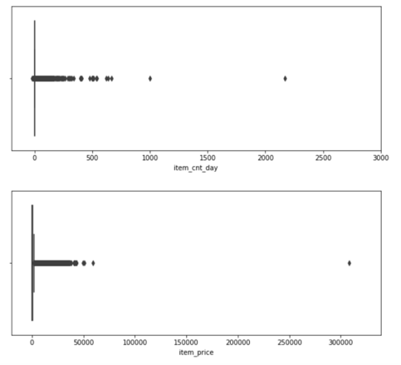
Data Preprocessing
Remove outliers, duplicates
Min Max Scaler
Reshape to [samples, time steps, features]

Slide 7
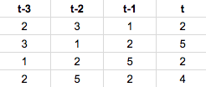
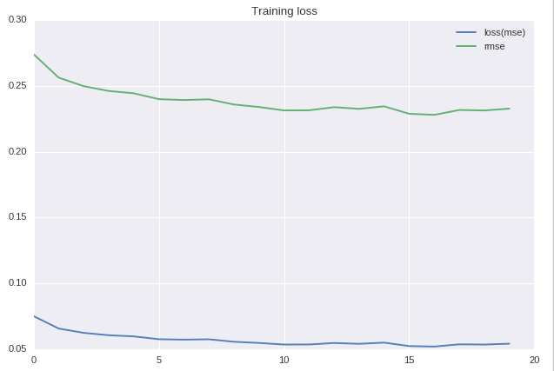
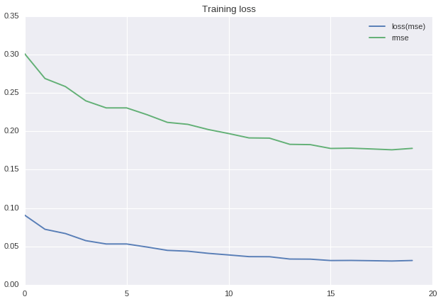
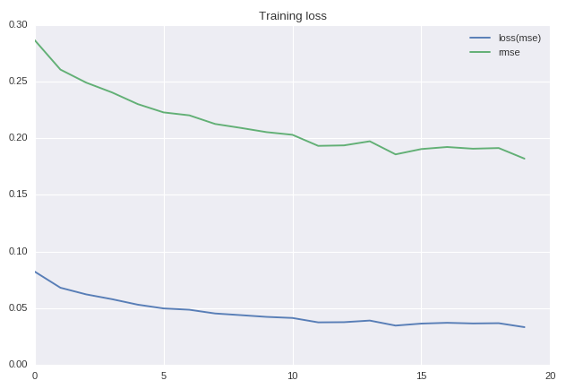
LSTM for one product
Choose a random product
Recreate the dataset
Tried different lookback
Lowest RMSE 0.2806

Slide 8
LSTM to predict sales
Set train, test, target
The last month ‘2015-10’ is the target to predict

Slide 9
Model compares
Epochs = 20
Optimizer: Adam
 | Hidden neuron | Batch size | stateful | shuffle | RMSE on test | Computation time
Model 1 | 32 | 1260 | False | False | 0.05941 | 88.8275
Model 2 | 64 | 1260 | True | False | 0.05945 | 93.122
Model 3 | 64 | 1260 | True | True | 0.05953 | 95.9197
Model 4 | 64 | 1260 | False | False | 0.05948 | 96.5655

Slide 10
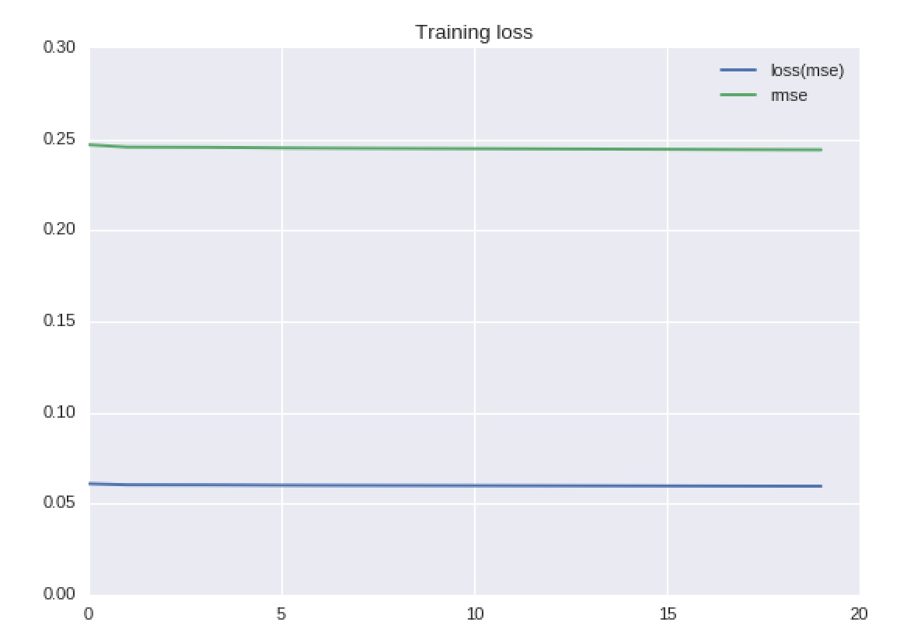
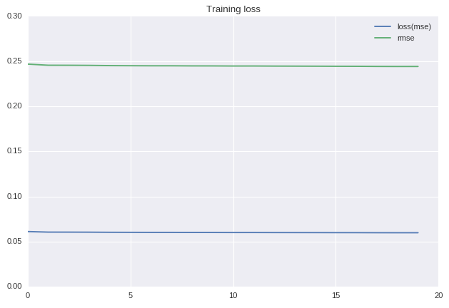
Stateful vs Stateless
Stateless
Stateful

Slide 11
Conclusion & Future Work
LSTM is a useful model to handle time series
Stateful and stateless is not showing a big difference in this dataset
Adding price as a feature

