Slide 1

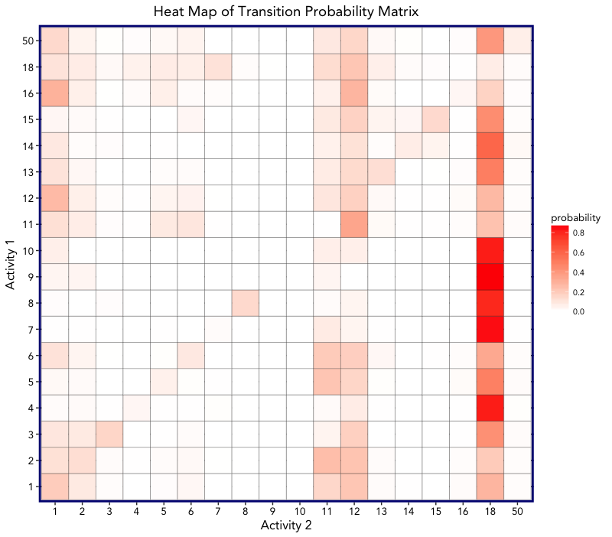
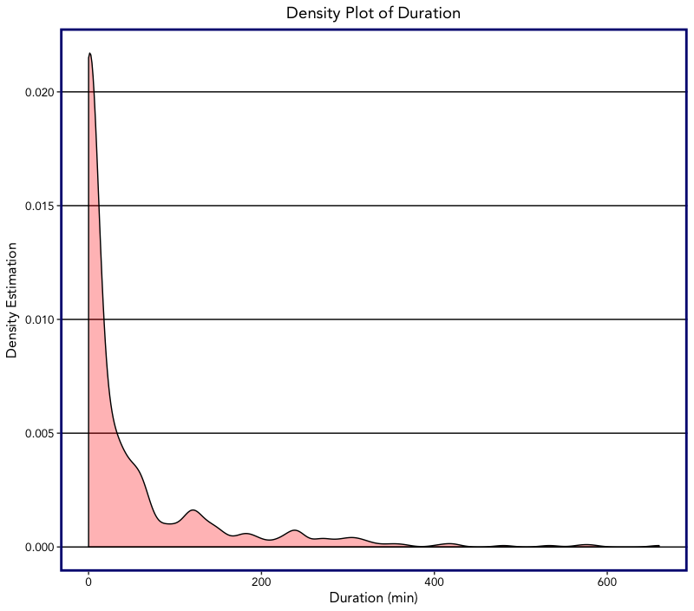
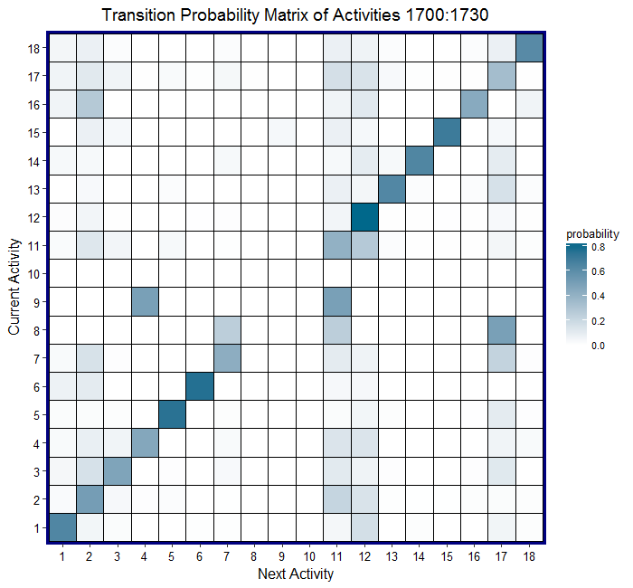
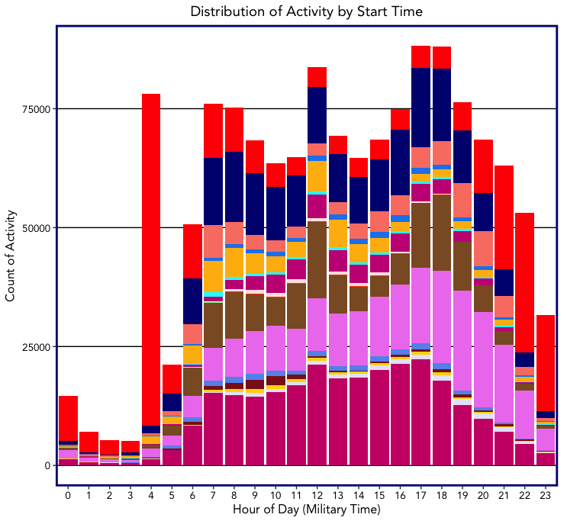
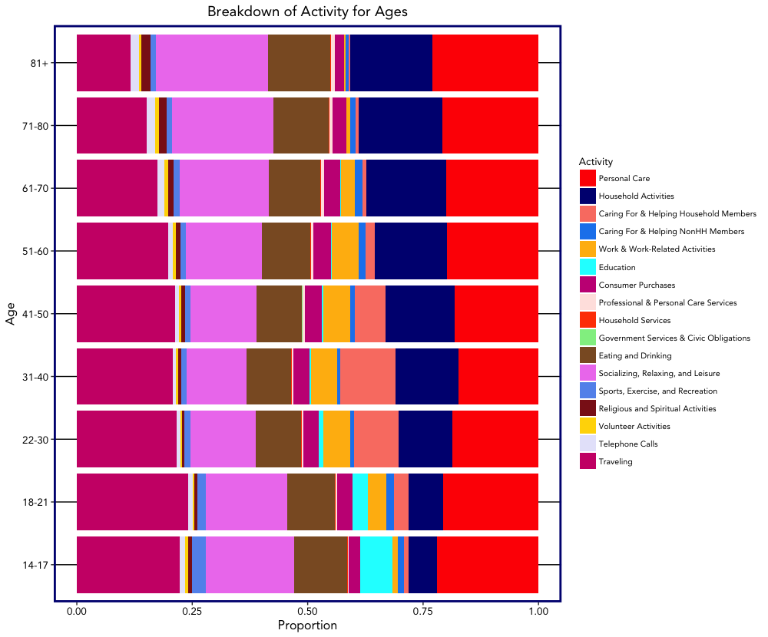
Statistical Approaches for Augmenting Synthetic Ecosystems with Agent Activities:
An Application of the American Time Use Survey
Isaac Haberman, LéShaun Jones, Grace Lee, & Angela Liang
Advisor: Sam Ventura | Instructors: Jordan Rodu & Shannon Gallagher (36-490)
Background
Modeling Transitions Between Agent Activities with Markov Chains
A synthetic ecosystem is a digital representation of a group of agents and is used as the input for agent-based modeling
Models of Infectious Diseases Agent Study (MIDAS) is part of a larger nation-wide research network
The CMU MIDAS team has developed the Synthetic Populations and Ecosystems of the World (SPEW) package for agent simulations in R
Our research explores the uses of the American Time Use Survey (ATUS) in augmenting SPEW. The survey has been conducted by the U.S. Census Bureau via telephone since 2003
We focused on the activities of the responder, as it was the most complete
We used Markov models to model activity codes. The transition probability matrices (TPMs) below visualize those models.
The Duration Model, the red matrix, ignores time of day and accounts for activity order and duration.
The Time Model, the blue matrix, accounts for time of day, activity order and duration.
The matrices display the probabilities of moving from one activity code to another activity code. The darker the color, the higher the probability of moving from the activity code on the y-axis, to the the activity code on the x-axis
Each plot was generated using data for 20 year old men in urban areas
TPM of Duration Model
Density Plot of Duration
TPM of Time Model 17:00-17:30
TPM of Time Model 17:00-17:30
Research Objectives
Probability
Current Activity
Probability
Augment the SPEW package with the proper actions and activities based on time, household composition, and demographics
Deploy a Shiny app to explore and visualize the activities done by the respondents of ATUS
Predict 1st order activities from ATUS through Markov modeling, a form of stochastic modeling detailing a sequence of possible events in which the probability of a prior event effect the state of the next event
Activity 1
Density Estimation
Current Activity
Activity 2
Duration (min)
Next Activity
Figure 4: Density plot generated from the Duration Model using Activity Code 4
Next Activity
Figure 3: TPM generated from the Duration Model
Figure 5: TPM generated from the Time Model between 17:00 and 17:30
Exploratory Data Analysis
Discussion
Distribution of Activity by Start Time
Breakdown of Activity for Ages
Both models generate understandable and reproducible results
Time of Day models may suffer from long chains of repeated activity codes, due to the variance of probabilities
Duration Model is less time specific and might overlook details
Both Models only use the 1st tier of the activity code
Key to Activity Codes
Personal Care
Household Activities
Caring for Household Members
Caring for non-Household Members
Work and Work Related Activities
Education
Consumer Purchases
Professional and Personal Care Services
Household Services
Government Services & Civic Obligations
Eating and Drinking
Socializing, Relaxing and leisure
Sports, Exercise and Recreation
Religious and Spiritual Activities
Volunteer Activities
Telephone Calls
Traveling
Undefined
Next Steps
Count of Activity
Age
Integrate models into SPEW
Integrate Shiny app capabilities into SPEW web app
Develop further models for more specific activities
Adjust predictions by performing more variable and demographic selection
Explore higher order Markov models
Explore other uses of models
Hour of Day (Military Time)
Proportion
Figure 1: Distribution of activities by start time
Figure 2: Breakdown of activities by age
Acknowledgements
These 18 Activity Codes are only the main groups and there are 2 additional activity codes that code for more specific activities
ATUS begins recording activities for the day at 4AM, which explains the huge influx of “Personal Care”, or more specifically, sleeping
Left: While there are fluctuations of activities during expected hours, many activities are constantly beginning throughout the day
Right: Proportion of “Household Activities” increases with age; Education essentially disappears after 30 years of age; “Caring for and Helping Household Members” is prevalent in middle age, but disappears again in later life
Our team thanks our advisor Dr. Sam Ventura as well as Dr. Jordan Rodu for their guidance on this project. Additionally, we would like to thank Dr. Bill Eddy, Shannon Gallagher and the rest of the MIDAS Team for their insights and assistance with the project.

