Slide 1

Linear Algebra: Theory and Applications
(MAT2041-L01)
Course Syllabus and Brief Introduction
Instructor: Hongyuan Zha

Slide 2
Introduction
Basic Information and Course Syllabus
Basic Introduction
Q&A

Slide 3
Myself
Hongyuan Zha
BSc in Math, Fudan
PhD in Scientific Computing and Computational Math, Stanford
Faculty member at Penn State and Gatech
Professor, CUHK-Shenzhen
Feel free to reach out!

Slide 4
Course Information
Instructor: Hongyuan Zha
Course schedule: Tue & Thu 8:30AM-10:00AM
Venue: TB104
Office Hour: Thu 4PM-5PM
(Daoyuan Building 603)
Email: zhahy@cuhk.edu.cn
Website: Blackboard and course website
Teaching Method: lectures + slides
For freshman year undergraduates

Slide 5

Useful Online Courses and Resources
MIT 18.06 “Introduction to Linear Algebra” by Gilbert Strang
BiliBili:

Slide 6
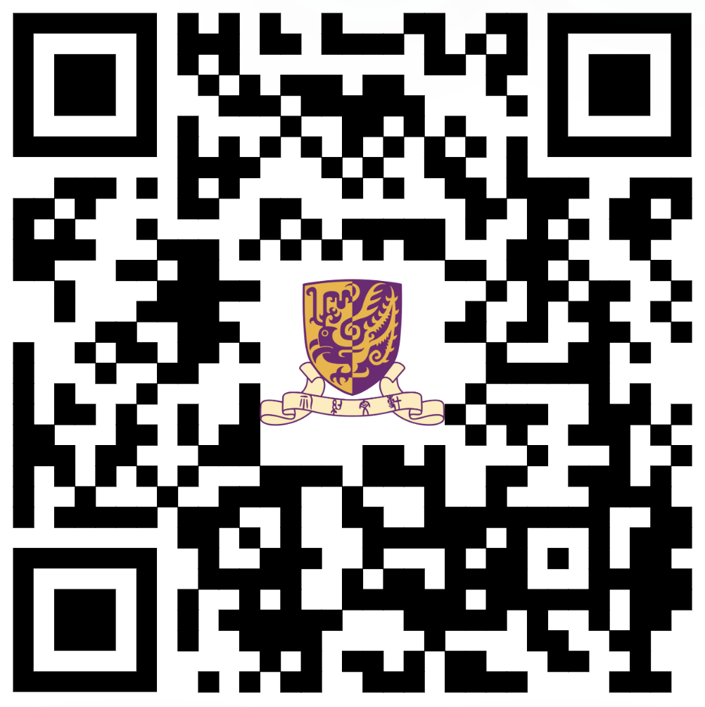
Course Information
Course Website

Slide 7
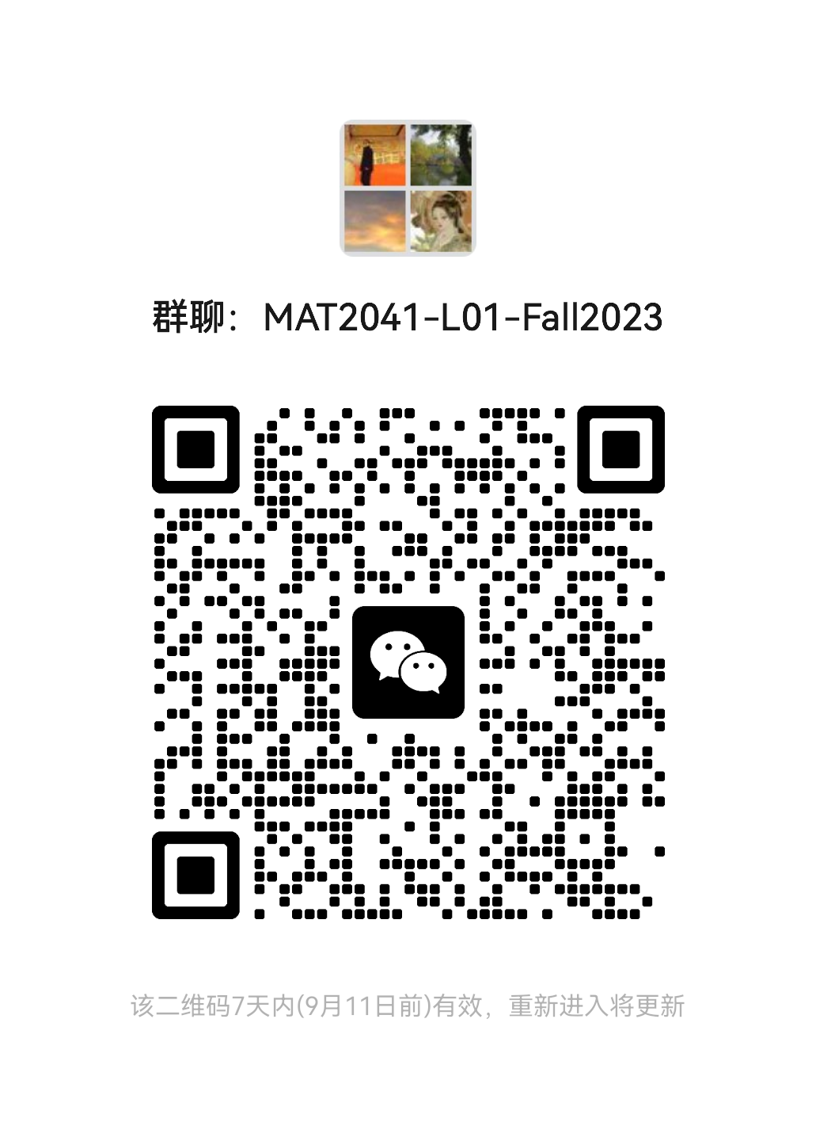
WeChat Group

Slide 8
Textbooks
Textbook:
Gilbert Strang, Introduction to Linear Algebra, 5th edition or 6th edition,
Wellesley-Cambridge Press
Recommended books:
Stephen P. Boyd and Lieven Vandenberghe, Introduction to Applied Linear Algebra
Steven J. Leon, Linear Algebra with Applications, 9th Edition
David C. Lay, et al., Linear Algebra and its Applications, 5th edition
Interactive Linear Algebra (2019) by Dan Margalit and Joseph Rabinoff

Slide 9
Grading Scheme
Assignments and Quiz:
35%
(In total 6 to 10 assignments)
Mid-term Exam: 30%
(Submit your assignments on Blackboard)
Final-term Exam: 35%
(Late Policy)

Slide 10
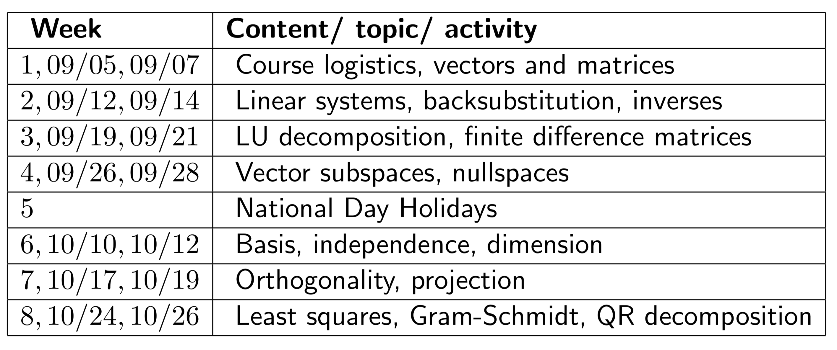
Course Syllabus

Slide 11
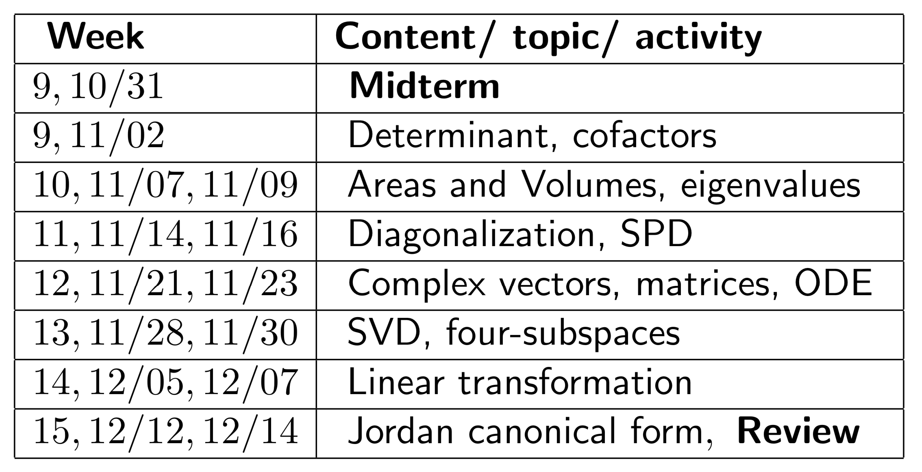
Course Syllabus

