Slide 1
Plan today
Plan for Tutorial 1 (50 min):
Introduction to homework policy (10min)
--regrading policy
--discussion policy
How to prepare e-version of homework (10 min)
--3 approaches
--tips for better clarity
How to submit homework via BB (5 min)
Exercise: (25 mins)

Slide 2
MAT2041 Tutorial 1: Homework --homework policy --homework submission

Slide 3
Basic LOGISTICS

Slide 4
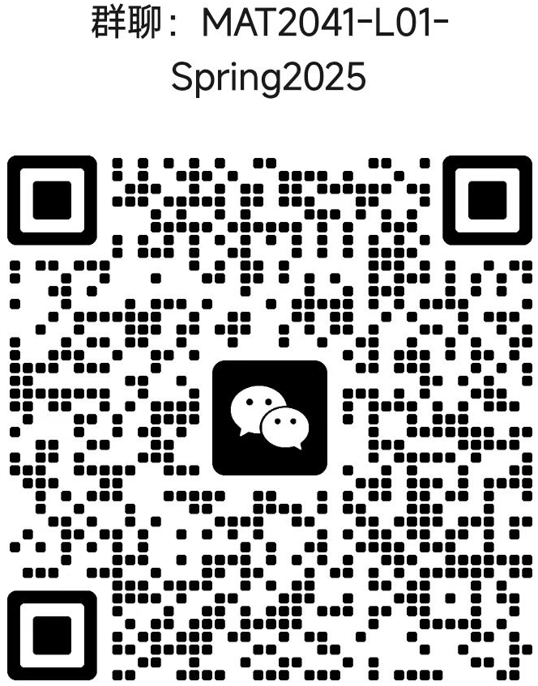
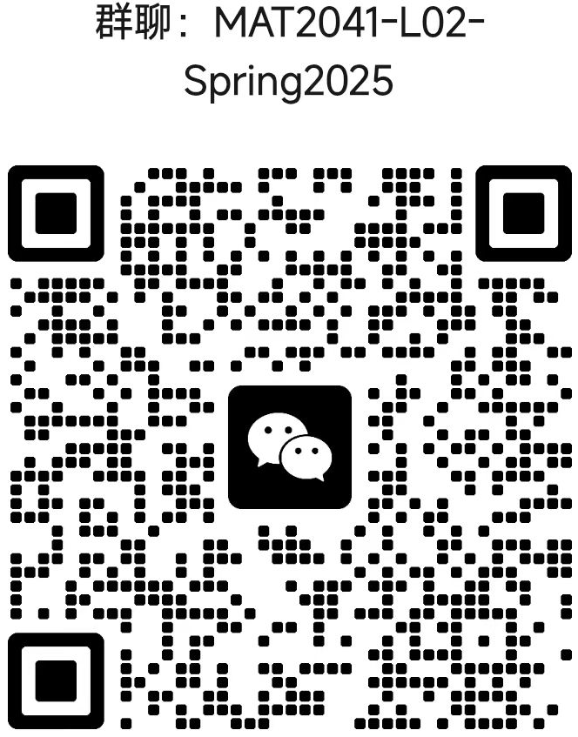
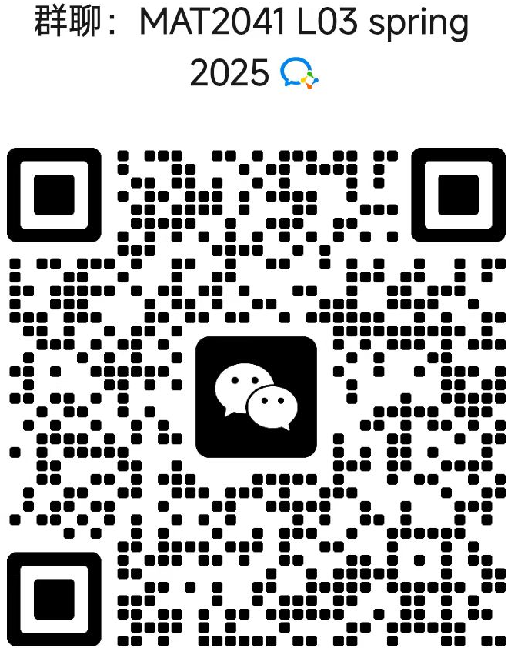
Wechat Group
Join Session L01, L02 or L03 WeChat group if you have not; scan the QR codes or ask TAs/classmates.
Check wechat group!
Check wechat group!
Check wechat group!
Check once every day
--even if emergency, check once every 2 days
Notes:
during class

Slide 5
Questions on the Course
Any logistic questions:
--ask in WeChat groups
--ask in Piazza (if not urgent)
Technical questions:
--Ask in Piazza
--Come to TA’s office hours
If these channels cannot resolve your questions: --Come to Prof.’s Office hours
--Send a private post in Piazza
--Send an email to Prof.
Notes:
during class

Slide 6
Homework Submission
Only via BB (will show a demo later)
--Ask your friends if you still don’t know how to use it after this tutorial
Electronic versions should be clear; otherwise you may lose all points. (will show tips later)
Notes:
Compass2g
Will use auto-grade. Make sure what you write in the box is clear.

Slide 7
Homework Policy: Regrading Policy I
Go to the office hours of the TAs who graded this assignment
if you have questions about the comment on your solution
if your final score doesn’t match the deductions
if you think your solution is mistakenly marked as incorrect
For any other issues, please contact the instructor
Notes:
and only given in exceptional situations

Slide 8
Homework Policy: Regrading Policy II
Regrade requests
must be made within one week of the score being posted in blackboard.
after the one-week period, only requests related to administrative mistakes (e.g., incorrectly adding up points) may be considered.
Notes:
and only given in exceptional situations

Slide 9
Homework Policy: Discussion Policy
Collaboration is NOT allowed. Every student is required to complete the questions independently.
Notes:
and only given in exceptional situations

Slide 10
Homework Policy:
The Assignment 1 (not released yet) will be graded by
Heshen Zhan and Xuanzhuo Liu
Notes:
and only given in exceptional situations

Slide 11
Academic Integrity
Academic Integrity: your assignments will contain only the work of you (though you may discuss with others)
Plagiarism causes loss of points for the homework
other penalties may also be pursued, as allowed by University policy
similar policy for exams
NOTE: The policies contained in this syllabus are subject to change. You will be notified promptly if any changes happen.
Notes:
Cell Phones and Other Devices: Please turn off all cell phones, or turn to air plane mode before class.
Use of other electronic devices (tablets, laptops,etc.) is allowed for course-related purposes only.

Slide 12
How to prepare e-version of homework

Slide 13
Three accepted types for homework solution
Method 1: Scan handwritten homework as PDF
Method 2: Write the solution on a tablet such as iPad, then export it as PDF
Method 3: Type up the solution via LaTeX, then generate a PDF
For all methods, you need to submit a PDF file

Slide 14
Scan handwritten homework
A guide of scanning solution: https://www.physics.umd.edu/courses/Phys401/AnlageSpring20/Scanning%20HW%20to%20PDF.pdf
Please make sure:
lighting is good;
angle of each page is correct.

Slide 15

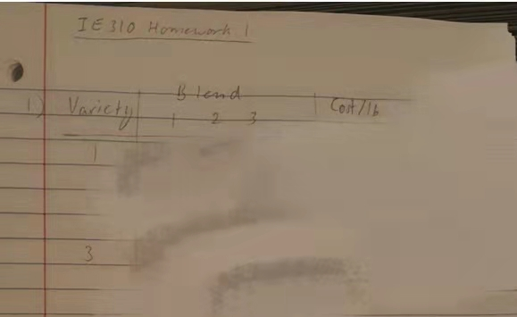
Invalid scanning -- lighting is bad
It is too dark to read! You may receive zero score if we cannot read your solution.

Slide 16
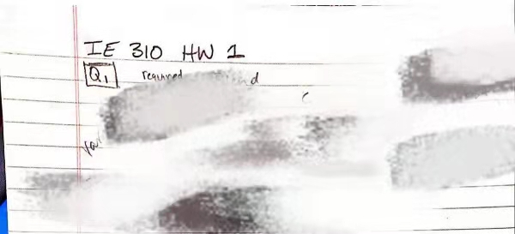

Valid scanning solution -- good lighting and right angle

Slide 17
Circle answers and state problem numbers
Circle your final answers for all questions
State each problem number before writing down the solution
The problems should appear in order in your submitted pdf to BB

Slide 18
S P A C E IS IMPORTANT
Do NOT squeeze your solution of all questions into one page
It would be better if each page only contain the solution of one question
Leave enough space between the solution of each part of the question

Slide 19
Assign page numbers to your submitted pdf
Assign each page of your submitted pdf to the corresponding question it contains.
Guidance of how to assign pages: https://help.gradescope.com/article/ccbpppziu9-student-submit-work#submitting_a_pdf
Attention!
If the submitted pdf does not have assigned pages, your solution will NOT be graded!

Slide 20
Summary
Scan the solution if it is handwritten
Make sure the lighting is good and the angle of each page is correct in the submitted pdf
Circle final answers and state problem numbers
Please follow those requirements to reduce our workload. This will help us to speed up the grading.
Thank you!

Slide 21
How to Submit Via BB
--Demo

Slide 22
Demo
How to submit via BB?
A quick 2-min Demo.

Slide 23
Exercises

Slide 24
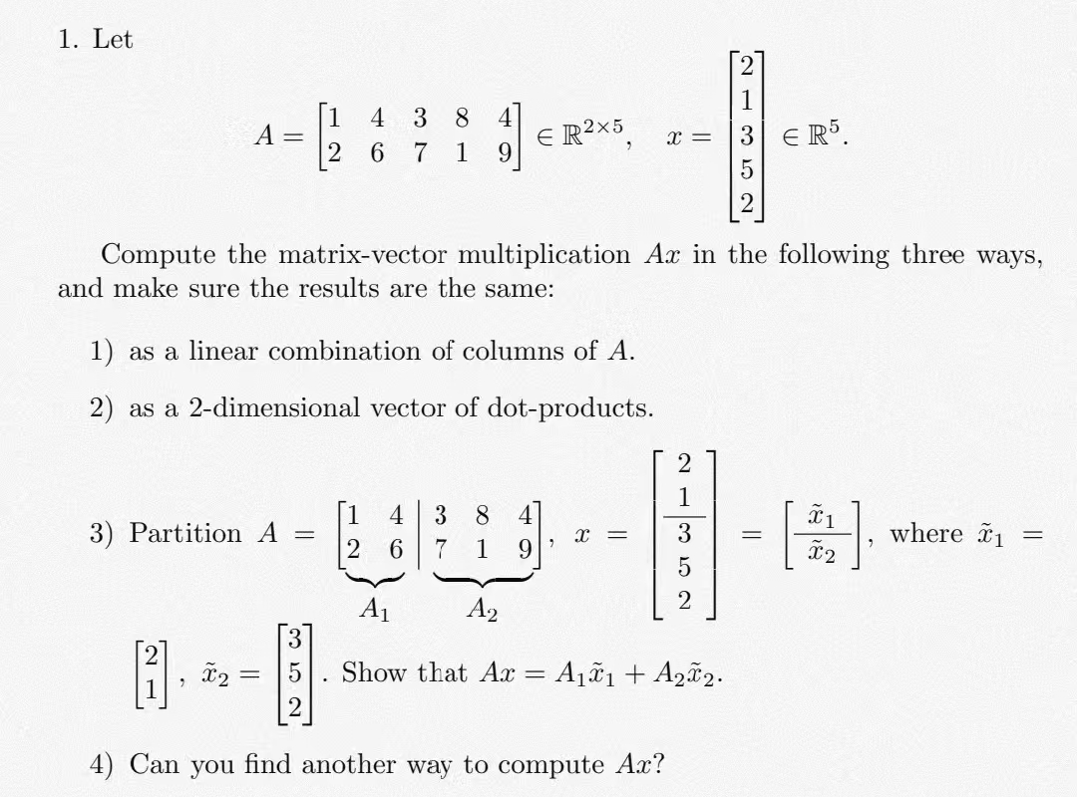
Exercise 1

Slide 25
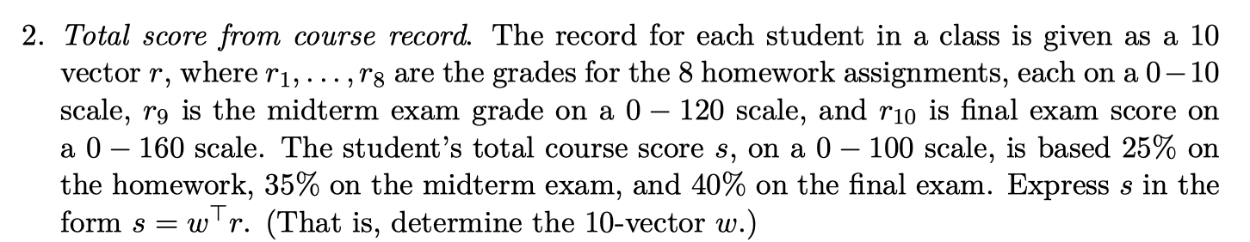
Exercise 2
Remark: This is NOT our course policy as we have attendance score.
This is just a practice problem.

Slide 26
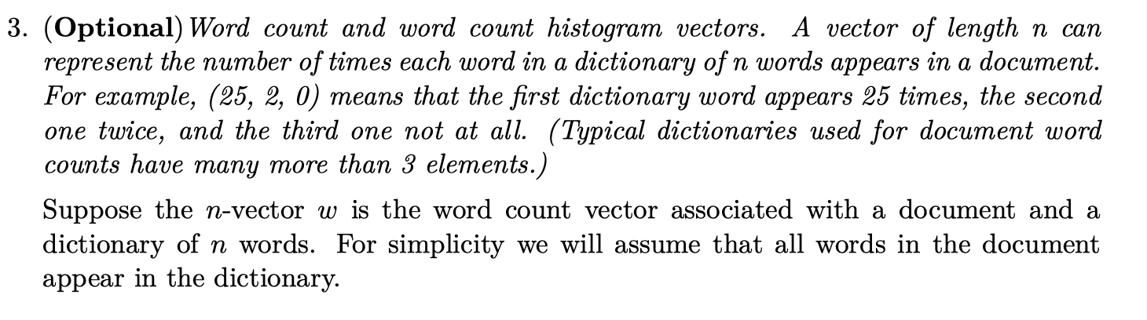
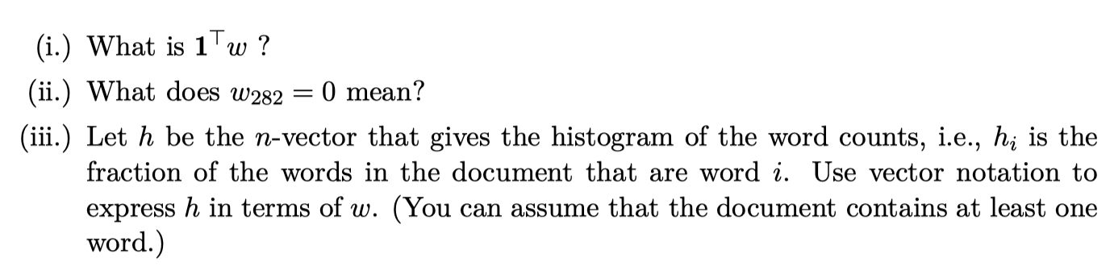
Exercise 3

Slide 27
Acknowledgement
These slides is based on previous tutorial materials of MAT2041. We thank previous TAs and instructors for sharing previous course materials.

