Slide 1

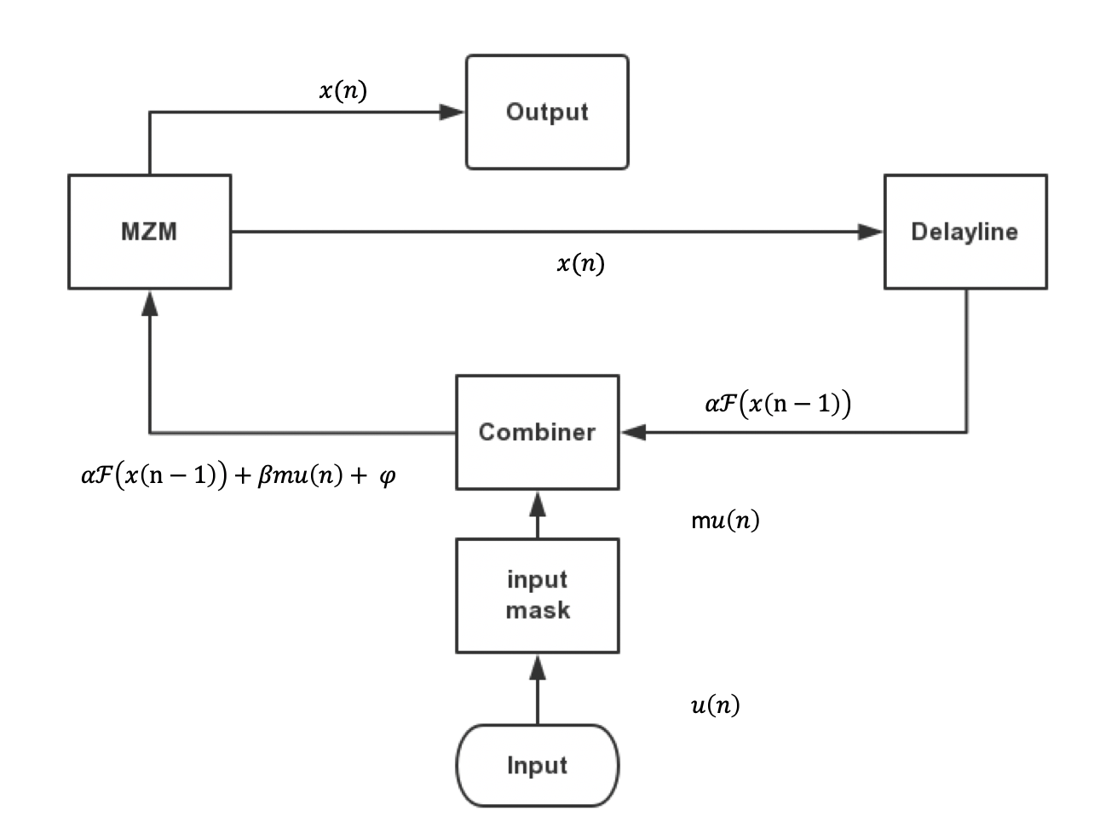
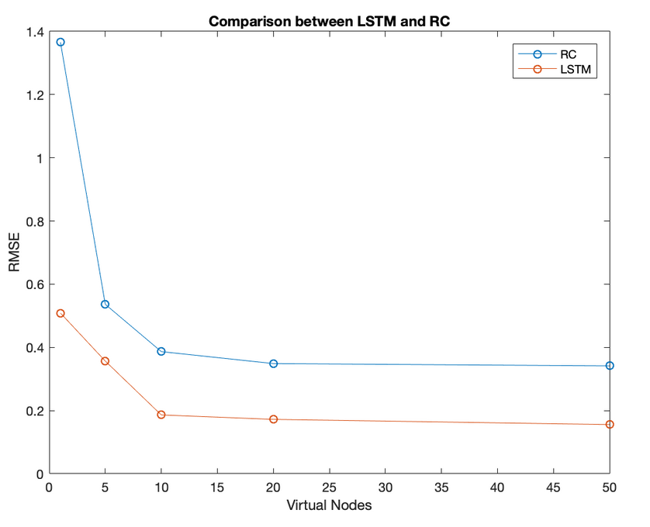
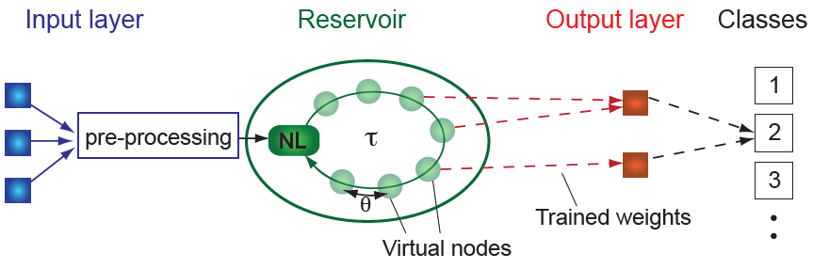
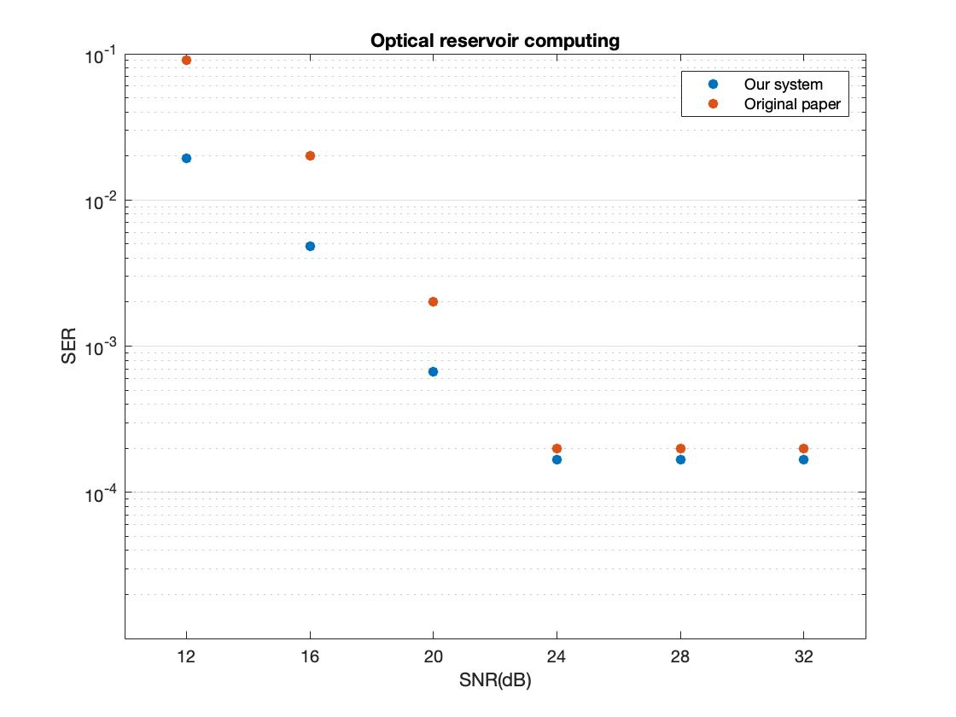
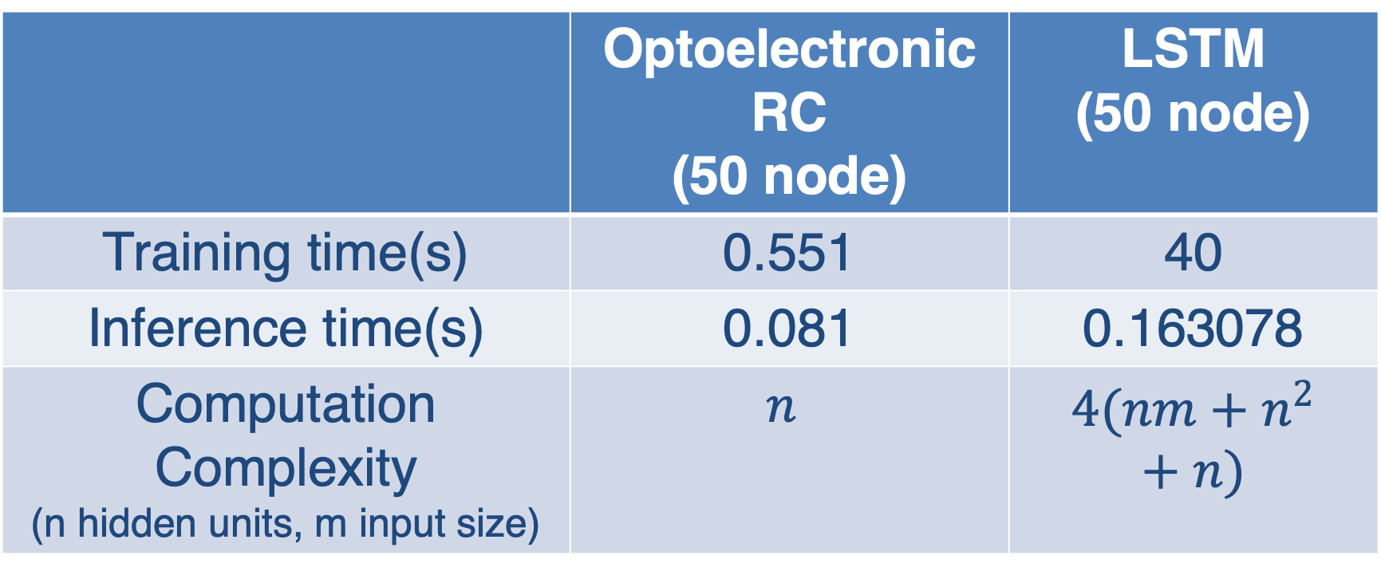
Comparison of Optoelectronic Reservoir Computing and LSTM Yijie Zhang, Alex Echeberria, Tingyi Zhou, Bahram Jalali Electrical and Computer Engineering, University of California, Los Angeles
INTRODUCTION
Optoelectronic implementation of reservoir computing consisting of a single non-linear node and a delay line has been used in classification and reconstruction of optical communication signals. The implementation is sufficiently fast for real-time information processing[2].
Recurrent Neural Networks (RNN), which are a subset of machine learning, are widely used to deal with nonlinear time dependent sequences such as signal classification, natural language processing, and nonlinear signal reconstruction. Unfortunately, computation time, and complexity, limits the use of RNNs.
Fig2. Flowchart of optoelectronic reservoir computing
Fig4. RMSE vs hidden nodes in optoelectronic RC and LSTM
RESULTS
 | Optoelectronic RC (50 node) | LSTM (50 node)
Training time(s) | 0.551 | 40
Inference time(s) | 0.081 | 0.163078
Computation Complexity (n hidden units, m input size) | $$n$$ | $$4(nm+n^{2}+n)$$
Our simulated system is more robust against noise than simulation implementation in previous papers[1] by adding bias on the MZM. This is because bias is DC component which can cover the noise and bias can introduce more non-linearity from MZM.
Table1. comparison between Optoelectronic RC and LSTM
Fig1. Delayed feedback reservoir computing
CONCLUSIONS
METHODS
Our optoelectronic reservoir computing system is more robust against bias than the system of original paper because we add a DC bias on Mach-Zender modulator.
The LSTM network need fewer hidden units to realize same performance (RMSE) of the optoelectronic reservoir computing system because LSTM can update its parameters by gradient while the reservoir and input mask of RC is fixed, which limits the application of RC to more difficult task.
Optoelectronic reservoir computing system need much less computation time and computation memory than the LSTM.
We implemented a simulation-based study of the optoelectronic reservoir computing system compared to Long short time memory (LSTM) and test these two networks on a non-linear equalization task.
A Mach-Zehnder modulator is used to introduce nonlinearity. An optical fiber produces the time delay.
We introduce a bias on the Mach-Zehnder modulator – which will make our system more robust against white noise on the input.
We perform a standard benchmark, nonlinear channel equalization on our RC. The symbol error rate (SER) and root mean square error (RMSE) are used to estimate the performance of networks.
A Long short-term memory (LSTM) network performs the same task in order to compare the performance between LSTM and our delayed feedback RC.
Fig3. SER versus SNR plot of our simulation and previous paper
Figure 4 shows RMSE vs number of hidden nodes in optoelectronic reservoir computing system and LSTM. LSTM needs less nodes than optoelectronic reservoir computing because of learnable parameters.
Table 1 shows optoelectronic reservoir computing system need much less computation time and computation memory than the LSTM. And inference time of optoelectronic reservoir computing is also smaller than LSTM. These comparison indicates optoelectronic RC still has its potential in application.
REFERENCES
Paquot, Y., Duport, F., Smerieri, A., Dambre, J., Schrauwen, B., Haelterman, M., & Massar, S. (2012). Optoelectronic reservoir computing. Scientific reports, 2, 287.
Tanaka, G., Yamane, T., Héroux, J. B., Nakane, R., Kanazawa, N., Takeda, S., ... & Hirose, A. (2019). Recent advances in physical reservoir computing: a review. Neural Networks.

