Slide 1
A Survey on
Transfer Learning
Sinno Jialin Pan
Department of Computer Science and Engineering
The Hong Kong University of Science and Technology
Joint work with Prof. Qiang Yang

Slide 2
Transfer Learning? (DARPA 05)
Transfer Learning (TL):
  The ability of a system to recognize and apply knowledge and skills learned in previous tasks to novel tasks (in new domains)
  It is motivated by human learning. People can often transfer knowledge learnt previously to novel situations
  Chess → Checkers
  Mathematics → Computer Science
  Table Tennis → Tennis
Notes:
Seems the changes is involved in moving to new tasks is more radical than moving to new domains.

Slide 3
Outline
Traditional Machine Learning vs. Transfer Learning
Why Transfer Learning?
Settings of Transfer Learning
Approaches to Transfer Learning
Negative Transfer
Conclusion

Slide 4
Outline
Traditional Machine Learning vs. Transfer Learning
Why Transfer Learning?
Settings of Transfer Learning
Approaches to Transfer Learning
Negative Transfer
Conclusion

Slide 5
Traditional ML vs. TL
(P. Langley 06)
Traditional ML in
multiple domains
Transfer of learning
across domains
training items
test items
test items
training items
Humans can learn in many domains.
Humans can also transfer from one domain to other domains.
Notes:
Generality means human can learn to perform a variety of tasks.

Slide 6
Traditional ML vs. TL
Learning Process of Traditional ML
Learning Process of Transfer Learning
training items
training items
Learning System
Learning System
Learning System
Learning System
Knowledge
Notes:
Generality means human can learn to perform a variety of tasks.

Slide 7

Notation
Domain:
It consists of two components: A feature space , a marginal distribution
In general, if two domains are different, then they may have different feature spaces
or different marginal distributions.
Task:
Given a specific domain and label space , for each in the domain, to
predict its corresponding label
In general, if two tasks are different, then they may have different label spaces or
different conditional distributions

Slide 8
Notation
For simplicity, we only consider at most two domains and two tasks.
Source domain:
Task in the source domain:
Target domain:
Task in the target domain

Slide 9
Outline
Traditional Machine Learning vs. Transfer Learning
Why Transfer Learning?
Settings of Transfer Learning
Approaches to Transfer Learning
Negative Transfer
Conclusion

Slide 10
Why Transfer Learning?
In some domains, labeled data are in short supply.
In some domains, the calibration effort is very expensive.
In some domains, the learning process is time consuming.
How to extract knowledge learnt from related domains to help learning in a target domain with a few labeled data?
How to extract knowledge learnt from related domains to speed up learning in a target domain?
Transfer learning techniques may help!

Slide 11
Outline
Traditional Machine Learning vs. Transfer Learning
Why Transfer Learning?
Settings of Transfer Learning
Approaches to Transfer Learning
Negative Transfer
Conclusion

Slide 12
Settings of Transfer Learning
Transfer learning settings | Labeled data in a source domain | Labeled data in a target domain | Tasks
Inductive Transfer Learning | × | √ | Classification Regression …
 | √ | √
Transductive Transfer Learning | √ | × | Classification Regression …
Unsupervised Transfer Learning | × | × | Clustering …

Slide 13
An overview of
various settings of
transfer learning
Self-taught Learning
Case 1
No labeled data in a source domain
Inductive Transfer Learning
Labeled data are available in a source domain
Labeled data are available in a target domain
Source and target tasks are learnt simultaneously
Multi-task Learning
Case 2
Transfer Learning
Labeled data are available only in a source domain
Assumption: different domains but single task
Transductive Transfer Learning
Domain Adaptation
No labeled data in both source and target domain
Assumption: single domain and single task
Unsupervised Transfer Learning
Sample Selection Bias /Covariance Shift

Slide 14
Outline
Traditional Machine Learning vs. Transfer Learning
Why Transfer Learning?
Settings of Transfer Learning
Approaches to Transfer Learning
Negative Transfer
Conclusion

Slide 15
Approaches to Transfer Learning
Transfer learning approaches | Description
Instance-transfer | To re-weight some labeled data in a source domain for use in the target domain
Feature-representation-transfer | Find a “good” feature representation that reduces difference between a source and a target domain or minimizes error of models
Model-transfer | Discover shared parameters or priors of models between a source domain and a target domain
Relational-knowledge-transfer | Build mapping of relational knowledge between a source domain and a target domain.

Slide 16
Approaches to Transfer Learning
 | Inductive Transfer Learning | Transductive Transfer Learning | Unsupervised Transfer Learning
Instance-transfer | √ | √
Feature-representation-transfer | √ | √ | √
Model-transfer | √
Relational-knowledge-transfer | √

Slide 17
Outline
Traditional Machine Learning vs. Transfer Learning
Why Transfer Learning?
Settings of Transfer Learning
Approaches to Transfer Learning
  Inductive Transfer Learning
  Transductive Transfer Learning
  Unsupervised Transfer Learning

Slide 18
Inductive Transfer Learning
Instance-transfer Approaches
Assumption: the source domain and target domain data use exactly the same features and labels.
Motivation: Although the source domain data can not be reused directly, there are some parts of the data that can still be reused by re-weighting.
Main Idea: Discriminatively adjust weighs of data in the source domain for use in the target domain.

Slide 19
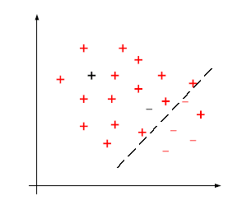
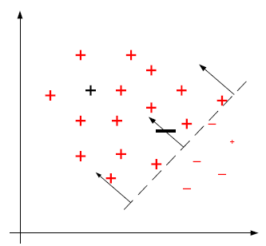

Inductive Transfer Learning
--- Instance-transfer Approaches
Non-standard SVMs
[Wu and Dietterich ICML-04]
Differentiate the cost for misclassification of the target and source data
Uniform weights
Correct the decision boundary by re-weighting
Loss function on the target domain data
Loss function on the source domain data
Regularization term

Slide 20

Inductive Transfer Learning
--- Instance-transfer Approaches
TrAdaBoost
[Dai et al. ICML-07]
Hedge ( )
[Freund et al. 1997]
AdaBoost
[Freund et al. 1997]
To decrease the weights of the misclassified data
To increase the weights of the misclassified data
Source domain
labeled data
The whole training data set
target domain
labeled data
Classifiers trained on
re-weighted labeled data
Target domain
unlabeled data

Slide 21
Inductive Transfer Learning
Feature-representation-transfer Approaches
Supervised Feature Construction
[Argyriou et al. NIPS-06, NIPS-07]
Assumption: If t tasks are related to each other, then they may
share some common features which can benefit for all tasks.
Input: t tasks, each of them has its own training data.
Output: Common features learnt across t tasks and t models for t
tasks, respectively.

Slide 22


Supervised Feature Construction
[Argyriou et al. NIPS-06, NIPS-07]
where
Average of the empirical error across t tasks
Regularization to make the representation sparse
Orthogonal Constraints

Slide 23
Inductive Transfer Learning
Feature-representation-transfer Approaches
Unsupervised Feature Construction
[Raina et al. ICML-07]
Three steps:
Applying sparse coding [Lee et al. NIPS-07] algorithm to learn higher-level representation from unlabeled data in the source domain.
Transforming the target data to new representations by new bases learnt in the first step.
Traditional discriminative models can be applied on new representations of the target data with corresponding labels.

Slide 24
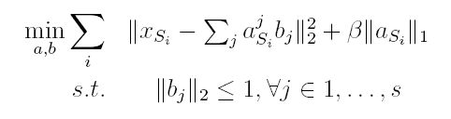






Unsupervised Feature Construction
[Raina et al. ICML-07]
Step1:
Input: Source domain data and coefficient
Output: New representations of the source domain data
and new bases
Step2:
Input: Target domain data , coefficient and bases
Output: New representations of the target domain data

Slide 25




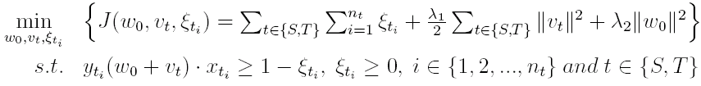
Inductive Transfer Learning
Model-transfer Approaches
Regularization-based Method
[Evgeiou and Pontil, KDD-04]
Assumption: If t tasks are related to each other, then they may share some
parameters among individual models.
Assume be a hyper-plane for task , where and
Encode them into SVMs:
Common part
Specific part for individual task
Regularization terms for multiple tasks

Slide 26
Inductive Transfer Learning
Relational-knowledge-transfer Approaches
TAMAR
[Mihalkova et al. AAAI-07]
Assumption: If the target domain and source domain are related, then there
may be some relationship between domains being similar, which can be used for
transfer learning
Input:
Relational data in the source domain and a statistical relational model, Markov Logic Network (MLN), which has been learnt in the source domain.
Relational data in the target domain.
Output: A new statistical relational model, MLN, in the target domain.
Goal: To learn a MLN in the target domain more efficiently and effectively.

Slide 27
TAMAR [Mihalkova et al. AAAI-07]
Two Stages:
Predicate Mapping
  Establish the mapping between predicates in the source and target domain. Once a mapping is established, clauses from the source domain can be translated into the target domain.
Revising the Mapped Structure
  The clauses mapping from the source domain directly may not be completely accurate and may need to be revised, augmented , and re-weighted in order to properly model the target data.

Slide 28
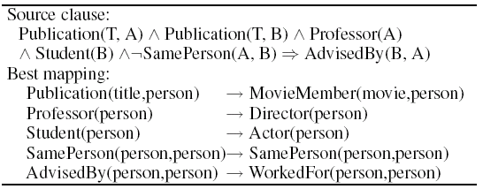
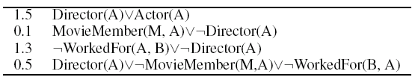
TAMAR [Mihalkova et al. AAAI-07]
Source domain (academic domain)
Target domain (movie domain)
Student (B)
AdvisedBy
Professor (A)
Actor(A)
WorkedFor
Director(B)
Publication
Publication
MovieMember
MovieMember
Paper (T)
Movie(M)
Mapping
Revising

Slide 29
Outline
Traditional Machine Learning vs. Transfer Learning
Why Transfer Learning?
Settings of Transfer Learning
Approaches to Transfer Learning
  Inductive Transfer Learning
  Transductive Transfer Learning
  Unsupervised Transfer Learning

Slide 30




Transductive Transfer Learning
Instance-transfer Approaches
Sample Selection Bias / Covariance Shift
[Zadrozny ICML-04, Schwaighofer JSPI-00]
Input: A lot of labeled data in the source domain and no labeled data in the
target domain.
Output: Models for use in the target domain data.
Assumption: The source domain and target domain are the same. In addition,
and are the same while and may be
different causing by different sampling process (training data and test data).
Main Idea: Re-weighting (important sampling) the source domain data.

Slide 31


Sample Selection Bias/Covariance Shift
To correct sample selection bias:
How to estimate ?
One straightforward solution is to estimate and ,
respectively. However, estimating density function is a hard problem.
weights for source domain data

Slide 32


Sample Selection Bias/Covariance Shift
Kernel Mean Match (KMM)
[Huang et al. NIPS 2006]
Main Idea: KMM tries to estimate directly instead of estimating
density function.
It can be proved that can be estimated by solving the following quadratic
programming (QP) optimization problem.
Theoretical Support: Maximum Mean Discrepancy (MMD) [Borgwardt et al.
BIOINFOMATICS-06]. The distance of distributions can be measured
by Euclid distance of their mean vectors in a RKHS.
To match means between training and test data in a RKHS

Slide 33
Transductive Transfer Learning
Feature-representation-transfer Approaches
Domain Adaptation
[Blitzer et al. EMNL-06, Ben-David et al. NIPS-07, Daume III ACL-07]
Assumption: Single task across domains, which means and
are the same while and may be different causing by feature
representations across domains.
Main Idea: Find a “good” feature representation that reduce the “distance”
between domains.
Input: A lot of labeled data in the source domain and only unlabeled data in the
target domain.
Output: A common representation between source domain data and target
domain data and a model on the new representation for use in the target domain.

Slide 34
Domain Adaptation
Structural Correspondence Learning (SCL)
[Blitzer et al. EMNL-06, Blitzer et al. ACL-07, Ando and Zhang JMLR-05]
Motivation: If two domains are related to each other, then there may exist
some “pivot” features across both domain. Pivot features are features that
behave in the same way for discriminative learning in both domains.
Main Idea: To identify correspondences among features from different
domains by modeling their correlations with pivot features. Non-pivot features
form different domains that are correlated with many of the same pivot
features are assumed to correspond, and they are treated similarly in a
discriminative learner.

Slide 35
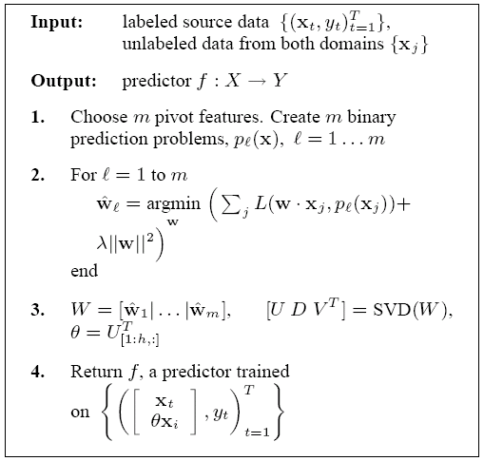
SCL
[Blitzer et al. EMNL-06, Blitzer et al. ACL-07, Ando and Zhang JMLR-05]
a) Heuristically choose m pivot features, which is task specific.
b) Transform each vector of pivot feature to a vector of binary values and then create corresponding prediction problem.
Learn parameters of each prediction problem
Do Eigen Decomposition on the matrix of parameters and learn the linear mapping function.
Use the learnt mapping function to construct new features and train classifiers onto the new representations.

Slide 36
Outline
Traditional Machine Learning vs. Transfer Learning
Why Transfer Learning?
Settings of Transfer Learning
Approaches to Transfer Learning
  Inductive Transfer Learning
  Transductive Transfer Learning
  Unsupervised Transfer Learning

Slide 37
Unsupervised Transfer Learning Feature-representation-transfer Approaches
Self-taught Clustering (STC)
[Dai et al. ICML-08]
Input: A lot of unlabeled data in a source domain and a few unlabeled data in a
target domain.
Goal: Clustering the target domain data.
Assumption: The source domain and target domain data share some common
features, which can help clustering in the target domain.
Main Idea: To extend the information theoretic co-clustering algorithm
[Dhillon et al. KDD-03] for transfer learning.

Slide 38

Self-taught Clustering (STC)
[Dai et al. ICML-08]
Common features
Target domain data
Source domain data
Co-clustering in the source domain
Objective function that need to be minimized
where
Co-clustering in the target domain
Output
Cluster functions

Slide 39
Outline
Traditional Machine Learning vs. Transfer Learning
Why Transfer Learning?
Settings of Transfer Learning
Approaches to Transfer Learning
Negative Transfer
Conclusion

Slide 40
Negative Transfer
Most approaches to transfer learning assume transferring knowledge across domains be always positive.
However, in some cases, when two tasks are too dissimilar, brute-force transfer may even hurt the performance of the target task, which is called negative transfer [Rosenstein et al NIPS-05 Workshop].
Some researchers have studied how to measure relatedness among tasks [Ben-David and Schuller NIPS-03, Bakker and Heskes JMLR-03].
How to design a mechanism to avoid negative transfer needs to be studied theoretically.

Slide 41
Outline
Traditional Machine Learning vs. Transfer Learning
Why Transfer Learning?
Settings of Transfer Learning
Approaches to Transfer Learning
Negative Transfer
Conclusion

Slide 42
Conclusion
 | Inductive Transfer Learning | Transductive Transfer Learning | Unsupervised Transfer Learning
Instance-transfer | √ | √
Feature-representation-transfer | √ | √ | √
Model-transfer | √
Relational-knowledge-transfer | √
How to avoid negative transfer need to be attracted more attention!

