Slide 1
DD traders case
By Jack & Yang

Slide 2
Problem statement
DD traders purchase top grossing products of Colorful Devotions and Bold Inspirations from three suppliers.
DD traders are trying to produce a purchasing plan for the most popular 20 SKUs from three different suppliers to lower the production risk, while each supplier has various prices.
Supplier number 2 has the potential to raise their price.
Each supplier has their capacity in each month
DD traders also has their budget plan for each month
The goal is to maximize the total quantity of the products under the given budget

Slide 3
Assumptions
Assumed the seasonal variation rate by each supplier is +/- 15 %
Assumed the currency exchange rate would not affect the case
Assumed Supplier 2 would increase their price by 5%
Assumed that the shaded region in Appendix 2 represents the market demand for each sku product, and the company must produce less than the demand to make sure no excess items would exist in the stock
The monthly budget limit is the same as the COG value in figure 2, meaning the total price for each month should be less than that amount
Each purchase should be either 0 or at least 300
Assumed supplier 2 does not produce sku #4 & #11 as they did not offer a price

Slide 4
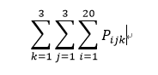
Model
Objective function:
The objective is to maximize the net purchase quantity
Decision variables: purchase quantity in each month for each SKU
i represents each sku product, j represents different suppliers, k represents different months,
For example, P123 means the production quantity of sku#1 in December by supplier 2

Slide 5
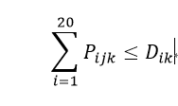
Model
Demand Constraints:
1.Each monthly net purchase should be less than the monthly net demand requested, no inventory is needed in this case and to get a reasonable solution.
For all i and j, Dik is the demand for each supplier in each month

Slide 6

Model
Capacity Constraint:
The total cost of each month should be less than the capacity given in appendix 2
For all i and j : CAjk is the capacity for each supplier in each month

Slide 7
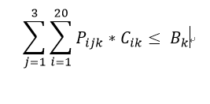
Model
Budget Constraints:
3. The net monthly purchase should be less than the COG budget given in figure 2
For all k : Bk is the budget(COG) in each month

Slide 8
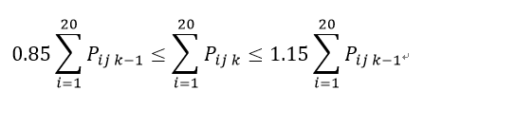
Model
Seasonal demand change Constraints:
Seasonal demand should in the range of +-15%
For k=2 and 3

Slide 9
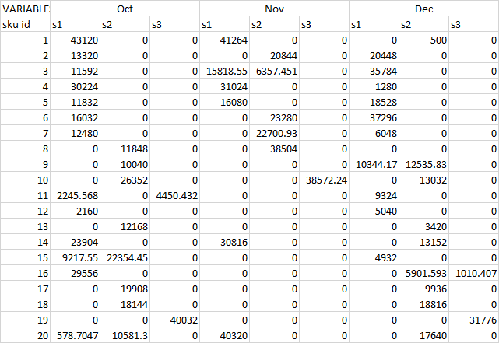
Result
Net purchase: 984465 using all the budget and capacity

Slide 10
Sensitivity Analysis
As the change of price of supplier 2 is uncertain, we decided to add a new parameter called β to represent the potential changes that could happen.
New supplier 2 price will be: original price* β
When β=1.05 total purchase 984465
While increasing β, all total purchase stays same, just purchase less from supplier 2.

Slide 11
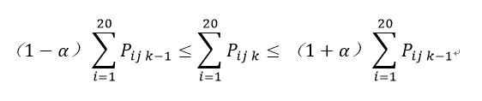
Sensitivity Analysis Cont’d
Also we added a new parameter called α that represents the allowable variation of amounts between months for each supplier, thus the new constraint will be
Using α = 0.15, the final production quantity will be 984465. Alternate α and we get:
α = 0.10 | α = 0.20 | α = 0.30
925896.6 | 1004814 | 1054233

Slide 12
Conclusion
Change of price does not affect the production quantity but will change the proportion of purchase from supplier 2
Using α = 0.15 and β = 1.05, the production quantity will be 984465 at a total cost of 3342095, the price per unit is 3.39
Using α = 0.2 and β = 1.05, the production quantity will be 1004814 at a total cost of 3327686, the price per unit is 3.31
Using α = 0.15 and β = 1.1, the production quantity will be 925896.6 at a total cost of 3328731, the price per unit is 3.38
Therefore, we suggest DD trader should negotiate with suppliers and raise the monthly variation limit

