Slide 1
Welcome from your admin team
ueco@essex.ac.uk

Slide 2
Rules of Assessment
Direct entry students must pass ALL 120 CREDITS of the final year to obtain an honours degree (i.e. 1st, 2:1, 2:2, 3rd).
If you fail any module, you must retake it to get your degree, EVEN IF you have a high enough year mark.

Slide 3
Assessment structure
Autumn Modules:
Spring Modules:
Midterm Test –
November/December 2026
Midterm Test –
February/March 2027
Exam – May/June 2027
Exam – May/June 2027

Slide 4
Results timelines
Exams (May-June 2027)
Exam boards (end June-July 2027)
Results released (early July 2027)
HEAR updated (transcripts and degree certificate) 7 days after results release
Resit Exams (August-September 2027)
Resit exam boards (end September 2027)
Results released (end September 2027)
HEAR updated (transcripts and degree certificate) 7 days after results release

Slide 5
Coursework mark transcripts
Consider the timing of your postgraduate application
No updates with new marks
10 working day turnaround

Slide 6
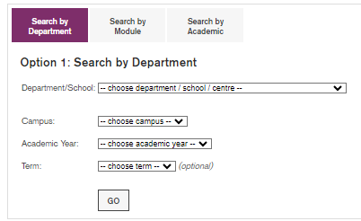
Choosing Modules
Other departments may not offer “in term” make-up tests!
You can go to any lecture/class in the first two weeks of term to see which modules you like best.
Choose/change your modules in MyEssex
https://www1.essex.ac.uk/depttimetables/
Enrol deadline: 8:59am BST on Monday 26 October 2026
module | failure rate (%)
BE130 | 38
MA320 | 33

Slide 7
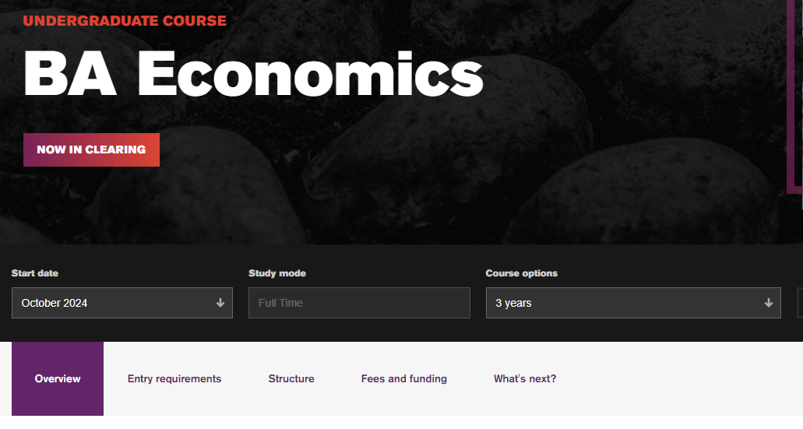

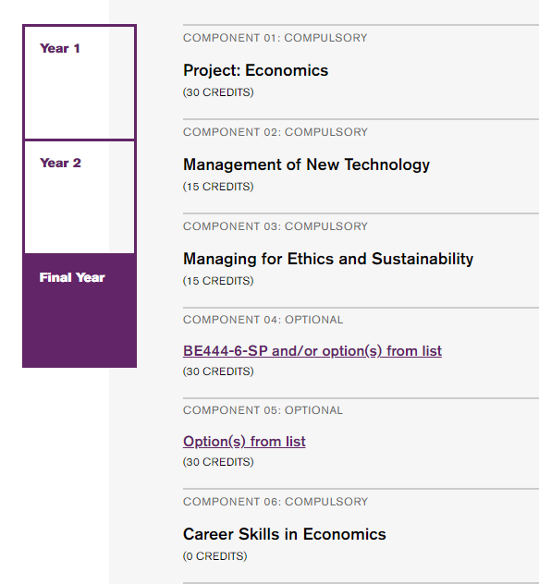
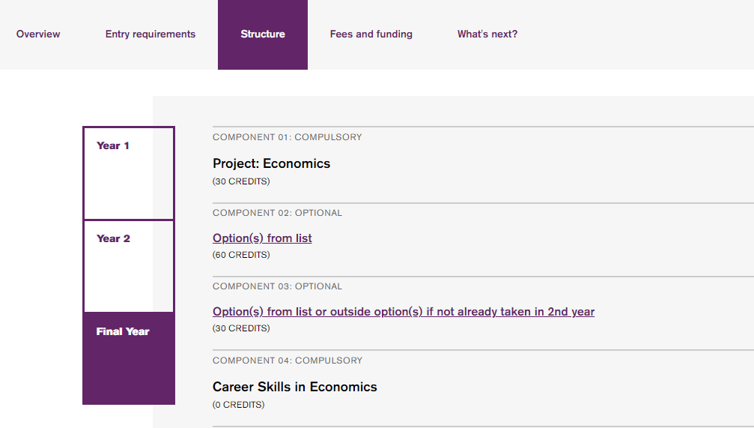
If you want to change a module that is "core" or "compulsory" it may be best to change your course.

Slide 8
Attendance does NOT impact marks
Notified absence from teaching (MyEssex)
Class clashes
Attendance

Slide 9
Fix a clash
Lectures and classes can’t be rescheduled – there is only lecture and one class per module
If you have a clash, you should choose another optional module that doesn’t clash
Look at department timetable
Always go to a test! Submit a notified absence if you are missing a lecture or class for your test.

Slide 10
Extenuating Circumstances
If you cannot submit coursework, take a test, or take an exam because you:
Have an ongoing, long-term health condition
Suffer a serious injury
Have serious personal problems
Are suffering with poor mental health
You can submit an extenuating circumstances claim

Slide 11
Link to the form is on My Essex
Give a detailed description of your situation
Select ALL modules affected
Provide evidence if you have it but this is NOT essential

Slide 12
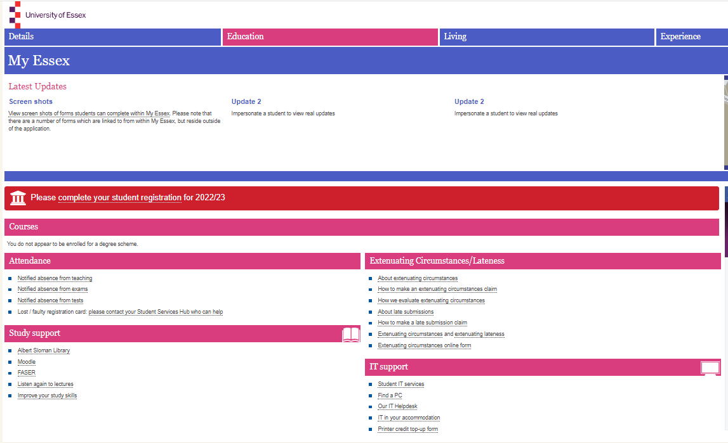

Slide 13
Late submissions
Short-term problem, like the flu or a minor injury, that causes you to miss a test/deadline → submit a late submissions claim
Essays and assignments can be submitted to FASER up to 7 days after the deadline
If claim accepted, no penalty
Use the Extenuating Circumstances form and select “Late Submission”

Slide 14
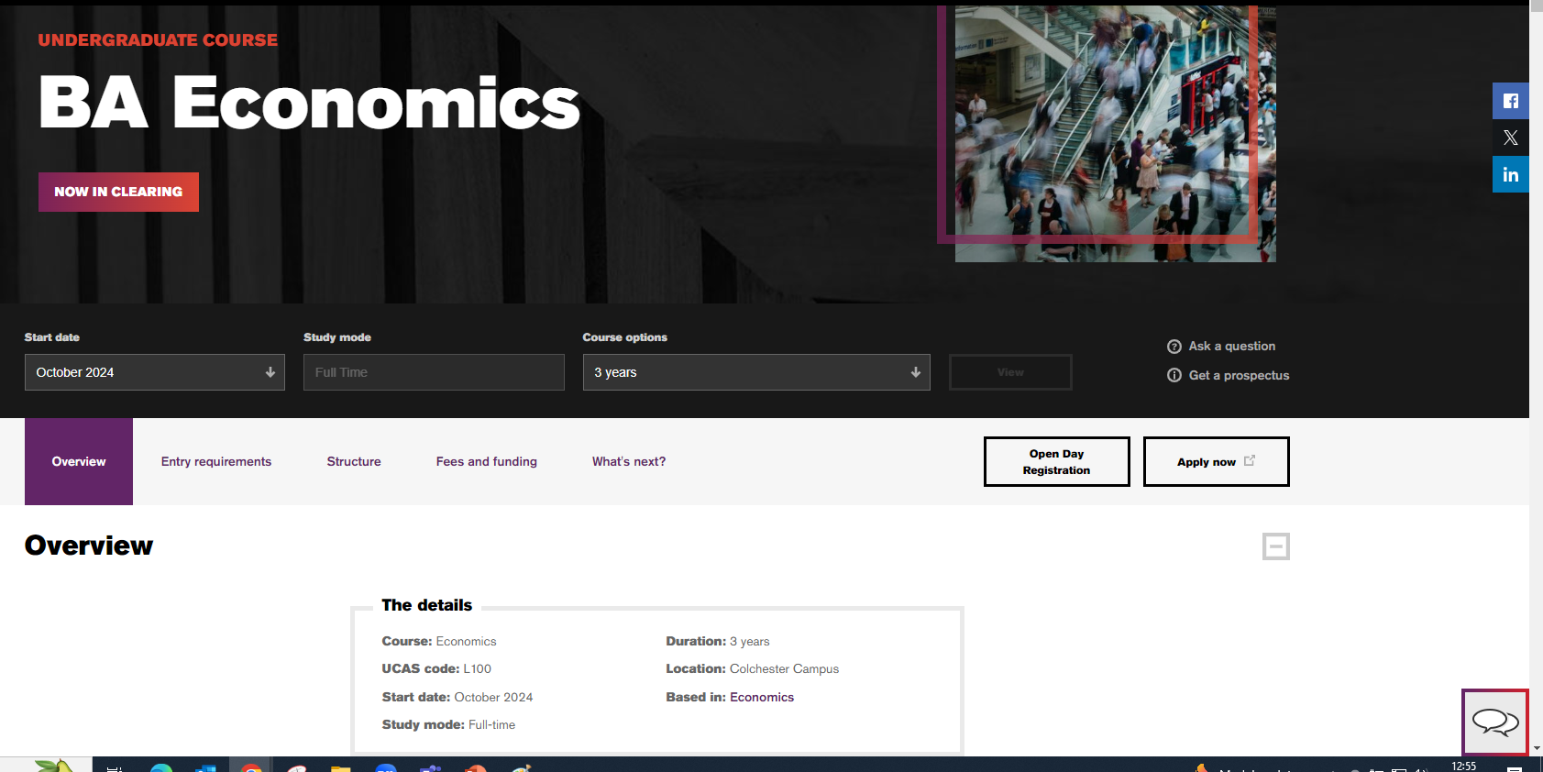
Live chat

Slide 15
The HEAR
(Higher Education Achievement Report)
Sign up for GradIntel and HEAR as early as possible to get updated transcripts.
(check your emails!)

Slide 16
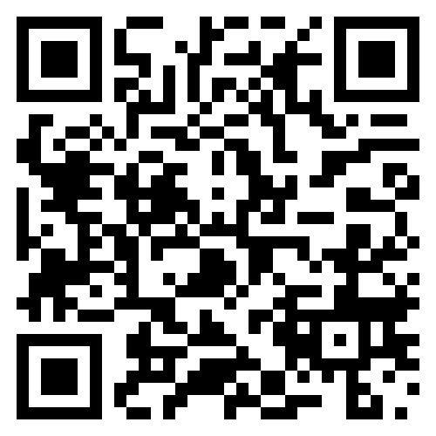
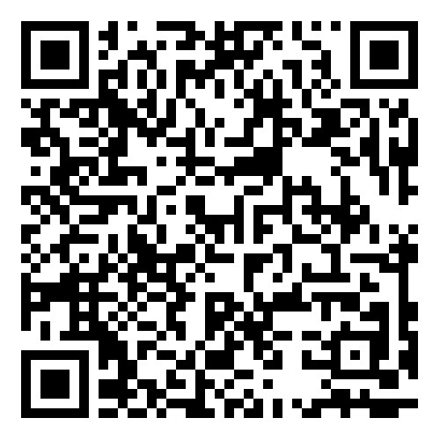
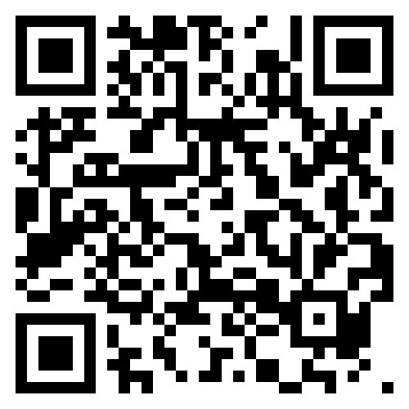
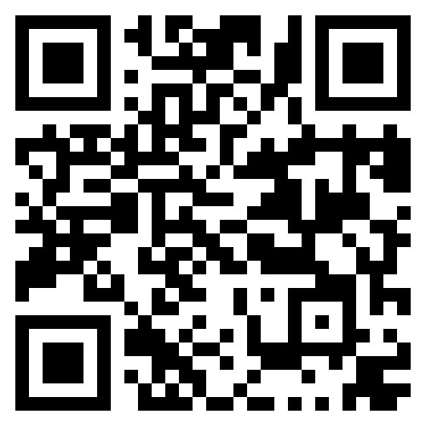




Please join us on social media!

