Slide 1

GitHub介绍
张新波
2012-12-7

Slide 2










What is GitHub？
0101010101110
0101010101110
0101010101110
Free Code Repository
Notes:
https://github.com/alibaba

Slide 3




Who @GitHub？

Slide 4




Not only A Repository
Collaboration
Blog & Wiki
Issue Tracking
Code Review

Slide 5



Why GitHub？

Slide 6


What is Git?
Kernal
Linus Torvalds

Slide 7
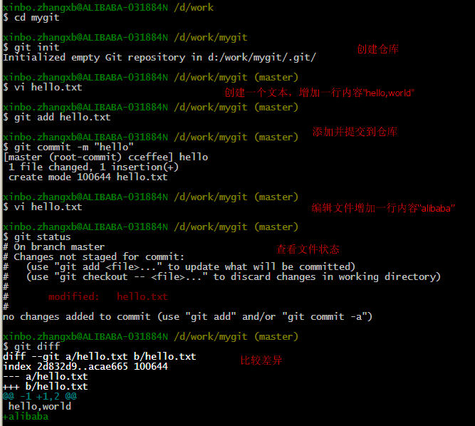
Use Git
Notes:
http://www.aqee.net/5-fundamental-differences-between-git-svn/

Slide 8
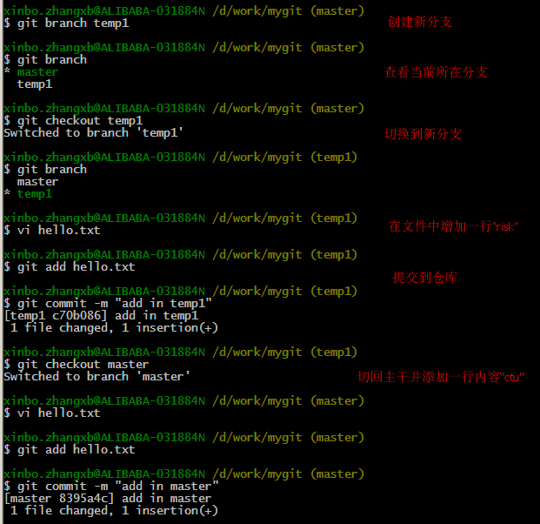

Slide 9
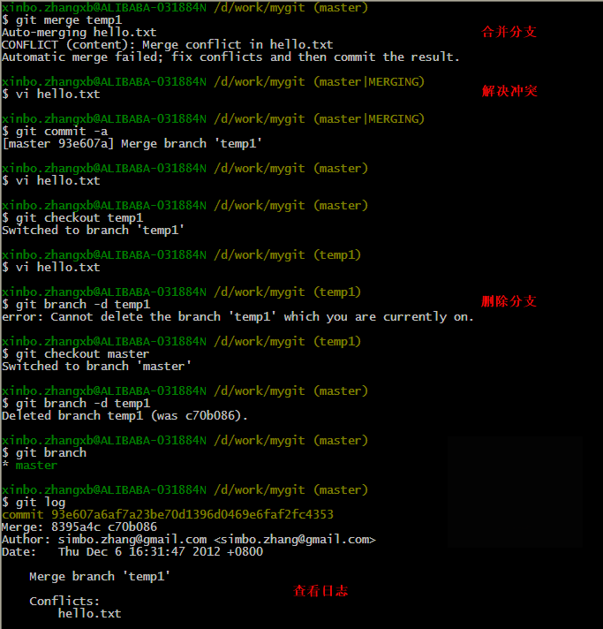
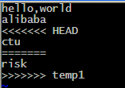
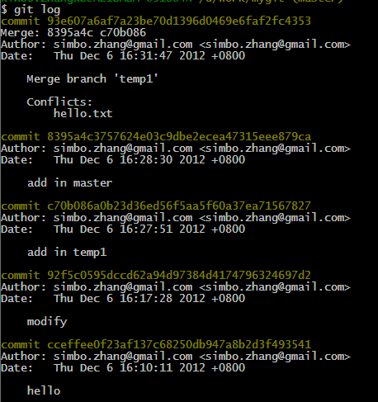

Slide 10
Git vs SVN
GIT是分布式的，SVN不是
GIT把内容按元数据方式存储，而SVN是按文件
GIT分支和SVN的分支不同
GIT没有一个全局的版本号，而SVN有
GIT的内容完整性要优于SVN
Notes:
http://www.aqee.net/5-fundamental-differences-between-git-svn/

Slide 11
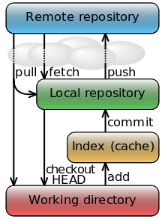
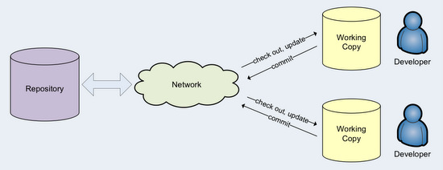

Slide 12
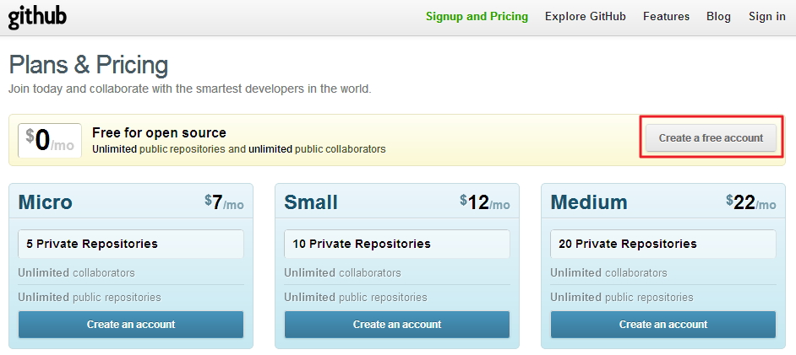
Create GitHub Account
Notes:
http://www.aqee.net/5-fundamental-differences-between-git-svn/

Slide 13
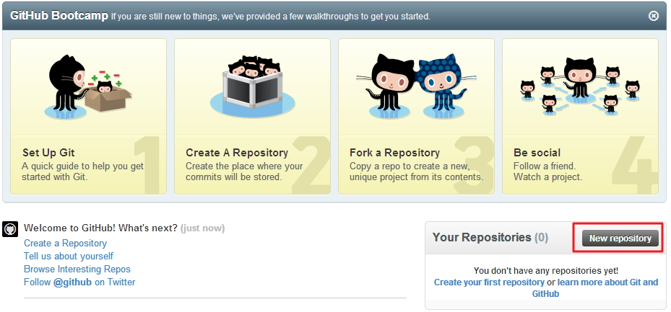
Create GitHub Repository
Notes:
http://www.aqee.net/5-fundamental-differences-between-git-svn/

Slide 14
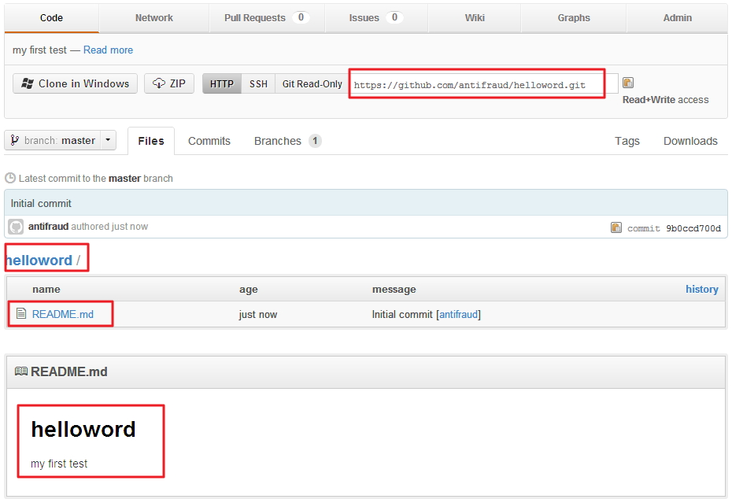
GitHub Project

Slide 15
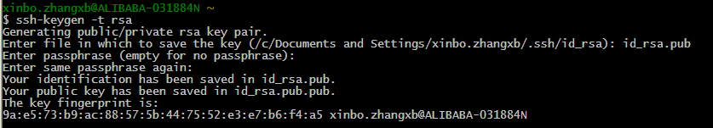
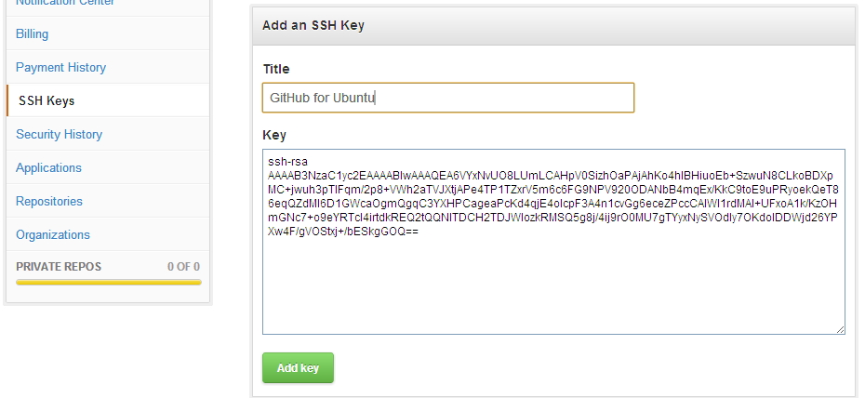
Config SSH Key

Slide 16
Clone And Push
#把代码checkout到本地，和svn co类似
git clone git@github.com:yikebocai/helloword.git helloword
#在README.md文件中增加一行内容，然后提交
git add README.md
#windows下一定要用双引号，否则会报error: pathspec 'commit''
#did not match any file(s) known to git.
git commit -m 'add one line'
git push origin master
#如果没有设置SSH免登录，需要输入GitHub的用户名和密码才能提交代码成功

Slide 17
参考资料
Git Magic
GotGitHub

