Slide 1
Kinesis Throughput Exception
⏱ TIME
An Amazon Kinesis application is trying to read data from a Kinesis data stream. However, the read data call is rejected. The following error message is displayed: ProvisionedThroughputExceededException. Which combination of steps will resolve the error? (Select TWO)
A
Configure enhanced fan-out on the stream
B
Enable enhanced monitoring on the stream
C
Increase the size of the GetRecords requests
D
Increase the number of shards within the stream to provide enough capacity for the read data calls
E
Make the application retry to read data from the stream

Slide 2
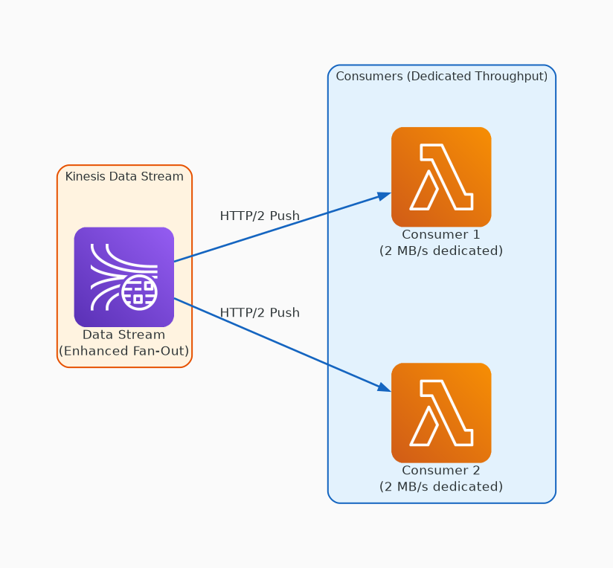
✗ INCORRECT
Option A: Configure enhanced fan-out on the stream
Why this is incorrect:
• Enhanced fan-out gives dedicated 2MB/s per consumer via HTTP/2
• Doesn't fix the root cause: shard-level read limit exceeded
• Only helps when multiple consumers compete for the same shard

Slide 3
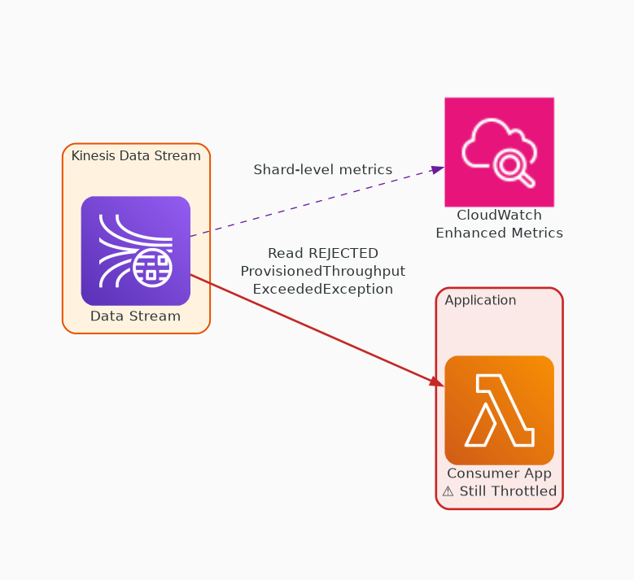
✗ INCORRECT
Option B: Enable enhanced monitoring on the stream
Why this is incorrect:
• Provides shard-level CloudWatch metrics
• Observability tool only — doesn't increase throughput
• Useful for diagnosis, not resolution

Slide 4
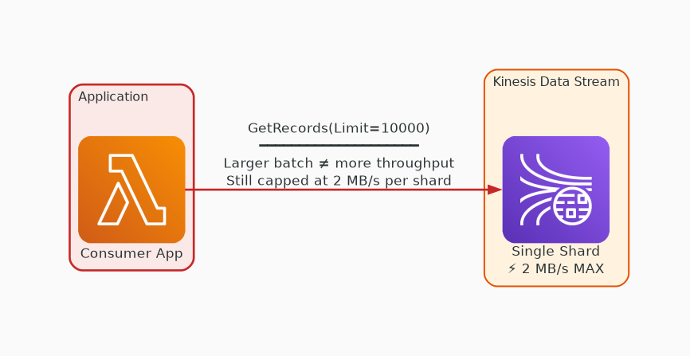
✗ INCORRECT
Option C: Increase the size of the GetRecords requests
Why this is incorrect:
• Larger batch size retrieves more records per call
• Does NOT increase the 2 MB/s per-shard read limit
• May actually worsen throttling by consuming more bandwidth per request

Slide 5
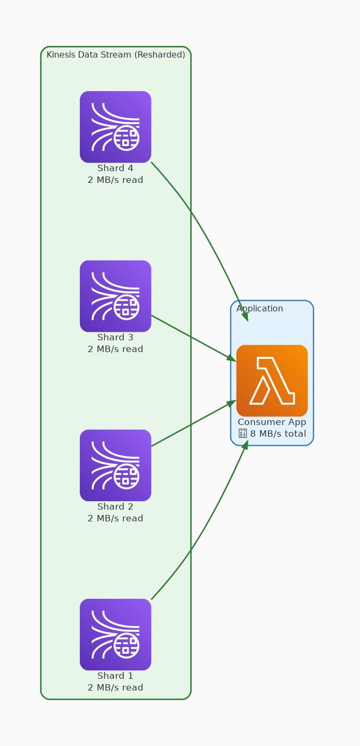
✓ CORRECT
Option D: Increase the number of shards within the stream to provide enough capacity for the read data calls
Why this is correct:
• Each shard provides 2 MB/s read throughput
• More shards = higher aggregate read capacity
• Directly addresses the throughput bottleneck

Slide 6
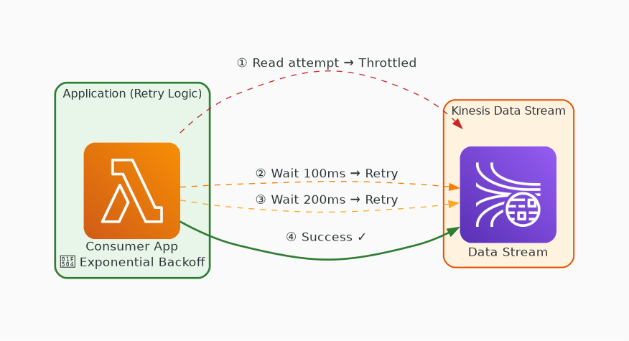
✓ CORRECT
Option E: Make the application retry to read data from the stream
Why this is correct:
• Exponential backoff handles transient throttling
• Exception may be temporary due to burst traffic
• AWS SDK best practice for handling throughput errors

