Slide 1
Data Pipeline Architecture
⏱ TIME
A data engineer at a multinational corporation is designing a new data pipeline architecture. The company needs to consolidate data from multiple transactional databases, enable data analysis for business intelligence teams, and ensure the production databases' performance isn't impacted. What is the recommended approach?
A
Direct all analytics queries to the transactional databases to ensure real-time data access
B
Land data in a data lake, prepare it, then move selected data to a data warehouse for reporting
C
Store all data directly in the data warehouse and perform transformations during query runtime
D
Create separate data marts for each business unit without a centralized data warehouse

Slide 2
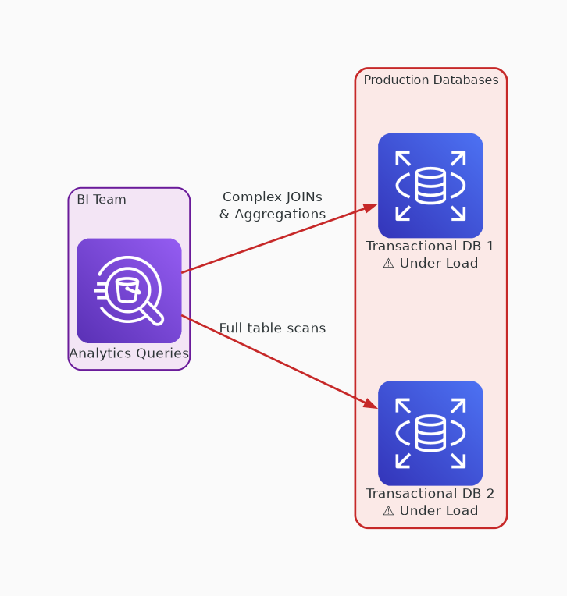
✗ INCORRECT
Option A: Direct all analytics queries to the transactional databases to ensure real-time data access
Why this is incorrect:
• Complex analytics queries degrade production DB performance
• Violates the requirement to protect production workloads
• No separation between OLTP and OLAP concerns

Slide 3
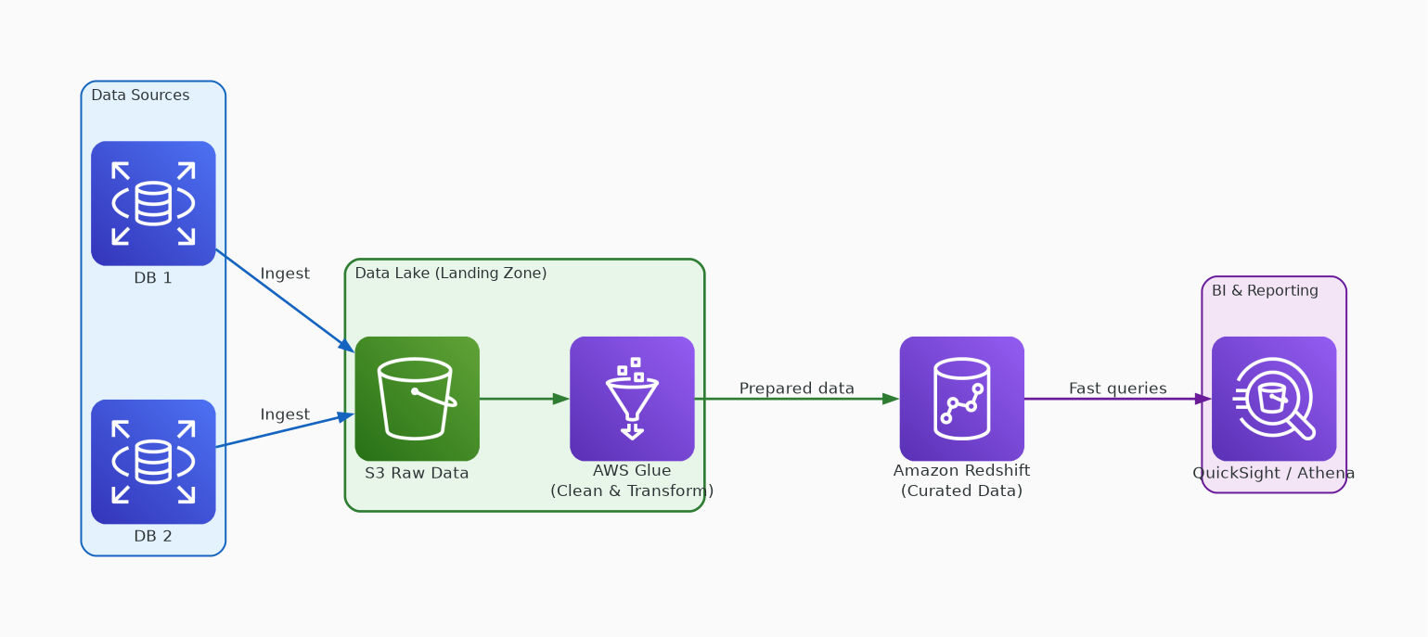
✓ CORRECT
Option B: Land data in a data lake, prepare it, then move selected data to a data warehouse for reporting
Why this is correct:
• Separates analytics from production databases
• S3 data lake provides flexible, scalable raw storage
• Glue transforms data; Redshift serves fast BI queries
• AWS recommended lake-to-warehouse pattern

Slide 4
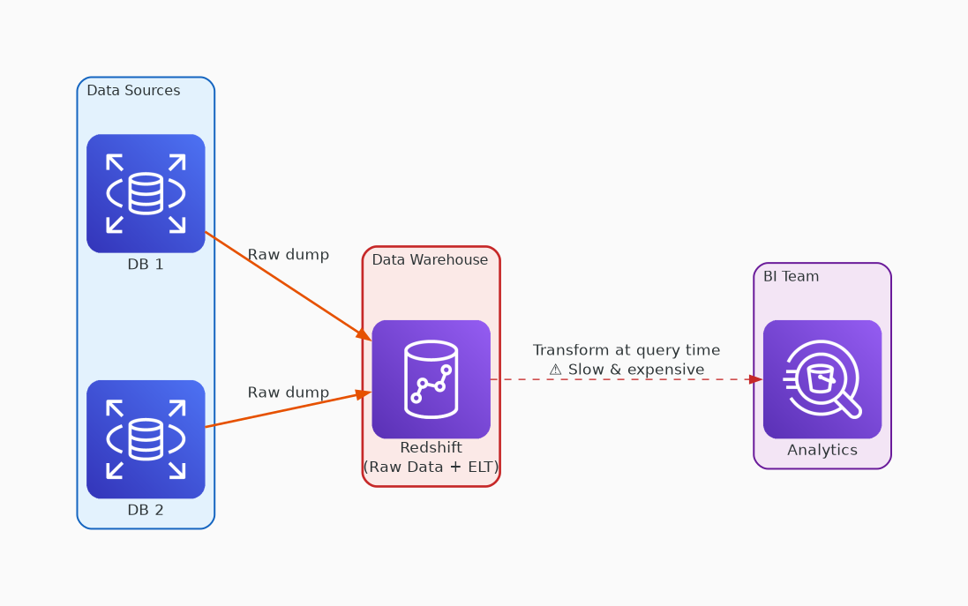
✗ INCORRECT
Option C: Store all data directly in the data warehouse and perform transformations during query runtime
Why this is incorrect:
• No data lake stage limits flexibility
• Query-time transforms are expensive and slow
• Raw data in warehouse increases storage costs

Slide 5
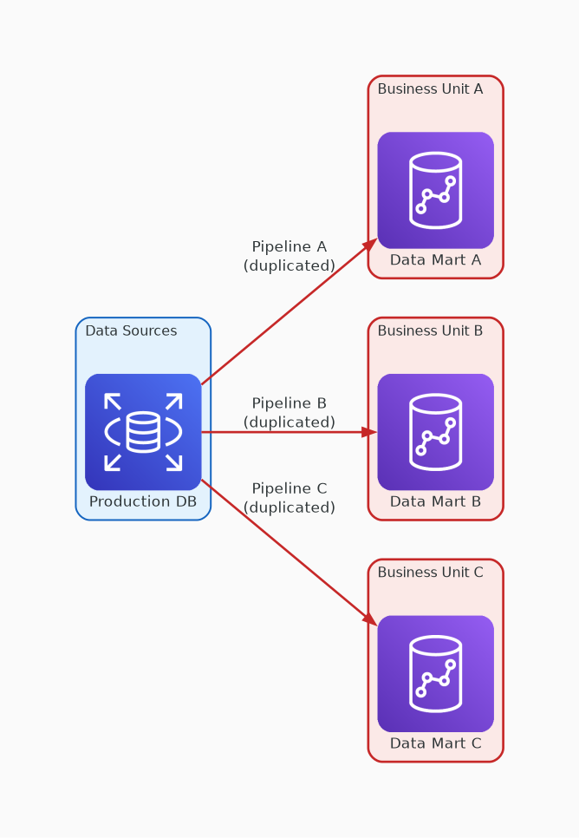
✗ INCORRECT
Option D: Create separate data marts for each business unit without a centralized data warehouse
Why this is incorrect:
• Creates data silos across business units
• Duplicate pipelines increase operational overhead
• Cross-unit analysis becomes impossible

