Slide 1
AWS Data Migration Strategy
Hybrid Environment | 5 PB Historical | 3 TB/month Ongoing | Amazon S3 + Redshift
Exam Strategy — Question 1 — Select TWO correct answers

Slide 2
QUESTION
Your customer is an enterprise sized business in the telecommunications industry. They are looking to setup a hybrid environment and intend to utilize AWS Redshift for querying a dataset comprising 5 PB of historical cell phone usage data. They have an ongoing data accumulation rate of 3 TB per month. The requirement is for the new incoming monthly data to be accessible for querying with less than a two-day delay. You are responsible for determining the most efficient method to transfer this data into Amazon S3.
Which combination of steps will provide an appropriate solution? (Select TWO)
A
Leverage AWS Direct Connect for both the initial bulk transfer of historical data and the ongoing monthly data transfers, ensuring consistent network performance.
B
Implement AWS DataSync for continuous synchronization of the 3 TB monthly data to Amazon S3, maintaining the required freshness of less than two days.
C
Configure Amazon S3 Transfer Acceleration for the ongoing 3 TB monthly data uploads to minimize transfer times and meet the delay requirements.
D
Use AWS Snowball for the initial migration of the 5 PB of historical data to Amazon S3, ensuring a fast and secure data transfer method for large datasets.
E
Directly upload the ongoing 3 TB of data each month via the Internet using the AWS CLI or SDKs, relying on your existing internet bandwidth.

Slide 3
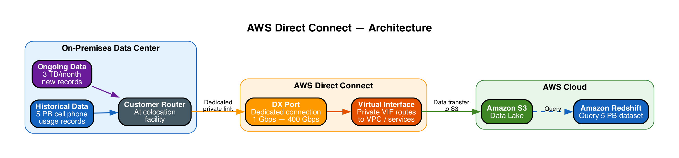
A
AWS Direct Connect
INCORRECT
A
Leverage AWS Direct Connect for both the initial bulk transfer of historical data and the ongoing monthly data transfers, ensuring consistent network performance.
Incorrect
|
Explanation
• Provides a dedicated 1-400 Gbps private network connection to AWS
▶ Primarily designed for low-latency hybrid access, not bulk data migration
▶ Snowball and DataSync are purpose-built for the 5 PB bulk and 3 TB/month recurring requirements
• Requires physical cross-connect setup at a colocation facility — adds weeks of lead time

Slide 4
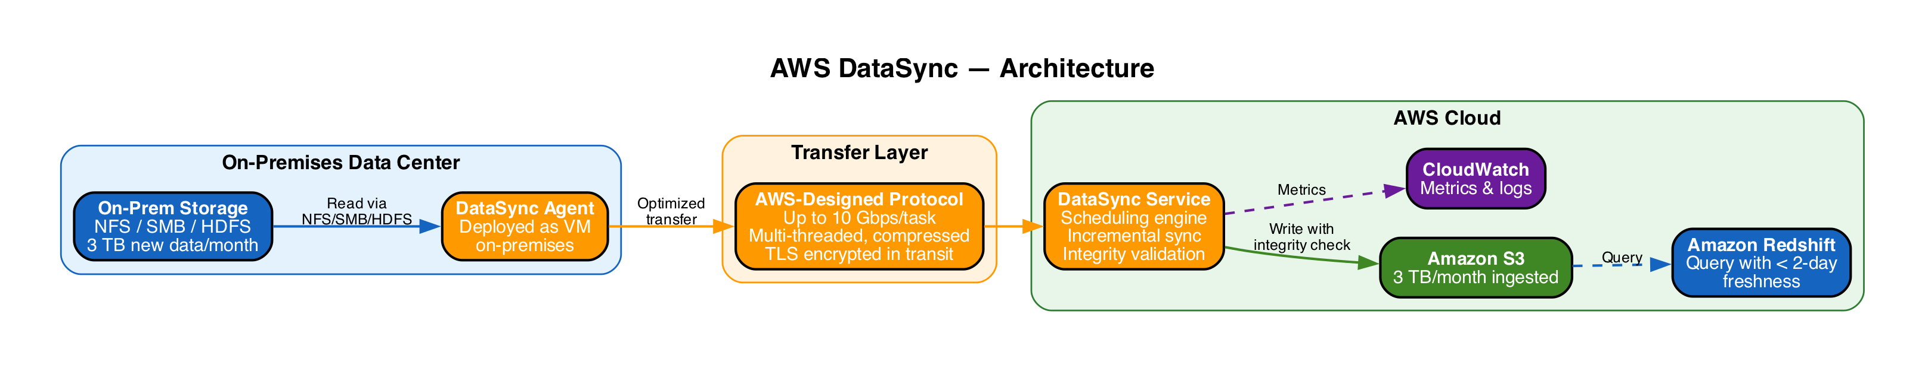
B
AWS DataSync
CORRECT
B
Implement AWS DataSync for continuous synchronization of the 3 TB monthly data to Amazon S3, maintaining the required freshness of less than two days.
Correct
|
Explanation
• Transfers data from on-premises (NFS/SMB/HDFS) to Amazon S3 or EFS
▶ Supports continuous synchronization with built-in scheduling — ideal for 3 TB/month
• Purpose-built protocol delivers up to 10 Gbps per task with TLS encryption
▶ Meets the < 2-day freshness requirement through automated, recurring transfers
• Includes in-transit and at-rest integrity validation

Slide 5
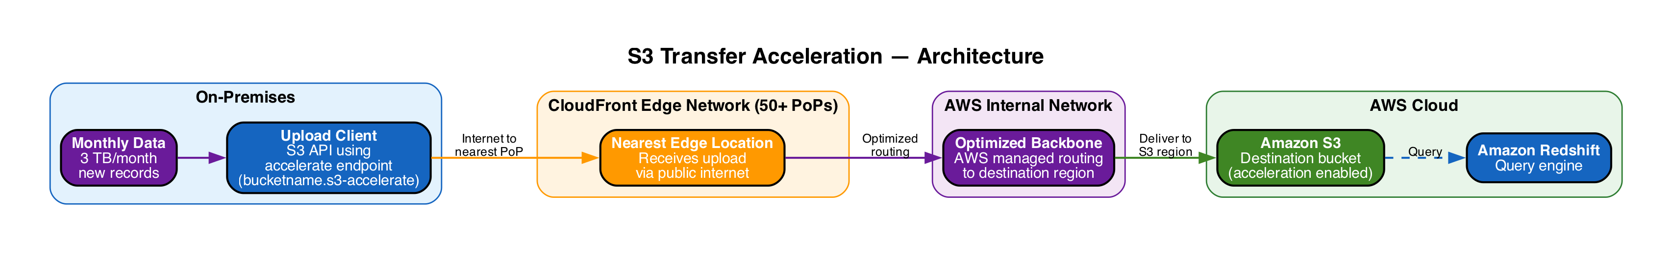
C
S3 Transfer Acceleration
INCORRECT
C
Configure Amazon S3 Transfer Acceleration for the ongoing 3 TB monthly data uploads to minimize transfer times and meet the delay requirements.
Incorrect
|
Explanation
• Speeds up uploads by routing data through 50+ CloudFront edge locations
▶ No built-in scheduling or incremental sync — must be managed manually
▶ DataSync is better suited for continuous synchronization and the < 2-day SLA
• Best for: geographically distant, ad-hoc large uploads — not recurring sync

Slide 6
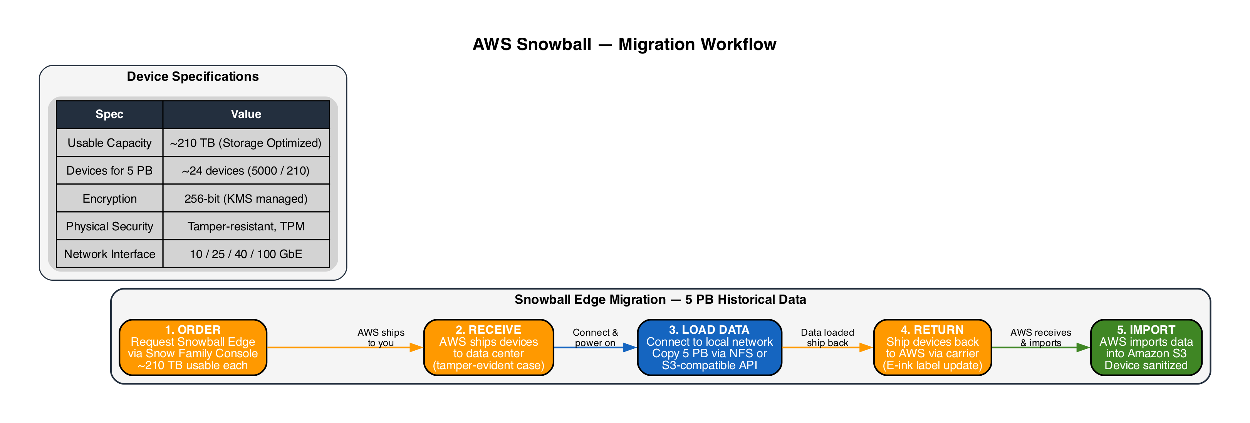
D
AWS Snowball
CORRECT
D
Use AWS Snowball for the initial migration of the 5 PB of historical data to Amazon S3, ensuring a fast and secure data transfer method for large datasets.
Correct
|
Explanation
• Physical storage devices (~210 TB each) shipped to your data center
▶ Optimized for large, one-time migrations — 5 PB is a perfect use case
▶ Physical transfer bypasses all network bottlenecks — faster than any link at PB scale
• 256-bit encryption with tamper-resistant enclosure and TPM chip
• AWS handles shipping, S3 import, and device sanitization

Slide 7
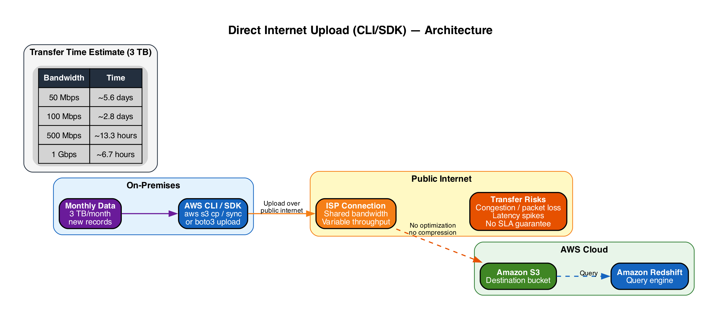
E
Direct Internet Upload (CLI/SDK)
INCORRECT
E
Directly upload the ongoing 3 TB of data each month via the Internet using the AWS CLI or SDKs, relying on your existing internet bandwidth.
Incorrect
|
Explanation
▶ Relies entirely on existing internet bandwidth — often limited for enterprises
• No transfer optimization, compression, or automatic retry on failure
▶ At 100 Mbps, 3 TB takes ~2.8 days — exceeds the < 2-day SLA
• DataSync provides scheduling, integrity checks, and optimized throughput natively

Slide 8
ANSWER KEY
A
AWS Direct Connect
INCORRECT
Dedicated private link — not optimized for bulk PB migration or scheduled recurring sync.
B
AWS DataSync
CORRECT
Scheduled sync with purpose-built protocol (10 Gbps), integrity checks — ideal for 3 TB/month.
C
S3 Transfer Acceleration
INCORRECT
Edge-routed uploads — no built-in scheduling or incremental sync capability.
D
AWS Snowball
CORRECT
Physical devices (~210 TB each) — fastest and most practical for 5 PB one-time migration.
E
Direct Upload (CLI/SDK)
INCORRECT
Public internet — unreliable, no optimization, 100 Mbps would take ~2.8 days exceeding SLA.
Correct Answers: B (DataSync for 3 TB/month) + D (Snowball for 5 PB historical)

