Slide 1
Redshift Cost Optimization Strategy
UNLOAD to S3 | Parquet Format | Redshift Spectrum | Query Data Lake
Exam Strategy — Question 2 — Choose TWO correct answers

Slide 2
QUESTION
A data engineer is tasked with optimizing the cost of a Redshift cluster by relocating data that is older than 6 months into Amazon S3. The goal is to store this data in a way that minimizes expenses while still allowing it to be easily queried and combined with data in the cluster for reporting and analytics purposes.
Which combination of steps will provide an appropriate solution. (Choose two)
A
Use the UNLOAD command to move data into S3 as JSON files
B
Use Redshift Federated Query to access the data in S3.
C
Use the COPY command to move data into S3 as Parquet files.
D
Use Redshift Spectrum to access the data in S3
E
Use the UNLOAD command to move data into S3 as Parquet files.

Slide 3
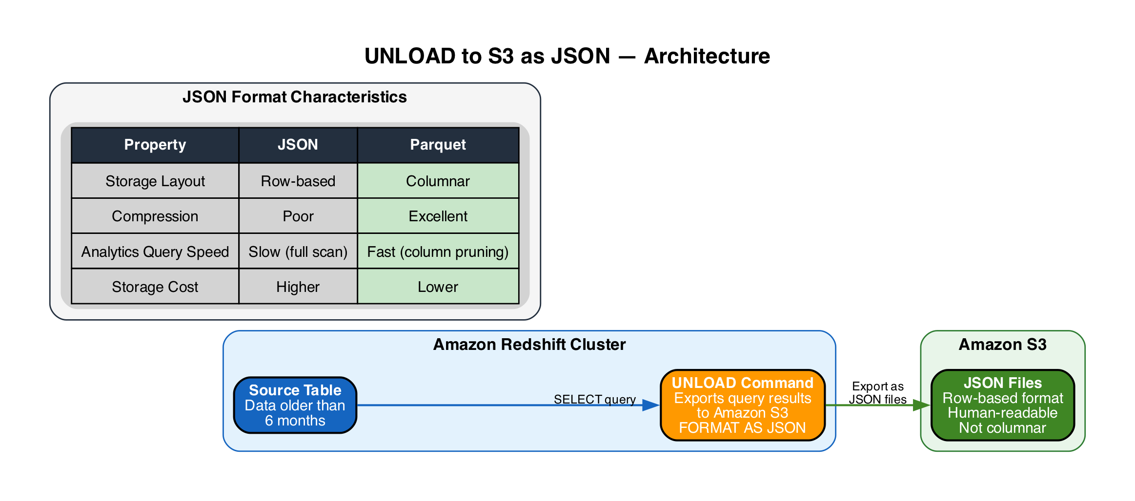
A
UNLOAD to S3 as JSON
INCORRECT
A
Use the UNLOAD command to move data into S3 as JSON files
Incorrect
|
Explanation
• UNLOAD is the correct command to export data from Redshift to S3
▶ JSON is a row-based format — not optimized for analytics or columnar queries
▶ Poor compression compared to Parquet — results in higher S3 storage costs
• Full file scans required for queries — no column pruning or predicate pushdown
• Parquet is the right format choice for cost-effective analytics on S3

Slide 4
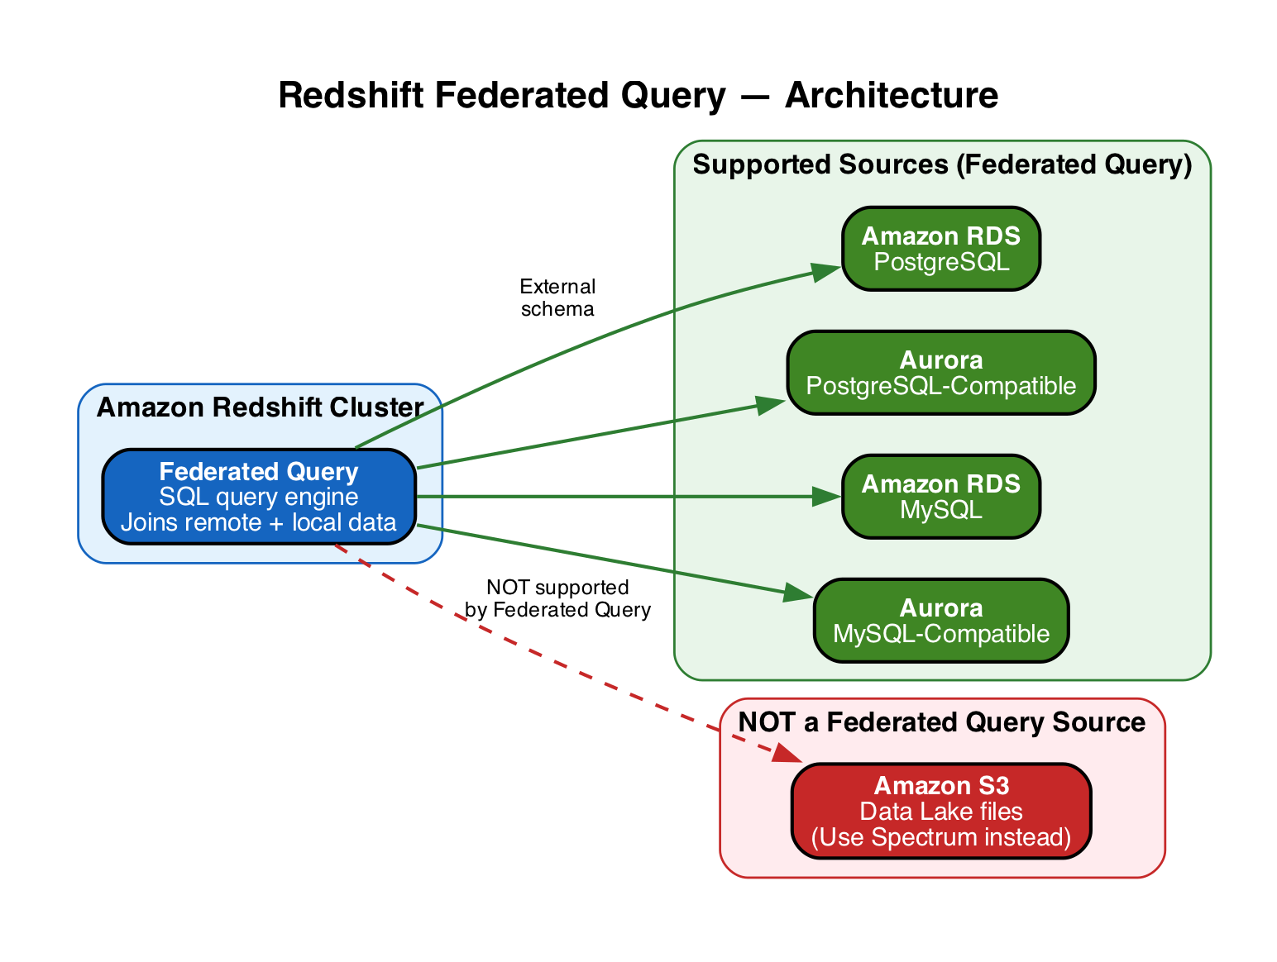
B
Redshift Federated Query
INCORRECT
B
Use Redshift Federated Query to access the data in S3.
Incorrect
|
Explanation
• Federated Query queries relational databases (RDS/Aurora PostgreSQL and MySQL)
▶ Does NOT support querying data in Amazon S3 — wrong service for this use case
▶ Redshift Spectrum is the correct feature for querying S3 data via SQL
• Federated Query is designed for live joins with operational databases, not data lakes

Slide 5
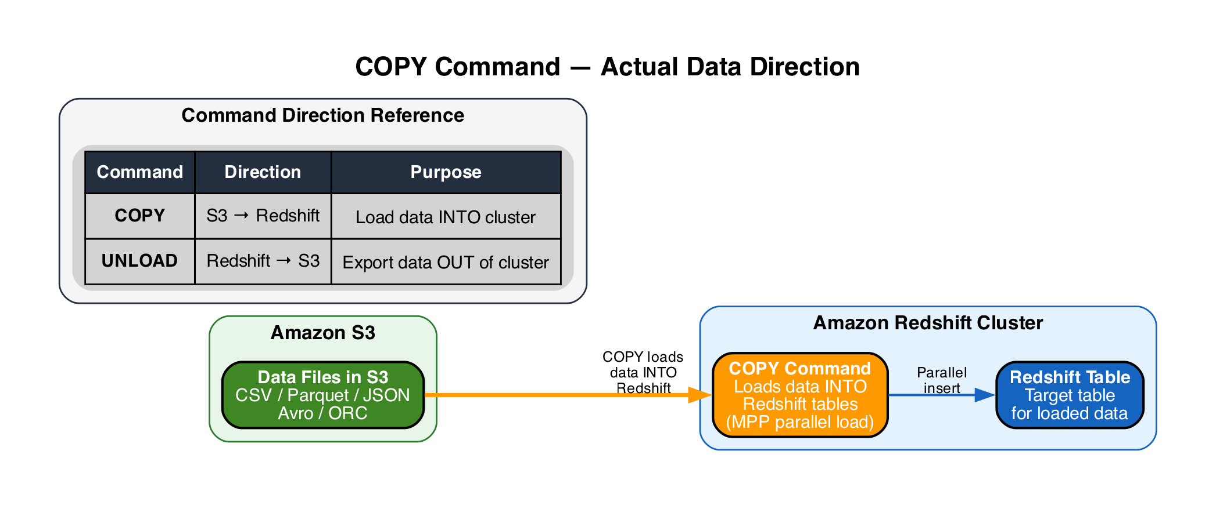
C
COPY Command to S3
INCORRECT
C
Use the COPY command to move data into S3 as Parquet files.
Incorrect
|
Explanation
▶ COPY loads data INTO Redshift from S3 — the direction is S3 to Redshift
▶ Cannot be used to export data from Redshift to S3
• UNLOAD is the correct command for exporting data OUT of Redshift to S3
• Common exam trap: confusing COPY (inbound) with UNLOAD (outbound)

Slide 6
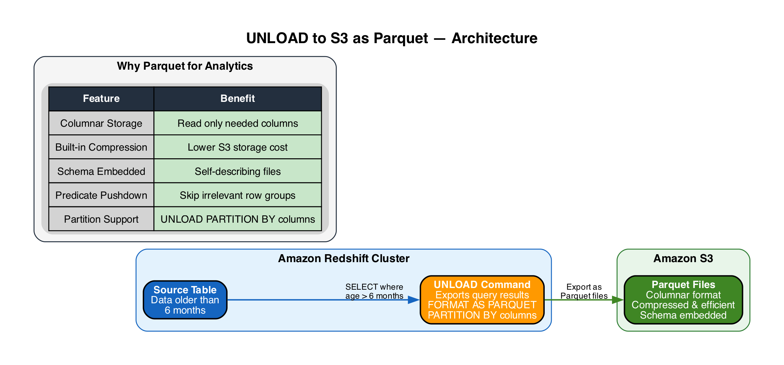
D
UNLOAD to S3 as Parquet
CORRECT
D
Use Redshift Spectrum to access the data in S3
Correct
|
Explanation
• UNLOAD exports query results from Redshift to S3 — correct command direction
▶ Parquet is columnar — optimized for analytics with column pruning and predicate pushdown
▶ Built-in compression reduces S3 storage costs — key for the cost optimization goal
• Supports PARTITION BY for organized, efficient data layout in S3
• Self-describing schema embedded in files — no external schema management needed

Slide 7
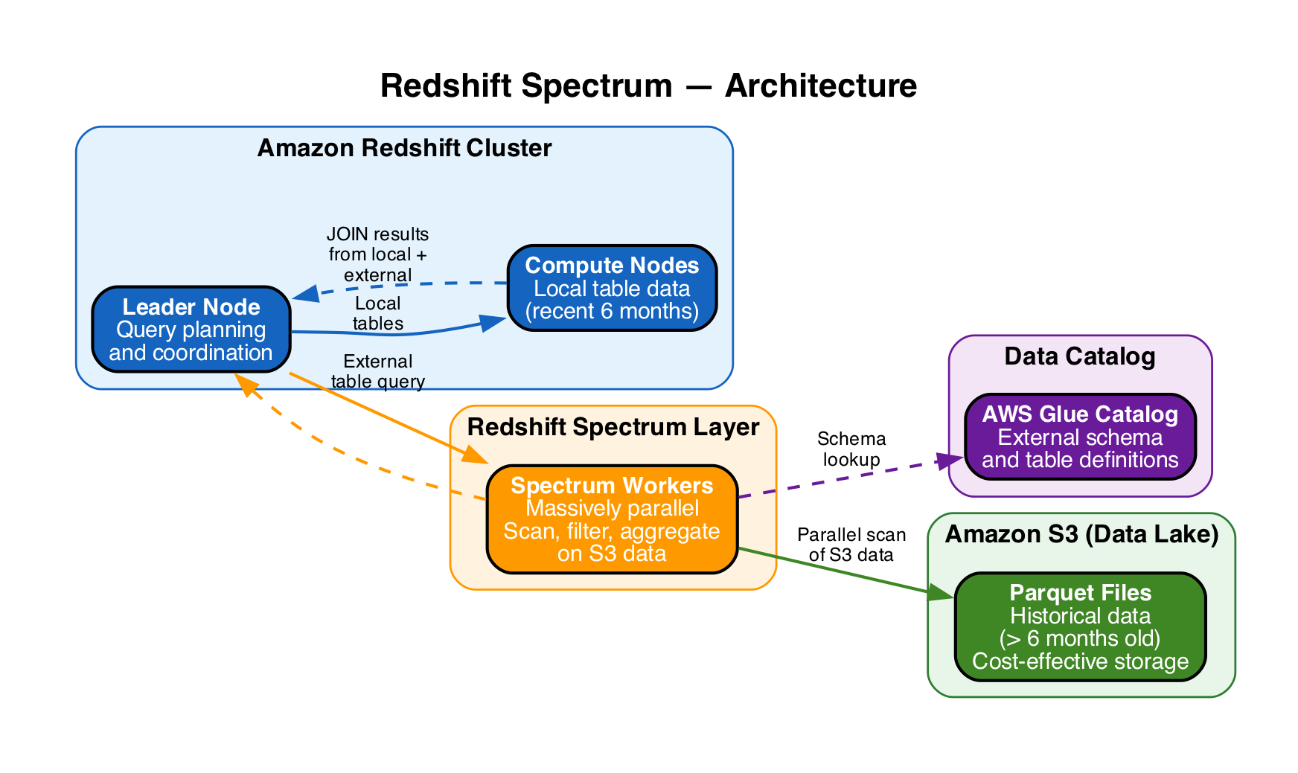
E
Redshift Spectrum
CORRECT
E
Use the UNLOAD command to move data into S3 as Parquet files.
Correct
|
Explanation
▶ Queries data directly in S3 using SQL — no need to load it back into Redshift
▶ Allows JOINs between S3 external tables and local Redshift tables for reporting
• Massively parallel Spectrum workers scan S3 data independently of cluster compute
• Keeps historical data in cost-effective S3 while maintaining full query capability
• Uses AWS Glue Data Catalog or Hive metastore for external table definitions

Slide 8
ANSWER KEY
A
UNLOAD as JSON
INCORRECT
UNLOAD is correct command, but JSON is row-based — not optimized for analytics.
B
Federated Query
INCORRECT
Queries RDS/Aurora databases, not S3 — wrong service for data lake access.
C
COPY to S3
INCORRECT
COPY loads data INTO Redshift from S3 — cannot export data out to S3.
D
UNLOAD as Parquet
CORRECT
UNLOAD exports to S3; Parquet is columnar, compressed — ideal for cost + analytics.
E
Redshift Spectrum
CORRECT
Queries S3 data via SQL, JOINs with local tables — no reload needed.
Correct Answers: D (UNLOAD as Parquet) + E (Redshift Spectrum)

