Slide 1
Data Lake Integration Strategy
S3 Data Lake | AWS Glue | Athena | Redshift | Hive | QuickSight
Exam Strategy — Question 3 — LEAST operational overhead

Slide 2
QUESTION
A financial services company maintains a vast and secure data lake built on Amazon S3. They analyze this data using a diverse set of tools, namely Apache Hive, Amazon Athena, Amazon Redshift, and Amazon QuickSight. The company has tasked you with identifying a solution to integrate the data lake and the above tools used by the engineering teams.
What solution accomplishes this with the LEAST amount of operational overhead?
A
Use AWS Glue to catalog the data and make it accessible to all the analysis tools.
B
Directly connect each analysis tool to Amazon S3, configuring each tool individually.
C
Export data from Amazon S3 to an Amazon EC2 instance and use it as a central analysis server.
D
Upload copies of the data to each analysis tool separately.

Slide 3
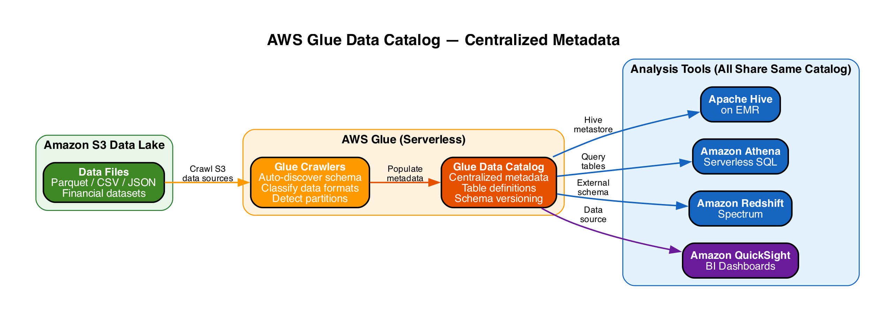
A
AWS Glue Data Catalog
CORRECT
A
Use AWS Glue to catalog the data and make it accessible to all the analysis tools.
Correct
|
Explanation
• Glue crawlers auto-discover schema from S3 and populate a centralized metadata catalog
▶ Single catalog shared by Athena, Redshift Spectrum, Hive, and QuickSight — zero duplication
▶ Fully serverless — no infrastructure to manage, patch, or scale
• Schema changes propagate automatically to all tools via the shared catalog
• Drop-in replacement for Apache Hive metastore — native integration with all listed tools

Slide 4
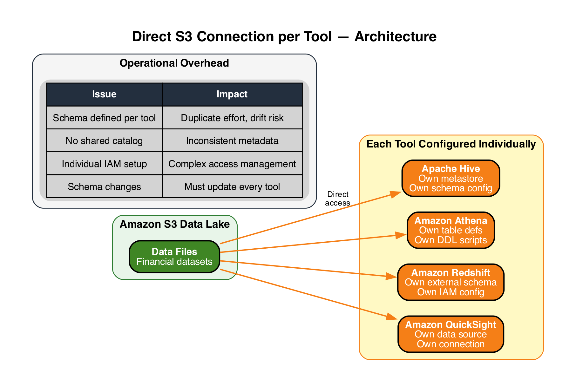
B
Direct S3 Connection per Tool
INCORRECT
B
Directly connect each analysis tool to Amazon S3, configuring each tool individually.
Incorrect
|
Explanation
• Each tool must define its own schema, table definitions, and IAM access independently
▶ Significant operational overhead — schema must be maintained separately in every tool
▶ No shared metadata catalog — risk of schema drift and inconsistencies across tools
• Any schema change requires updating configuration in all four tools manually

Slide 5
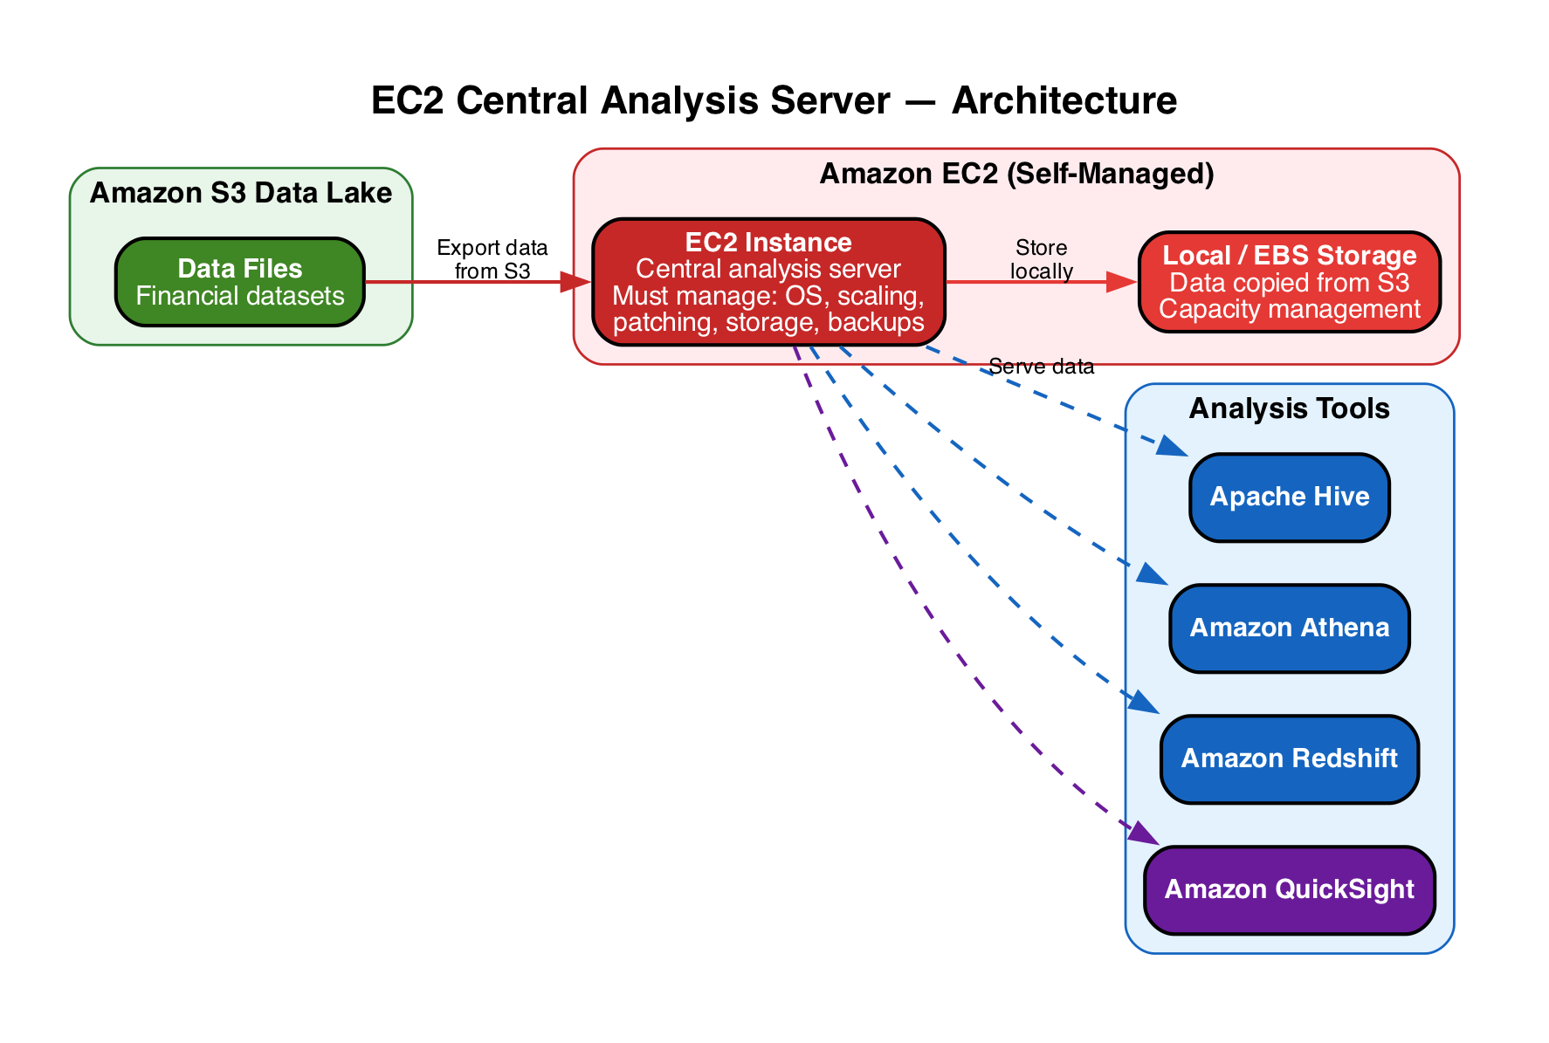
C
EC2 Central Analysis Server
INCORRECT
C
Export data from Amazon S3 to an Amazon EC2 instance and use it as a central analysis server.
Incorrect
|
Explanation
• Requires managing EC2 instances: OS patching, scaling, storage, backups
▶ Adds unnecessary infrastructure overhead — the opposite of LEAST operational overhead
▶ Data must be copied from S3 to EC2 storage — transfer cost and staleness risk
• AWS Glue provides the same centralization benefit as a fully managed serverless service

Slide 6
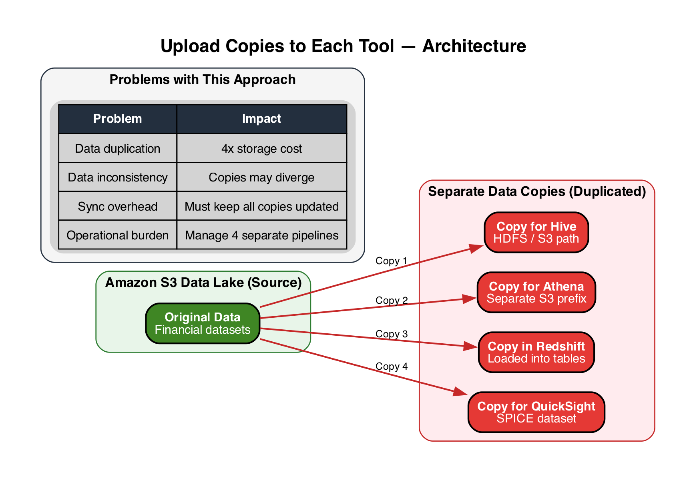
D
Upload Copies to Each Tool
INCORRECT
D
Upload copies of the data to each analysis tool separately.
Incorrect
|
Explanation
• Creates 4 separate copies of the data — massive storage cost increase
▶ Data duplication leads to inconsistencies when source data changes
▶ Must build and maintain 4 separate sync pipelines — highest operational overhead
• Completely unnecessary when Glue Catalog lets all tools query the same S3 data

Slide 7
ANSWER KEY
A
AWS Glue Data Catalog
CORRECT
Serverless, centralized catalog — all tools share one metadata source with zero infra overhead.
B
Direct S3 per Tool
INCORRECT
Each tool configured separately — duplicate schema effort, drift risk, high maintenance.
C
EC2 Analysis Server
INCORRECT
Self-managed EC2 — OS patching, scaling, data copy overhead. Opposite of least overhead.
D
Copy Data to Each Tool
INCORRECT
4x data duplication — storage cost, inconsistency, 4 sync pipelines to maintain.
Correct Answer: A (AWS Glue Data Catalog)

