Slide 1
Database Migration Strategy
On-Premises to RDS | Schema Conversion | AWS SCT | AWS DMS
Exam Strategy — Question 4 — Most operationally efficient approach

Slide 2
QUESTION
A data engineer is planning to migrate their on-premises database to Amazon RDS. As part of the migration, they need to perform a schema conversion from the on-premises database to the Amazon RDS database. The data engineer also wants the solution to scan their application source code for embedded SQL statements and convert them as part of the project.
What is the recommended approach to perform the schema conversion for the migration in the most operationally efficient way?
A
Use the AWS Database Migration Service (AWS DMS) to convert the database schema and migrate the data.
B
Manually convert the database schema using SQL scripts and then use AWS DMS to migrate the data.
C
Use the AWS Schema Conversion Tool (AWS SCT) to convert the database schema and then use AWS DMS to migrate the data.
D
Use the AWS Schema Conversion Tool (AWS SCT) to convert the database schema, and then use the AWS Transfer family to migrate the data the data.

Slide 3
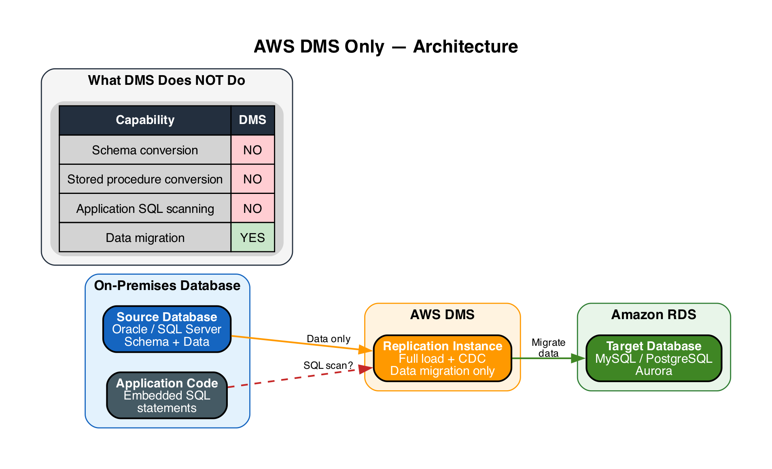
A
AWS DMS Only
INCORRECT
A
Use the AWS Database Migration Service (AWS DMS) to convert the database schema and migrate the data.
Incorrect
|
Explanation
• DMS migrates data between source and target databases (full load + CDC)
▶ DMS does NOT perform schema conversion — it only moves data
▶ Cannot scan application source code for embedded SQL statements
• A separate tool (AWS SCT) is needed for schema and SQL conversion

Slide 4
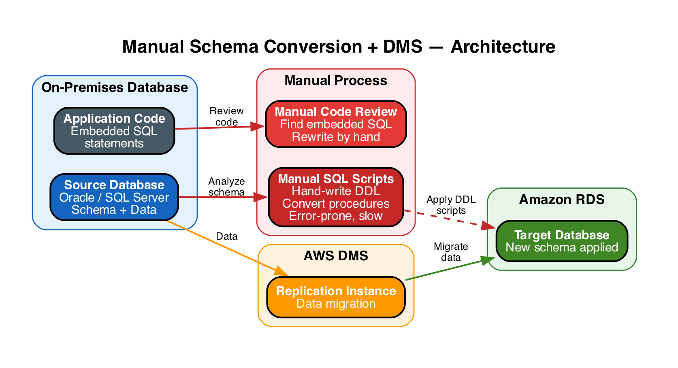
B
Manual SQL Scripts + DMS
INCORRECT
B
Manually convert the database schema using SQL scripts and then use AWS DMS to migrate the data.
Incorrect
|
Explanation
• Manually writing DDL conversion scripts is possible but error-prone and slow
▶ Not operationally efficient — AWS SCT automates this entire process
▶ Cannot automatically scan application code for embedded SQL
• DMS for data migration is correct, but the schema step adds unnecessary manual effort

Slide 5
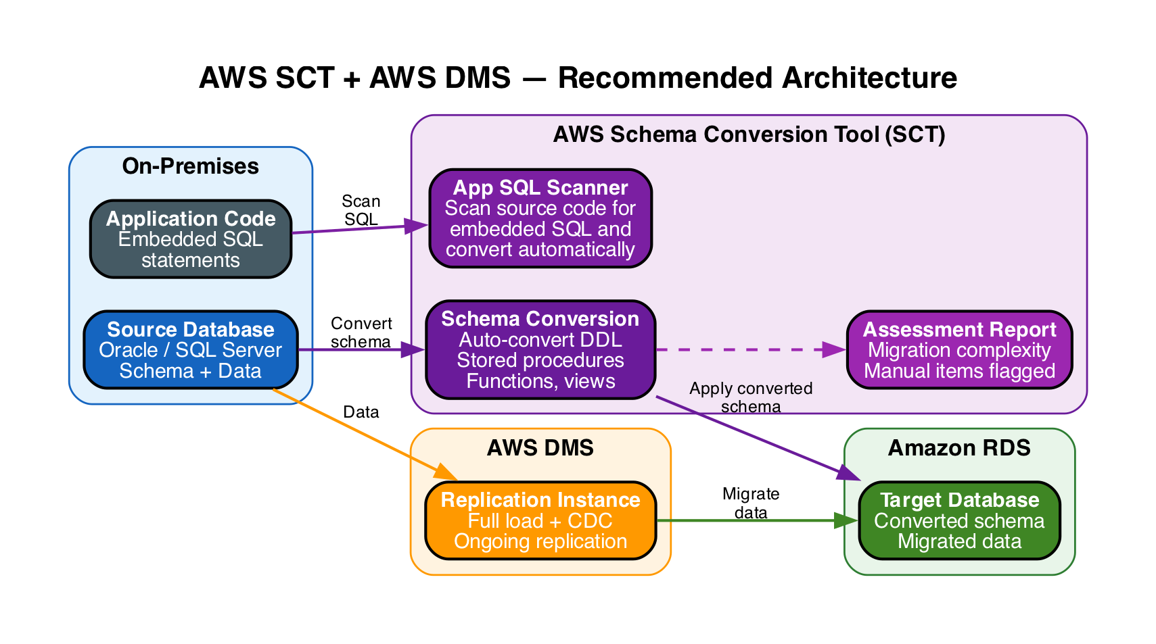
C
AWS SCT + AWS DMS
CORRECT
C
Use the AWS Schema Conversion Tool (AWS SCT) to convert the database schema and then use AWS DMS to migrate the data.
Correct
|
Explanation
• SCT auto-converts database schema: DDL, stored procedures, functions, views
▶ SCT scans application source code for embedded SQL and converts it automatically
• SCT generates an assessment report flagging items needing manual attention
• DMS handles data migration with full load + change data capture (CDC)
▶ Purpose-built combination: SCT for schema, DMS for data — most operationally efficient

Slide 6
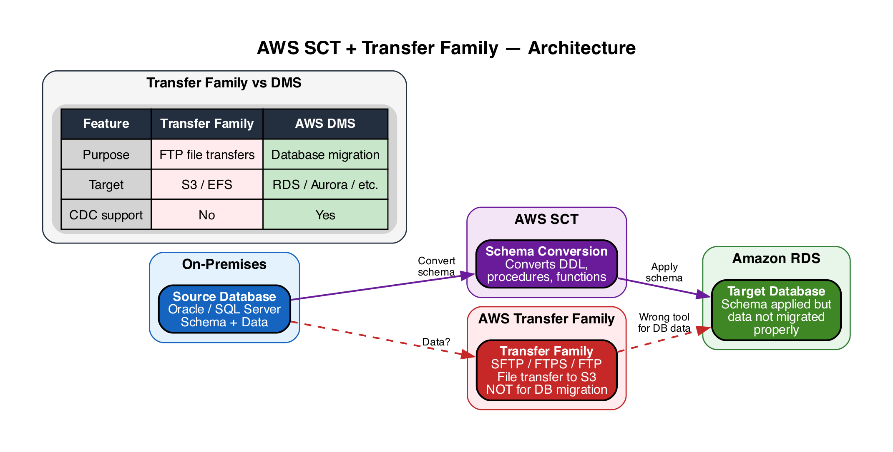
D
AWS SCT + Transfer Family
INCORRECT
D
Use the AWS Schema Conversion Tool (AWS SCT) to convert the database schema, and then use the AWS Transfer family to migrate the data the data.
Incorrect
|
Explanation
• SCT for schema conversion is correct — handles DDL and SQL conversion
▶ AWS Transfer Family is for SFTP/FTPS/FTP file transfers to S3 — not database migration
▶ Transfer Family cannot migrate database data to RDS or perform CDC replication
• DMS is the correct service for migrating database data to Amazon RDS

Slide 7
ANSWER KEY
A
DMS Only
INCORRECT
DMS migrates data only — does not convert schema or scan application SQL.
B
Manual SQL + DMS
INCORRECT
Manual scripts are error-prone and slow — SCT automates the entire conversion.
C
SCT + DMS
CORRECT
SCT converts schema + scans app SQL; DMS migrates data — purpose-built combination.
D
SCT + Transfer Family
INCORRECT
Transfer Family is for FTP file transfers to S3 — not for database data migration.
Correct Answer: C (AWS SCT + AWS DMS)

