Slide 1

Demo: Data Lake Storage
Machine Learning
ETL
ETL
Raw Bucket
Processed Bucket
Dashboard
App Integration
Curated Buckets
Notes:
1. Run Generator - python ~/BLDT/02-Ingestion/lambda/generator.py
2. Run Crawler - aws glue stop-crawler --name 'ingest-crawler’
3. Use Athena Query – Workgroup –Ingestion Workgroup

Slide 2



Demo: Ingestion
Processed Bucket
Ingest
Ingest
Load
AWS IoT Core
Amazon Kinesis Data Streams
Amazon Kinesis Data Firehose
Raw Bucket
Self Driving Cars
Curated Bucket
Notes:
1. Run Generator - python ~/BLDT/02-Ingestion/lambda/generator.py
2. Run Crawler - aws glue stop-crawler --name 'ingest-crawler’
3. Use Athena Query – Workgroup –Ingestion Workgroup

Slide 3



Demo: Crawl and Catalog
AWS Glue
Crawler
Crawl
AWS Glue Data Catalog
Ingest
Ingest
Load
AWS IoT Core
Amazon Kinesis Data Streams
Amazon Kinesis Data Firehose
Raw Bucket
Self Driving Cars
Notes:
1. Run Generator - python ~/BLDT/02-Ingestion/lambda/generator.py
2. Run Crawler - aws glue stop-crawler --name 'ingest-crawler’
3. Use Athena Query – Workgroup –Ingestion Workgroup

Slide 4

Demo: Transform, Format, Partition, Compress, Compact
Crawler
Data Catalog
ETL Job
AWS Glue
AWS Glue
Crawl
Transform
Format
Partition
Compress
Ingest
Ingest
Load
Compact
AWS IoT Core
Amazon Kinesis Data Streams
Amazon Kinesis Data Firehose
Raw Bucket
Processed Bucket
Self Driving Cars
Notes:
"groupFiles": "inPartition",
"groupSize": "10485760"

Slide 5

Demo: Analyze and Query
AWS Glue Data Catalog
AWS Glue Data Catalog
Crawler
ETL Job
Crawler
AWS Glue
AWS Glue
Crawl
AWS Glue
Crawl
Transform
Format
Partition
Compress
Ingest
Ingest
Load
Query
Compact
AWS IoT Core
Amazon Kinesis Data Streams
Amazon Kinesis Data Firehose
Raw
Bucket
Processed Bucket
Amazon Athena
Self Driving Cars
Notes:
1. Run Generator - python ~/BLDT/02-Ingestion/lambda/generator.py
2. Run Crawler - aws glue stop-crawler --name 'ingest-crawler’
3. Use Athena Query – Workgroup –Ingestion Workgroup

Slide 6
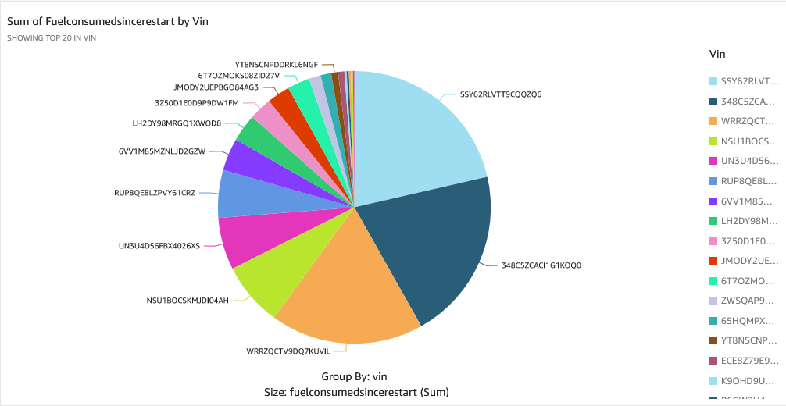

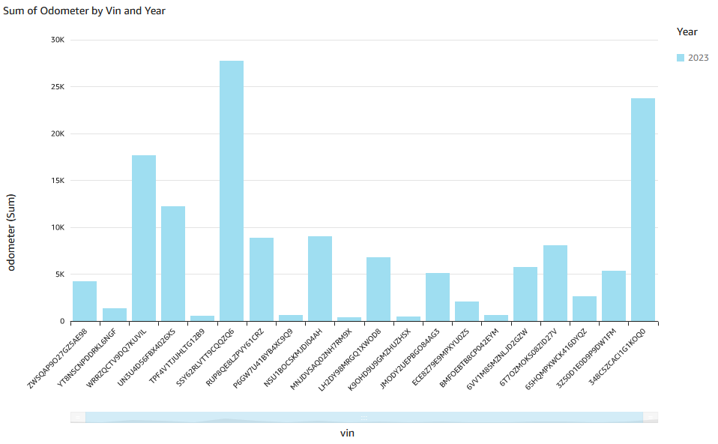
Demo: Visualize
AWS Glue Data Catalog
AWS Glue Data Catalog
Crawler
ETL Job
Crawler
AWS Glue
AWS Glue
Crawl
AWS Glue
Crawl
Format
Partition
Compress
Ingest
Ingest
Load
Query
Compact
AWS IoT Core
Amazon Kinesis Data Streams
Amazon Kinesis Data Firehose
Raw
Bucket
Processed Bucket
Amazon Athena
Visualize
Self Driving Cars
QuickSight
Notes:
1. Run Generator - python ~/BLDT/02-Ingestion/lambda/generator.py
2. Run Crawler - aws glue stop-crawler --name 'ingest-crawler’
3. Use Athena Query – Workgroup –Ingestion Workgroup

