Slide 1
PII Detection & Masking
⏱ TIME
A company is collecting data in an Amazon S3 data lake that includes personally identifiable information (PII). They need an automated solution to identify PII in new and existing data, provide an overview of findings, and invoke a masking application in real time when PII is found. Which solution meets these requirements with the LEAST operational overhead?
A
Create an AWS Lambda function to analyze data for PII. Configure S3 bucket notifications to invoke the Lambda when a new object is uploaded.
B
Configure S3 bucket notifications with an Amazon EventBridge rule for new object uploads. Set the masking application as the target.
C
Enable Amazon Macie. Create an EventBridge rule for Macie findings. Set the masking application as the target.
D
Enable Amazon Macie. Create a Lambda function on a schedule to poll Macie findings and invoke the masking application.

Slide 2
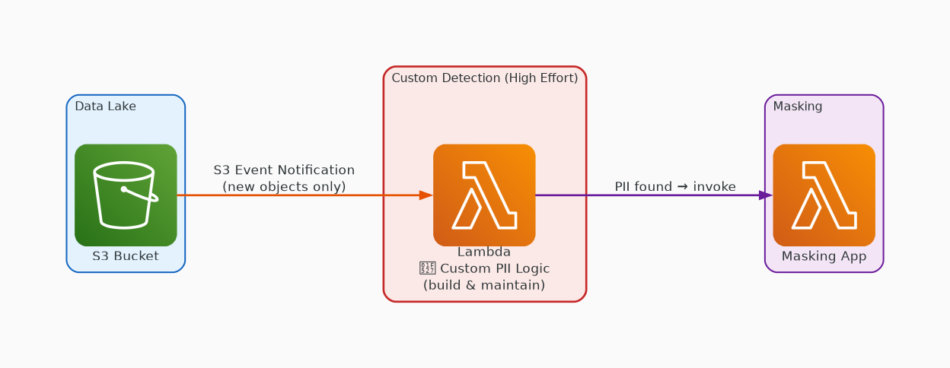
✗ INCORRECT
Option A: Create an AWS Lambda function to analyze data for PII. Configure S3 bucket notifications to invoke the Lambda when a new object is uploaded.
Why this is incorrect:
• Requires building and maintaining custom PII detection logic
• Only scans new uploads, not existing data
• No built-in reporting or overview of findings
• High operational overhead

Slide 3
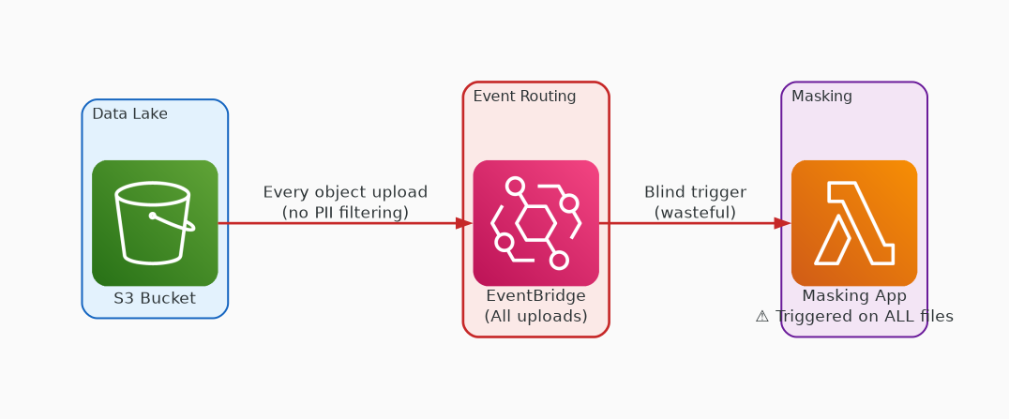
✗ INCORRECT
Option B: Configure S3 bucket notifications with an Amazon EventBridge rule for new object uploads. Set the masking application as the target.
Why this is incorrect:
• No PII identification step at all
• Triggers masking on every upload blindly
• Wasteful — processes files without PII
• Doesn't meet the 'identify PII' requirement

Slide 4
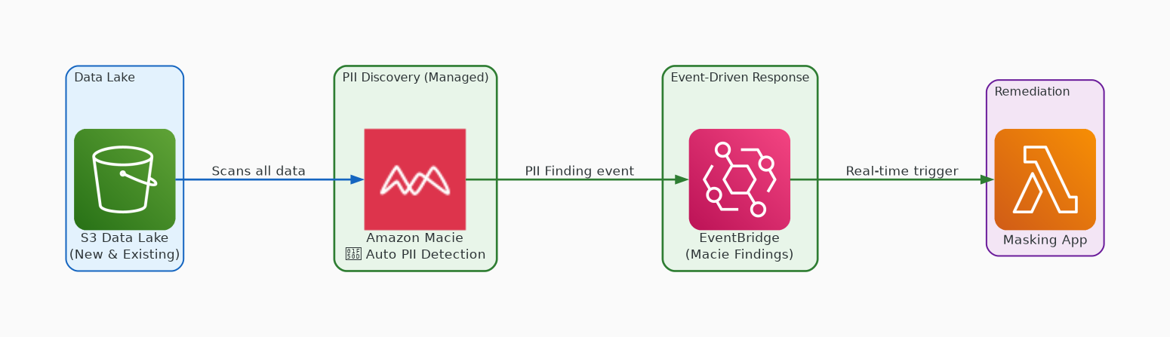
✓ CORRECT
Option C: Enable Amazon Macie. Create an EventBridge rule for Macie findings. Set the masking application as the target.
Why this is correct:
• Macie is purpose-built for PII discovery in S3
• Scans both new and existing data automatically
• EventBridge provides real-time event-driven response
• Fully managed with built-in reporting dashboard

Slide 5
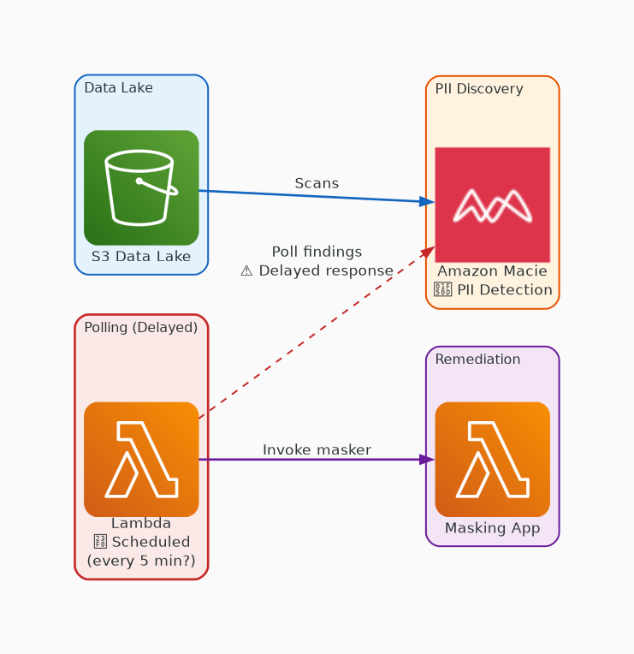
✗ INCORRECT
Option D: Enable Amazon Macie. Create a Lambda function on a schedule to poll Macie findings and invoke the masking application.
Why this is incorrect:
• Polling adds latency — not real-time
• Scheduled Lambda adds operational overhead
• May miss findings between poll intervals
• Event-driven approach is simpler and faster

