Slide 1
NFS Migration for Lambda
⏱ TIME
A company has data in an on-premises NFS file share and plans to migrate to AWS. They use AWS Lambda functions to analyze the data and want to continue using NFS. The data must be shared across all concurrently running Lambda functions. Which solution should the company use?
A
Migrate the data into the local storage for each Lambda function. Use the local storage for data access.
B
Migrate the data to Amazon Elastic Block Store (Amazon EBS) volumes. Access the EBS volumes from the Lambda functions.
C
Migrate the data to Amazon DynamoDB. Ensure the Lambda functions have permissions to access the table.
D
Migrate the data to Amazon Elastic File System (Amazon EFS). Configure the Lambda functions to mount the file system.

Slide 2
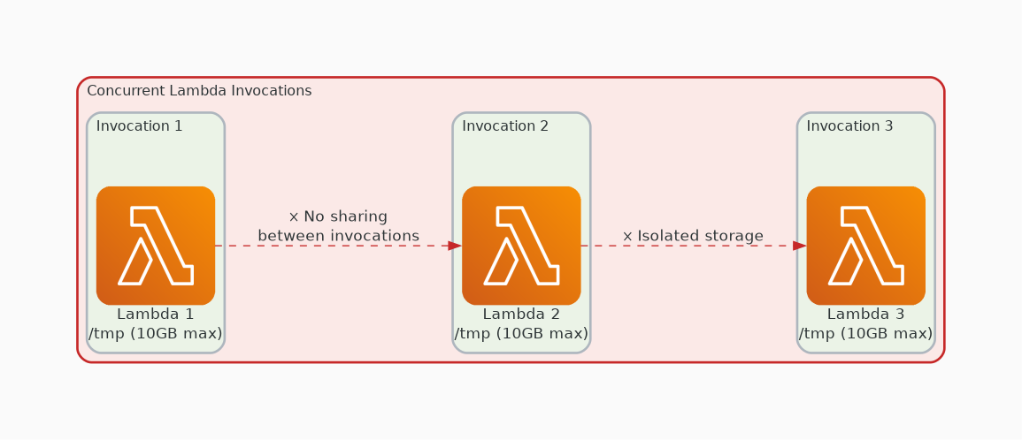
✗ INCORRECT
Option A: Migrate the data into the local storage for each Lambda function. Use the local storage for data access.
Why this is incorrect:
• Lambda /tmp is ephemeral (max 10 GB)
• Isolated per invocation — no sharing possible
• Data lost when function execution ends

Slide 3
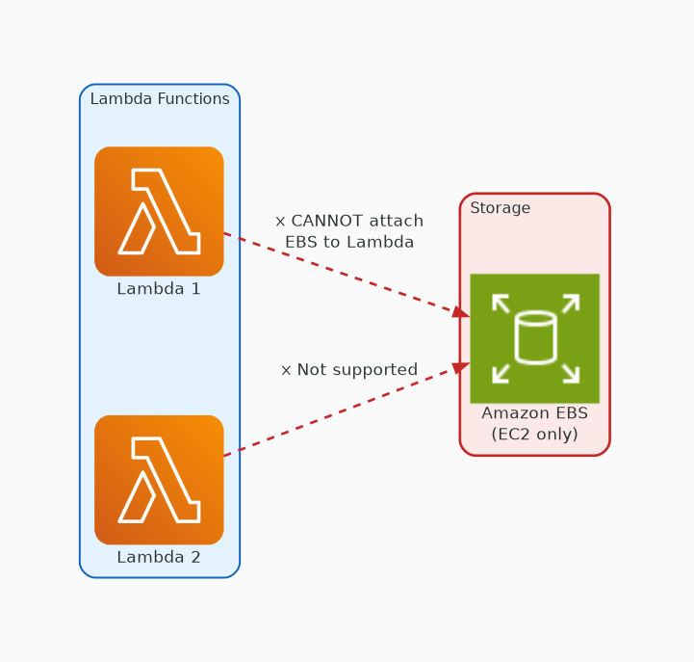
✗ INCORRECT
Option B: Migrate the data to Amazon Elastic Block Store (Amazon EBS) volumes. Access the EBS volumes from the Lambda functions.
Why this is incorrect:
• EBS can only attach to EC2 instances
• Lambda does not support EBS volume mounting
• Architecturally incompatible

Slide 4
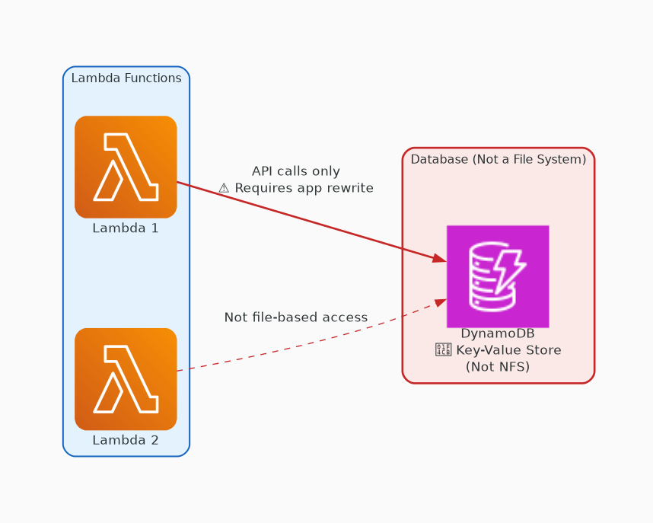
✗ INCORRECT
Option C: Migrate the data to Amazon DynamoDB. Ensure the Lambda functions have permissions to access the table.
Why this is incorrect:
• DynamoDB is a key-value database, not a file system
• Not NFS compatible — violates the requirement
• Would require complete application rewrite

Slide 5
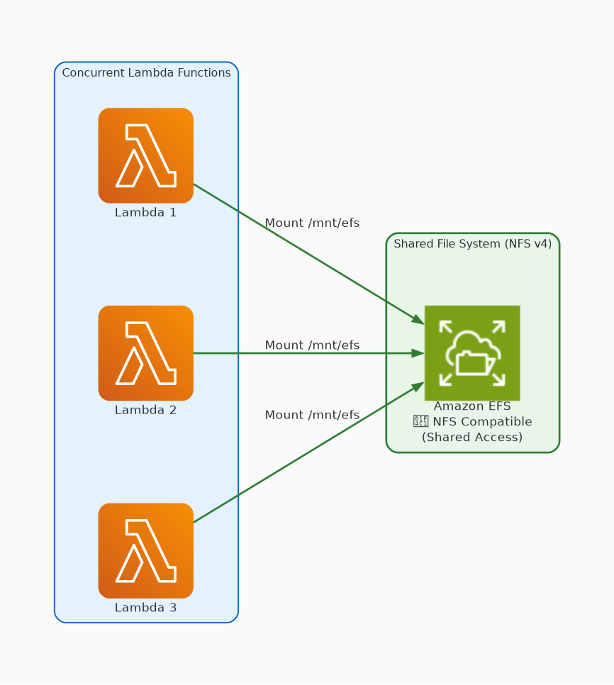
✓ CORRECT
Option D: Migrate the data to Amazon Elastic File System (Amazon EFS). Configure the Lambda functions to mount the file system.
Why this is correct:
• EFS provides NFS v4 compatible shared storage
• Lambda can mount EFS via VPC configuration
• All concurrent invocations access the same files
• Meets both NFS and shared access requirements

