Slide 1
VPC Security for Data Pipeline
⏱ TIME
A data engineer is designing a data processing pipeline that ingests sensitive customer data, processes it using EC2 instances in a VPC, and stores results in Amazon S3. The EC2 instances cannot be directly accessed from the internet. Which combination of VPC security features should be implemented?
A
Use public subnets for EC2 instances and rely solely on security groups to control access
B
Place EC2 instances in private subnets, use a NAT gateway for internet access, and implement security groups
C
Use VPC endpoints for S3 access and place EC2 instances in public subnets with restrictive NACLs
D
Implement VPC peering between multiple VPCs, each containing a different part of the pipeline

Slide 2
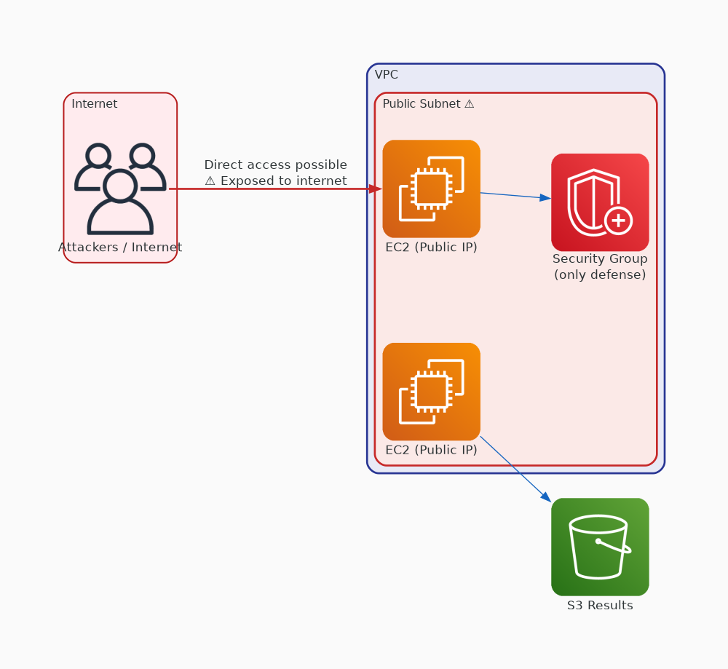
✗ INCORRECT
Option A: Use public subnets for EC2 instances and rely solely on security groups to control access
Why this is incorrect:
• Public subnets assign public IPs to instances
• Instances are directly reachable from the internet
• Violates the core security requirement
• Security groups alone are not defense-in-depth

Slide 3
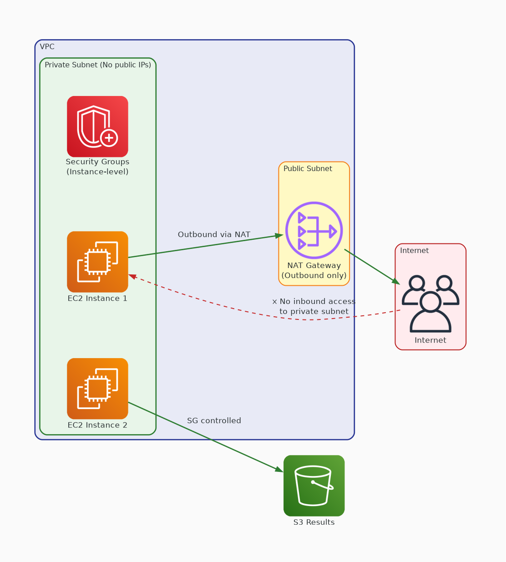
✓ CORRECT
Option B: Place EC2 instances in private subnets, use a NAT gateway for internet access, and implement security groups
Why this is correct:
• Private subnets have no internet gateway route
• NAT gateway enables outbound-only connectivity
• Security groups control instance-level traffic
• Meets all stated security requirements

Slide 4
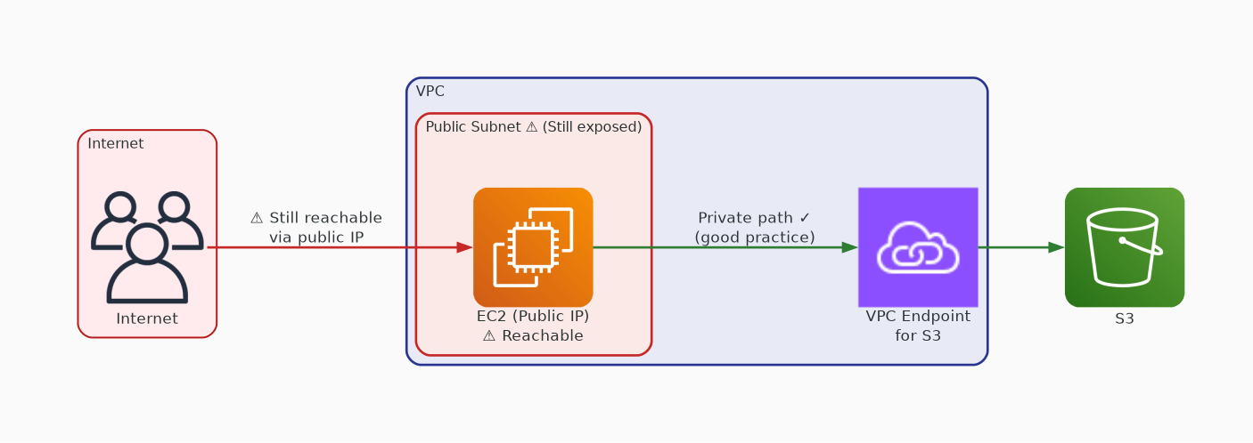
✗ INCORRECT
Option C: Use VPC endpoints for S3 access and place EC2 instances in public subnets with restrictive NACLs
Why this is incorrect:
• VPC endpoints for S3 are good practice
• BUT public subnets still expose instances to internet
• NACLs are stateless and harder to manage
• Doesn't meet the 'no internet access' requirement

Slide 5
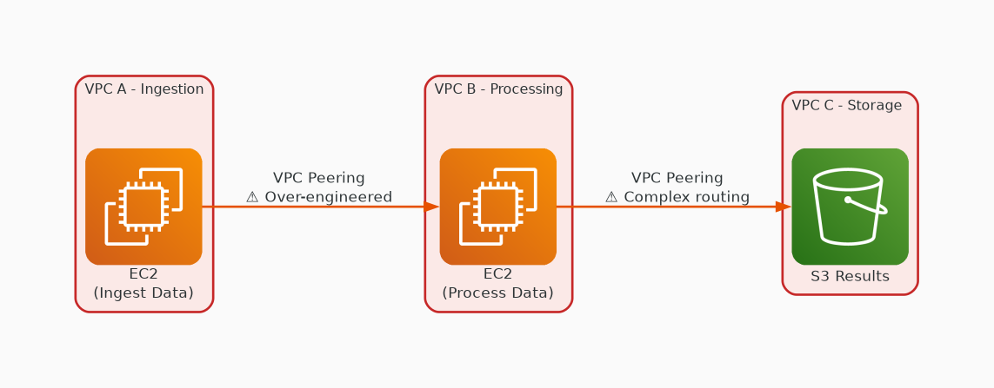
✗ INCORRECT
Option D: Implement VPC peering between multiple VPCs, each containing a different part of the pipeline
Why this is incorrect:
• VPC peering enables inter-VPC communication
• Doesn't address internet access prevention
• Adds unnecessary architectural complexity
• Over-engineered for a single-pipeline use case

