Slide 1
Data Transfer to S3
⏱ TIME
Your customer is an enterprise sized business in the telecommunications industry. They are looking to setup a hybrid environment and intend to utilize AWS Redshift for querying a dataset comprising 5 PB of historical cell phone usage data. They have an ongoing data accumulation rate of 3 TB per month. The requirement is for the new incoming monthly data to be accessible for querying with less than a two-day delay. Which combination of steps will provide an appropriate solution? (Select TWO)
A
Leverage AWS Direct Connect for both the initial bulk transfer of historical data and the ongoing monthly data transfers, ensuring consistent network performance.
B
Implement AWS DataSync for continuous synchronization of the 3 TB monthly data to Amazon S3, maintaining the required freshness of less than two days.
C
Configure Amazon S3 Transfer Acceleration for the ongoing 3 TB monthly data uploads to minimize transfer times and meet the delay requirements.
D
Use AWS Snowball for the initial migration of the 5 PB of historical data to Amazon S3, ensuring a fast and secure data transfer method for large datasets.
E
Directly upload the ongoing 3 TB of data each month via the Internet using the AWS CLI or SDKs, relying on your existing internet bandwidth.

Slide 2
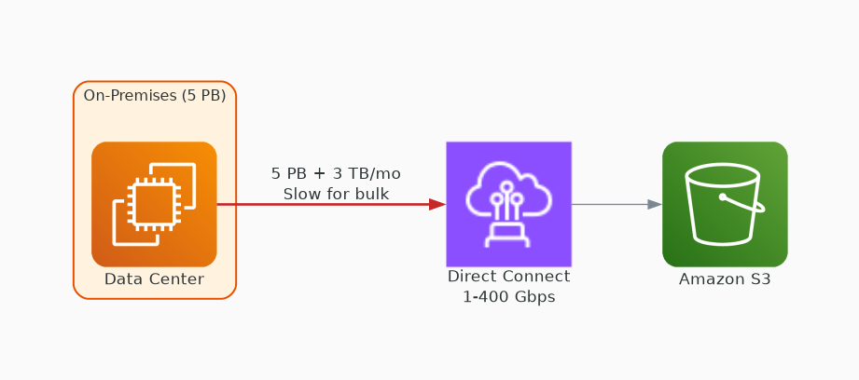
✗ INCORRECT
Option A: Leverage AWS Direct Connect for both the initial bulk transfer of historical data and the ongoing monthly data transfers, ensuring consistent network performance.
Why this is incorrect:
• Dedicated 1-400 Gbps private network connection
• Not optimized for PB-scale bulk migration
• Snowball and DataSync are purpose-built for these requirements
• Requires physical cross-connect setup adding weeks of lead time

Slide 3
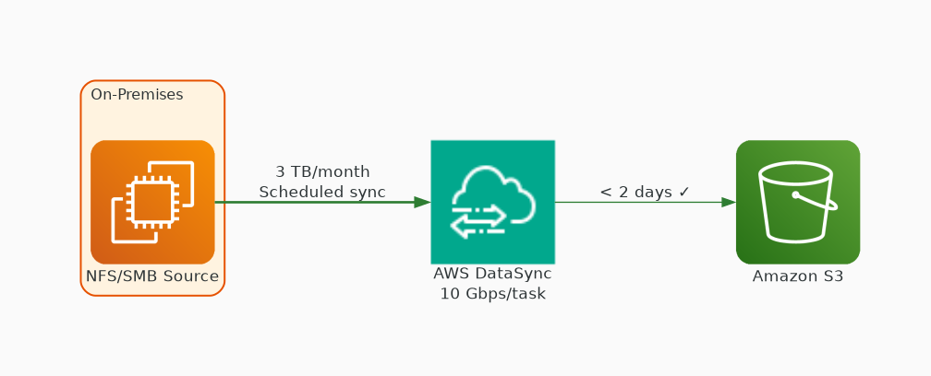
✓ CORRECT
Option B: Implement AWS DataSync for continuous synchronization of the 3 TB monthly data to Amazon S3, maintaining the required freshness of less than two days.
Why this is correct:
• Transfers data from on-premises to S3 with built-in scheduling
• Purpose-built protocol delivers up to 10 Gbps per task
• Meets the < 2-day freshness requirement
• Includes in-transit and at-rest integrity validation

Slide 4
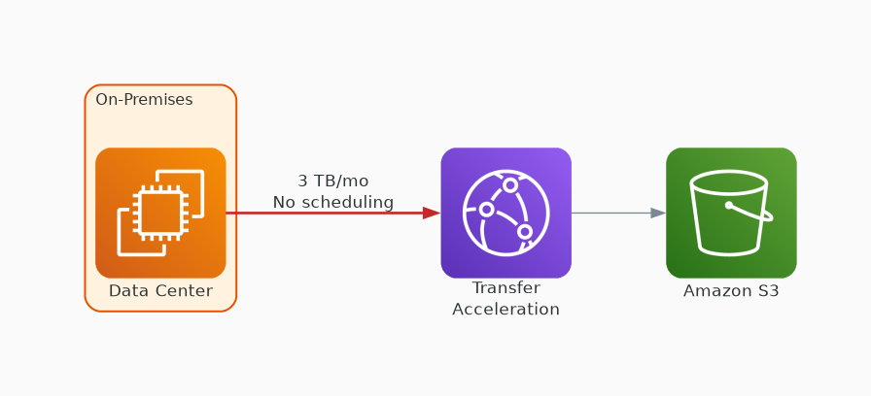
✗ INCORRECT
Option C: Configure Amazon S3 Transfer Acceleration for the ongoing 3 TB monthly data uploads to minimize transfer times and meet the delay requirements.
Why this is incorrect:
• Speeds uploads via CloudFront edge locations
• No built-in scheduling or incremental sync
• Must be managed manually
• DataSync is better for continuous synchronization

Slide 5
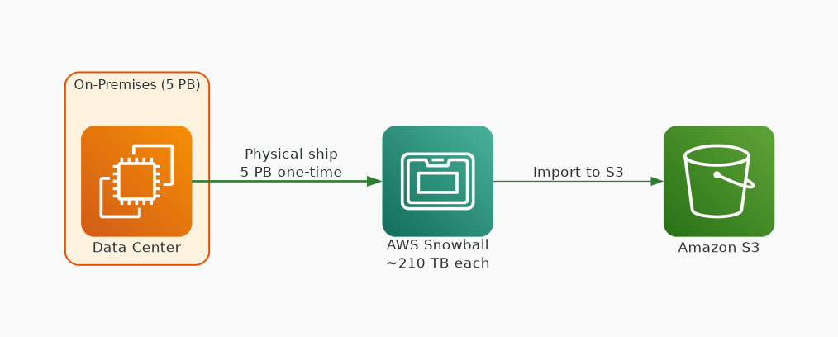
✓ CORRECT
Option D: Use AWS Snowball for the initial migration of the 5 PB of historical data to Amazon S3, ensuring a fast and secure data transfer method for large datasets.
Why this is correct:
• Physical storage devices (~210 TB each) shipped to data center
• Optimized for large one-time migrations — 5 PB is perfect
• Physical transfer bypasses all network bottlenecks
• 256-bit encryption with tamper-resistant enclosure

Slide 6
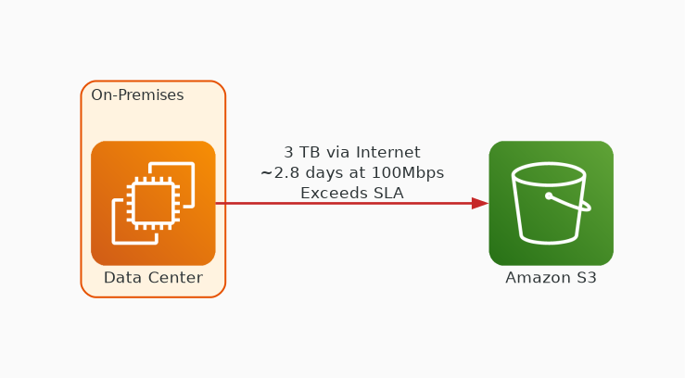
✗ INCORRECT
Option E: Directly upload the ongoing 3 TB of data each month via the Internet using the AWS CLI or SDKs, relying on your existing internet bandwidth.
Why this is incorrect:
• Relies entirely on existing internet bandwidth
• No transfer optimization or automatic retry
• At 100 Mbps, 3 TB takes ~2.8 days — exceeds SLA
• DataSync provides scheduling and optimized throughput natively

