Slide 1
Redshift Data Offloading
⏱ TIME
A data engineer is tasked with optimizing the cost of a Redshift cluster by relocating data that is older than 6 months into Amazon S3. The goal is to store this data in a way that minimizes expenses while still allowing it to be easily queried and combined with data in the cluster for reporting and analytics purposes. Which combination of steps will provide an appropriate solution? (Choose two)
A
Use the UNLOAD command to move data into S3 as JSON files
B
Use Redshift Federated Query to access the data in S3
C
Use the COPY command to move data into S3 as Parquet files
D
Use Redshift Spectrum to access the data in S3
E
Use the UNLOAD command to move data into S3 as Parquet files

Slide 2
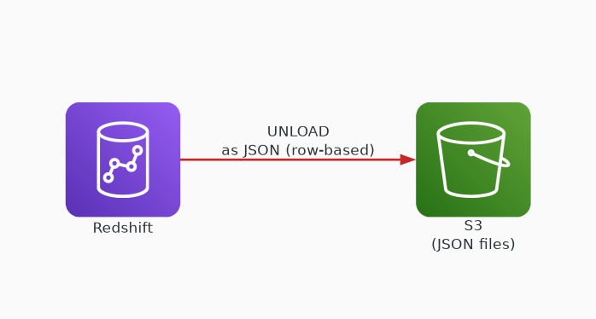
✗ INCORRECT
Option A: Use the UNLOAD command to move data into S3 as JSON files
Why this is incorrect:
• UNLOAD is the correct command to export from Redshift
• JSON is row-based — not optimized for analytics
• Poor compression vs Parquet — higher storage costs
• No column pruning or predicate pushdown

Slide 3
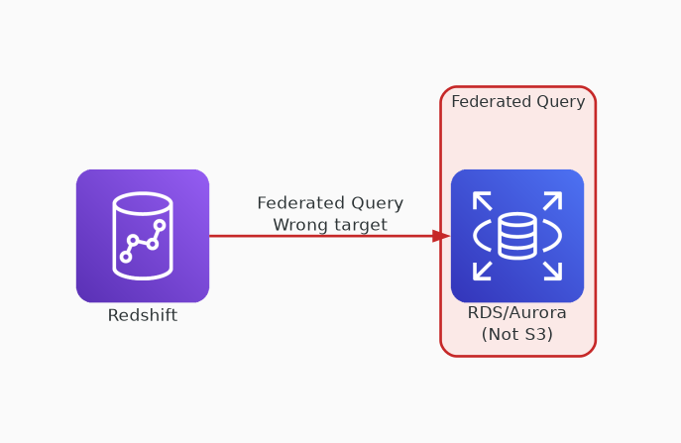
✗ INCORRECT
Option B: Use Redshift Federated Query to access the data in S3
Why this is incorrect:
• Federated Query queries RDS/Aurora databases
• Does NOT support querying data in S3
• Redshift Spectrum is the correct feature for S3
• Designed for live joins with operational DBs

Slide 4
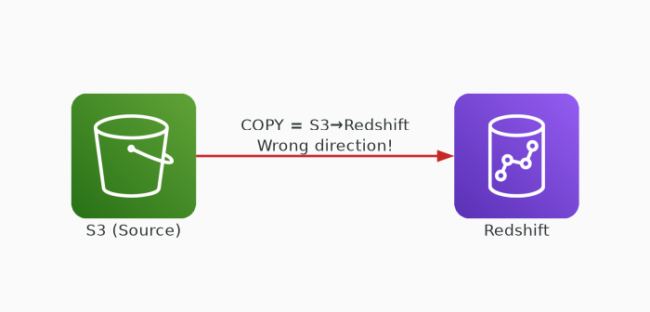
✗ INCORRECT
Option C: Use the COPY command to move data into S3 as Parquet files
Why this is incorrect:
• COPY loads data INTO Redshift from S3
• Cannot export data from Redshift to S3
• Direction is wrong: S3 → Redshift only
• Common exam trap: COPY (inbound) vs UNLOAD (outbound)

Slide 5
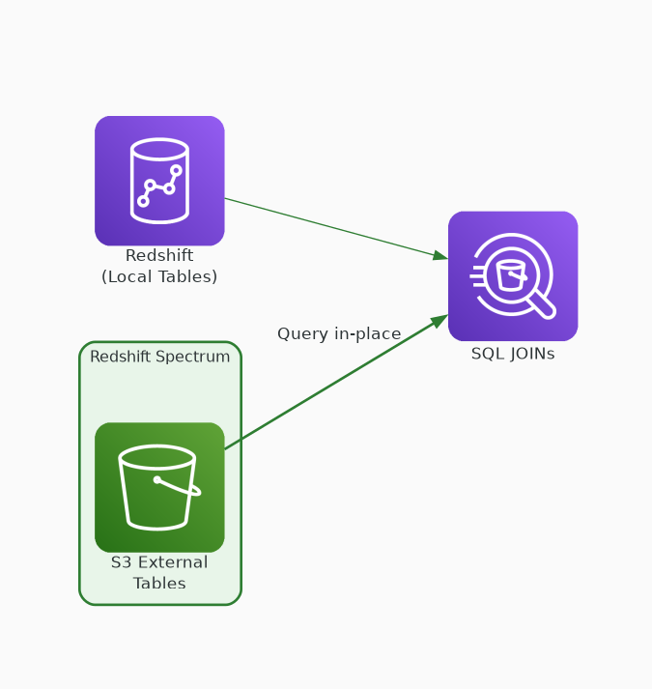
✓ CORRECT
Option D: Use Redshift Spectrum to access the data in S3
Why this is correct:
• Queries data directly in S3 using SQL
• Allows JOINs between S3 external tables and local tables
• Massively parallel Spectrum workers scan S3 independently
• Uses Glue Data Catalog for external table definitions

Slide 6
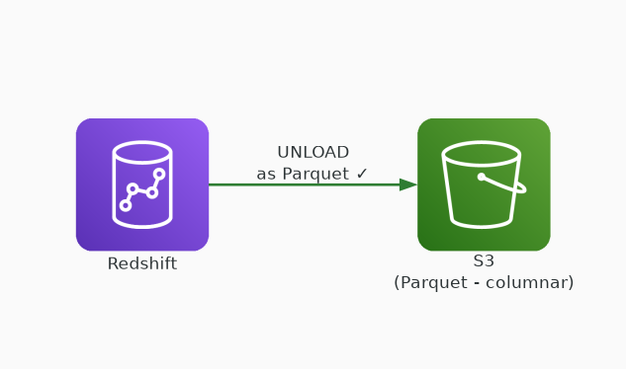
✓ CORRECT
Option E: Use the UNLOAD command to move data into S3 as Parquet files
Why this is correct:
• UNLOAD exports query results from Redshift to S3
• Parquet is columnar — optimized for analytics
• Built-in compression reduces S3 storage costs
• Supports PARTITION BY for organized data layout

