Slide 1
Data Lake Integration
⏱ TIME
A financial services company maintains a vast and secure data lake built on Amazon S3. They analyze this data using Apache Hive, Amazon Athena, Amazon Redshift, and Amazon QuickSight. The company needs to identify a solution to integrate the data lake and the tools used by the engineering teams. What solution accomplishes this with the LEAST amount of operational overhead?
A
Use AWS Glue to catalog the data and make it accessible to all the analysis tools.
B
Directly connect each analysis tool to Amazon S3, configuring each tool individually.
C
Export data from Amazon S3 to an Amazon EC2 instance and use it as a central analysis server.
D
Upload copies of the data to each analysis tool separately.

Slide 2
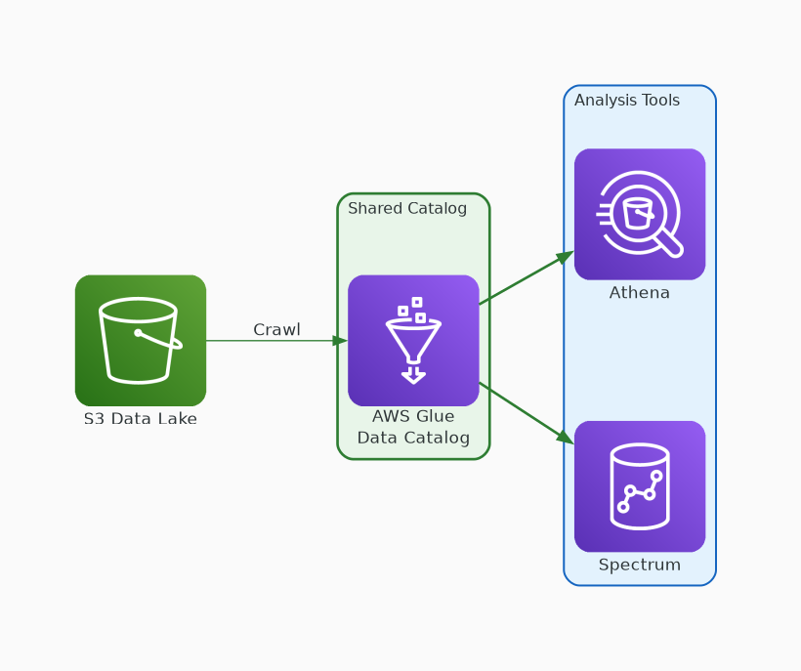
✓ CORRECT
Option A: Use AWS Glue to catalog the data and make it accessible to all the analysis tools.
Why this is correct:
• Glue crawlers auto-discover schema from S3
• Single catalog shared by Athena, Spectrum, Hive, QuickSight
• Fully serverless — no infrastructure to manage
• Schema changes propagate automatically to all tools

Slide 3
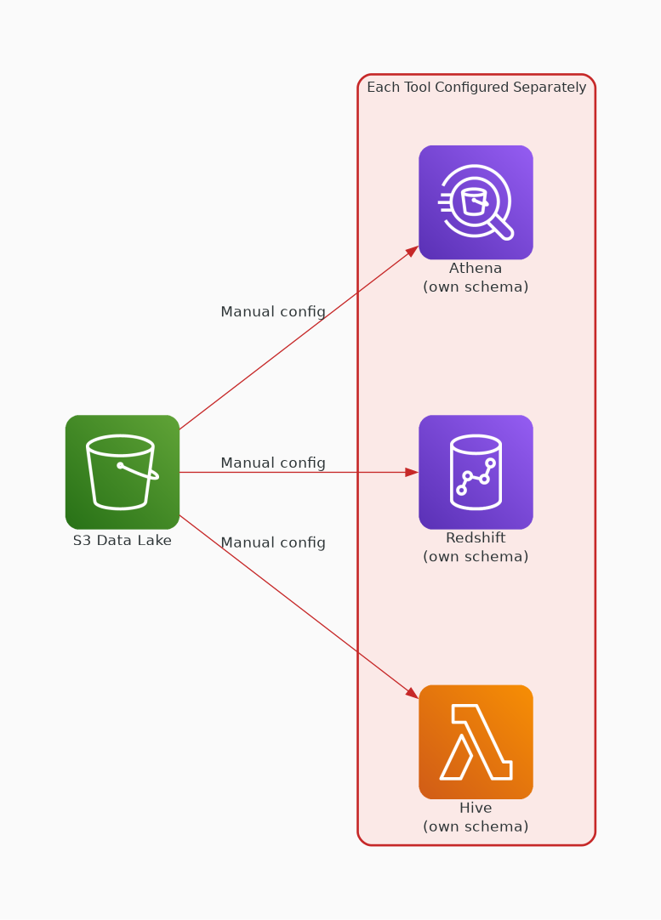
✗ INCORRECT
Option B: Directly connect each analysis tool to Amazon S3, configuring each tool individually.
Why this is incorrect:
• Each tool must define its own schema independently
• Significant operational overhead maintaining schemas
• No shared metadata — risk of schema drift
• Schema changes require updating all four tools manually

Slide 4
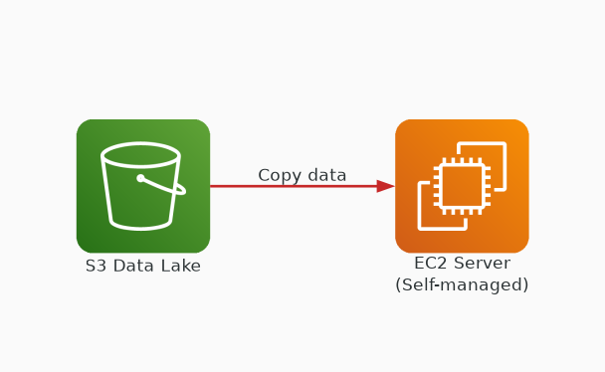
✗ INCORRECT
Option C: Export data from Amazon S3 to an Amazon EC2 instance and use it as a central analysis server.
Why this is incorrect:
• Requires managing EC2: OS patching, scaling, backups
• Adds unnecessary infrastructure overhead
• Data must be copied from S3 — transfer cost and staleness
• Glue provides same benefit as fully managed service

Slide 5
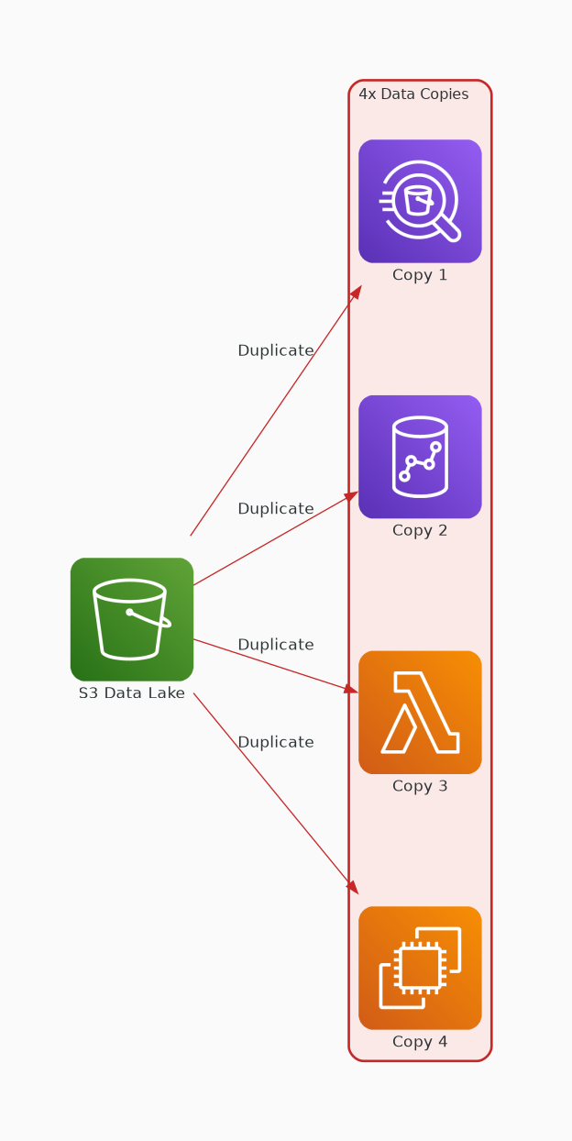
✗ INCORRECT
Option D: Upload copies of the data to each analysis tool separately.
Why this is incorrect:
• Creates 4 separate copies — massive storage cost
• Data duplication leads to inconsistencies
• Must maintain 4 separate sync pipelines
• Highest operational overhead of all options

