Slide 1
Schema Conversion & Migration
⏱ TIME
A data engineer is planning to migrate their on-premises database to Amazon RDS. They need to perform a schema conversion and also want the solution to scan application source code for embedded SQL statements and convert them. What is the recommended approach to perform the schema conversion in the most operationally efficient way?
A
Use AWS Database Migration Service (AWS DMS) to convert the database schema and migrate the data.
B
Manually convert the database schema using SQL scripts and then use AWS DMS to migrate the data.
C
Use the AWS Schema Conversion Tool (AWS SCT) to convert the database schema and then use AWS DMS to migrate the data.
D
Use the AWS Schema Conversion Tool (AWS SCT) to convert the database schema, and then use the AWS Transfer Family to migrate the data.

Slide 2
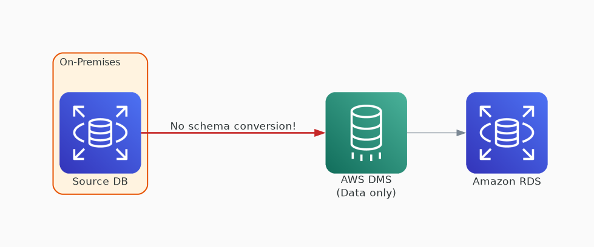
✗ INCORRECT
Option A: Use AWS Database Migration Service (AWS DMS) to convert the database schema and migrate the data.
Why this is incorrect:
• DMS migrates data between databases (full load + CDC)
• DMS does NOT perform schema conversion
• Cannot scan application source code for SQL
• A separate tool (SCT) is needed for schema conversion

Slide 3
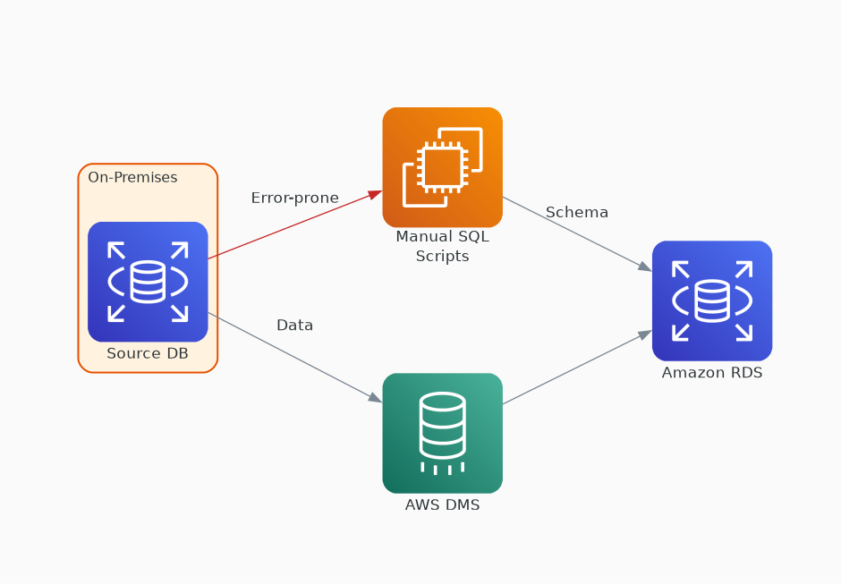
✗ INCORRECT
Option B: Manually convert the database schema using SQL scripts and then use AWS DMS to migrate the data.
Why this is incorrect:
• Manual DDL conversion is error-prone and slow
• Not operationally efficient — SCT automates this
• Cannot automatically scan app code for embedded SQL
• DMS for data is correct but schema step is manual

Slide 4
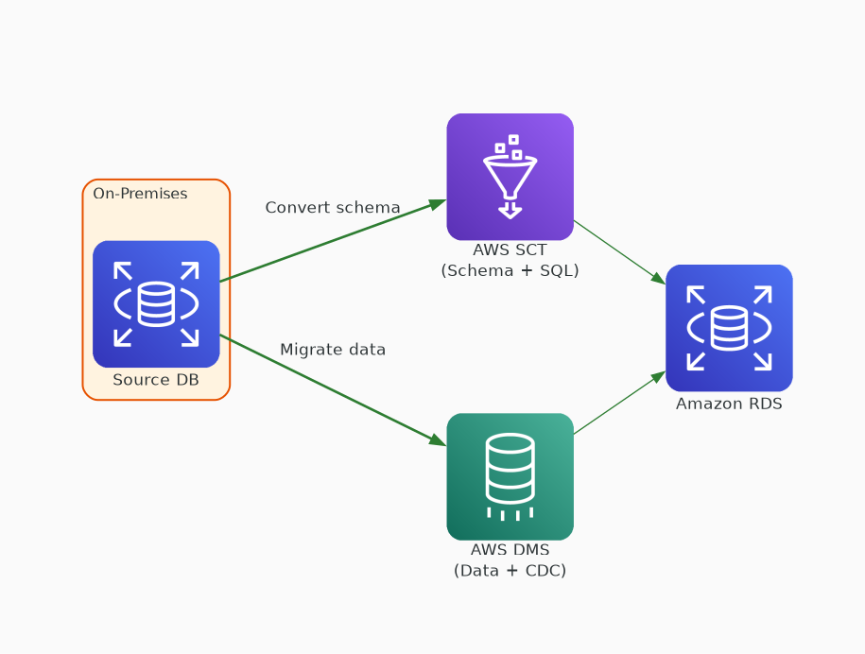
✓ CORRECT
Option C: Use the AWS Schema Conversion Tool (AWS SCT) to convert the database schema and then use AWS DMS to migrate the data.
Why this is correct:
• SCT auto-converts schema: DDL, stored procedures, views
• SCT scans application source code for embedded SQL
• SCT generates assessment report for manual items
• DMS handles data migration with full load + CDC

Slide 5
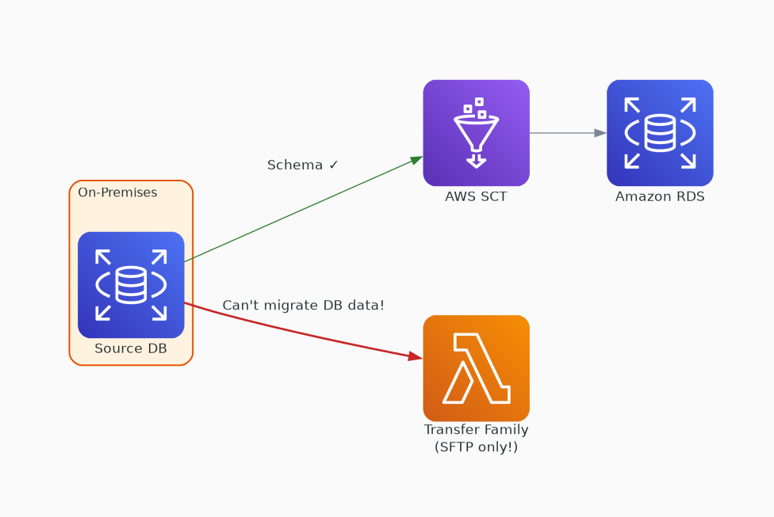
✗ INCORRECT
Option D: Use the AWS Schema Conversion Tool (AWS SCT) to convert the database schema, and then use the AWS Transfer Family to migrate the data.
Why this is incorrect:
• SCT for schema conversion is correct
• AWS Transfer Family is for SFTP/FTP file transfers to S3
• Transfer Family cannot migrate database data to RDS
• DMS is the correct service for database data migration

