Slide 1
S3 Storage Classes
⏱ TIME
A video streaming service stores large amounts of video content on Amazon S3. They have frequently accessed content that needs to be readily available and older content accessed once per quarter. The data engineer is tasked with optimizing storage costs while maintaining required performance. Which combination of Amazon S3 storage classes will meet the requirements in the most cost effective way?
A
S3 Standard for frequently accessed content and S3 Glacier Instant Retrieval for infrequently accessed content.
B
S3 Standard for frequently accessed content and S3 Infrequent-Access for infrequently accessed content.
C
S3 Glacier Instant Retrieval for frequently accessed content and S3 Glacier Deep Archive for infrequently accessed archive content.
D
S3 Standard-IA for frequently accessed content, S3 Glacier Instant Retrieval for infrequently accessed archive content.

Slide 2
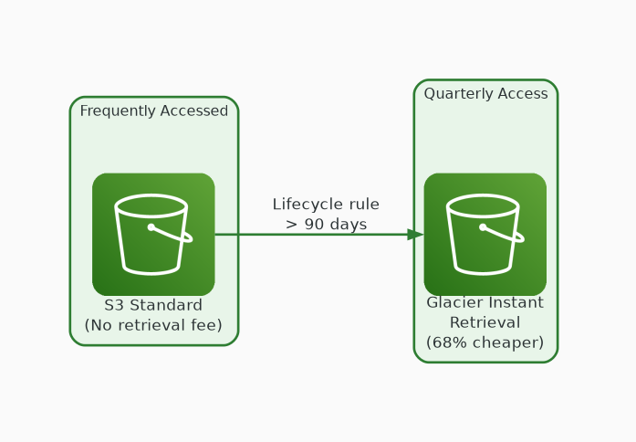
✓ CORRECT
Option A: S3 Standard for frequently accessed content and S3 Glacier Instant Retrieval for infrequently accessed content.
Why this is correct:
• S3 Standard for hot content — no retrieval fee
• Glacier Instant Retrieval saves 68% vs Standard-IA at quarterly access
• Still provides millisecond access — no latency trade-off
• AWS recommends this for data accessed once per quarter

Slide 3
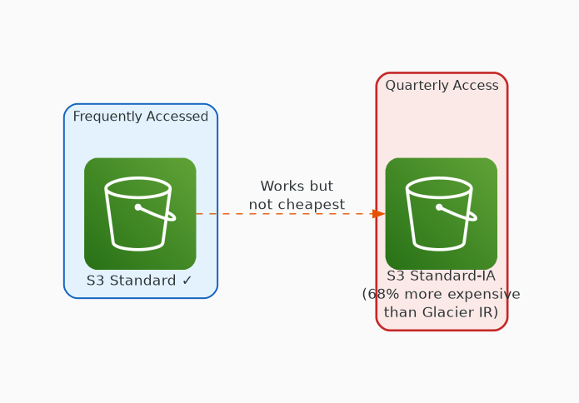
✗ INCORRECT
Option B: S3 Standard for frequently accessed content and S3 Infrequent-Access for infrequently accessed content.
Why this is incorrect:
• S3 Standard for hot content is correct
• Standard-IA costs 68% more than Glacier IR at quarterly access
• Standard-IA better suited for monthly access patterns
• Functional but not the MOST cost-effective option

Slide 4
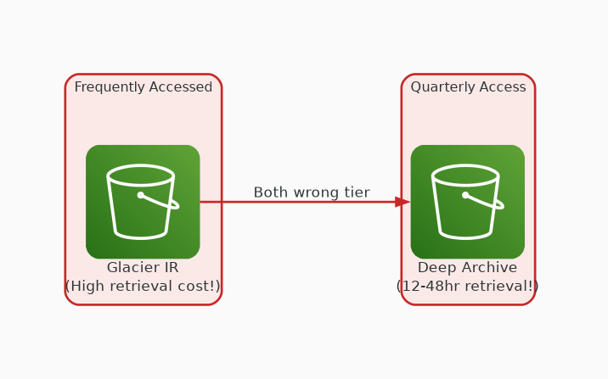
✗ INCORRECT
Option C: S3 Glacier Instant Retrieval for frequently accessed content and S3 Glacier Deep Archive for infrequently accessed archive content.
Why this is incorrect:
• Glacier IR NOT designed for frequently accessed content
• High retrieval costs on frequent access
• Deep Archive has 12-48 hour retrieval — too slow
• Frequently accessed content requires S3 Standard

Slide 5
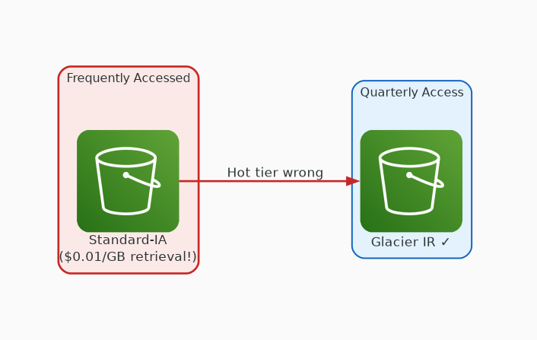
✗ INCORRECT
Option D: S3 Standard-IA for frequently accessed content, S3 Glacier Instant Retrieval for infrequently accessed archive content.
Why this is incorrect:
• Standard-IA NOT suitable for frequent access
• $0.01/GB retrieval fee accumulates quickly
• Glacier IR for quarterly content is correct
• But the hot tier choice is wrong — needs S3 Standard

