Slide 1
Athena Query Optimization
⏱ TIME
A sports organization stores extensive web server logs on Amazon S3 from historic sporting events and intends to analyze this data swiftly using Amazon Athena. The majority of their queries are operational, focusing on logs from a specific day or sporting match. How should the organization structure their log data in the MOST cost effective manner?
A
Keep logs in their original format and rely on Amazon Athena's automatic data partitioning.
B
Partition logs by year, then by month, and use gzip compression for each file.
C
Store all logs in a single, large file and use Athena's built-in query optimization features.
D
Partition logs by day and convert them into Apache Parquet format.

Slide 2
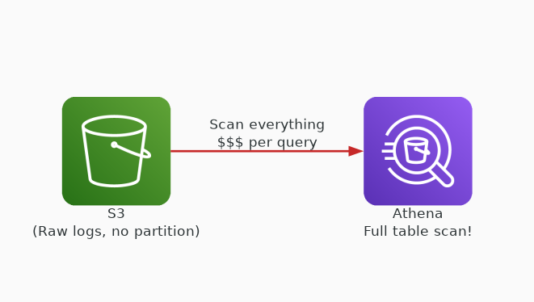
✗ INCORRECT
Option A: Keep logs in their original format and rely on Amazon Athena's automatic data partitioning.
Why this is incorrect:
• Athena does NOT automatically partition data
• Full table scans on raw format are expensive
• No compression or columnar optimization
• Highest cost per query of all options

Slide 3
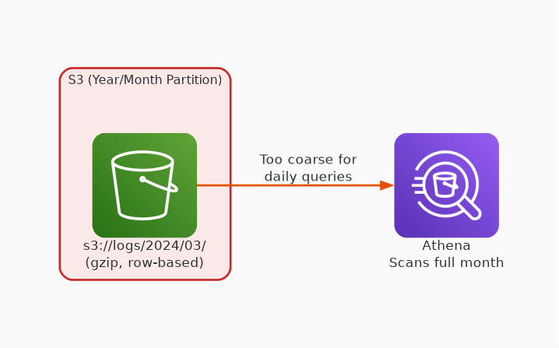
✗ INCORRECT
Option B: Partition logs by year, then by month, and use gzip compression for each file.
Why this is incorrect:
• Year/month partitioning is too coarse for daily queries
• Gzip is splittable but row-based — no column pruning
• Queries for a specific day still scan entire month
• Parquet + day partition is more cost-effective

Slide 4
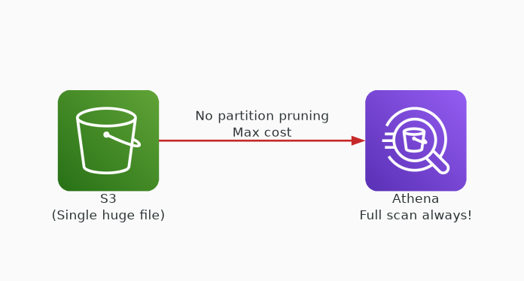
✗ INCORRECT
Option C: Store all logs in a single, large file and use Athena's built-in query optimization features.
Why this is incorrect:
• Single large file forces full scan on every query
• No partition pruning possible
• Athena charges per TB scanned — maximum cost
• Worst possible approach for cost optimization

Slide 5
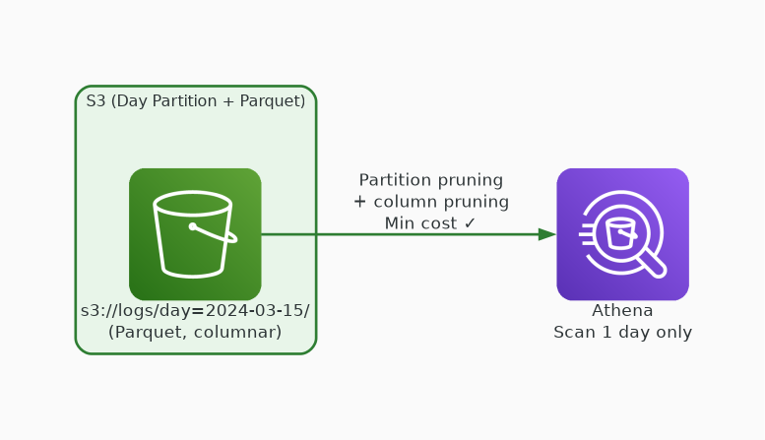
✓ CORRECT
Option D: Partition logs by day and convert them into Apache Parquet format.
Why this is correct:
• Day-level partitioning matches query patterns exactly
• Parquet is columnar — enables column pruning
• Parquet has built-in compression (snappy/zstd)
• Minimizes data scanned = minimizes Athena cost

