Slide 1
EMR Cost Optimization
⏱ TIME
A company recently migrated a batch job to an Amazon EMR cluster that uses On-Demand Instances. The job is critical to operations with an SLA of 3 hours and takes an average of 2 hours to complete. The company wants to reduce costs while minimizing impact on availability. Which combination of steps should a data analytics specialist take? (Select TWO)
A
Configure Amazon EMR to use instance fleets with a provisioning timeout for the core nodes.
B
Configure Amazon EMR uniform instance groups.
C
Change the instance purchasing option for core nodes from On-Demand Instances to Spot Instances.
D
Use Spot Instances for the task nodes.
E
Use Spot Instances for all node types in the cluster.

Slide 2
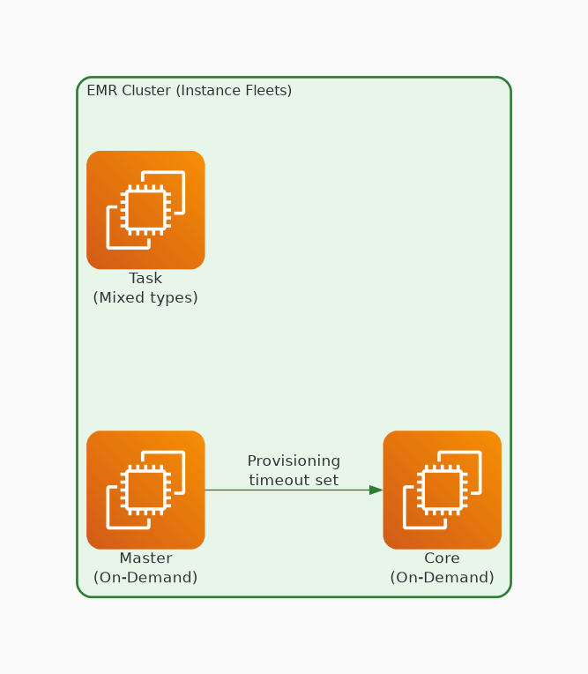
✓ CORRECT
Option A: Configure Amazon EMR to use instance fleets with a provisioning timeout for the core nodes.
Why this is correct:
• Instance fleets allow mixing instance types for availability
• Provisioning timeout ensures capacity is obtained within SLA
• Diversifies across instance types to reduce interruption risk
• Best practice for critical workloads needing cost savings

Slide 3
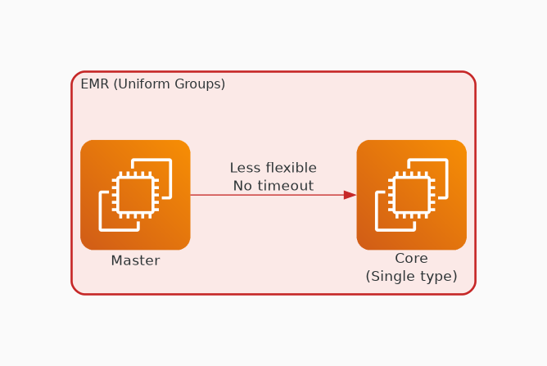
✗ INCORRECT
Option B: Configure Amazon EMR uniform instance groups.
Why this is incorrect:
• Uniform instance groups use single instance type
• Less flexible — higher risk of capacity unavailability
• No provisioning timeout capability
• Instance fleets are the better choice for cost optimization

Slide 4
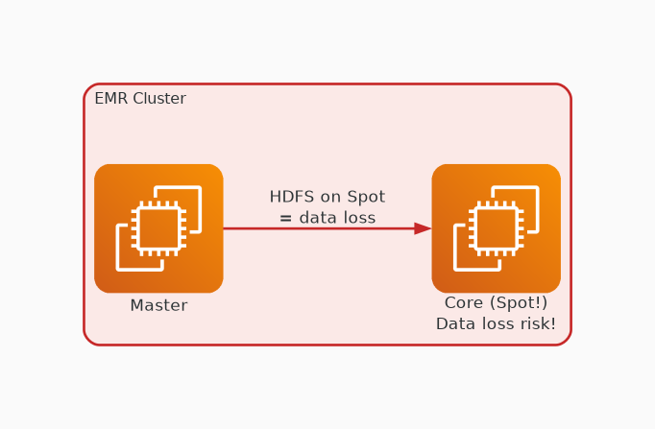
✗ INCORRECT
Option C: Change the instance purchasing option for core nodes from On-Demand Instances to Spot Instances.
Why this is incorrect:
• Core nodes store HDFS data — interruption causes data loss
• Spot interruption on core nodes can fail the entire job
• Critical workloads should keep core nodes on On-Demand
• Risk to availability is too high for a 3-hour SLA job

Slide 5
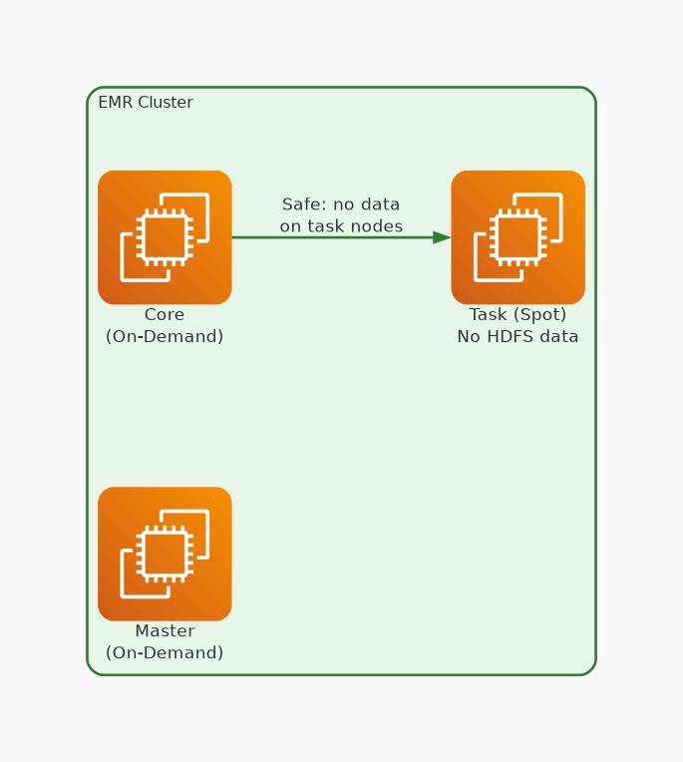
✓ CORRECT
Option D: Use Spot Instances for the task nodes.
Why this is correct:
• Task nodes only process data — no HDFS storage
• Spot interruption on task nodes doesn't lose data
• Significant cost savings with minimal availability risk
• Job continues on remaining nodes if Spot is reclaimed

Slide 6
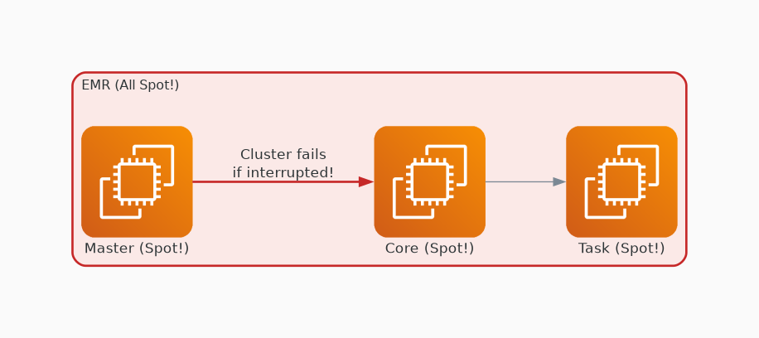
✗ INCORRECT
Option E: Use Spot Instances for all node types in the cluster.
Why this is incorrect:
• Master node on Spot = cluster failure if interrupted
• Core nodes on Spot = data loss risk
• Too risky for a critical job with 3-hour SLA
• Only task nodes are safe for Spot in critical workloads

