Slide 1
Glue Workflow Orchestration
⏱ TIME
A transportation company uses AWS Glue ETL jobs to run transformations on data lake data. A data engineer must visualize dependencies between transformations and run multiple transformations concurrently to reduce processing time. How can the data engineer meet these requirements with the LEAST operational overhead?
A
Use a scheduled trigger to start an AWS Glue workflow that will launch the required AWS Glue jobs.
B
Use Amazon EventBridge to schedule an event to initiate an AWS Lambda function that will launch the required AWS Glue jobs.
C
Use Amazon EventBridge to schedule an event to initiate an AWS Step Functions workflow that will launch the required AWS Glue jobs.
D
Launch an Amazon EC2 instance that runs Apache Airflow to start the required AWS Glue jobs.

Slide 2
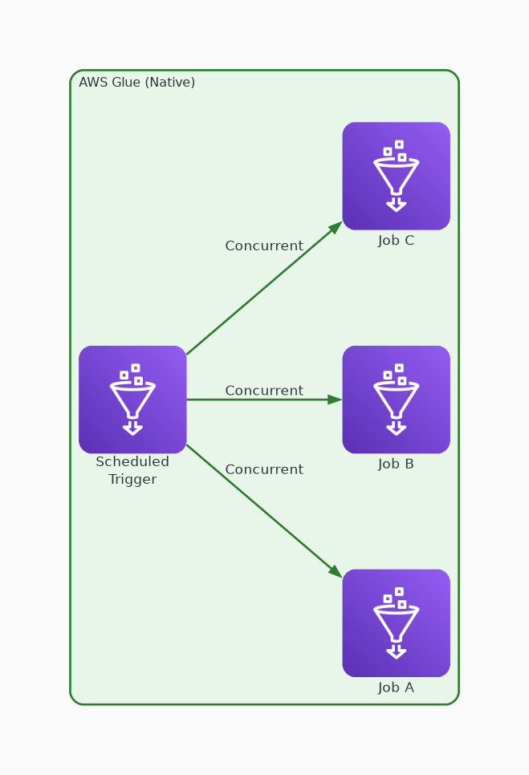
✓ CORRECT
Option A: Use a scheduled trigger to start an AWS Glue workflow that will launch the required AWS Glue jobs.
Why this is correct:
• Glue workflows natively visualize job dependencies
• Built-in concurrent execution of independent jobs
• Scheduled triggers are fully managed — no extra services
• Least operational overhead — single service solution

Slide 3
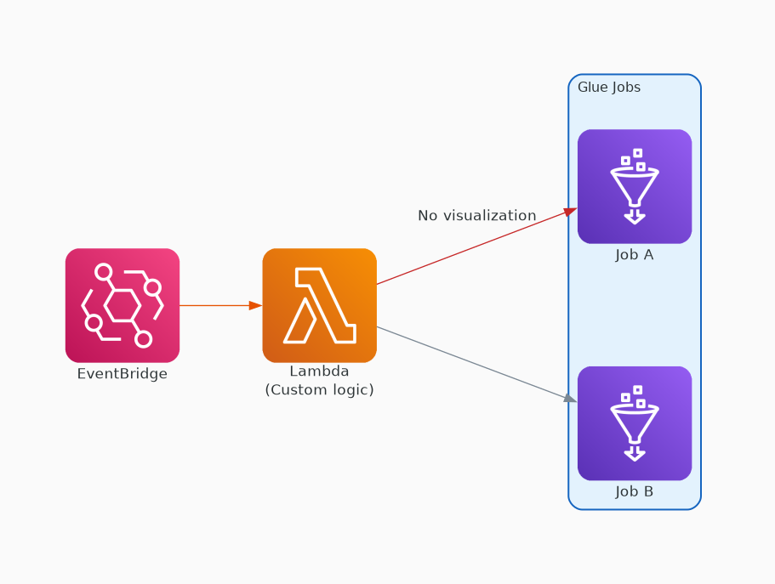
✗ INCORRECT
Option B: Use Amazon EventBridge to schedule an event to initiate an AWS Lambda function that will launch the required AWS Glue jobs.
Why this is incorrect:
• Lambda can start Glue jobs but no dependency visualization
• Must build custom orchestration logic in Lambda
• Additional service to manage (EventBridge + Lambda)
• More overhead than native Glue workflows

Slide 4
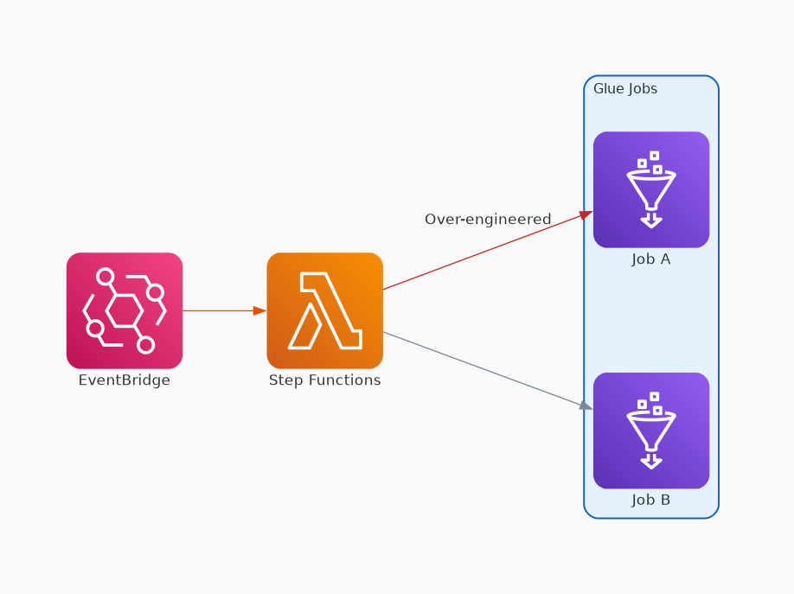
✗ INCORRECT
Option C: Use Amazon EventBridge to schedule an event to initiate an AWS Step Functions workflow that will launch the required AWS Glue jobs.
Why this is incorrect:
• Step Functions can orchestrate but adds complexity
• Two additional services (EventBridge + Step Functions)
• Glue workflows already provide this natively
• Over-engineered for Glue-to-Glue orchestration

Slide 5
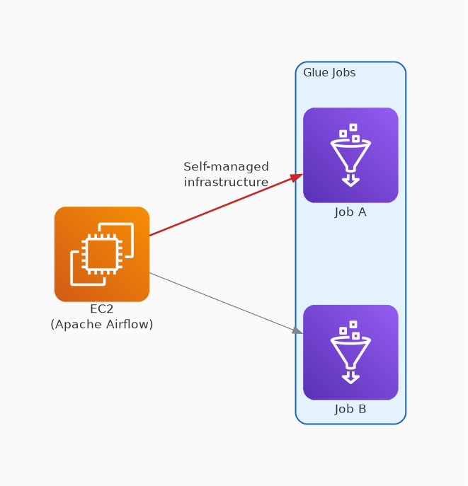
✗ INCORRECT
Option D: Launch an Amazon EC2 instance that runs Apache Airflow to start the required AWS Glue jobs.
Why this is incorrect:
• EC2 + Airflow requires infrastructure management
• OS patching, scaling, Airflow maintenance
• Highest operational overhead of all options
• Managed alternatives exist for this use case

