Slide 1
EMR Idle Cluster Termination
⏱ TIME
A company uses Amazon EMR clusters for workload analysis. Data engineers often forget to terminate clusters after work is complete, causing unnecessary costs. The company needs an automated solution to terminate idle clusters. Which solution meets these requirements?
A
Tag EMR clusters. Create a CloudWatch alarm on estimated monthly bill. When billing exceeds threshold, invoke a Lambda function to terminate clusters.
B
Configure a CloudWatch metrics alarm on the IsIdle metric from EMR clusters to publish to an SNS topic. Subscribe a Lambda function to terminate the clusters.
C
Implement a bash script on the primary node scheduled every 5 minutes to terminate clusters after 8 hours each day.
D
Use AWS Trusted Advisor cost optimization to check for idle EMR clusters. Terminate using the AWS CLI.

Slide 2
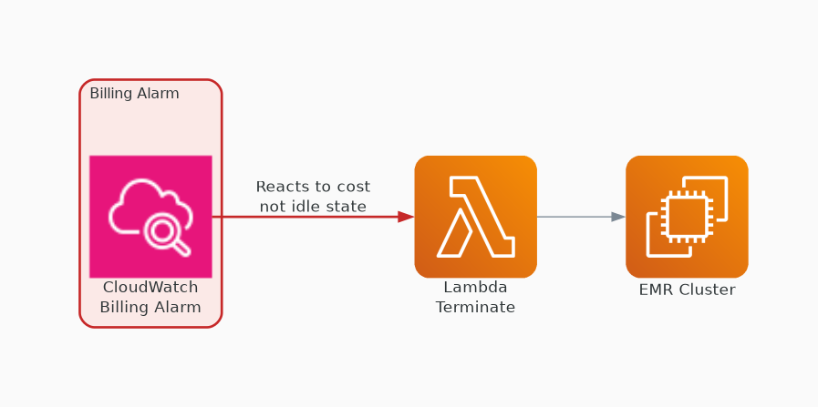
✗ INCORRECT
Option A: Tag EMR clusters. Create a CloudWatch alarm on estimated monthly bill. When billing exceeds threshold, invoke a Lambda function to terminate clusters.
Why this is incorrect:
• Billing alarms react to cost, not idle state
• Cluster may be idle long before billing threshold
• Not targeted — terminates based on cost not usage
• Delayed response — damage already done to budget

Slide 3
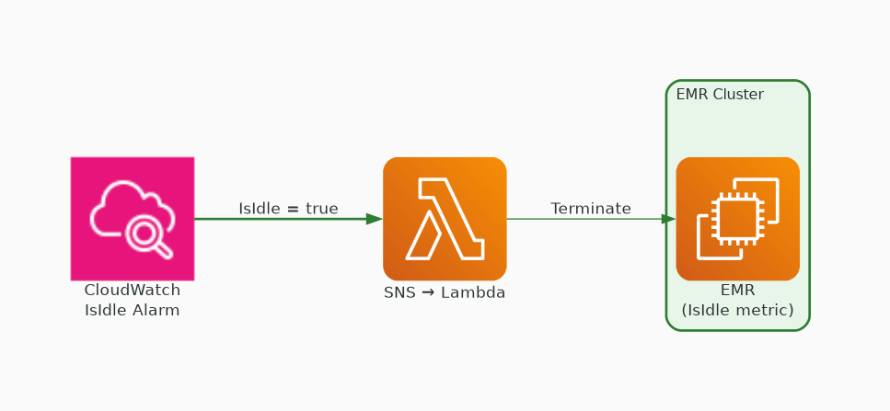
✓ CORRECT
Option B: Configure a CloudWatch metrics alarm on the IsIdle metric from EMR clusters to publish to an SNS topic. Subscribe a Lambda function to terminate the clusters.
Why this is correct:
• IsIdle is a native EMR CloudWatch metric
• Directly detects when cluster has no running jobs
• SNS + Lambda provides automated real-time response
• Purpose-built metric for exactly this use case

Slide 4
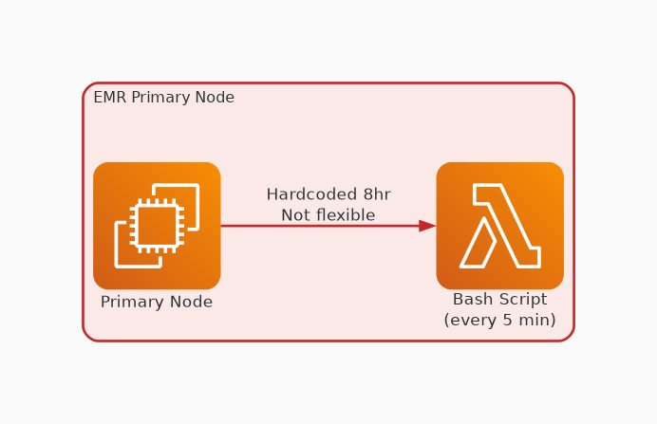
✗ INCORRECT
Option C: Implement a bash script on the primary node scheduled every 5 minutes to terminate clusters after 8 hours each day.
Why this is incorrect:
• Hardcoded 8-hour limit is arbitrary and inflexible
• Bash script on primary node is fragile
• Doesn't detect actual idle state
• Not a scalable or maintainable solution

Slide 5
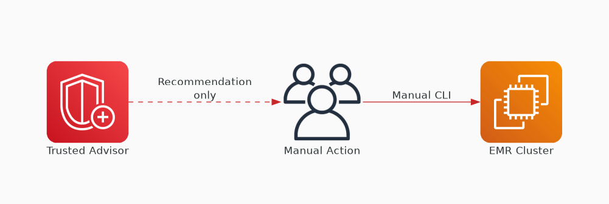
✗ INCORRECT
Option D: Use AWS Trusted Advisor cost optimization to check for idle EMR clusters. Terminate using the AWS CLI.
Why this is incorrect:
• Trusted Advisor provides recommendations, not automation
• Requires manual intervention to act on findings
• Not real-time — periodic checks only
• Doesn't meet the 'automated solution' requirement

