Slide 1
Redshift ML
⏱ TIME
A retail company uses Amazon Redshift for transactional data. They want to leverage machine learning models for insights. Data preparation and feature engineering are time-consuming. They need an efficient solution leveraging existing Redshift data. Which approach should you take?
A
Use Amazon Redshift ML to create and train machine learning models using SQL directly within Amazon Redshift.
B
Extract data from Redshift into S3, then use Amazon SageMaker to build, train, and deploy models.
C
Provision EC2 instances with Apache Spark, extract data from Redshift, and perform data preparation before training models.
D
Use AWS Glue to extract data from Redshift, perform transformation with Spark, then load into SageMaker for training.

Slide 2
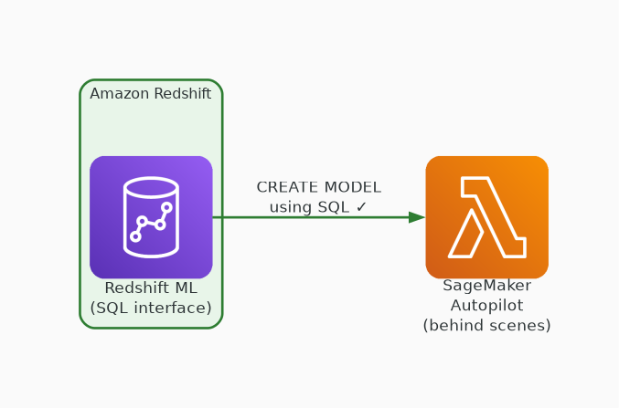
✓ CORRECT
Option A: Use Amazon Redshift ML to create and train machine learning models using SQL directly within Amazon Redshift.
Why this is correct:
• Redshift ML uses SQL — no data movement needed
• Automatically handles feature engineering
• Integrates with SageMaker Autopilot behind the scenes
• Most efficient — leverages existing data in place

Slide 3
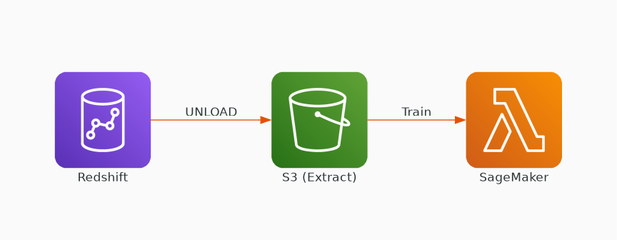
✗ INCORRECT
Option B: Extract data from Redshift into S3, then use Amazon SageMaker to build, train, and deploy models.
Why this is incorrect:
• Requires data extraction step to S3
• Additional data movement and storage costs
• More complex pipeline to manage
• Works but not the most efficient approach

Slide 4
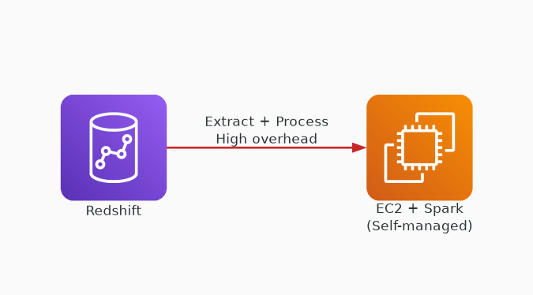
✗ INCORRECT
Option C: Provision EC2 instances with Apache Spark, extract data from Redshift, and perform data preparation before training models.
Why this is incorrect:
• Requires provisioning and managing EC2 infrastructure
• Manual data extraction and preparation
• Highest operational overhead
• Self-managed Spark adds significant complexity

Slide 5
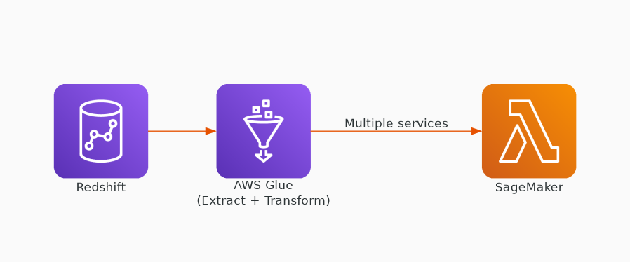
✗ INCORRECT
Option D: Use AWS Glue to extract data from Redshift, perform transformation with Spark, then load into SageMaker for training.
Why this is incorrect:
• Multiple services to orchestrate (Glue + SageMaker)
• Data must be extracted and transformed externally
• More operational overhead than Redshift ML
• Over-engineered when Redshift ML exists

