Slide 1
S3 Upload Integrity
⏱ TIME
An international investment banking firm frequently uploads 100 MB files to Amazon S3 for analysis with Amazon Athena. Recently, some uploads have become corrupted. They need to ensure successful upload and verify file contents remain unchanged from on-premises to S3. Which recommendation is the MOST cost effective?
A
Use the AWS CLI to upload files with the --sse parameter for server-side encryption, ensuring data integrity during transit.
B
Utilize the S3 Multipart upload feature with MD5 checksum validation for each part, providing a strong guarantee that files are uploaded successfully and remain unaltered.
C
Enable versioning on the S3 bucket to keep multiple versions of an object, allowing the company to revert to uncorrupted versions if necessary.
D
Implement S3 Transfer Acceleration to increase the speed of file transfers and reduce the likelihood of corruption due to connection issues.

Slide 2
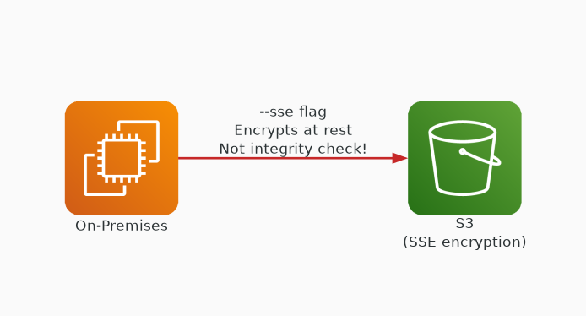
✗ INCORRECT
Option A: Use the AWS CLI to upload files with the --sse parameter for server-side encryption, ensuring data integrity during transit.
Why this is incorrect:
• SSE encrypts data at rest, not integrity validation
• Encryption doesn't detect or prevent upload corruption
• Doesn't verify content matches source
• Solves a different problem (confidentiality, not integrity)

Slide 3
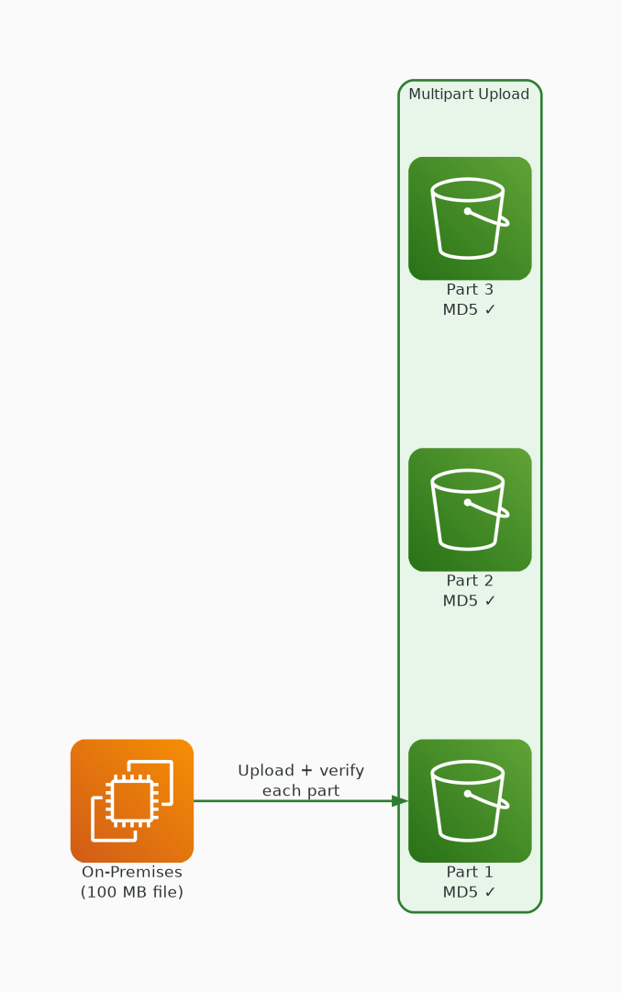
✓ CORRECT
Option B: Utilize the S3 Multipart upload feature with MD5 checksum validation for each part, providing a strong guarantee that files are uploaded successfully and remain unaltered.
Why this is correct:
• Multipart upload splits file into verifiable parts
• MD5 checksum validates each part independently
• S3 rejects parts that fail checksum — guarantees integrity
• 100 MB files benefit from parallel part uploads

Slide 4
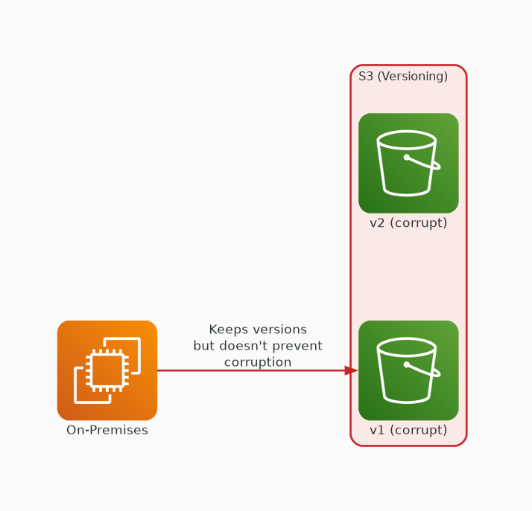
✗ INCORRECT
Option C: Enable versioning on the S3 bucket to keep multiple versions of an object, allowing the company to revert to uncorrupted versions if necessary.
Why this is incorrect:
• Versioning keeps old copies but doesn't prevent corruption
• Doesn't detect corruption at upload time
• Reactive approach — corruption already happened
• Adds storage cost without solving root cause

Slide 5
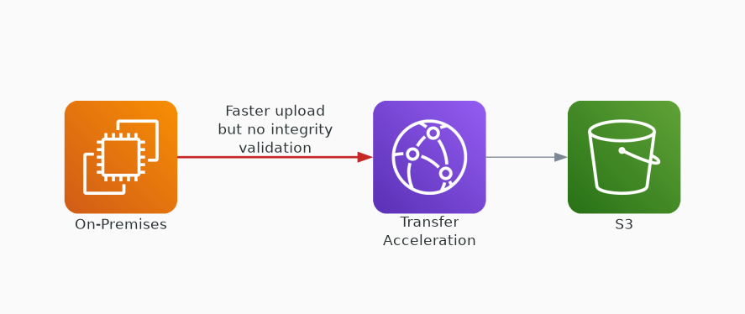
✗ INCORRECT
Option D: Implement S3 Transfer Acceleration to increase the speed of file transfers and reduce the likelihood of corruption due to connection issues.
Why this is incorrect:
• Transfer Acceleration speeds up uploads via edge locations
• Speed doesn't guarantee data integrity
• Doesn't validate content matches source
• Addresses latency, not corruption detection

