Slide 1
S3 Object Lambda
⏱ TIME
A data engineering team is building a real-time data processing pipeline where application logs stored in S3 need to be filtered and compressed using a custom algorithm before being delivered to downstream applications. The team wants to maintain the standard S3 API interface while adding this transformation capability. Which solution would best meet these requirements?
A
Use Amazon Athena with custom SQL queries
B
Implement client-side filtering with the S3 GET API
C
Configure S3 Object Lambda with a custom transformation function
D
Use Amazon EMR with Apache Spark for data transformation

Slide 2
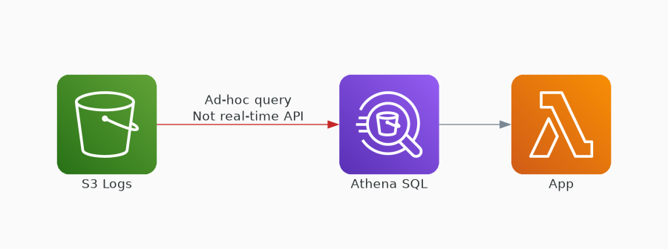
✗ INCORRECT
Option A: Use Amazon Athena with custom SQL queries
Why this is incorrect:
• Athena is for ad-hoc analytics, not real-time transformation
• Doesn't maintain standard S3 API interface
• Not designed for per-request data transformation
• Adds query overhead for simple filtering

Slide 3
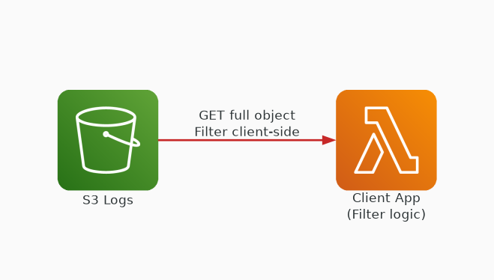
✗ INCORRECT
Option B: Implement client-side filtering with the S3 GET API
Why this is incorrect:
• Requires all clients to implement filtering logic
• Transfers full objects before filtering — wasteful
• Doesn't maintain transparent S3 API interface
• Pushes complexity to every downstream application

Slide 4
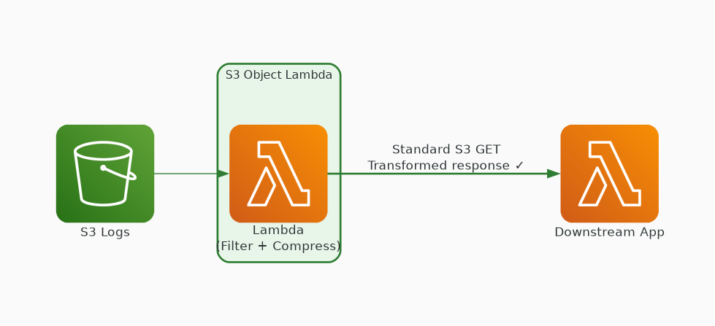
✓ CORRECT
Option C: Configure S3 Object Lambda with a custom transformation function
Why this is correct:
• Transforms data on-the-fly during S3 GET requests
• Maintains standard S3 API — transparent to clients
• Custom Lambda function applies filtering + compression
• Purpose-built for this exact use case

Slide 5
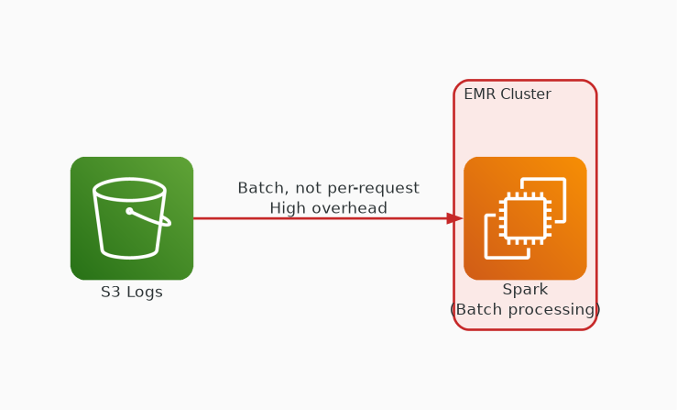
✗ INCORRECT
Option D: Use Amazon EMR with Apache Spark for data transformation
Why this is incorrect:
• EMR is for batch processing, not per-request transforms
• Requires cluster management — high overhead
• Doesn't maintain S3 API interface
• Over-engineered for filtering and compression

