Slide 1
Redshift Data Sharing
⏱ TIME
Your company operates a large e-commerce platform with multiple Redshift data warehouses. The marketing team needs read access to specific data sets for personalized recommendations without compromising security. Data must be up-to-date and consistent across all regions. Which approach would you recommend?
A
Create a separate Redshift cluster and export data from existing clusters to the new cluster for the marketing team.
B
Grant the marketing team's IAM roles access to existing Redshift clusters with specific SQL permissions.
C
Have the marketing team spin up a new Redshift cluster and use Amazon Redshift data sharing to securely share data across clusters.
D
Export data from Redshift to S3 using UNLOAD. Have the marketing team query S3 using Amazon Athena.

Slide 2
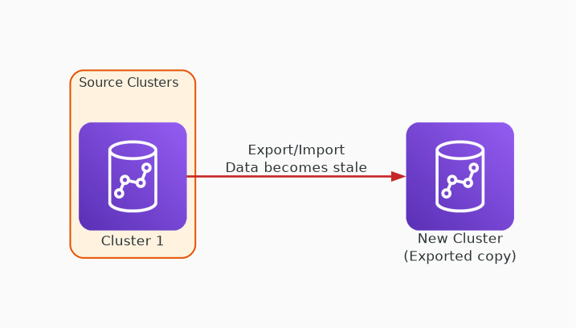
✗ INCORRECT
Option A: Create a separate Redshift cluster and export data from existing clusters to the new cluster for the marketing team.
Why this is incorrect:
• Requires data export/import — not real-time
• Data becomes stale immediately after export
• Duplicate storage costs
• Doesn't maintain consistency across regions

Slide 3
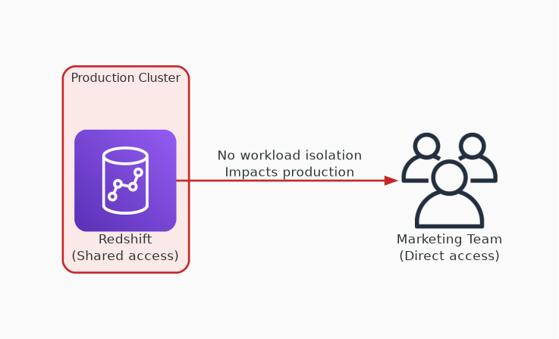
✗ INCORRECT
Option B: Grant the marketing team's IAM roles access to existing Redshift clusters with specific SQL permissions.
Why this is incorrect:
• Direct access to production clusters
• Marketing queries may impact production workloads
• No workload isolation
• Violates security and governance requirements

Slide 4
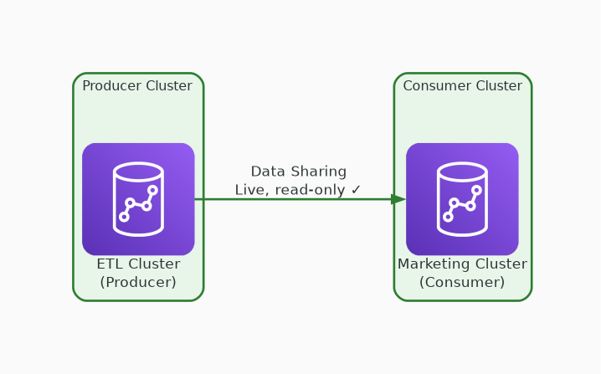
✓ CORRECT
Option C: Have the marketing team spin up a new Redshift cluster and use Amazon Redshift data sharing to securely share data across clusters.
Why this is correct:
• Data sharing provides live, read-only access
• No data copying — always up-to-date and consistent
• Workload isolation — separate compute for marketing
• Granular access control at schema/table level

Slide 5
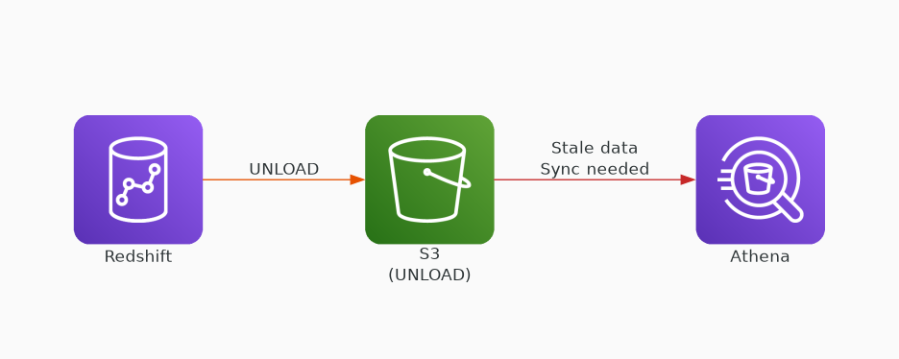
✗ INCORRECT
Option D: Export data from Redshift to S3 using UNLOAD. Have the marketing team query S3 using Amazon Athena.
Why this is incorrect:
• Data in S3 becomes stale after UNLOAD
• Requires ongoing sync pipeline to maintain freshness
• Athena query performance differs from Redshift
• Additional operational overhead for pipeline management

