Slide 1
Credential Management
⏱ TIME
A company runs a cloud-based application in EC2 backed by RDS for Microsoft SQL Server. The application stores confidential information. The company wants to eliminate the risk of credential exposure. Which solution will meet this requirement?
A
Use AWS IAM database authentication to configure authentication to the RDS for Microsoft SQL Server database.
B
Use AWS Systems Manager Parameter Store to store credentials. Configure automatic rotation every 30 days.
C
Use AWS Security Token Service (AWS STS) to configure authentication to the RDS for Microsoft SQL Server database.
D
Use AWS Secrets Manager to store the credentials. Configure automatic rotation every 30 days.

Slide 2
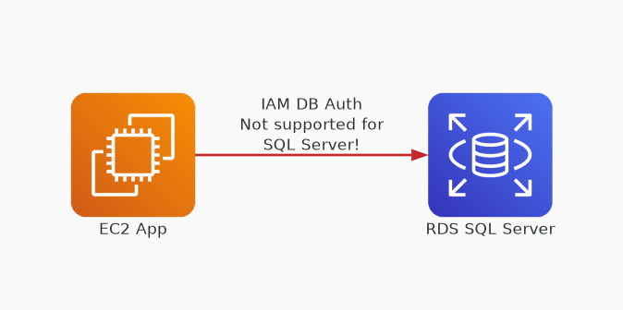
✗ INCORRECT
Option A: Use AWS IAM database authentication to configure authentication to the RDS for Microsoft SQL Server database.
Why this is incorrect:
• IAM database auth is NOT supported for SQL Server
• Only works with MySQL, PostgreSQL, and MariaDB on RDS
• Cannot be used for this specific database engine
• Common exam trap — know which engines support IAM auth

Slide 3
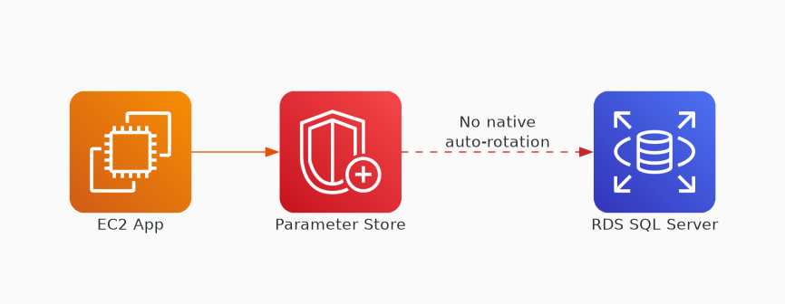
✗ INCORRECT
Option B: Use AWS Systems Manager Parameter Store to store credentials. Configure automatic rotation every 30 days.
Why this is incorrect:
• Parameter Store can store credentials securely
• Does NOT have built-in automatic rotation
• Rotation requires custom Lambda implementation
• More operational overhead than Secrets Manager

Slide 4
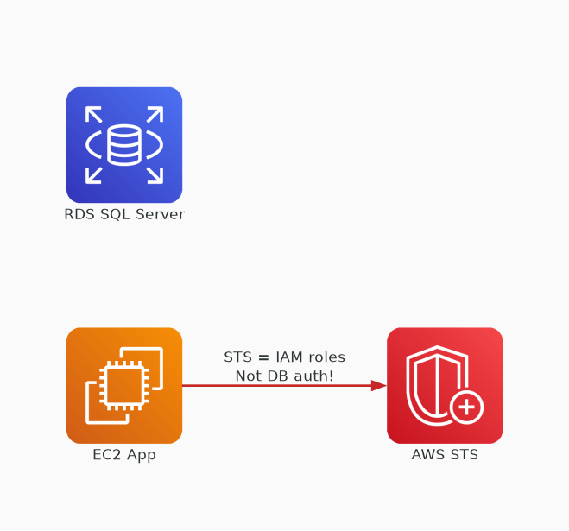
✗ INCORRECT
Option C: Use AWS Security Token Service (AWS STS) to configure authentication to the RDS for Microsoft SQL Server database.
Why this is incorrect:
• STS provides temporary security credentials for AWS services
• Cannot directly authenticate to RDS databases
• Designed for assuming IAM roles, not DB authentication
• Wrong service for database credential management

Slide 5
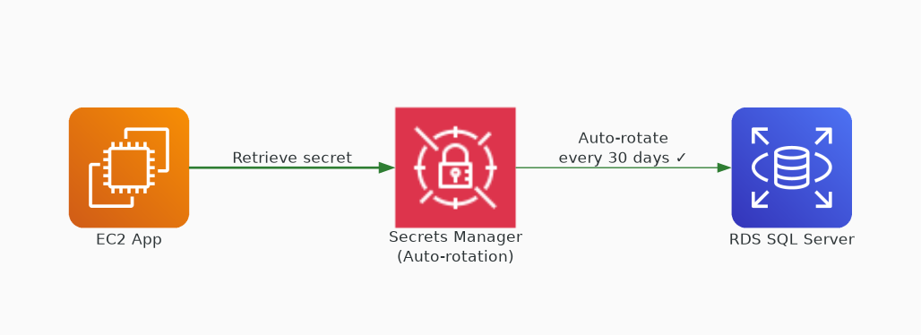
✓ CORRECT
Option D: Use AWS Secrets Manager to store the credentials. Configure automatic rotation every 30 days.
Why this is correct:
• Secrets Manager is purpose-built for credential management
• Native automatic rotation for RDS databases
• Supports SQL Server credential rotation out of the box
• Eliminates credential exposure with zero custom code

