Slide 1
Redshift Data Sharing (Cross-Account)
⏱ TIME
A data engineer needs to distribute processed data from a central Redshift ETL cluster to multiple BI teams across different AWS accounts and regions. Teams need different access levels, real-time updates without data copies, cost-effectiveness, and workload isolation. What is the most suitable approach?
A
Set up cross-region snapshot copies and restore them in each region.
B
Use Amazon Redshift data sharing with a central ETL cluster.
C
Implement real-time replication using AWS DMS.
D
Create separate ETL processes in each region.

Slide 2
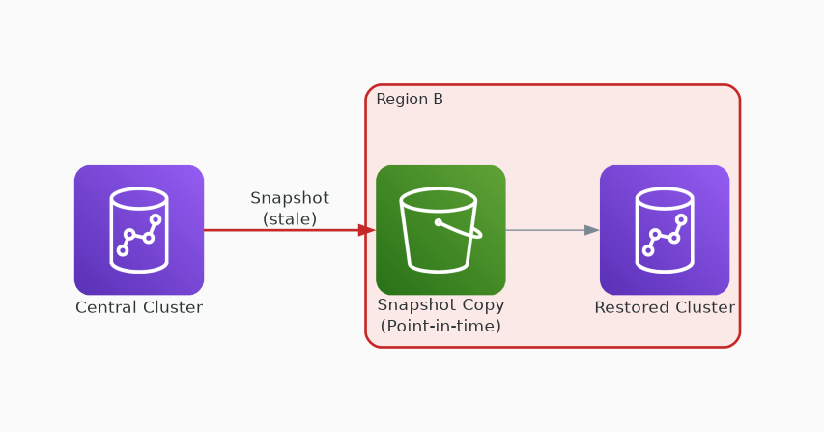
✗ INCORRECT
Option A: Set up cross-region snapshot copies and restore them in each region.
Why this is incorrect:
• Snapshots create point-in-time copies — not real-time
• Requires restore in each region — operational overhead
• Data becomes stale between snapshot intervals
• Storage duplication across regions increases cost

Slide 3
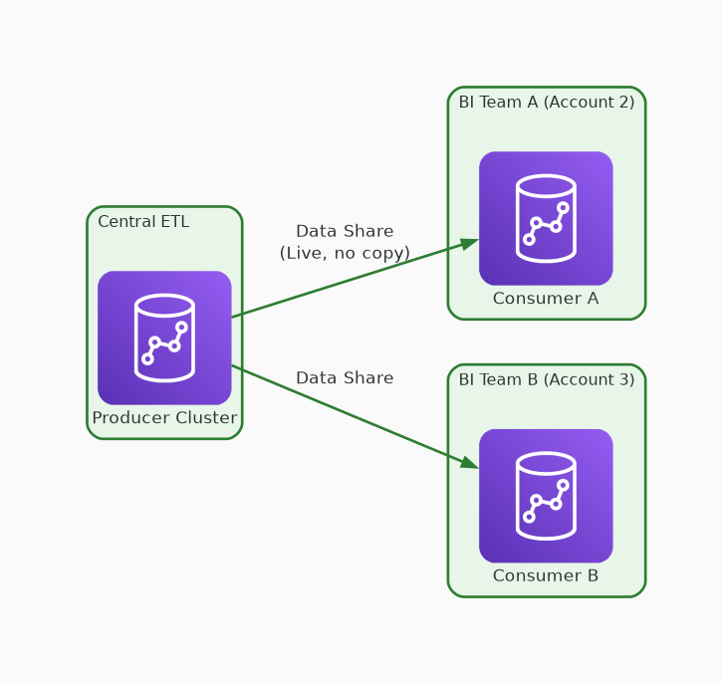
✓ CORRECT
Option B: Use Amazon Redshift data sharing with a central ETL cluster.
Why this is correct:
• Live data sharing — no copies, always current
• Supports cross-account and cross-region sharing
• Granular access control per consumer cluster
• Workload isolation with separate compute per team

Slide 4
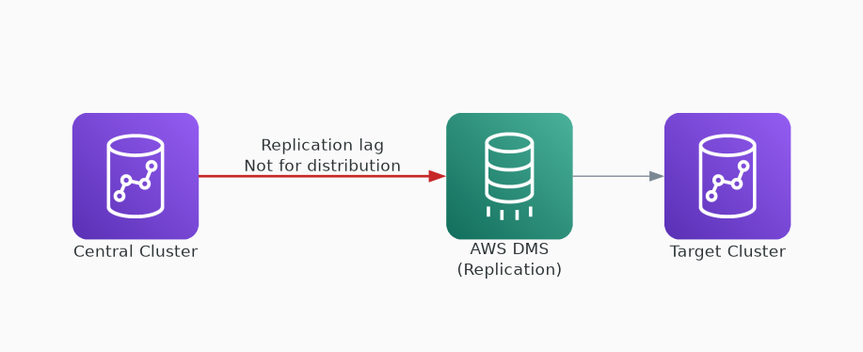
✗ INCORRECT
Option C: Implement real-time replication using AWS DMS.
Why this is incorrect:
• DMS is for database migration, not data distribution
• Adds replication lag and operational complexity
• Not designed for multi-consumer read access patterns
• Over-engineered for this use case

Slide 5
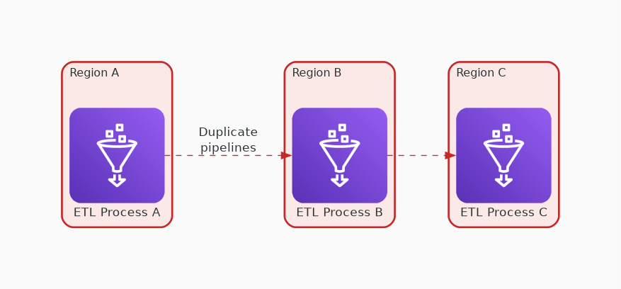
✗ INCORRECT
Option D: Create separate ETL processes in each region.
Why this is incorrect:
• Duplicate ETL pipelines in every region
• Highest operational overhead and cost
• Data inconsistency risk across regions
• Violates the 'no data copies' requirement

