Slide 1
Redshift Encryption Modification
⏱ TIME
A data engineer needs to enable encryption on an existing unencrypted Redshift cluster using RA3 nodes. The cluster processes critical financial data 24/7. They need to minimize downtime and maintain query capabilities during encryption. Which statement accurately describes the capabilities for this encryption modification?
A
The cluster must be completely stopped during encryption, and no queries can be run until the process is complete.
B
Only read queries can be executed during the encryption process, and write operations must be suspended.
C
Both read and write queries can continue during encryption with RA3 nodes, but elastic resize should be performed after encryption starts.
D
Both read and write queries can continue during encryption with RA3 nodes, but elastic resize should be performed before encryption starts.

Slide 2
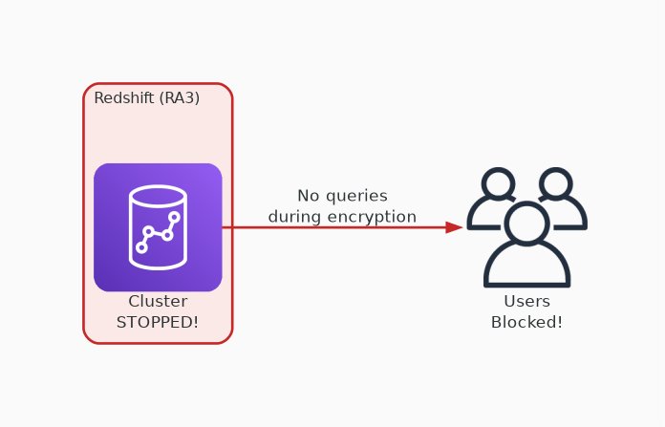
✗ INCORRECT
Option A: The cluster must be completely stopped during encryption, and no queries can be run until the process is complete.
Why this is incorrect:
• RA3 nodes support in-place encryption without stopping
• Cluster remains fully operational during encryption
• No downtime required for RA3 node types
• This was true for older node types, not RA3

Slide 3

✗ INCORRECT
Option B: Only read queries can be executed during the encryption process, and write operations must be suspended.
Why this is incorrect:
• RA3 supports both read AND write during encryption
• No need to suspend write operations
• Full query capability is maintained
• Overly restrictive — doesn't reflect RA3 capabilities

Slide 4
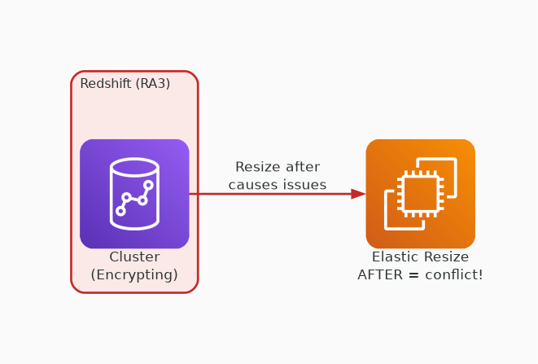
✗ INCORRECT
Option C: Both read and write queries can continue during encryption with RA3 nodes, but elastic resize should be performed after encryption starts.
Why this is incorrect:
• Read and write continuing is correct for RA3
• But elastic resize AFTER encryption causes issues
• Resize during encryption can conflict with the process
• Resize should be done BEFORE to avoid complications

Slide 5
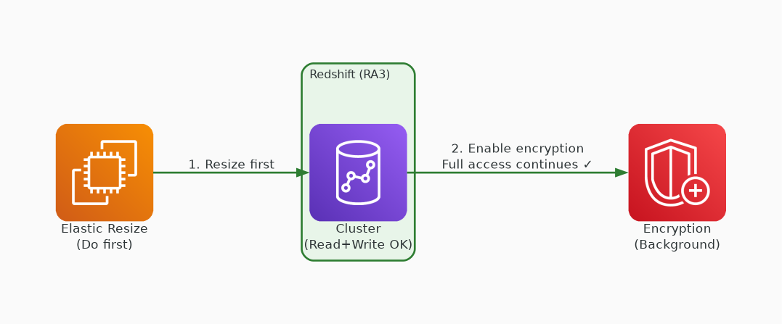
✓ CORRECT
Option D: Both read and write queries can continue during encryption with RA3 nodes, but elastic resize should be performed before encryption starts.
Why this is correct:
• RA3 nodes support full read/write during encryption
• Elastic resize before encryption avoids conflicts
• Encryption process runs in background on RA3
• Best practice: resize first, then enable encryption

