Slide 1
Lake Formation Permissions
⏱ TIME
A retail company manages a data lake with sensitive customer data. They use complex IAM roles and S3 bucket policies for access. They're experiencing challenges with permission management, especially column-level access for different analyst groups. Which solution would best address their needs following AWS best practices?
A
Create additional IAM roles with specific S3 bucket policies for each analyst group.
B
Implement AWS Lake Formation to manage permissions on Data Catalog resources and underlying S3 data.
C
Use AWS Secrets Manager to store access credentials for different analyst groups.
D
Configure VPC endpoints with custom route tables for controlled access to S3 buckets.

Slide 2
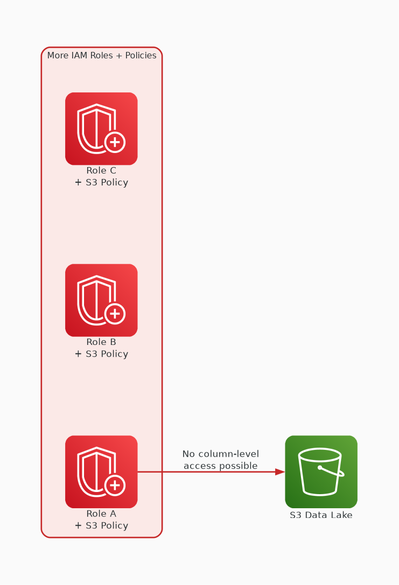
✗ INCORRECT
Option A: Create additional IAM roles with specific S3 bucket policies for each analyst group.
Why this is incorrect:
• More IAM roles adds to existing complexity
• S3 bucket policies cannot provide column-level access
• Doesn't simplify — makes the problem worse
• IAM + bucket policies is what they're trying to move away from

Slide 3
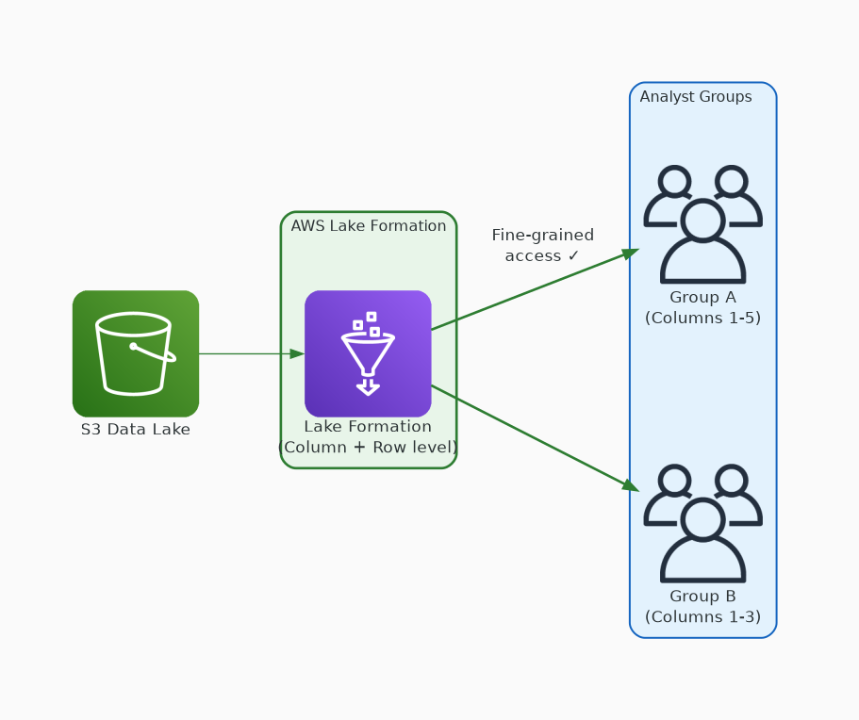
✓ CORRECT
Option B: Implement AWS Lake Formation to manage permissions on Data Catalog resources and underlying S3 data.
Why this is correct:
• Lake Formation provides centralized permission management
• Supports column-level and row-level access control
• Simplifies complex IAM/S3 policy combinations
• AWS recommended approach for data lake security

Slide 4
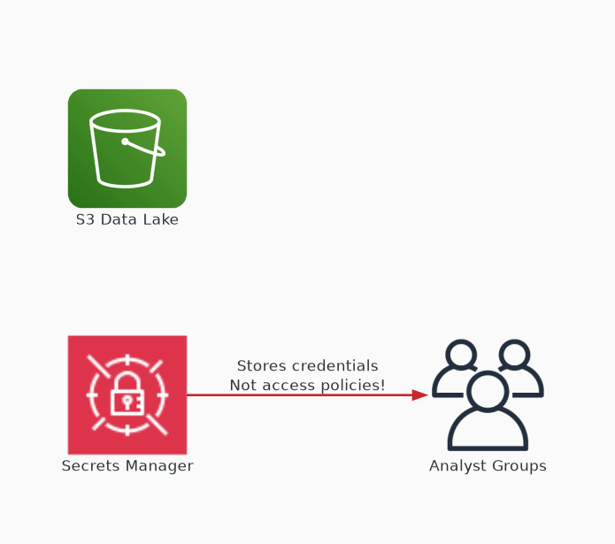
✗ INCORRECT
Option C: Use AWS Secrets Manager to store access credentials for different analyst groups.
Why this is incorrect:
• Secrets Manager stores credentials, not access policies
• Doesn't provide column-level access control
• Wrong tool — designed for secrets, not authorization
• Doesn't address the permission management challenge

Slide 5
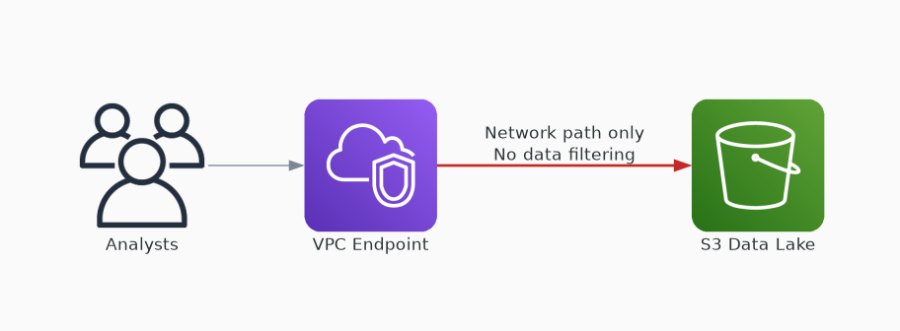
✗ INCORRECT
Option D: Configure VPC endpoints with custom route tables for controlled access to S3 buckets.
Why this is incorrect:
• VPC endpoints control network path, not data access
• Cannot provide column-level permissions
• Route tables don't filter data content
• Addresses network security, not data authorization

