Slide 1
Glue Data Catalog Encryption
⏱ TIME
A financial services company needs to implement encryption for their AWS Glue Data Catalog. They want full control over encryption keys, ability to rotate cryptographic material, modify key policies, and ensure audit logging support. What should they implement?
A
Customer managed keys with CloudTrail logging enabled.
B
AWS managed keys with CloudTrail logging enabled.
C
AWS managed keys with encryption context only.
D
Custom encryption keys stored in AWS Secrets Manager.

Slide 2
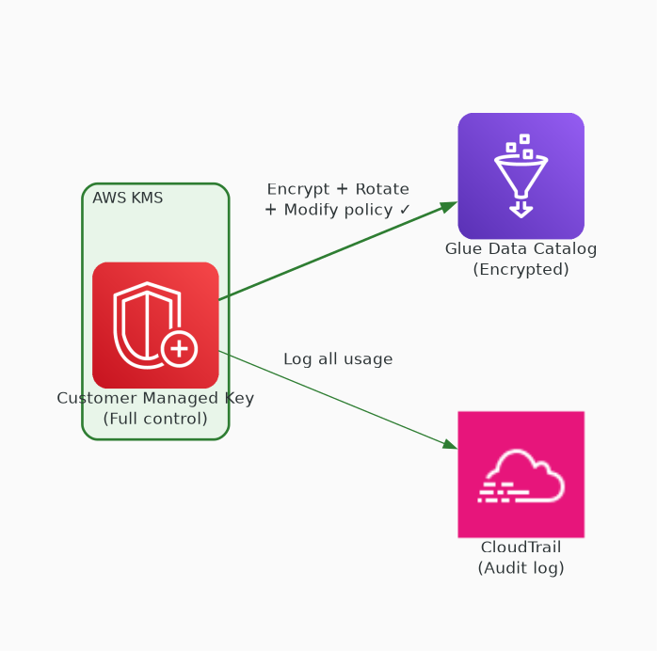
✓ CORRECT
Option A: Customer managed keys with CloudTrail logging enabled.
Why this is correct:
• Customer managed keys (CMK) provide full control
• Can rotate cryptographic material on schedule
• Can modify key policies and grant access
• CloudTrail logs all key usage for audit compliance

Slide 3
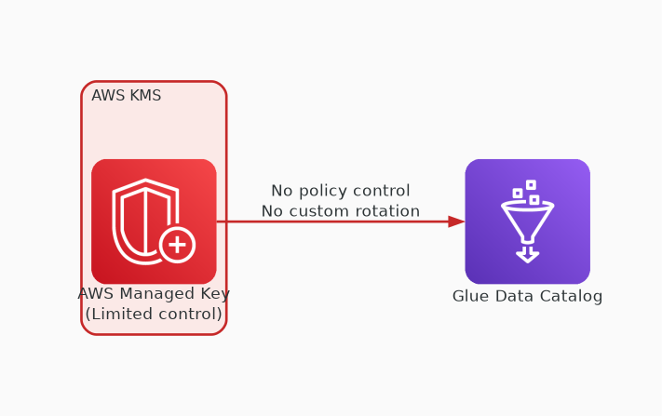
✗ INCORRECT
Option B: AWS managed keys with CloudTrail logging enabled.
Why this is incorrect:
• AWS managed keys don't allow key policy modification
• Cannot control rotation schedule
• Limited control over key lifecycle
• CloudTrail logging works but key control is insufficient

Slide 4
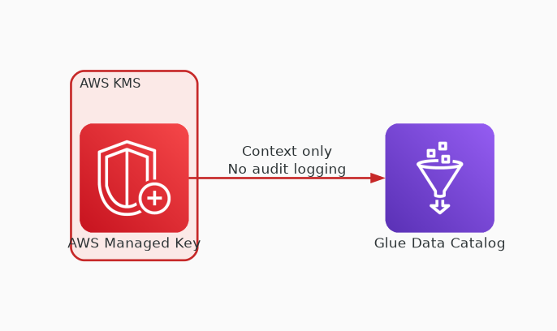
✗ INCORRECT
Option C: AWS managed keys with encryption context only.
Why this is incorrect:
• AWS managed keys lack required control
• Encryption context alone doesn't provide audit logging
• Cannot rotate or modify key policies
• Doesn't meet the full control requirement

Slide 5
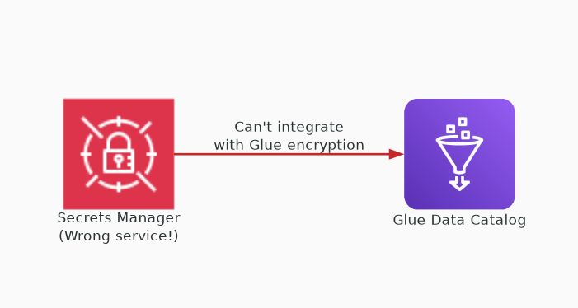
✗ INCORRECT
Option D: Custom encryption keys stored in AWS Secrets Manager.
Why this is incorrect:
• Secrets Manager stores secrets, not encryption keys
• KMS is the correct service for encryption key management
• Cannot integrate with Glue Data Catalog encryption
• Wrong service for this use case entirely

