Slide 1
S3 Dual-Layer Encryption
⏱ TIME
A healthcare company needs enhanced security for storing sensitive patient data in S3. Compliance requires multiple layers of encryption for all data at rest. The engineer wants to enforce dual-layer encryption for all objects uploaded to an S3 bucket. Which combination of services and configurations would meet these requirements?
A
Configure SSE-S3 encryption with S3 Bucket Keys enabled.
B
Use client-side encryption with AWS KMS keys before uploading to S3.
C
Implement DSSE-KMS encryption using AWS KMS keys in the same region as the bucket.
D
Enable both SSE-KMS and SSE-S3 encryption on the bucket simultaneously.

Slide 2
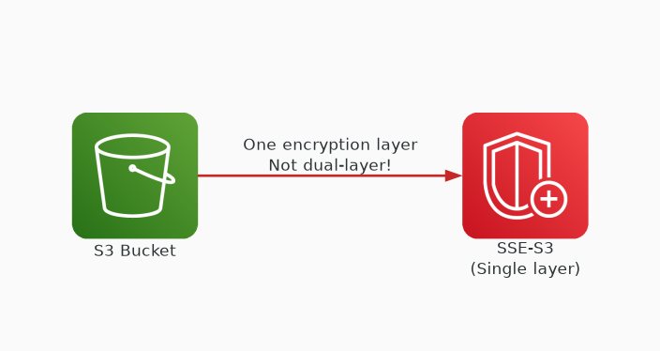
✗ INCORRECT
Option A: Configure SSE-S3 encryption with S3 Bucket Keys enabled.
Why this is incorrect:
• SSE-S3 is single-layer encryption only
• Bucket Keys optimize KMS costs but don't add layers
• Doesn't meet dual-layer encryption requirement
• Only one encryption layer applied

Slide 3
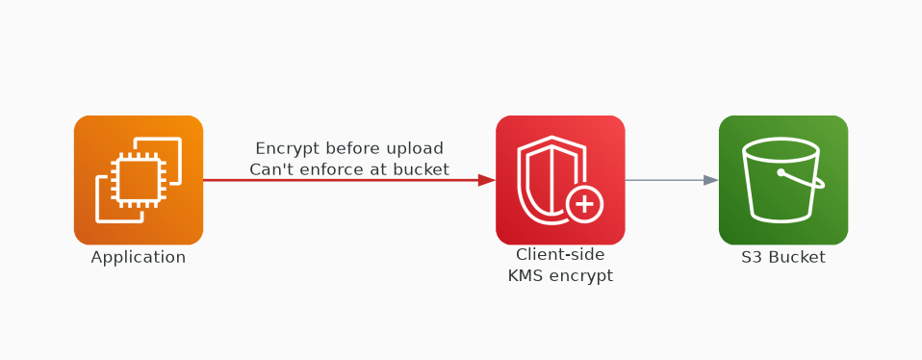
✗ INCORRECT
Option B: Use client-side encryption with AWS KMS keys before uploading to S3.
Why this is incorrect:
• Client-side + server-side could provide two layers
• But this is client-side only — not enforced at bucket level
• Cannot enforce via bucket policy alone
• Operational overhead managing client-side encryption

Slide 4
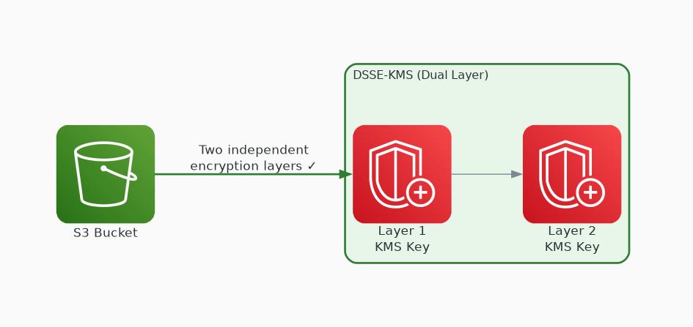
✓ CORRECT
Option C: Implement DSSE-KMS encryption using AWS KMS keys in the same region as the bucket.
Why this is correct:
• DSSE-KMS is purpose-built dual-layer server-side encryption
• Two independent layers of encryption applied automatically
• KMS keys in same region required for DSSE-KMS
• Can be enforced via bucket policy — meets compliance

Slide 5
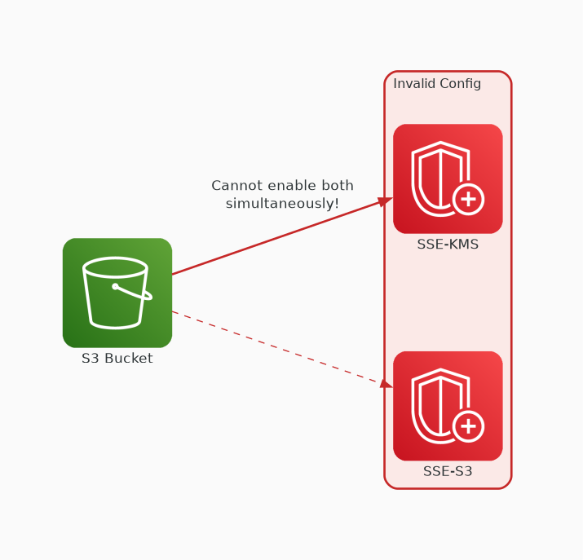
✗ INCORRECT
Option D: Enable both SSE-KMS and SSE-S3 encryption on the bucket simultaneously.
Why this is incorrect:
• S3 doesn't support enabling two SSE types simultaneously
• Must choose one server-side encryption method per object
• This configuration is not technically possible
• Invalid approach — S3 rejects conflicting encryption settings

