Slide 1
Session 1 - Question 1
⏱ TIME
As a developer you are tasked with creating an application so that your customers can leverage your microservices by making HTTP API calls. Your goal is to create an event-driven architecture to support this application. What combination of AWS Services can you use so that your customers can make the HTTP API calls, serverless compute containing the business logic processes the incoming API calls, and the corresponding microservices data can be persistently stored? (SELECT THREE)
A
Amazon CloudWatch
B
Amazon API Gateway
C
AWS Secrets Manager
D
Amazon DynamoDB
E
AWS Lambda
F
AWS Elastic Beanstalk

Slide 2
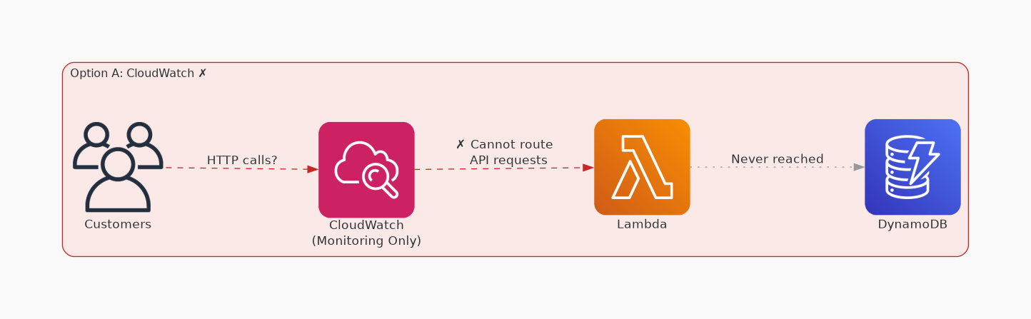
✗ INCORRECT
Option A: Amazon CloudWatch
Why this is incorrect:
• While Amazon CloudWatch is a monitoring service for AWS resources and applications, it is not directly related to creating an event-driven architecture for handling HTTP API calls and persistently storing microservices data.

Slide 3
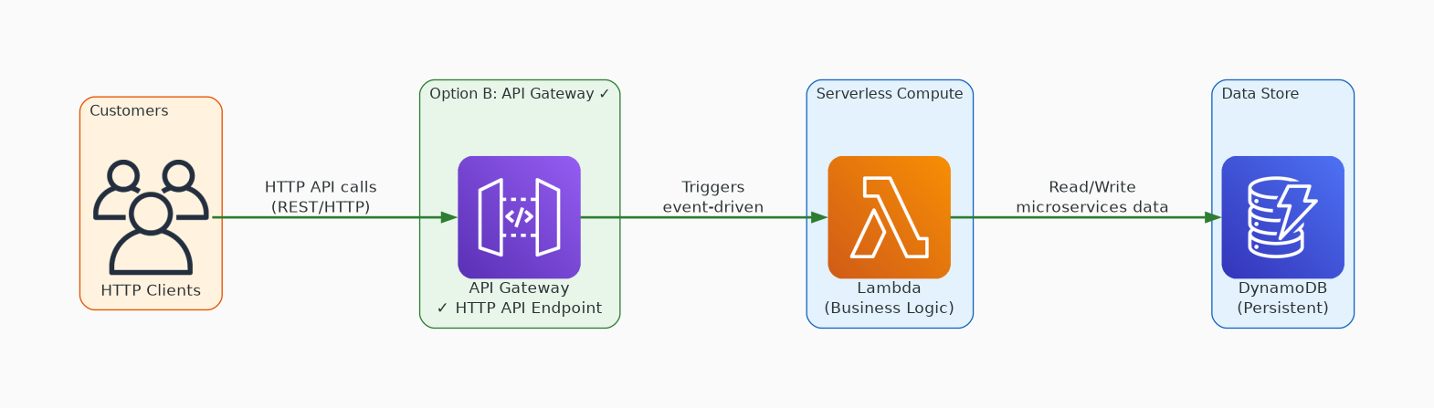
✓ CORRECT
Option B: Amazon API Gateway
Why this is correct:
• Amazon API Gateway allows you to create, publish, maintain, monitor, and secure APIs at any scale.
• It enables customers to make HTTP API calls to interact with your application.

Slide 4
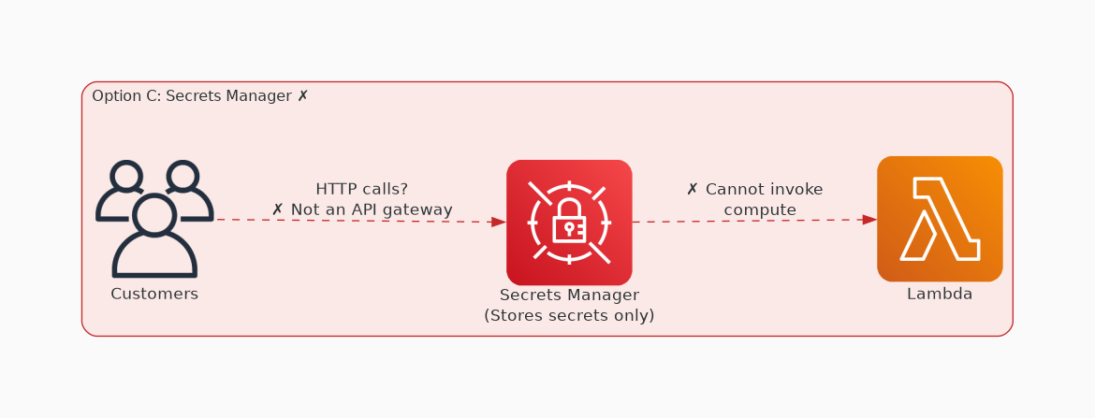
✗ INCORRECT
Option C: AWS Secrets Manager
Why this is incorrect:
• AWS Secrets Manager is a service that helps you protect access to your applications, services, and IT resources.
• While it plays a crucial role in managing secrets, it is not directly involved in creating an event-driven architecture for handling HTTP API calls and persistently storing microservices data.

Slide 5
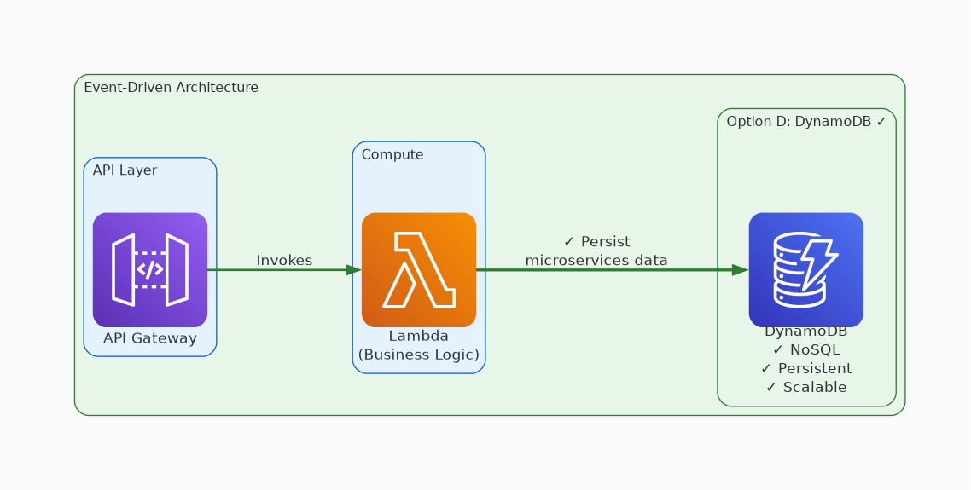
✓ CORRECT
Option D: Amazon DynamoDB
Why this is correct:
• Amazon DynamoDB is a fully managed NoSQL database service that provides fast and predictable performance with seamless scalability.
• It can persistently store the microservices data.

Slide 6
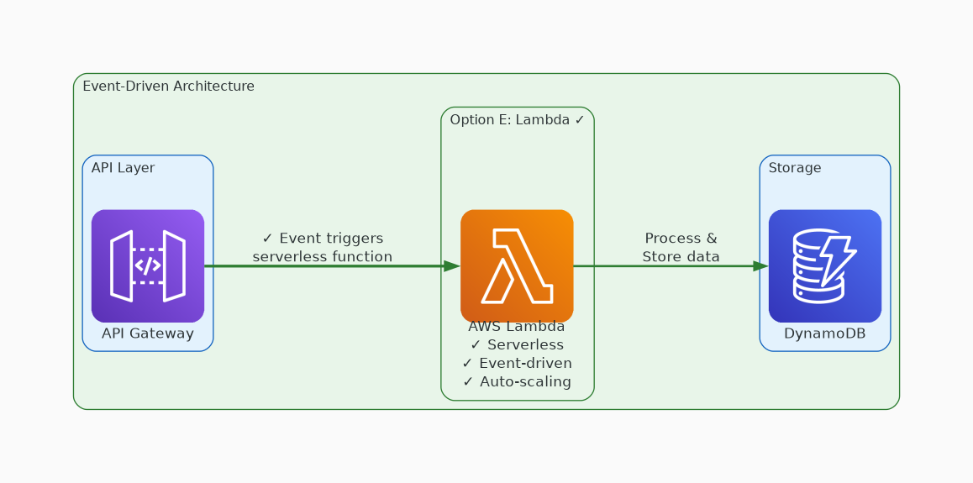
✓ CORRECT
Option E: AWS Lambda
Why this is correct:
• AWS Lambda is a serverless compute service that runs your code in response to events and automatically scales to handle them.
• It can contain the business logic processes for handling the incoming API calls without provisioning or managing servers.

Slide 7
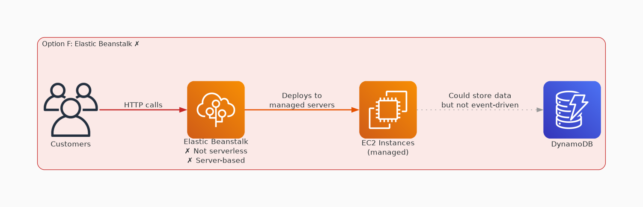
✗ INCORRECT
Option F: AWS Elastic Beanstalk
Why this is incorrect:
• AWS Elastic Beanstalk is an easy-to-use service for deploying and scaling web applications and services.
• However, it is not specifically designed for creating event-driven architectures or handling HTTP API calls and persistently storing microservices data in a serverless manner.

