Slide 1
Session 1 - Question 3
⏱ TIME
A company has an inventory system that receives sporadic inventory updates from a fulfillment system in the form of large JSON files. While many files can be sent in a short time period, days can pass when no files are sent. The company wants to process these files as soon as they arrive. Which solution will meet these requirements?
A
Sending the JSON files to Amazon Elastic File System (Amazon EFS) and configuring an AWS Lambda function with an Amazon EFS event source: While this option uses Amazon EFS for file storage, it does not address the requirement to process the files as soon as they arrive. Additionally, using an EFS event source would require the Lambda function to wait for files to be written to the EFS, rather than triggering the function immediately upon file upload.
B
Sending the JSON files to Amazon Elastic File System (Amazon EFS) and scheduling an AWS Lambda function to process the files once each hour: This option does not meet the requirement to process the files as soon as they arrive. Additionally, scheduling the Lambda function to run once each hour may result in delays in processing the files, especially during periods when no files are sent for days.
C
Send the JSON files to an Amazon S3 bucket. Configure an AWS Lambda function with an S3 event source to process the S3 objects.
D
Sending the JSON files to an Amazon S3 bucket and scheduling an AWS Lambda function to process the S3 objects once each hour: Similar to option B, this solution does not meet the requirement to process the files as soon as they arrive. Additionally, scheduling the Lambda function to run once each hour may introduce delays in processing the files, especially during periods when no files are sent for days.

Slide 2
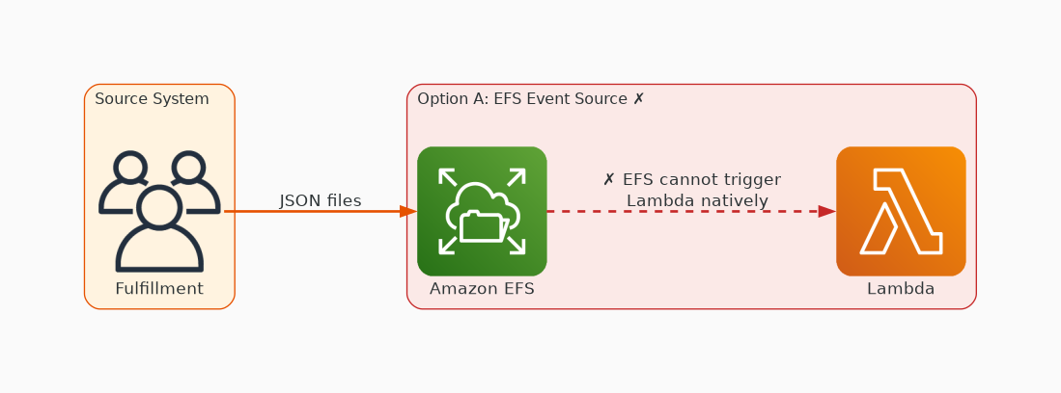
✗ INCORRECT
Option A: Sending the JSON files to Amazon Elastic File System (Amazon EFS) and configuring an AWS Lambda function with an Amazon EFS event source: While this option uses Amazon EFS for file storage, it does not address the requirement to process the files as soon as they arrive. Additionally, using an EFS event source would require the Lambda function to wait for files to be written to the EFS, rather than triggering the function immediately upon file upload.
Why this is incorrect:
• Sending the JSON files to Amazon Elastic File System (Amazon EFS) and configuring an AWS Lambda function with an Amazon EFS event source: While this option uses Amazon EFS for file storage, it does not address the requirement to process the files as soon as they arrive.
• Additionally, using an EFS event source would require the Lambda function to wait for files to be written to the EFS, rather than triggering the function immediately upon file upload.

Slide 3
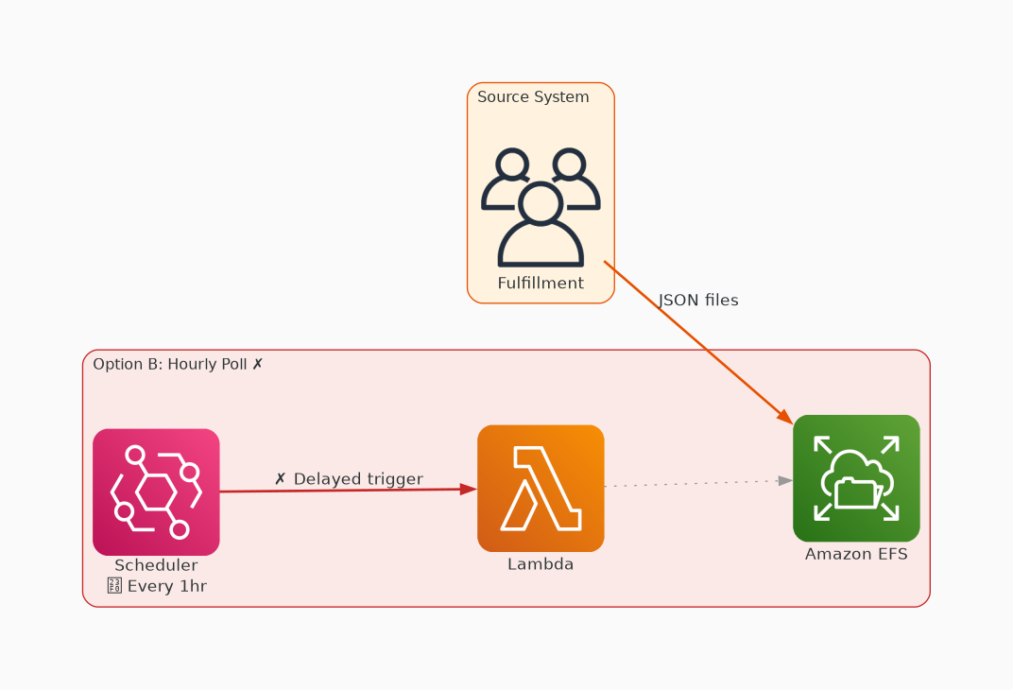
✗ INCORRECT
Option B: Sending the JSON files to Amazon Elastic File System (Amazon EFS) and scheduling an AWS Lambda function to process the files once each hour: This option does not meet the requirement to process the files as soon as they arrive. Additionally, scheduling the Lambda function to run once each hour may result in delays in processing the files, especially during periods when no files are sent for days.
Why this is incorrect:
• Sending the JSON files to Amazon Elastic File System (Amazon EFS) and scheduling an AWS Lambda function to process the files once each hour: This option does not meet the requirement to process the files as soon as they arrive.
• Additionally, scheduling the Lambda function to run once each hour may result in delays in processing the files, especially during periods when no files are sent for days.

Slide 4
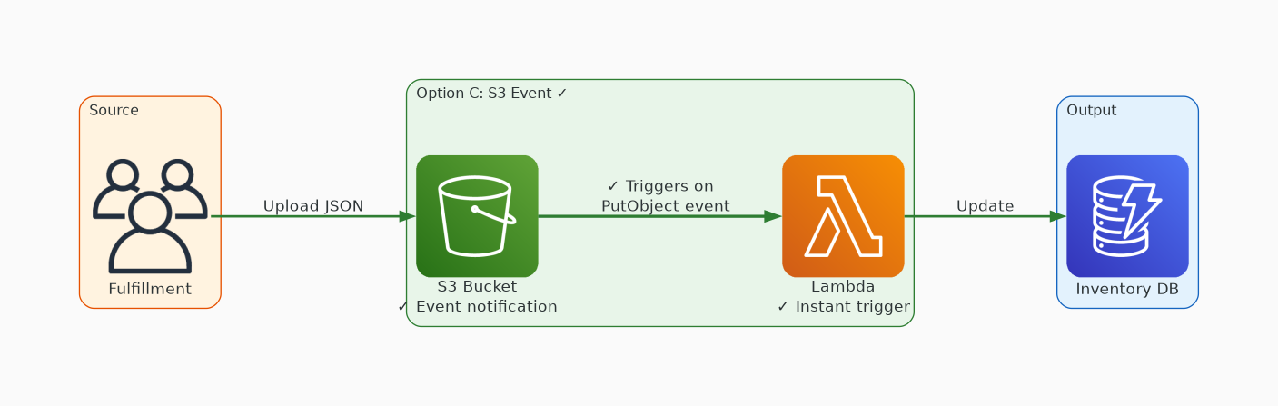
✓ CORRECT
Option C: Send the JSON files to an Amazon S3 bucket. Configure an AWS Lambda function with an S3 event source to process the S3 objects.
Why this is correct:
• Send the JSON files to an Amazon S3 bucket.
• Configure an AWS Lambda function with an S3 event source to process the S3 objects.
• This solution meets the requirements because it leverages Amazon S3, a highly durable object storage service, to store the JSON files.
• AWS Lambda can be configured with an S3 event source, allowing it to process the files as soon as they are uploaded to the S3 bucket.
• This ensures that the files are processed promptly upon arrival, even if there are days when no files are sent.

Slide 5
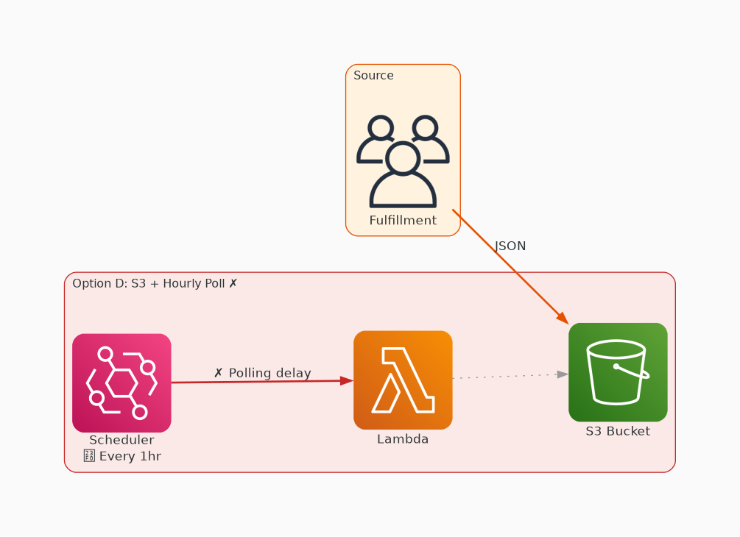
✗ INCORRECT
Option D: Sending the JSON files to an Amazon S3 bucket and scheduling an AWS Lambda function to process the S3 objects once each hour: Similar to option B, this solution does not meet the requirement to process the files as soon as they arrive. Additionally, scheduling the Lambda function to run once each hour may introduce delays in processing the files, especially during periods when no files are sent for days.
Why this is incorrect:
• Sending the JSON files to an Amazon S3 bucket and scheduling an AWS Lambda function to process the S3 objects once each hour: Similar to option B, this solution does not meet the requirement to process the files as soon as they arrive.
• Additionally, scheduling the Lambda function to run once each hour may introduce delays in processing the files, especially during periods when no files are sent for days.

