Slide 1
Session 1 - Question 4
⏱ TIME
An application running on Amazon EC2 instances processes sensitive information stored on Amazon S3. The information is accessed over the Internet. The security team is concerned that the Amazon EC2 instance connectivity to the to Amazon S3 bucket is a security risk. Which solution will resolve the security concern?
A
Configuring the EC2 instance to access the data through an Internet Gateway: This option does not address the security concern, as it would still require the EC2 instance to access S3 over the public Internet, which poses a security risk.
B
Configuring the EC2 instance to access the data through a VPN connection: While a VPN connection can provide secure access to resources over the Internet, it does not eliminate the security risk associated with accessing S3 over the public Internet.
C
Configuring the EC2 instance to access the data through a NAT Gateway: NAT Gateway allows instances in a private subnet to initiate outbound traffic to the Internet, but it does not provide a secure way to access resources like Amazon S3.
D
Configure the EC2 instance to access the data through a VPC endpoint for Amazon S3.

Slide 2
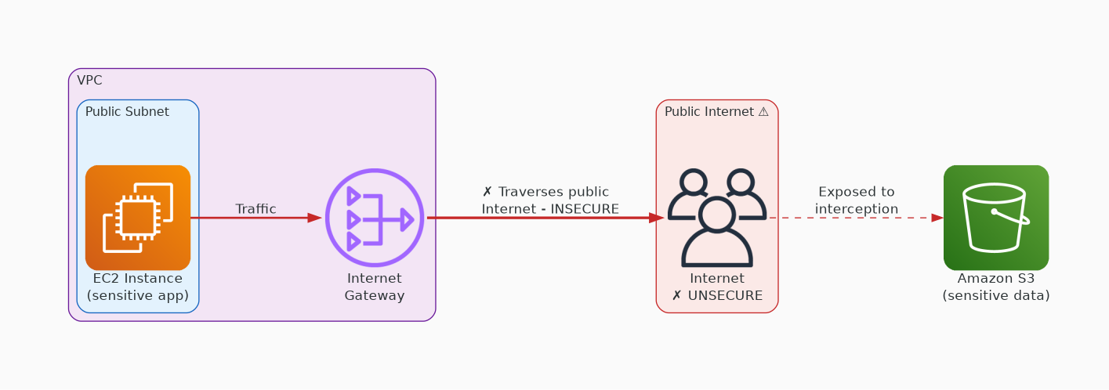
✗ INCORRECT
Option A: Configuring the EC2 instance to access the data through an Internet Gateway: This option does not address the security concern, as it would still require the EC2 instance to access S3 over the public Internet, which poses a security risk.
Why this is incorrect:
• Configuring the EC2 instance to access the data through an Internet Gateway: This option does not address the security concern, as it would still require the EC2 instance to access S3 over the public Internet, which poses a security risk.

Slide 3
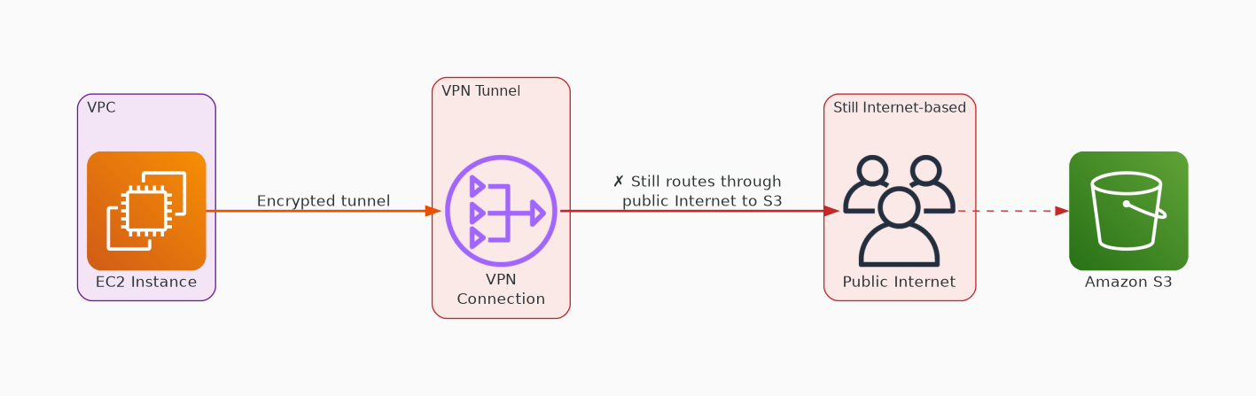
✗ INCORRECT
Option B: Configuring the EC2 instance to access the data through a VPN connection: While a VPN connection can provide secure access to resources over the Internet, it does not eliminate the security risk associated with accessing S3 over the public Internet.
Why this is incorrect:
• Configuring the EC2 instance to access the data through a VPN connection: While a VPN connection can provide secure access to resources over the Internet, it does not eliminate the security risk associated with accessing S3 over the public Internet.

Slide 4
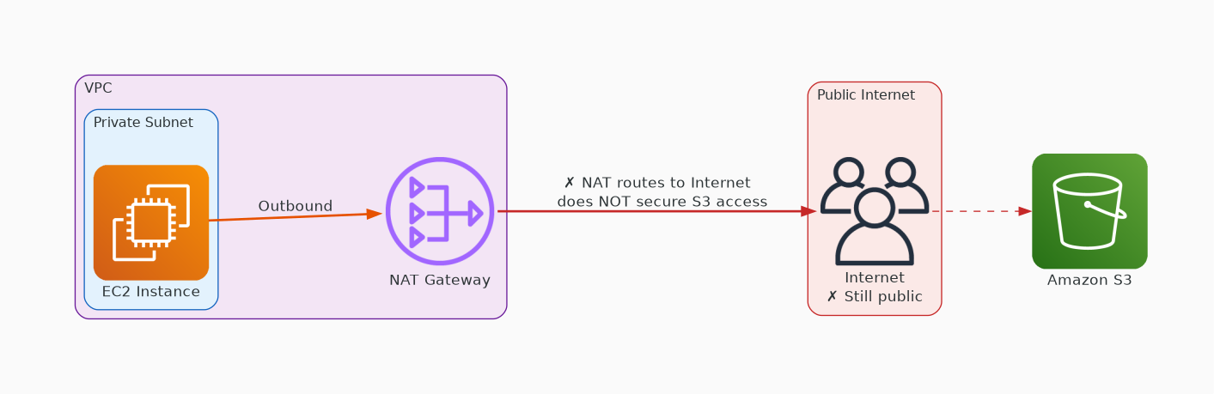
✗ INCORRECT
Option C: Configuring the EC2 instance to access the data through a NAT Gateway: NAT Gateway allows instances in a private subnet to initiate outbound traffic to the Internet, but it does not provide a secure way to access resources like Amazon S3.
Why this is incorrect:
• Configuring the EC2 instance to access the data through a NAT Gateway: NAT Gateway allows instances in a private subnet to initiate outbound traffic to the Internet, but it does not provide a secure way to access resources like Amazon S3.

Slide 5
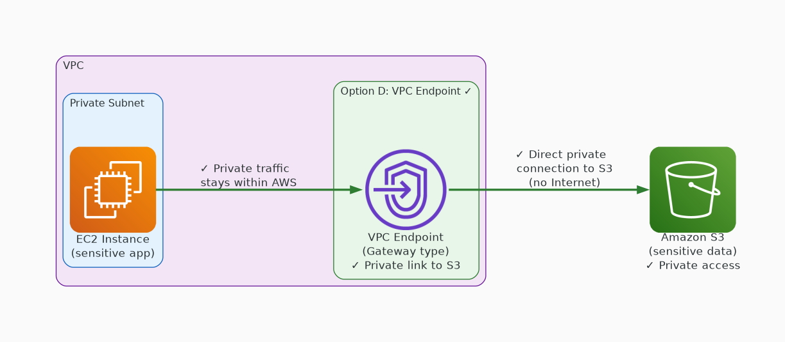
✓ CORRECT
Option D: Configure the EC2 instance to access the data through a VPC endpoint for Amazon S3.
Why this is correct:
• Configure the EC2 instance to access the data through a VPC endpoint for Amazon S3.
• This solution resolves the security concern by ensuring that the EC2 instance can access the data stored on Amazon S3 without traversing the public Internet.
• A VPC endpoint for Amazon S3 allows communication between the EC2 instance and S3 to occur entirely within the AWS network, eliminating the need for Internet access.
• This enhances security by reducing exposure to potential security risks associated with Internet connectivity.

