Slide 1
Session 1 - Question 5
⏱ TIME
A developer has built a three-tier application and needs to verify security group rules that have been setup by a security engineer: Presentation Tier - Accessed by users over the web, protected by the security group, presentation-sg Logic Tier - RESTful API accessed from the Presentation Tier via https, protected by the security group, logic-sg Data Tier - SQL Server database accessed over port 1433 from the Logic Tier, protected by the security group, data-sg What combination of the followi...
A
presentation-sg: Allow ports 80 and 443 from 0.0.0.0/0 - This rule allows access to the Presentation Tier over the web via HTTP (port 80) and HTTPS (port 443) from anywhere.
B
data-sg: Allow port 1433 from presentation-sg - This rule would allow access from the Presentation Tier to the Data Tier's SQL Server database, which is not the desired configuration according to the application's architecture.
C
data-sg: Allow port 1433 from logic-sg - This rule allows access to the Data Tier SQL Server database from the Logic Tier via port 1433, as required by the application architecture.
D
presentation-sg: Allow port 1433 from data-sg - This rule would allow access from the Data Tier to the Presentation Tier, which is not necessary for the application's functionality.
E
logic-sg: Allow port 443 from presentation-sg - This rule allows access to the Logic Tier RESTful API from the Presentation Tier via HTTPS (port 443).
F
logic-sg: Allow port 443 from 0.0.0.0/0 - This rule would allow access to the Logic Tier RESTful API over HTTPS from anywhere, which may not align with the desired security posture.

Slide 2
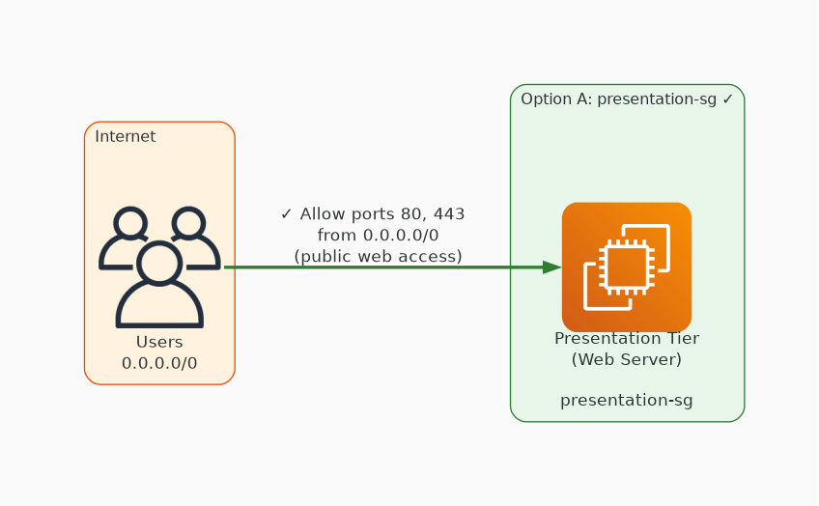
✓ CORRECT
Option A: presentation-sg: Allow ports 80 and 443 from 0.0.0.0/0 - This rule allows access to the Presentation Tier over the web via HTTP (port 80) and HTTPS (port 443) from anywhere.
Why this is correct:
• presentation-sg: Allow ports 80 and 443 from 0.
• 0.0.0/0 - This rule allows access to the Presentation Tier over the web via HTTP (port 80) and HTTPS (port 443) from anywhere.

Slide 3
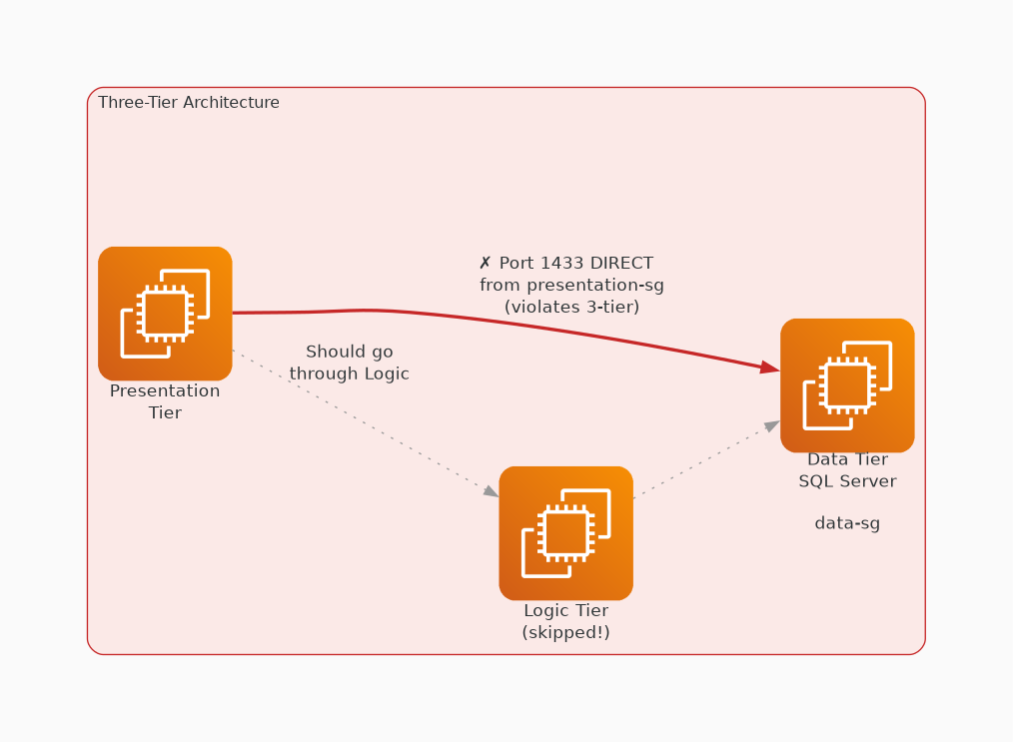
✗ INCORRECT
Option B: data-sg: Allow port 1433 from presentation-sg - This rule would allow access from the Presentation Tier to the Data Tier's SQL Server database, which is not the desired configuration according to the application's architecture.
Why this is incorrect:
• data-sg: Allow port 1433 from presentation-sg - This rule would allow access from the Presentation Tier to the Data Tier's SQL Server database, which is not the desired configuration according to the application's architecture.

Slide 4
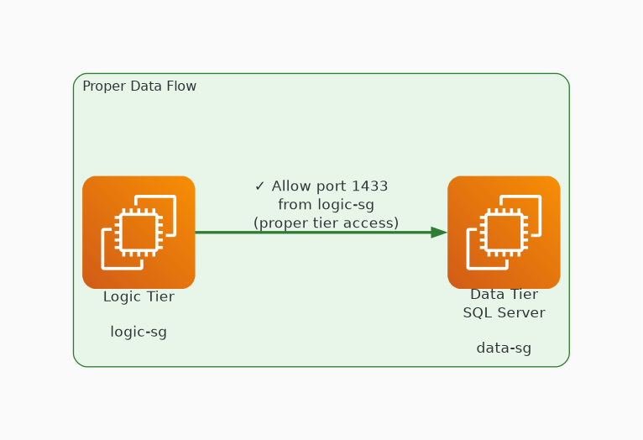
✓ CORRECT
Option C: data-sg: Allow port 1433 from logic-sg - This rule allows access to the Data Tier SQL Server database from the Logic Tier via port 1433, as required by the application architecture.
Why this is correct:
• data-sg: Allow port 1433 from logic-sg - This rule allows access to the Data Tier SQL Server database from the Logic Tier via port 1433, as required by the application architecture.

Slide 5
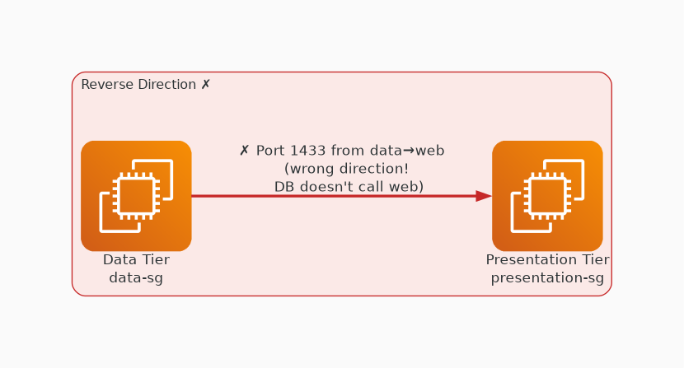
✗ INCORRECT
Option D: presentation-sg: Allow port 1433 from data-sg - This rule would allow access from the Data Tier to the Presentation Tier, which is not necessary for the application's functionality.
Why this is incorrect:
• presentation-sg: Allow port 1433 from data-sg - This rule would allow access from the Data Tier to the Presentation Tier, which is not necessary for the application's functionality.

Slide 6
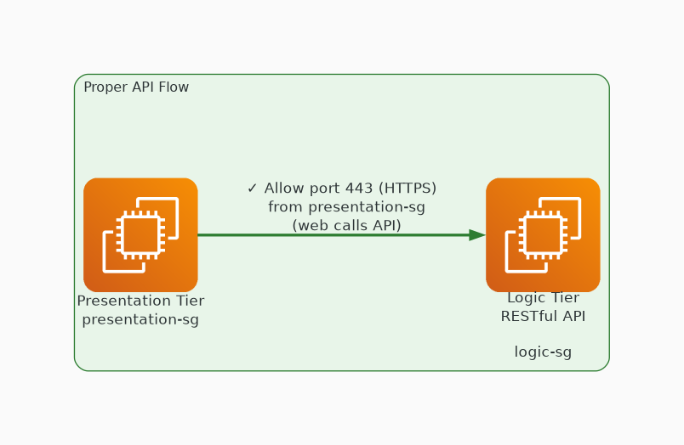
✓ CORRECT
Option E: logic-sg: Allow port 443 from presentation-sg - This rule allows access to the Logic Tier RESTful API from the Presentation Tier via HTTPS (port 443).
Why this is correct:
• logic-sg: Allow port 443 from presentation-sg - This rule allows access to the Logic Tier RESTful API from the Presentation Tier via HTTPS (port 443).

Slide 7
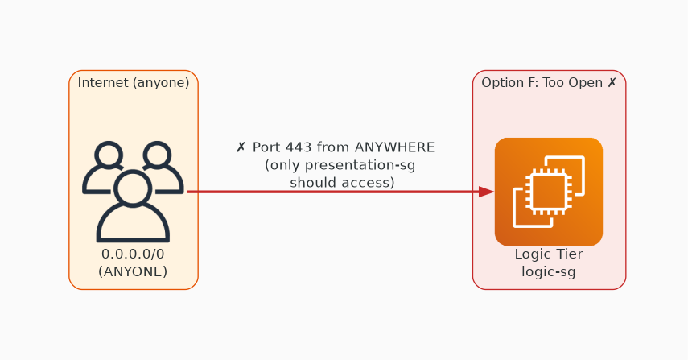
✗ INCORRECT
Option F: logic-sg: Allow port 443 from 0.0.0.0/0 - This rule would allow access to the Logic Tier RESTful API over HTTPS from anywhere, which may not align with the desired security posture.
Why this is incorrect:
• logic-sg: Allow port 443 from 0.
• 0.0.0/0 - This rule would allow access to the Logic Tier RESTful API over HTTPS from anywhere, which may not align with the desired security posture.

