Slide 1
Session 1 - Question 6
⏱ TIME
A security engineer attached the following IAM policy to a developer's IAM user account: { "Version": "2012-10-17", "Statement": { "Effect": "Allow", "Action": "dynamodb:GetItem", "Resource": "*", "Condition": { "DateGreaterThan": { "aws:CurrentTime": "2020-07-01T00:00:00Z" }, "DateLessThan": { "aws:CurrentTime": "2020-12-31T23:59:59Z" }, "StringEquals": { "aws:SourceVpc": "vpc-111bbb22" } } } } Which permission will the developer have for using GetItem?
A
Access is allowed on or between July 1, 2020, and December 31, 2020 (UTC), and if the request is initiated from vpc-111bbb22 - This option specifies that access to GetItem is allowed only if the request is initiated from the specified VPC within the specified time frame.
B
Access is allowed on or between July 1, 2020, and December 31, 2020 (UTC), or if the request is initiated from vpc-111bbb22 - This option implies that access is granted if either the time condition or the VPC condition is met, which does not align with the IAM policy provided.
C
Access is allowed on or between July 1, 2020, and December 31, 2020 (UTC), and if the request uses a VPC endpoint in vpc-111bbb22 - This option introduces the concept of a VPC endpoint, which is not mentioned in the IAM policy.
D
Access is allowed on or between July 1, 2020, and December 31, 2020 (UTC), or if the request uses a VPC endpoint in vpc-111bbb22 - Similar to option C, this option also introduces the concept of a VPC endpoint, which is not specified in the IAM policy.

Slide 2
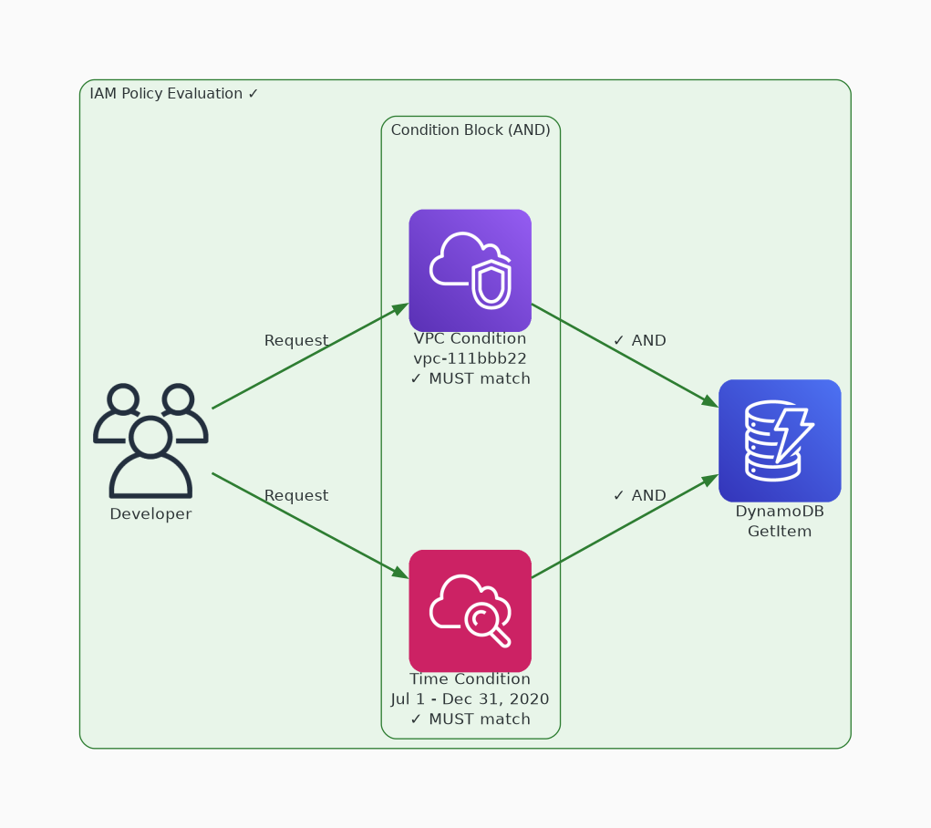
✓ CORRECT
Option A: Access is allowed on or between July 1, 2020, and December 31, 2020 (UTC), and if the request is initiated from vpc-111bbb22 - This option specifies that access to GetItem is allowed only if the request is initiated from the specified VPC within the specified time frame.
Why this is correct:
• Access is allowed on or between July 1, 2020, and December 31, 2020 (UTC), and if the request is initiated from vpc-111bbb22 - This option specifies that access to GetItem is allowed only if the request is initiated from the specified VPC within the specified time frame.

Slide 3
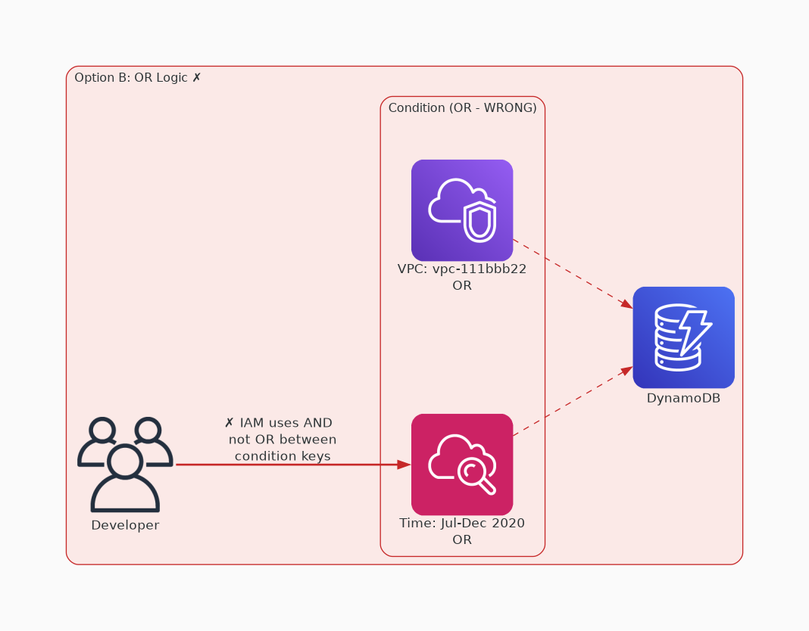
✗ INCORRECT
Option B: Access is allowed on or between July 1, 2020, and December 31, 2020 (UTC), or if the request is initiated from vpc-111bbb22 - This option implies that access is granted if either the time condition or the VPC condition is met, which does not align with the IAM policy provided.
Why this is incorrect:
• Access is allowed on or between July 1, 2020, and December 31, 2020 (UTC), or if the request is initiated from vpc-111bbb22 - This option implies that access is granted if either the time condition or the VPC condition is met, which does not align with the IAM policy provided.

Slide 4
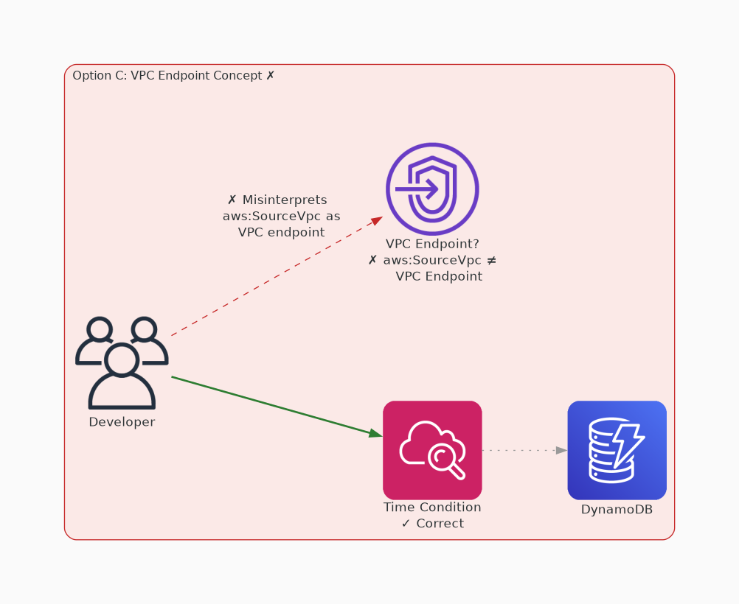
✗ INCORRECT
Option C: Access is allowed on or between July 1, 2020, and December 31, 2020 (UTC), and if the request uses a VPC endpoint in vpc-111bbb22 - This option introduces the concept of a VPC endpoint, which is not mentioned in the IAM policy.
Why this is incorrect:
• Access is allowed on or between July 1, 2020, and December 31, 2020 (UTC), and if the request uses a VPC endpoint in vpc-111bbb22 - This option introduces the concept of a VPC endpoint, which is not mentioned in the IAM policy.

Slide 5
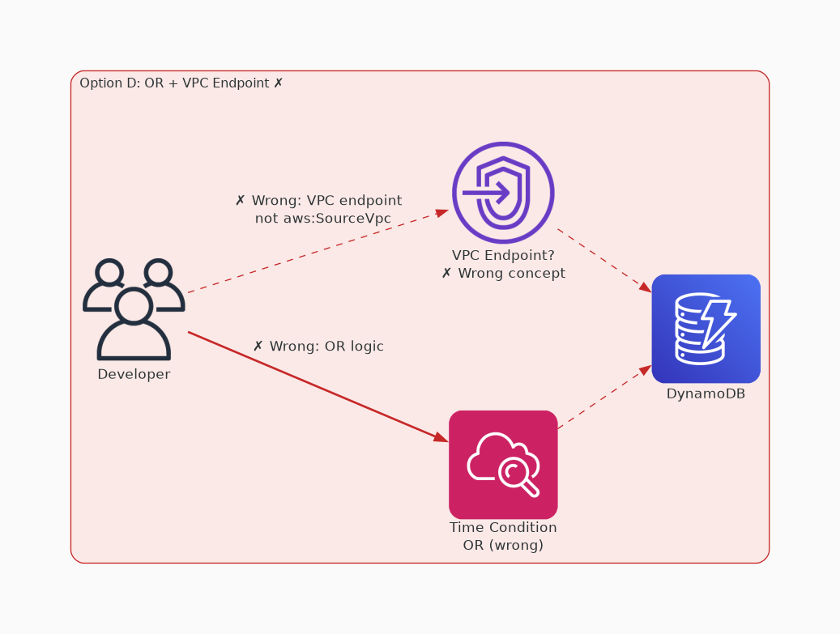
✗ INCORRECT
Option D: Access is allowed on or between July 1, 2020, and December 31, 2020 (UTC), or if the request uses a VPC endpoint in vpc-111bbb22 - Similar to option C, this option also introduces the concept of a VPC endpoint, which is not specified in the IAM policy.
Why this is incorrect:
• Access is allowed on or between July 1, 2020, and December 31, 2020 (UTC), or if the request uses a VPC endpoint in vpc-111bbb22 - Similar to option C, this option also introduces the concept of a VPC endpoint, which is not specified in the IAM policy.

