Slide 1
Session 2 - Question 1
⏱ TIME
A developer is testing an application locally and has deployed the application to an AWS Lambda function. To avoid exceeding the deployment package size quota, the developer did not include the dependencies in the deployment file. When the developer tests the application remotely, the Lambda function does not run because of missing dependencies. Which solution will resolve this issue?
A
Use the Lambda console editor to update the code and include the missing dependencies
B
Create an additional .zip file that contains the missing dependencies. Include the .zip file in the original Lambda deployment package.
C
Add references to the missing dependencies in the Lambda function's environment variables.
D
Create a layer that contains the missing dependencies. Attach the layer to the Lambda function.

Slide 2
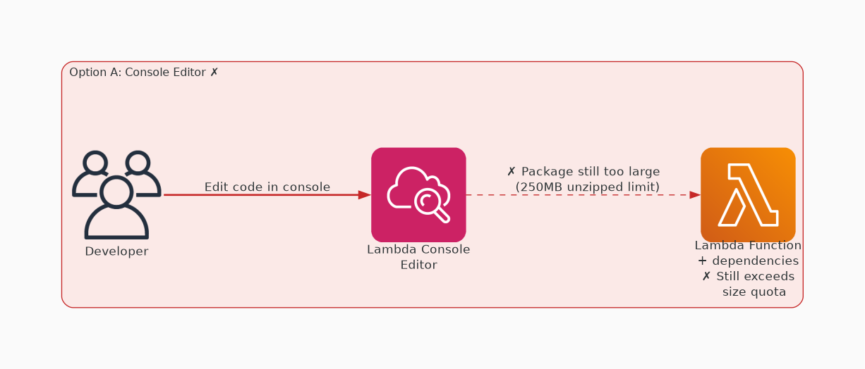
✗ INCORRECT
Option A: Use the Lambda console editor to update the code and include the missing dependencies
Why this is incorrect:
• because this will not necessarily avoid exceeding the deployment package size quota

Slide 3
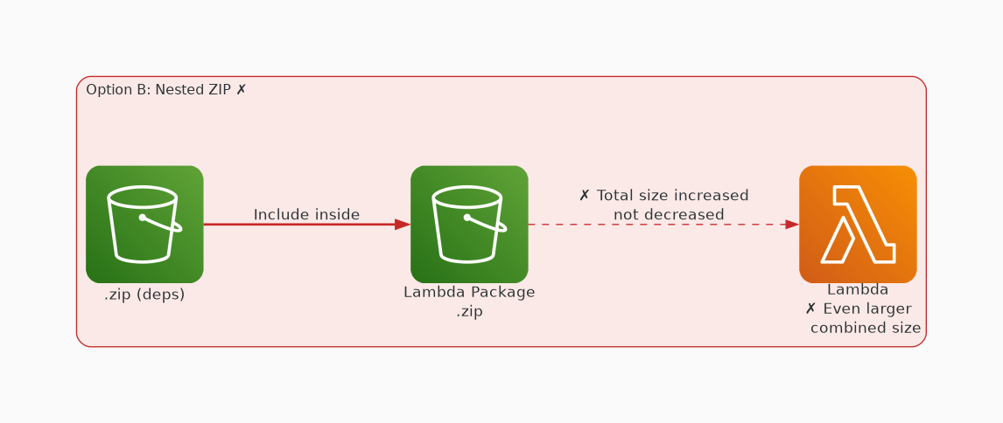
✗ INCORRECT
Option B: Create an additional .zip file that contains the missing dependencies. Include the .zip file in the original Lambda deployment package.
Why this is incorrect:
• because this will not necessarily avoid exceeding the deployment package size quota.
• Even when you zip it.

Slide 4
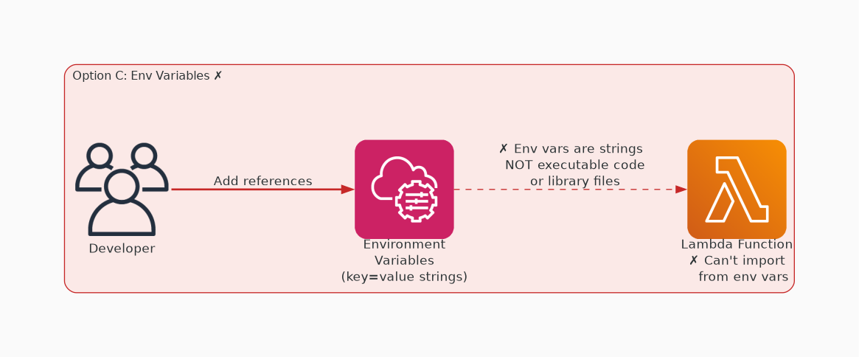
✗ INCORRECT
Option C: Add references to the missing dependencies in the Lambda function's environment variables.
Why this is incorrect:
• because Lambda environment variables are pairs of strings that is stored in a function's version-specific configuration.
• The Lambda runtime makes environment variables available to your code and sets additional environment variables that contain information about the function and invocation request.
• They’re not meant to store missing dependencies.

Slide 5
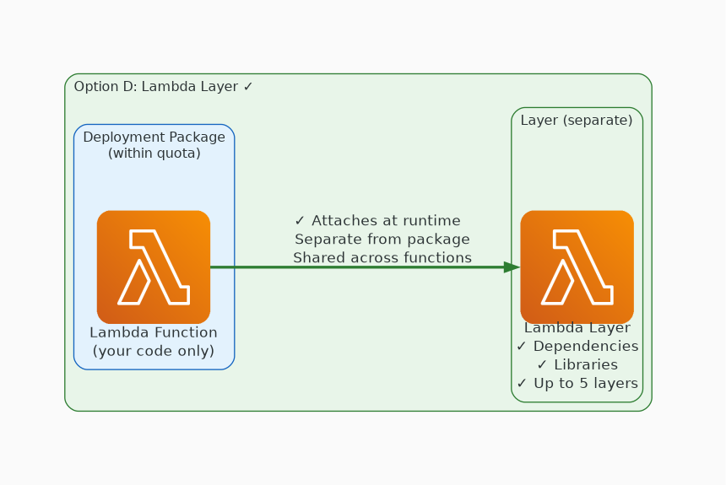
✓ CORRECT
Option D: Create a layer that contains the missing dependencies. Attach the layer to the Lambda function.
Why this is correct:
• You can configure an AWS Lambda function to pull in additional code and content in the form of layers.
• A layer is a .zip file archive that contains libraries, a custom runtime, or other dependencies.
• With layers, you can use libraries in a Lambda function without needing to include the libraries in a deployment package.

